Slide 2
WCW: Gerty Cori
Biology

Slide 3
Essential Questions
How have female scientists shaped science today?
What happens to our body when our cells do not receive an adequate amount of oxygen?

Slide 4
Lesson Objectives
Explain how organisms under anaerobic conditions perform respiration in different environments.
Construct a model of an organism under anaerobic respiration conditions.
Determine the effect of Gerty Cori’s contributions to the studies of respiration in relation to how energy drives the cycling of matter within a system.

Slide 5

Who Was Gerty Cori?
Familiarize yourself with Gerty Cori and her contributions to science by reading the excerpt from Women in Science.
Ignotofsky, R. (2016). Women in science: 50 fearless pioneers who changed the world. Berkeley, CA: Ten Speed Press.

Slide 6
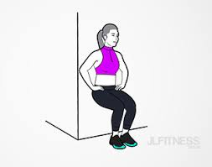
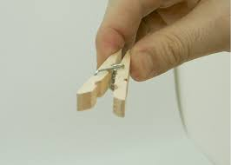
Can You Handle It?
For this exercise, we will do two activities to explore alternative pathways that our bodies may experience in cellular respiration:
  Wall Sit
  Clothes Pin
After completion of each activity, fill out your data tables and analysis questions.

Slide 7
Discussion Questions
When are some moments where you have also felt that kind of pain/ fatigue in your muscle?
What do you typically do to relieve that pain/fatigue?
Why do you think this is happening?

Slide 8
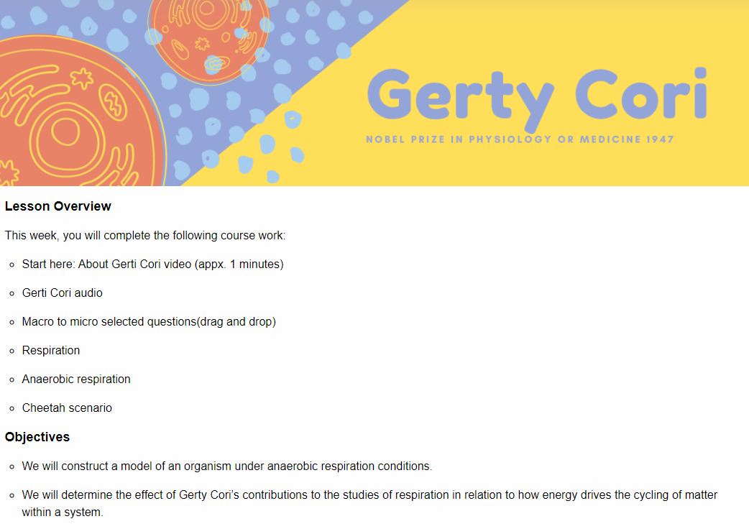
How Do I Breathe Without You?
Answer the questions as you complete the interactive.

Slide 9
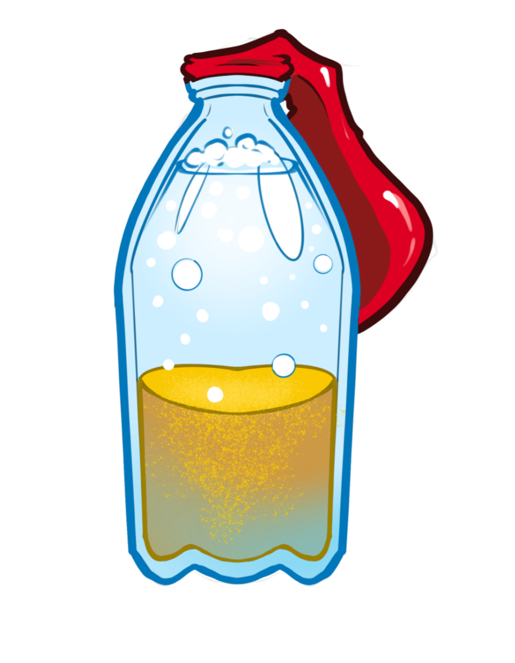
Yeast Lab
Today you and your partner will explore anaerobic respiration in yeast.

Slide 10

Respiration Careers
Use the QR Codes to sort the cards into four categories:
  Career Title
  Type of postsecondary education required for the career
  Time to complete the educational program
  Salary range for the career

Slide 11
Career Reflection
Think about the careers you have just learned about.
Consider the following:
  What career interested you the most?
  What is the job description for that career?
  What post-secondary options are available for the career near you?
  What is a different career of your interest and how does it relate to respiration?

Slide 12

30-Second Expert
Gerty Cori studies two hormones that have an effect on respiration.
Using your knowledge on respiration, write what Gerty Cori may have discovered about one of the two hormones effect on respiration, especially in anaerobic conditions.

