Slide 2
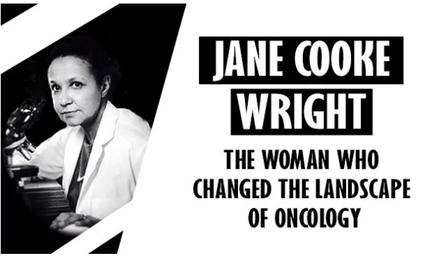
Woman Crush Wednesday: Jane Cooke Wright
Understanding Mitosis
Notes:
Large, H. (2020, Mar 8). Jane C. Wright: The woman who changed the landscape of oncology. [Digital image]. Technology Networks. https://www.technologynetworks.com/tn/articles/jane-c-wright-the-woman-who-changed-the-landscape-of-oncology-331263

Slide 3
Essential Questions
What role does mitosis play in cancer?
How have women in history shaped science today?

Slide 4
Lesson Objectives
Analyze the role that mitosis plays in cancer.
Identify the contributions of Jane Cooke Wright to science.

Slide 5
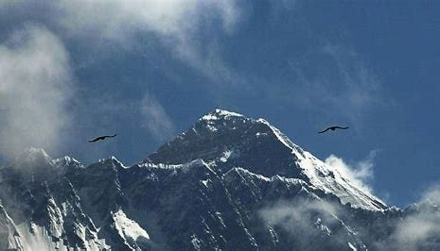
Trailblazer
How would you define the word trailblazer?
Can you think of any trailblazers?
What makes them a trailblazer?

Slide 6
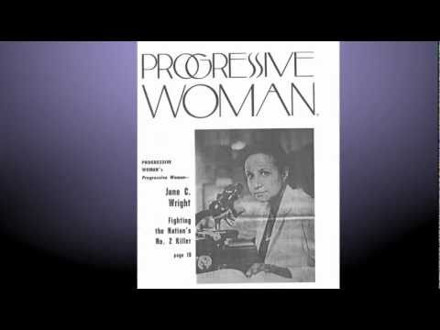
Let’s Meet a Real Life Trailblazer!
Notes:
ConquerCancerFdtn. (2011, June 21). Paying Tribute to ASCO Founder Jane C. Wright, MD [video]. Youtube. https://www.youtube.com/watch?v=6hHiWeki9GE

Slide 7

Dr. Jane Cooke Wright
Graduated with honors from New York Medical College in 1954;
Became Professor of Surgery, Head of the Cancer Chemotherapy department and Associate Dean at the New York Medical College in 1967;
Developed new ways to test chemotherapy drugs;
Discovered non-surgical ways to treat hard-to-reach tumors;
Co-founded the American Society of Clinical Oncology;
Researched methotrexate (breast, lung, leukemia cancer drug);
Discovered tumors could be studied in labs (called tissue cultures) vs. inside a body.
Notes:
Hibrida. (2020). Black History Month Firsts. Stock.adobe.com. http://www.mycitymag.com/black-history-month-firsts/

Slide 8
Tag
Round 2
Round 1
“Tagger” starts tagging healthy cells.
New abnormal cells keep tagging healthy cells.
“Treatment” taggers seek out and tag abnormal cell taggers.
Any abnormal cell tagger must FREEZE in place if tagged by the “Treatment” tagger.
“Treatment” taggers CANNOT be tagged.
One person is the “tagger” and is an abnormal cell.
Any cell that gets tagged may then immediately start tagging other healthy cells (students).

Slide 9
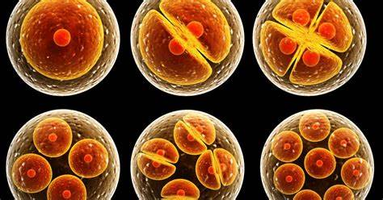
Unpacking the Game of Tag
How did this game demonstrate uncontrolled cell division?
How did Round 1 differ from Round 2?
How did the game reflect Jane Cooke Wright’s work?
Notes:
Stanford University, (2015). Stanford biologists crack centuries-od mystery of how cell growth triggers cell division. [Digital image]. https://biox.stanford.edu/highlight/stanford-biologists-crack-centuries-old-mystery-how-cell-growth-triggers-cell-division

Slide 10
TIP Chart
Term | Information | Picture
Cell cycle
Cell division
Mitosis
Cancer
Tumor
Radiation
Chemotherapy

Slide 11
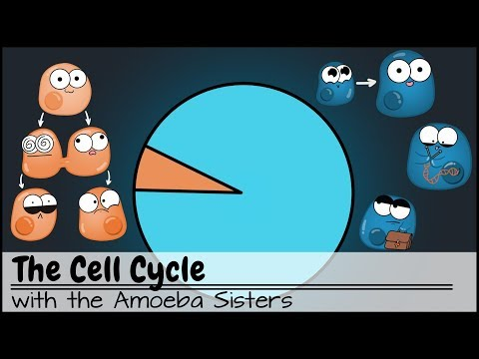
Notes:
Amoeba Sisters. (2018, March 20). The Cell Cycle (and cancer) [Updated]. [video]. Youtube. https://www.youtube.com/watch?v=QVCjdNxJreE

Slide 12
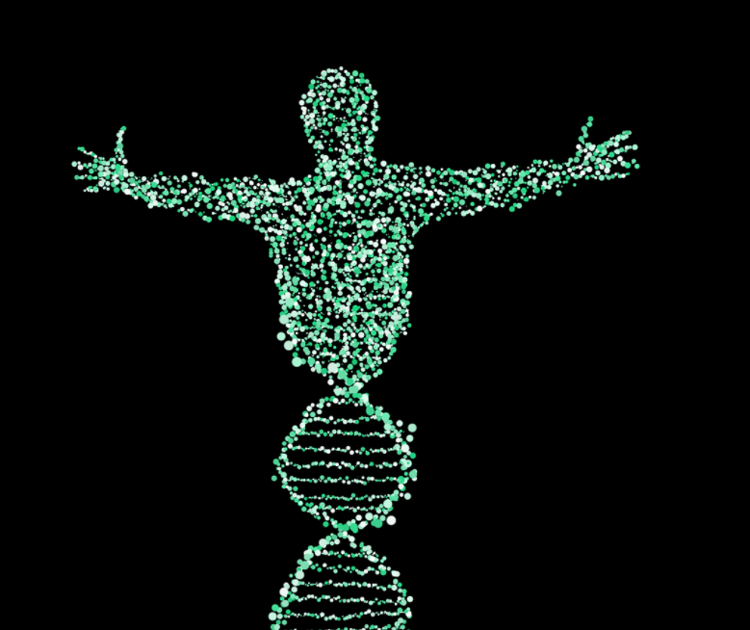
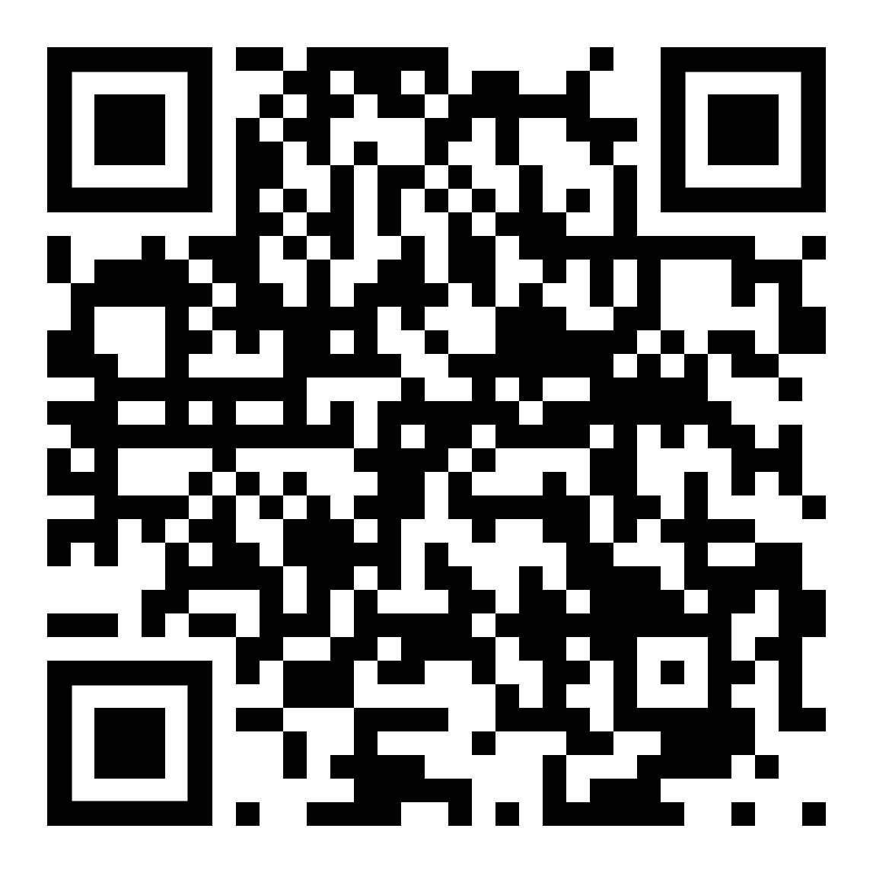
Cancer Treatments
National Cancer Institute
1. Biomarker testing
2. Chemotherapy
3. Hormone therapy
4. Immunotherapy
5. Radiation
6. Stem cell transplant
7. Surgery
8. Targeted therapy
https://www.cancer.gov/about-cancer/treatment/types
Notes:
Schaferle. (2017). Man DNA Spiral. Pixabay. https://pixabay.com/illustrations/man-dna-spiral-biology-merge-2125123/

Slide 13
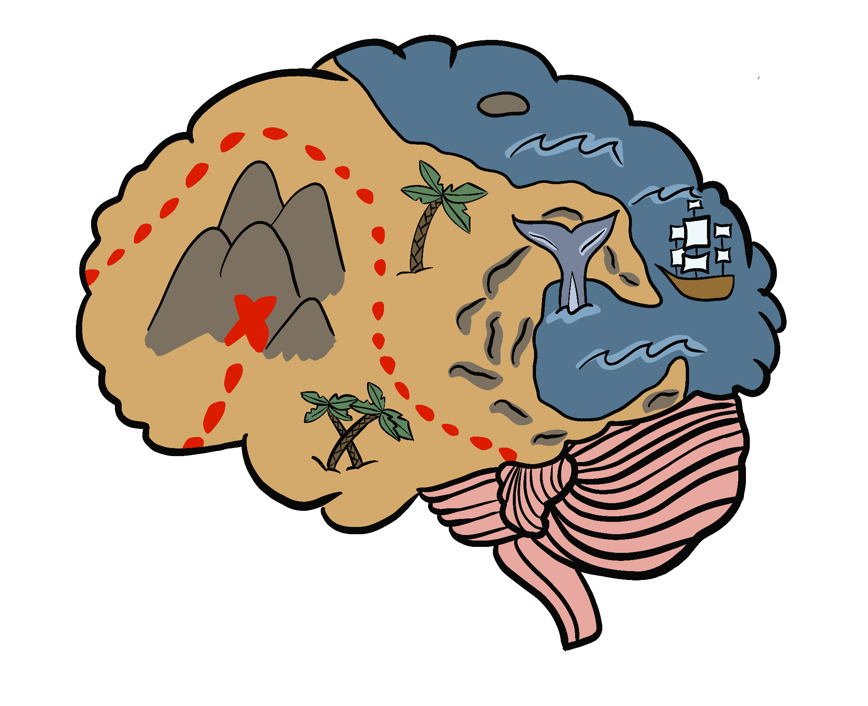
Mind Map
With Jane Cooke Wright in the center of your map, use lines, arrows, images, and the words below to represent connections between ideas.
Biomarker Testing Cancer Cell Division Tumor Trailblazer | Chemotherapy Hormone therapy Immunotherapy Mitosis Targeted Therapy | Oncology Radiation Stem Cell Transplant Surgery
Notes:
K20 Center. (n.d.). Mind Map. Strategies. https://learn.k20center.ou.edu/strategy/1277

