Slide 2
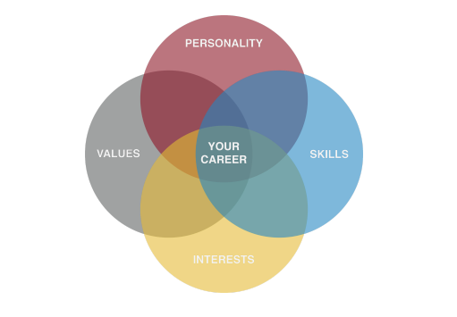
What did you want to do when you were younger?
Notes:
https://learn.k20center.ou.edu/strategy/186

Slide 3
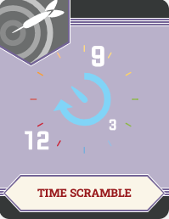
Time Scramble
Write down any jobs you may have wanted as a child.
You have five minutes to make your list.

Slide 4
Time Scramble
Pass your paper clockwise to the neighboring group.
Review their list.
Add any jobs that were on your list, but not on theirs.
See one you had on your list? Place a tally mark!
You have four minutes to review their list.

Slide 5
Time Scramble
Pass your paper clockwise to the neighboring group.
Review their list.
Add any jobs that were on your list, but not theirs.
See one you had? Place a tally mark!
You have three minutes to review their list.

Slide 6
Time Scramble
Pass your paper clockwise to the neighboring group.
Review their list.
Add any jobs that were on your list, but not theirs.
See one you had? Place a tally mark!
You have two minutes to review their list.

Slide 7
Time Scramble
Pass your paper clockwise to the neighboring group.
Review their list.
Add any jobs that were on your list, but not theirs.
See one you had? Place a tally mark!
You have one minute to review their list.

Slide 8
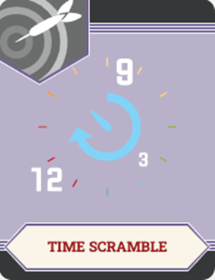
Time Scramble
Rotate your papers once more.
You should now have your original list.
Spend a minute reviewing your list.

Slide 9
Time Scramble
Consider these questions and share out.
What were the most common jobs on the list?
What were some of the more unique jobs on the list?
How do the jobs on the list differ from the careers you want now?

Slide 10
To Be Or Not To Be? That’s a Career Question!
College and Career Readiness

Slide 11
Essential Question
What does it take to achieve the career you want?

Slide 12
Lesson Objectives
Identify and research careers that interest them most;
Create an action plan for achieving their chosen career;
Create an Anchor Chart to display their research findings.

Slide 13
How Do I Know?
Many people find jobs based on their personal interests.
There are many different careers out there, but you might not know all of the options. That’s okay!
Take a closer look at all of the possibilities through the Career Cluster Survey.
Circle or check each statement you agree with on the Career Cluster Survey.
Notes:
Grand Rapids Community College. (n.d.). Your career starts here. [Digital image]. https://subjectguides.grcc.edu/c.php?g=257560&p=1721102

Slide 14
Tally Your Results
Score each section of the survey.
Use a blank sheet of paper to tally your score.
For each statement you agree with, give yourself one point.
Total your points on each Survey Card in the lower right-hand corner.
Notes:
Wikimedia. (2015). Tally. https://commons.wikimedia.org/wiki/File:NYW-Tally.png

Slide 15
Career Interest Survey, Part 2
Based on your results…
Review the 16 career clusters.
Highlight any careers that you might be interested in pursuing or that you scored high on in Part 1 of the Survey.

Slide 16
Elbow Partners
With your Elbow Partner, discuss your results.
Did your results match your current dream career?
What surprised you?
Once you are done, be ready to share out.
Notes:
https://learn.k20center.ou.edu/strategy/116u.edu)

Slide 17
What’s Your Plan?
Regardless of the career you want to pursue, you should have a plan to achieve it.
Want to be a doctor?
Bachelor’s degree, MCAT, medical school, board certifications, residency, etc.
Want to be a truck driver?
No degree, CDL, truck
Whatever career you choose, you should have a plan.

Slide 18
KWHL Chart
At the top of your KWHL Chart, write down your selected career.
In the K column, write down what you know about your selected career.
In the W column, write down what you need or want to know about the career.
Notes:
3-minute timer
https://learn.k20center.ou.edu/strategy/127

Slide 19
KWHL Chart
In the H column, write down what you know about your selected career.
Do not fill out the L column just yet.
Notes:
3-minute timer

Slide 20
Research
Use your KWHL Chart and Action Plan to help you organize as your research your career.
Address those items you identified in the W column.
Need a place to start?
Zoom Into Your Career video playlist
ICAP video playlist
CareerOneStop
U.S. Bureau of Labor Statistics
UC-Santa Cruz Career Center
Notes:
2-minute timer
https://www.youtube.com/watch?v=raPkWwV_hPc&list=PL-aUhEQeaZXIhi-ivvrQTrrEAlWvFWisR

Slide 21
Put Your Research Into Action
Use the information you have collected in your research to create an Anchor Chart.
Include the following details:
Career Title
Brief explanation of the career
Educational path and/or requirements
Chosen school and admission requirements
Estimated costs
Relevant Images
Notes:
3-minute timer
https://learn.k20center.ou.edu/strategy/58 (ou.edu)

Slide 22
Gallery Walk
Review your classmates’ Anchor Charts in a Gallery Walk.
Provide feedback on sticky notes.
See a typo? Say something.
Think it is great? Say so!
Have a question? Ask!

Slide 23
Let’s Revise
Review the feedback you received from the Gallery Walk.
Did anyone identify a typo or spelling error?
Did anyone ask for more clarification?
Make any revisions you think are necessary.

Slide 24
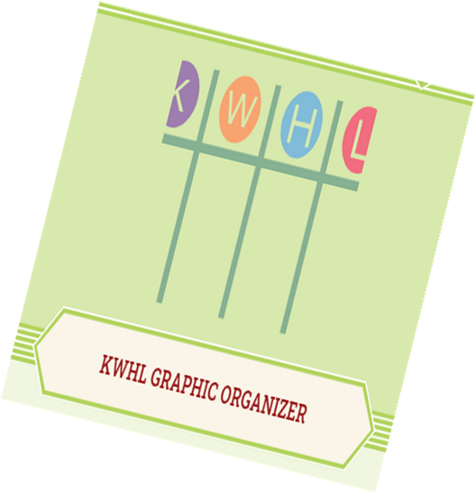
KWHL Chart
Go back to your KWHL Chart.
Based on your action plan, research, and Anchor Chart, what have you learned about your selected career?
Fill out this information in the L column.

