Slide 2
Sentence Structure in Siddhartha
Simple, Compound, Complex, and Compound-Complex Sentences

Slide 3
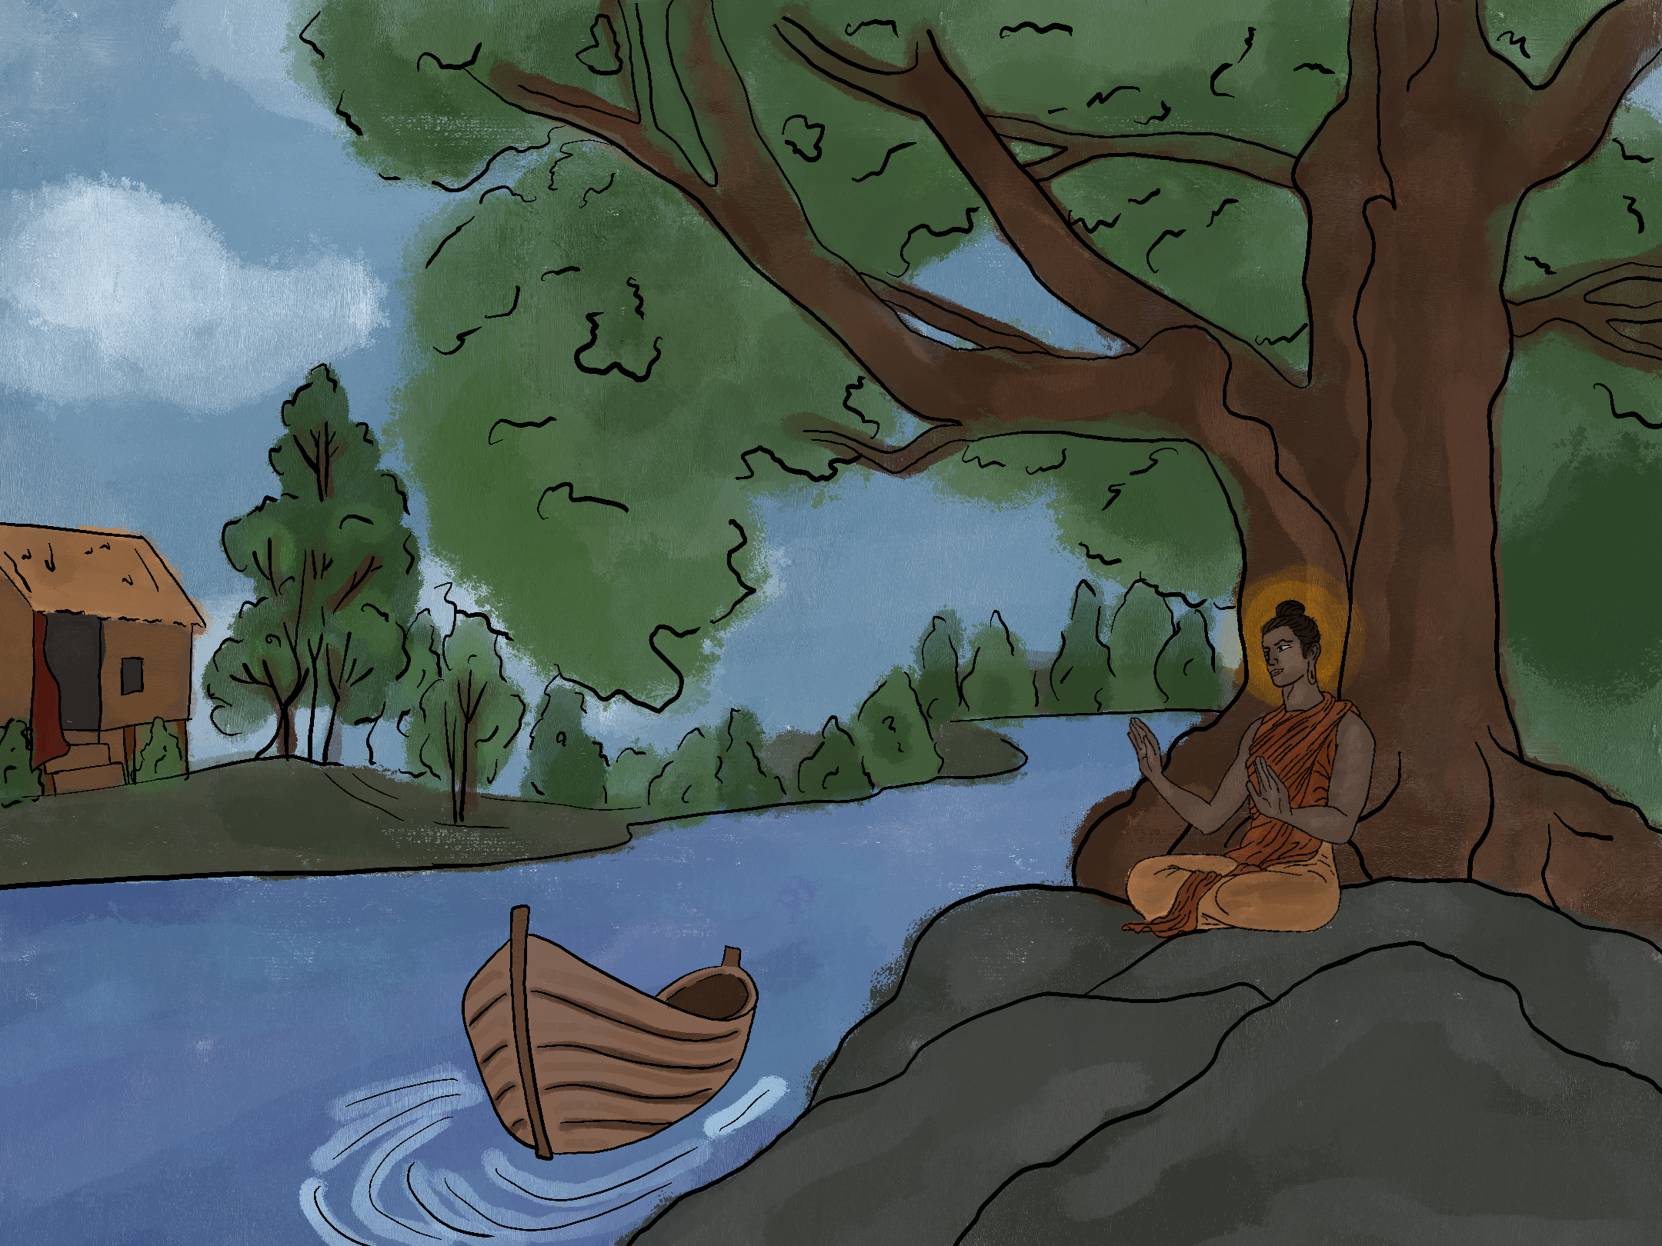

Slide 4
Siddhartha grew up in his house. He grew up near a riverbank with boats. He grew up near the Sal-wood forest. He spent time by a fig tree. Siddhartha was a handsome son of a Brahman. Siddhartha grew up with his friend Govinda. Govinda was also the son of a Brahman. The Brahman’s were the highest Hindu caste.

Slide 5
Siddhartha grew up in his house, and he grew up near a riverbank with boats. He grew up near the Sal-wood forest, and he spent time by a fig tree. Siddhartha was a handsome son of a Brahman, and he grew up with his friend Govinda. Govinda was also the son of a Brahman, and the Brahman’s were the highest Hindu caste.

Slide 6
Siddhartha grew up in his house, which was near a riverbank with boats. He grew up near the Sal-wood forest, yet also spent time by a fig tree. Siddhartha was a handsome son of a Brahman, much like his friend Govinda. Govinda was also the son of a Brahman, which were the highest Hindu caste.

Slide 7
While Siddhartha grew up in his house, which was near a riverbank with boats, he was also near the Sal-wood forest spending time by a fig tree. Being the handsome son of a Brahman, much like his friend Govinda, Siddhartha belonged to the highest Hindu caste.

Slide 8

Siddhartha
Written in 1922 by Herman Hesse.
Siddhartha is both the novel’s title and the name of the protagonist. Siddhartha goes on a journey of self-discovery and spiritual enlightenment. In his quest to understand the world, he desires to live simply.
Notes:
M. (2007, September 28). Siddhartha Gautama Buddha portrait [Digital image]. Retrieved March 23, 2021, from https://commons.wikimedia.org/wiki/File:Siddhartha_Gautama_Buddha_portrait.PNG

Slide 9
How Can Living Simply Read So Complicated?
Although Siddhartha seeks a simplified life, Herman Hesse wrote the novel in a beautifully lyrical style that can sometimes feel complicated to the reader.
The effect of Hesse’s writing style in Siddhartha is intended to mimic the spiritual texts that guide Siddhartha’s journey and the inner experiences of Siddhartha’s learning and states of mind.

Slide 10
Essential Question
How does sentence structure impact the effect of an author’s words?

Slide 11
Lesson Objectives
Students will be able to identify structures of sentences in a text and their impact on the text.
Students will be able to adapt sentences to evaluate how different structure types change the impact on a text.

Slide 12

Rainbow Write
Using the Jamboard, compose a sentence by moving the stickies to the box.
You should use one of each color
You may change the the tense to fit the sentence’s needs

Slide 13
Sentence Structure
Sentence structures add variety, interest, and impact to a text.
Each sentence type is made of phrases and clauses.
There are two types of clauses:
  independent
  dependent

Slide 14
Independent Clauses
An independent clause is a group of words with a subject and a predicate. It expresses a complete thought.
Examples:
I sold a bike to my brother.
Our class works together.
She wants to go to the restaurant.
The dog ran by the fence.

Slide 15
Dependent Clauses
A dependent clause is a group of words with a subject and a verb. It does not express a complete thought.
Examples:
Before I sold a bike to my brother
Until they moved the tables
Because he sang too early
When the boxes fell

Slide 16
Sentence Structure Types
Simple
Compound
Complex
Compound-Complex

Slide 17
Simple Sentences
A simple sentence has one (1) independent clause.
Example:
I sold a bike to my brother.
Subject: I
Predicate: sold a bike

Slide 18
Compound Sentences
A compound sentence has two (2) independent clauses
Example:
I sold a bike to my brother, and I made a good deal.
Independent Clause 1
  subject: I
  predicate: sold a bike
Independent Clause 2
  subject: I
  predicate: made a good deal

Slide 19
Complex Sentences
A complex sentence has one (1) independent clause and one (1) dependent clause.
Example:
Before I sell my bike,
I need to clean it first.
Dependent Clause
  subject: I
  verb: sell my bike
Independent Clause
  subject: I
  predicate: need to clean it first

Slide 20
Compound-Complex Sentences
A compound-complex sentence has at least two (2) independent clauses and one (1) or two (2) dependent clauses
Example:
Before I sell it, I need to clean my bike and I need to pay attention to the bike’s wheels.
Independent Clause 1
  subject: I
  predicate: need to clean my bike
Independent Clause 2
  subject: I
  predicate: need to pay attention to the bike’s wheels
Dependent Clause
  subject: I
  verb: sell it

Slide 21
Essential Question
How does sentence structure impact the effect of an author’s words?

Slide 22
Siddhartha
Read the brief introduction from chapter one of Siddhartha.
How did sentence structure impact the effect of Herman Hesse’s words in this first chapter portion of Siddhartha?
Notes:
M. (2007, September 28). Siddhartha Gautama Buddha portrait [Digital image]. Retrieved March 23, 2021, from https://commons.wikimedia.org/wiki/File:Siddhartha_Gautama_Buddha_portrait.PNG

Slide 23
Sentence Modification - Practice
In the Siddhartha passages on the handout, choose a sentence structure (simple, compound, complex, or compound-complex) and try your hand at modifying the sentences to suit that structure.
You must use each type of sentence structure once.

Slide 24
Sentence Modification - Reflection
How did changing the sentences impact the text?
How would the readers experience be different with Hesse’s lyrical approach “reduced” to many simple sentences rather than long, flowing sentences?

Slide 25

Muddiest Point
Why is sentence variety important?

Slide 26
Muddiest Point
How does understanding the intentional effect of sentence structure help prepare you to read Siddhartha? Other texts?

