Slide 2
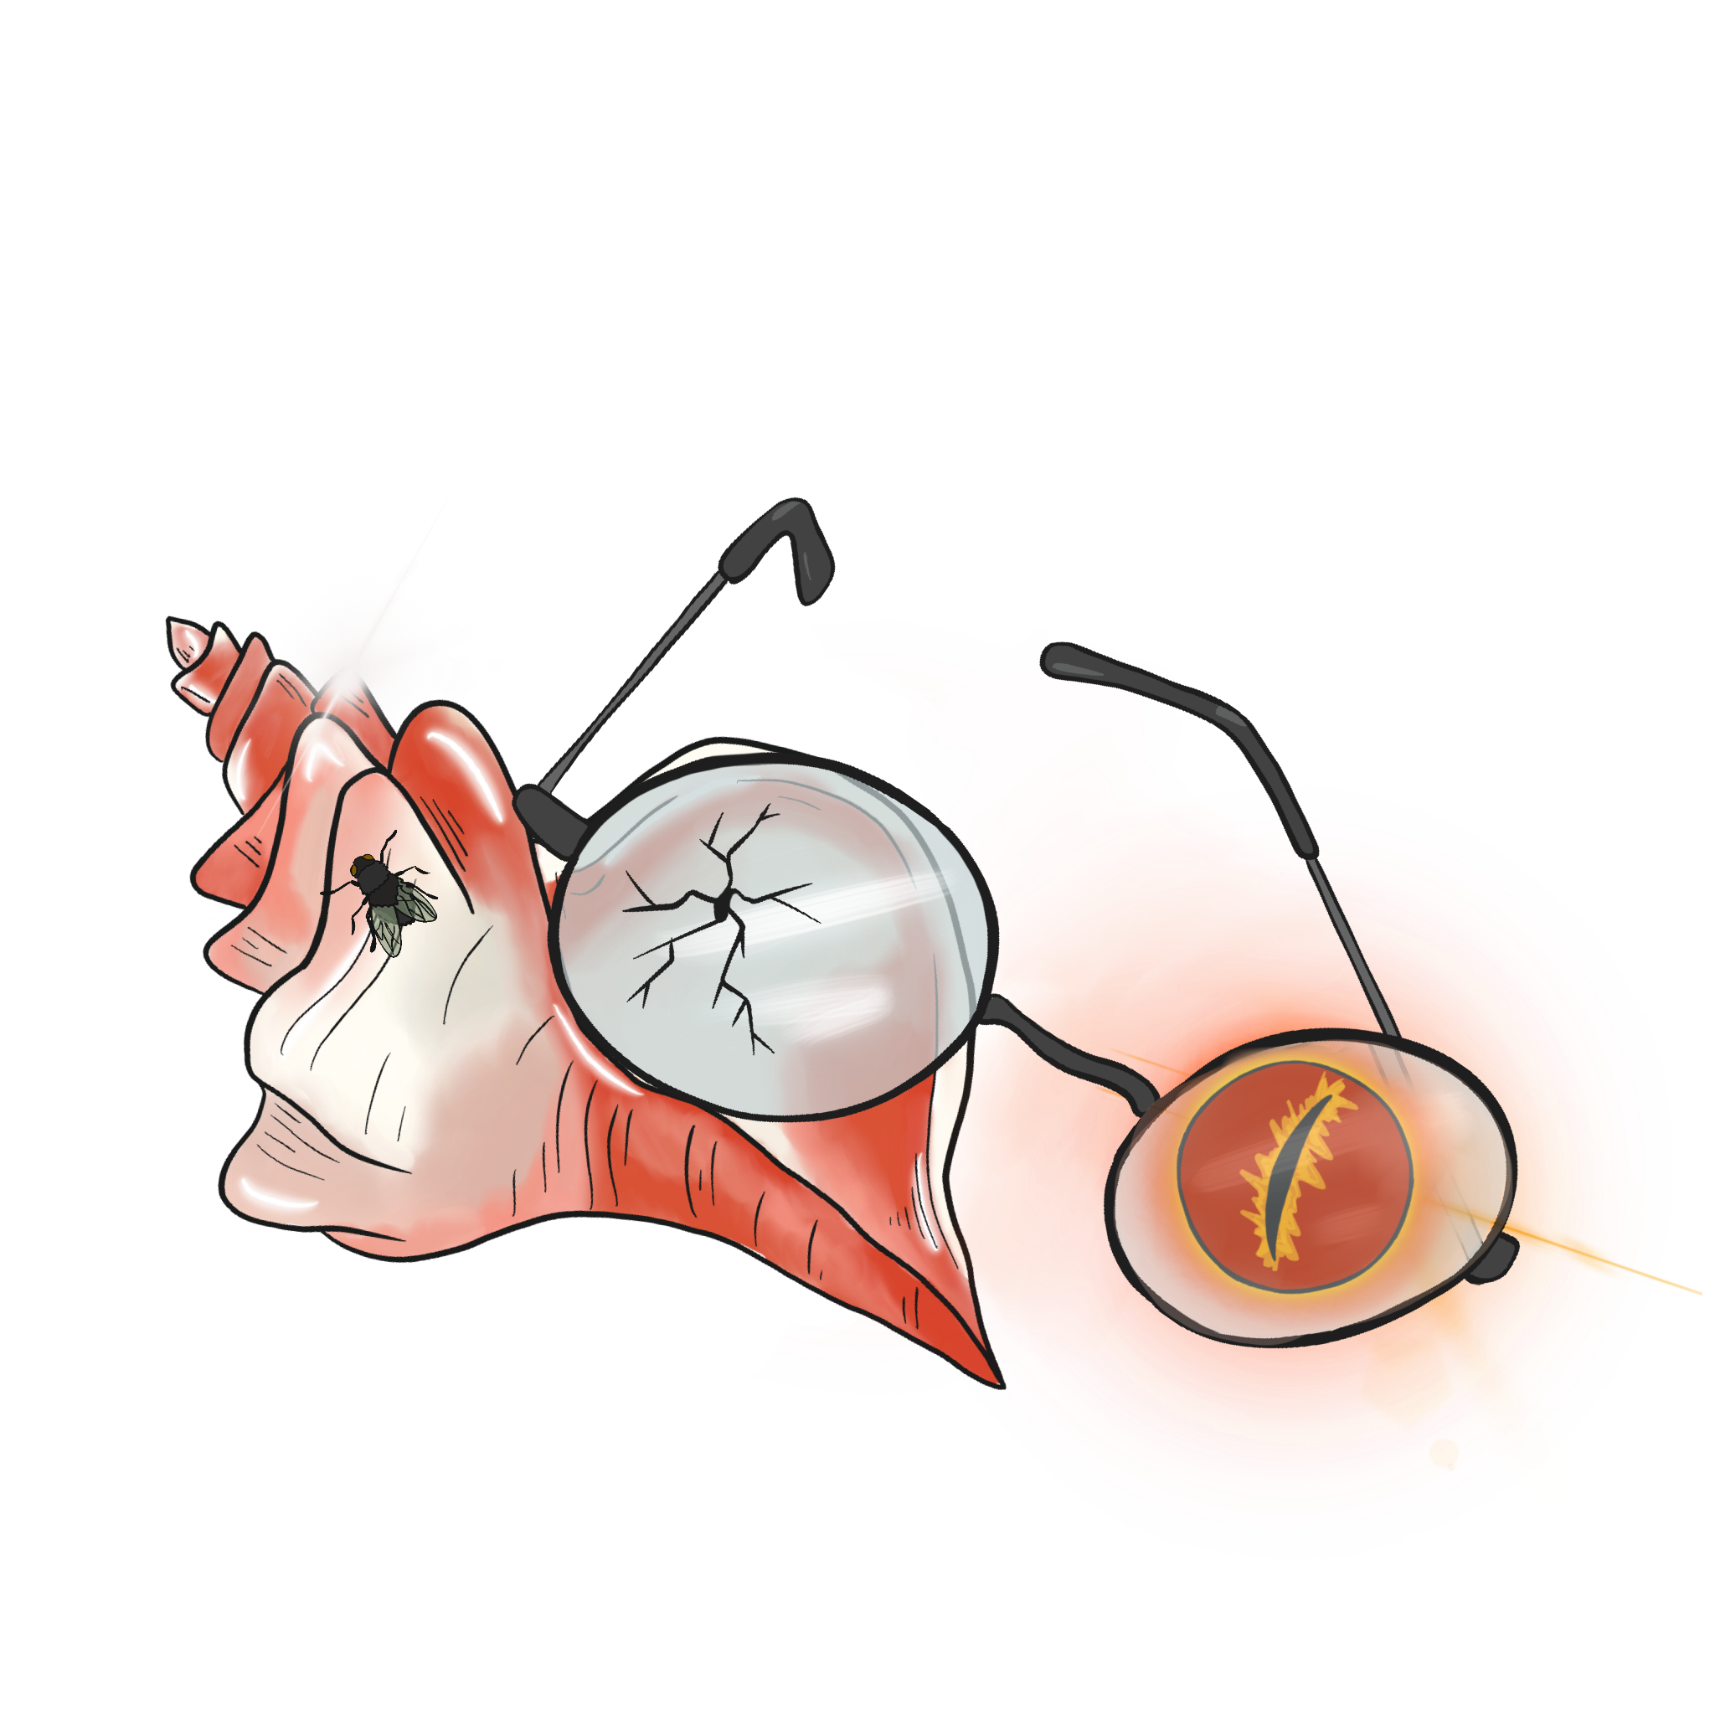
I’m a Survivor
Lord of the Flies: Lesson 1

Slide 3
Essential Question
How does the author use symbolism to develop characterization and theme?

Slide 4
Lesson Objectives
Understand the concept of microcosm;
Create a microcosm.

Slide 5
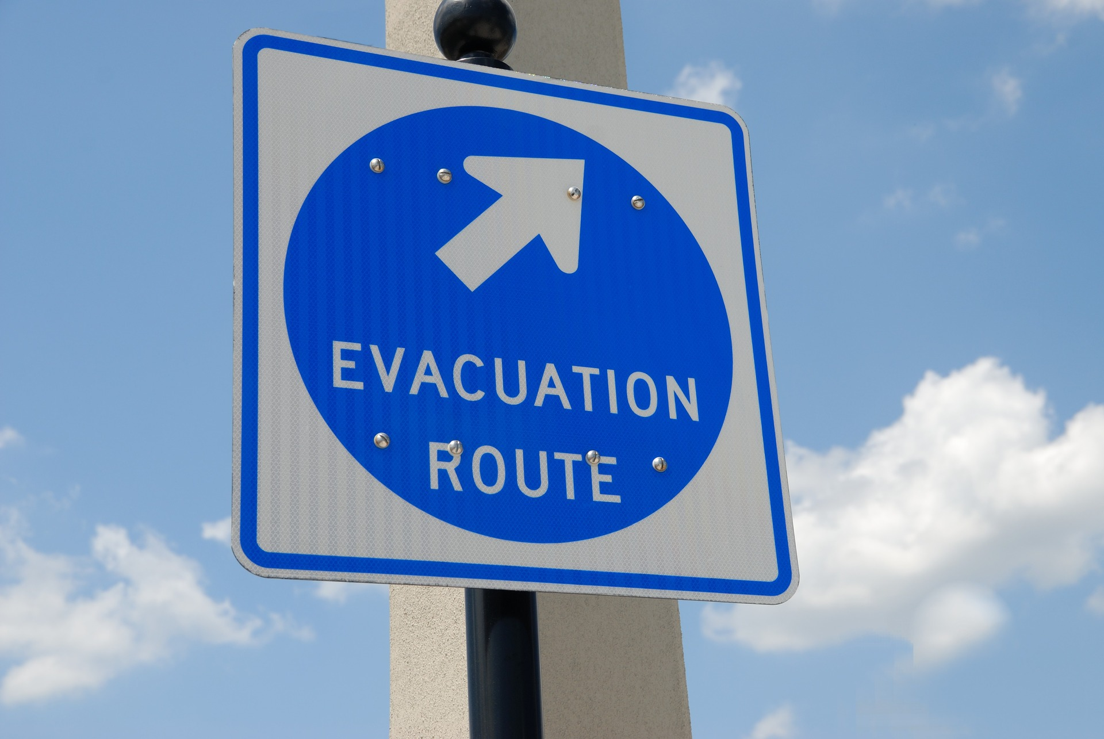
Digital Survey
What three (3) things would you take with you in an emergency?
Keep in mind that these are items that should be nearby.
Notes:
https://pixabay.com/photos/evacuation-sign-signage-safety-1738375/
https://k20center.padlet.org/lindseylink/uqanbzkbgp6of3hg

Slide 6
I Notice, I Wonder
Looking at the items listed, do you notice any patterns?
Based on gender?
Based on age/grade level?
Are there any other patterns that emerge?
Notes:
K20 Center. (n.d.). I notice, I wonder. Strategy. https://learn.k20center.ou.edu/strategy/180

Slide 7
Categorical Highlighting
As you read the passage, highlight the following key information:
Pink – Identifies your understanding of a microcosm;
Blue – Identifies your understanding of symbolism:
Yellow – Identifies any connections you find between microcosms and symbolism.
Notes:
K20 Center. (n.d.). Categorical highlighting. Strategy. https://learn.k20center.ou.edu/strategy/192

Slide 8
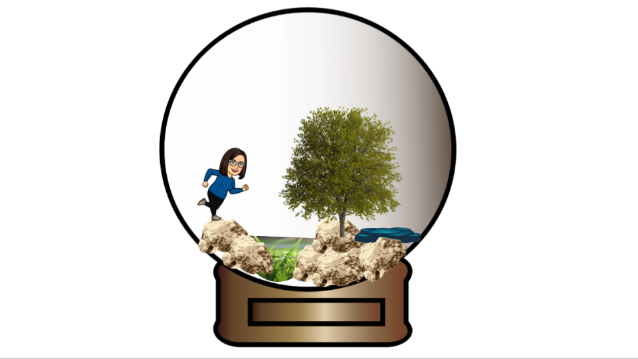
Questions to Consider
What is a microcosm?
How does it relate to symbolism?
What do you think the novel Lord of the Flies is a microcosm of?
Make a prediction: What might this story be about/include?
Notes:
K20 Center. (n.d.) Snow globe. [Original image].

Slide 9
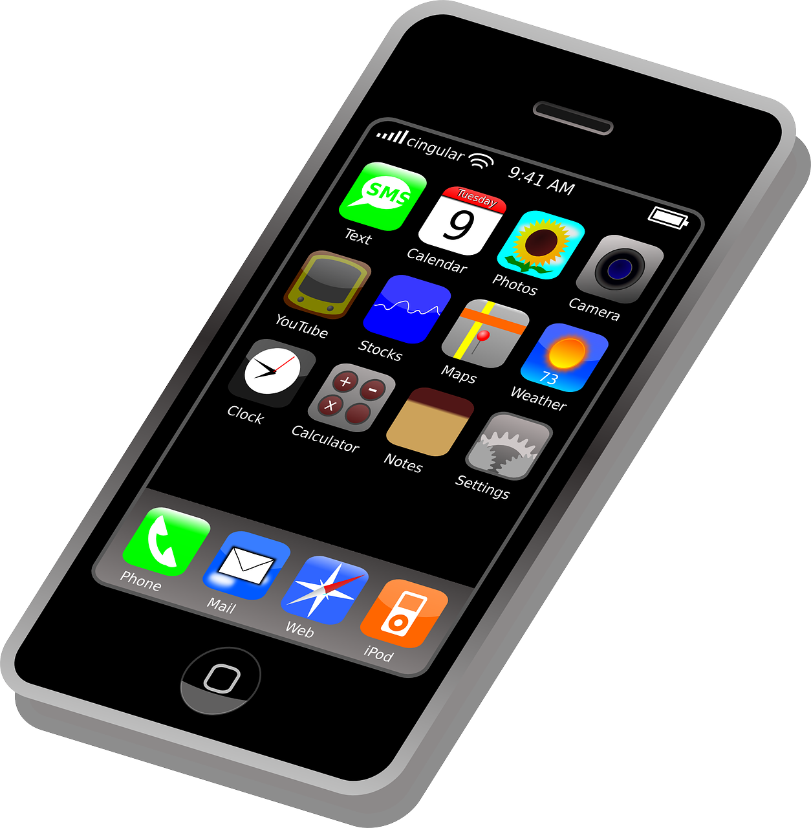
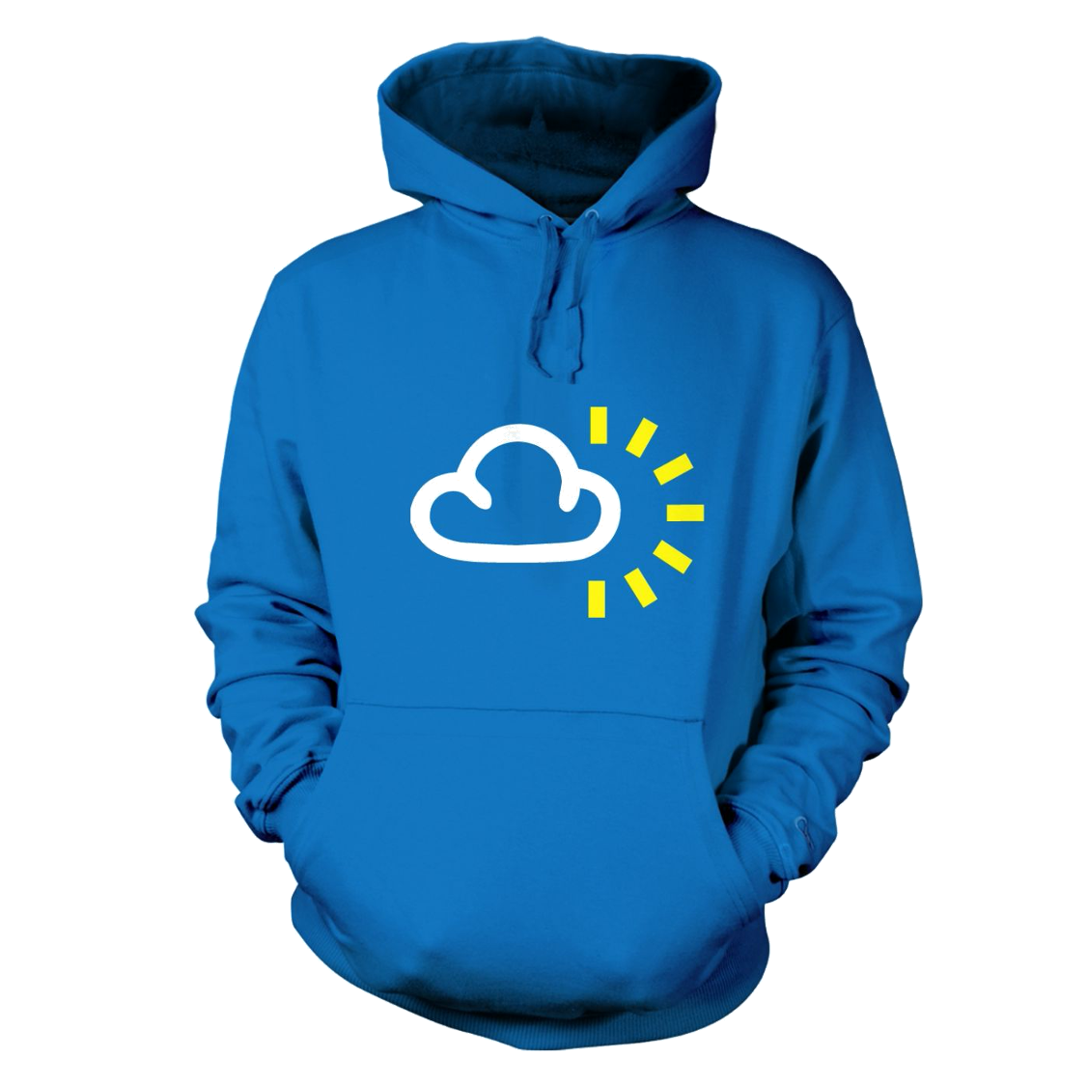
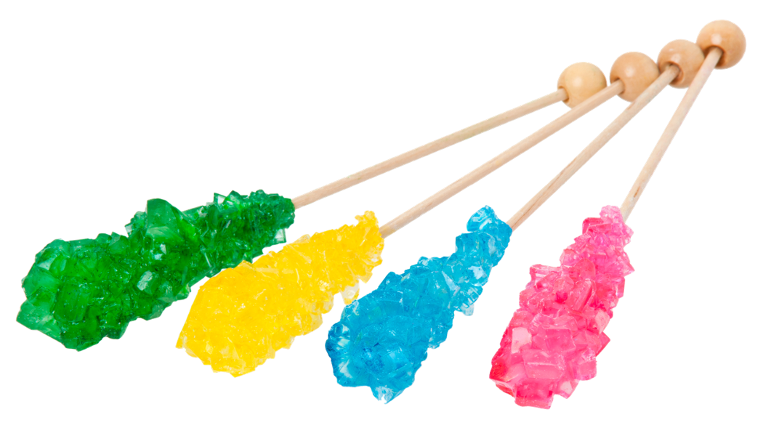
How do the items you chose represent you?
Cell Phone/iPad
This represents the parts of me that like to stay connected with my friends and family.
Hoodie
This represents the parts of me that like to snuggle up and have some quiet, alone time.
Candy
This represents my sweet tooth and the fact that I am usually always eating something.
Notes:
Cliker-Free-Vector-Images. (2012). Smartphone. https://pixabay.com/vectors/iphone-cellphone-smartphone-mobile-37856/.
Evan-Amos. (2012). Rock Candy Sticks. https://commons.wikimedia.org/wiki/File:Rock-Candy-Sticks.jpg.
Weather Symbol on a Hoodie as a Picture for Clipart. (n.d.). https://pixy.org/996909/.
K20 Center. (n.d.). One-Pager. Strategy. https://learn.k20center.ou.edu/strategy/72

Slide 10
Symbolism
The use of symbols to represent ideas or qualities.
Examples:
Harry Potter’s scar symbolizes his bravery, like a badge of honor.
A dove symbolizes peace.
Apples symbolize knowledge.

Slide 11
Microcosm
A community, place, or situation regarded as encapsulating in miniature qualities or features of something much larger.
Examples:
One football game is a microcosm of the entire season.
Washington, D.C., is a microcosm of the United States.

Slide 12
Symbolism
The use of symbols to represent ideas or qualities.

Slide 13
Symbolism
Harry Potter’s scar symbolizes his bravery like a badge of honor.
Notes:
Locad, G. B. (n.d.). Harry Potter Scar and Glasses. https://thenounproject.com/term/harry-potter-scar-and-glasses/1223750/ .

Slide 14
Symbolism
A dove symbolizes peace.
Notes:
Clker-Free-Vector-Images. (2012). Animals. https://pixabay.com/vectors/dove-peace-flying-olive-branch-41260/.

Slide 15
Microcosm
A community, place, or situation regarded as encapsulating in miniature characteristic qualities or features of something much larger.

Slide 16
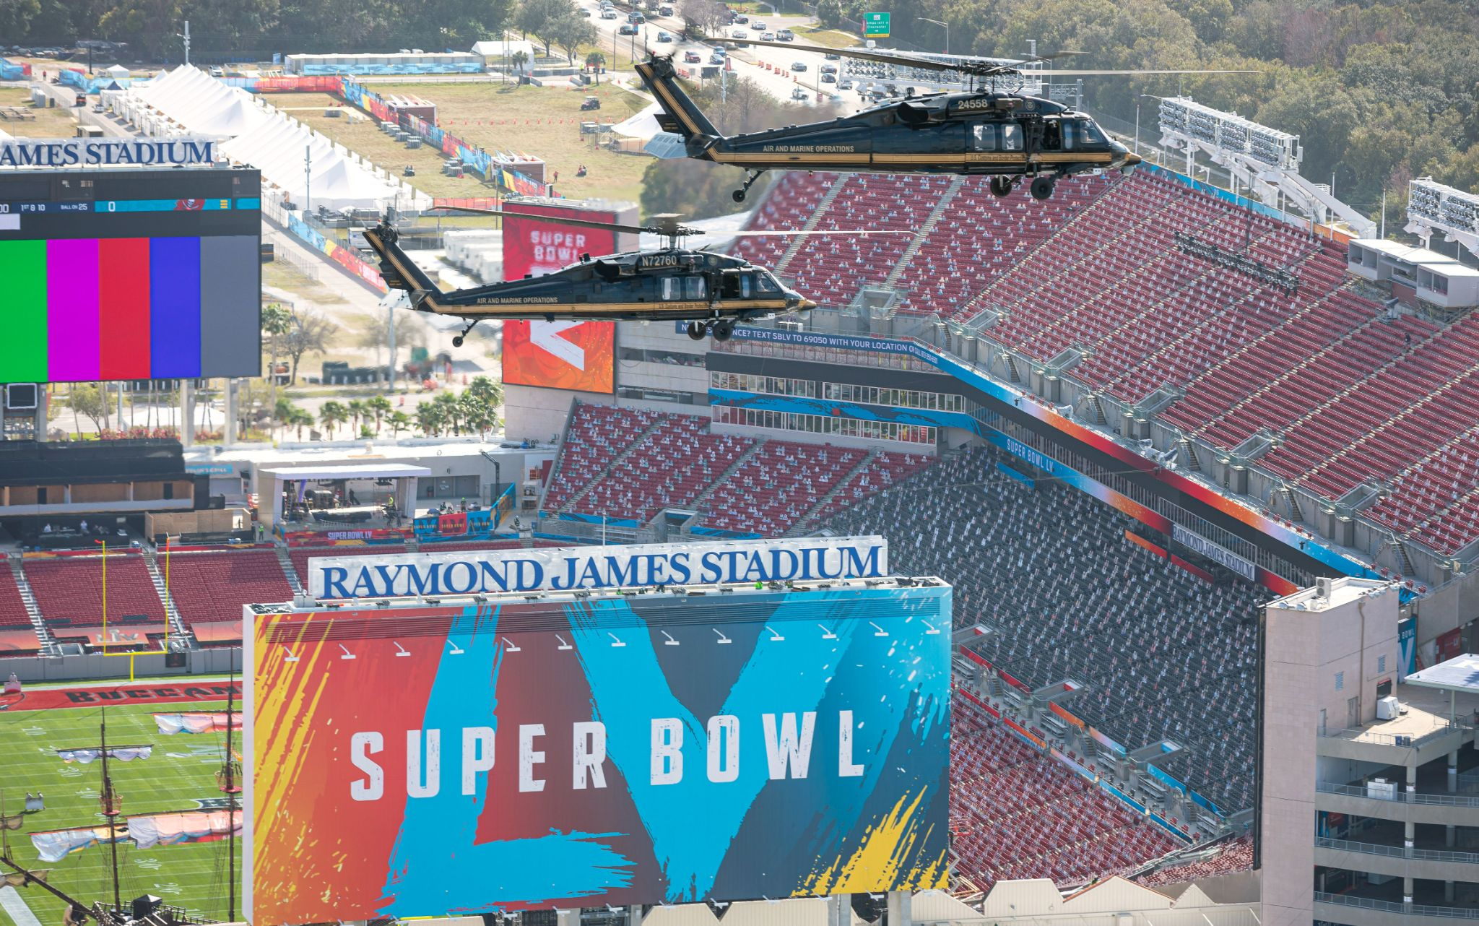
Microcosm
One football game is a microcosm of the entire season.
Notes:
Wikimedia. (2021). Raymond James Stadium. https://commons.wikimedia.org/wiki/File:Raymond_James_Stadium_(2021)_A.jpg.
Hassan, M. . (2018). Nfl logo. https://pixabay.com/vectors/nfl-national-football-league-logo-3644686/.

Slide 17
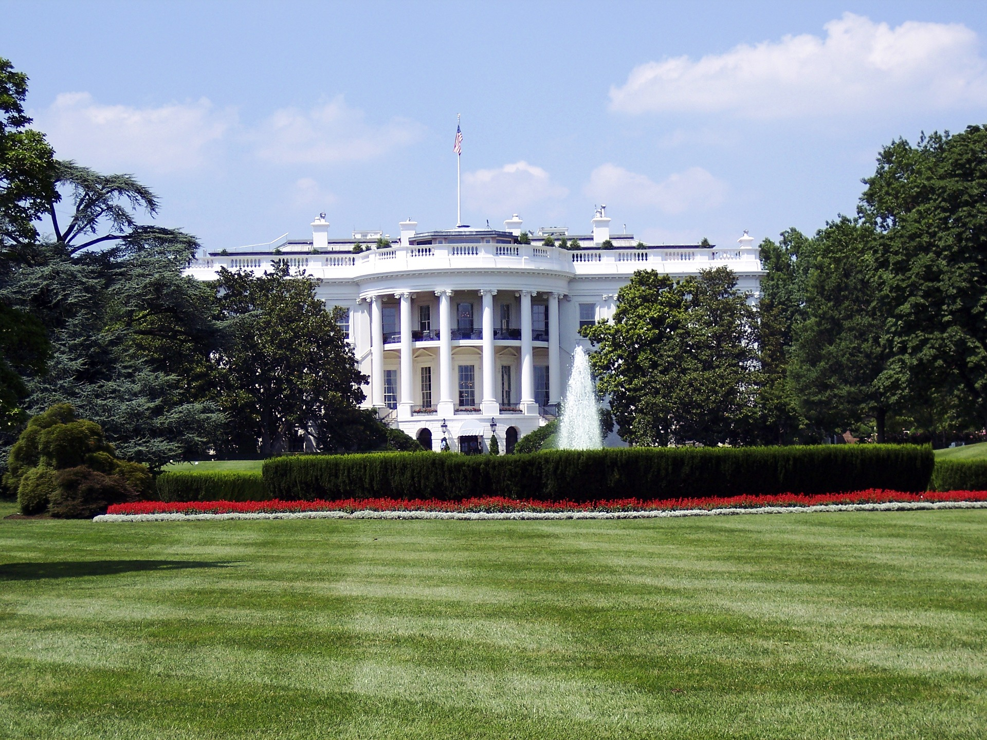
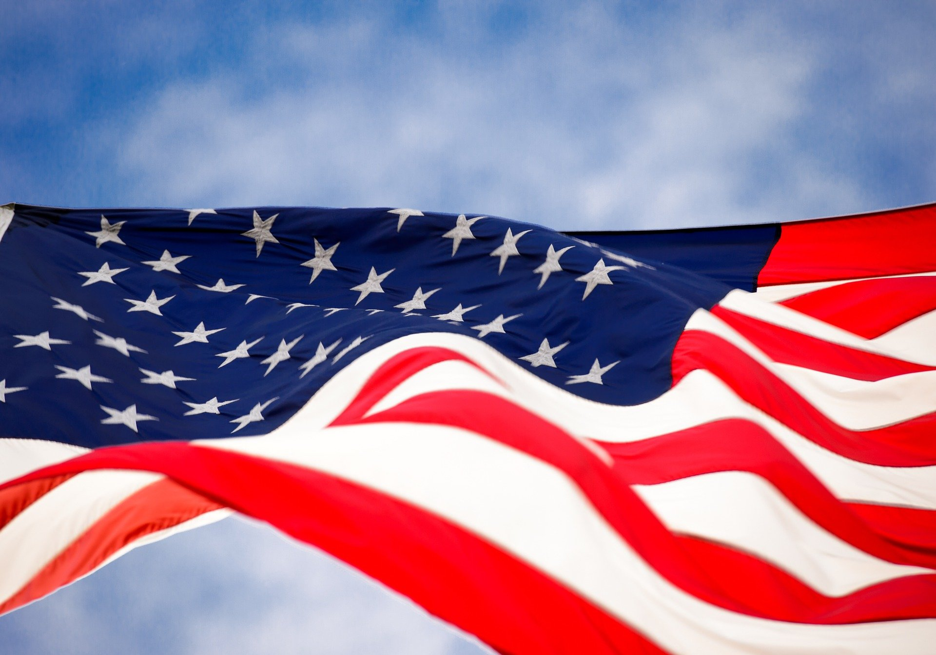
Microcosm
Washington, D.C., is a microcosm of the United States.
Notes:
Pexels. (2016). White House. https://pixabay.com/photos/administration-architecture-building-1846270/.
Pixabay.(2016). American Flag. https://pixabay.com/photos/flag-america-usa-states-1291945/.

Slide 18
Building Your Own Microcosm
Your microcosm will be a reflection of the world as YOU see it.
Yourself and those most important to you:
Family
Friends
Sports Team
Setting
Survival Items
Food and water source
Shelter
Clothing
Power Structure
Include a paragraph description to go along with the image/display that explains the reasoning for each item you chose.
Notes:
K20 Center. (n.d.) Snow globe. [Original image.]

Slide 19
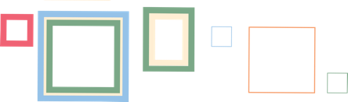
Gallery Walk
Take some time to view each of the microcosms created by your classmates.
Notes:
K20 Center. (n.d.). Gallery walk/carousel. Strategy. https://learn.k20center.ou.edu/strategy/118

Slide 20
Muddiest Point
What about microcosm and/or symbolism is still a little murky to you?
Notes:
K20 Center. (n.d.). Muddiest point. Strategy. https://learn.k20center.ou.edu/strategy/109

