Slide 2
Power to the People
The Civil Rights Movement and the Black Panther Party

Slide 3
Essential Question
How can understanding advocacy help create change?

Slide 4
Learning Objective(s)
Analyze the role of organizations such as the Black Panthers.
Examine different tactics used at different times during the Civil Rights Movement.

Slide 5
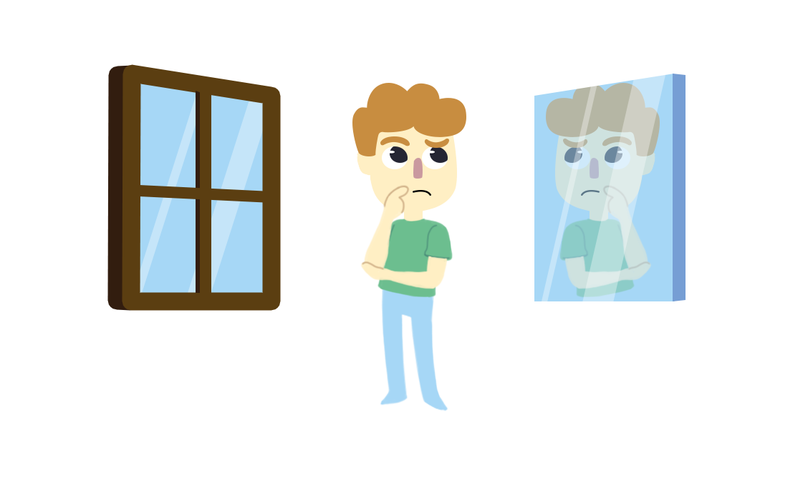
Windows and Mirrors
The following terms will be used to analyze different perspectives:
Window: What you observe does not reflect your experiences or identities. It is a "window" into experiences and identities that are different from your own.
Mirror: What you observe reflects some of your experiences and identities. It is a "mirror" of some aspects of your own life.
Notes:
K20 Center. (n.d.). Windows and mirrors. Strategies. https://learn.k20center.ou.edu/strategy/948

Slide 6
“Laws should be made to serve the people. People should not be made to serve the laws”
-Huey P. Newton
Notes:
Newton, H. P. (1972). To die for the people: The writing of Huey P. Newton. Writers & Readers.

Slide 7
Windows and Mirrors
“Laws should be made to serve the people. People should not be made to serve the laws” -Huey P. Newton
Window: How could this quote help you understand the perspective of someone who has experienced injustice?
Mirror: In what ways does this quote reflect your own beliefs, experiences, or observations about rules or laws in your community or life?

Slide 8

Painting a Picture
As a group, review the images in the Panther Programs Picture Set handout.
For each set of images, record your observations and inferences in the Painting a Picture Chart.
  Observation: anything you see in the images.
  Inferences: a conclusion you make based on your observations and prior knowledge.
Notes:
K20 Center. (n.d.). Painting a picture. Strategies. https://learn.k20center.ou.edu/strategy/1331

Slide 9

Notes:
K20 Center. (2021, September 21). 15 Minute Timer. YouTube. https://youtu.be/m3zT2IxZQaw?si=e5t6maSu94jBzCzF

Slide 10
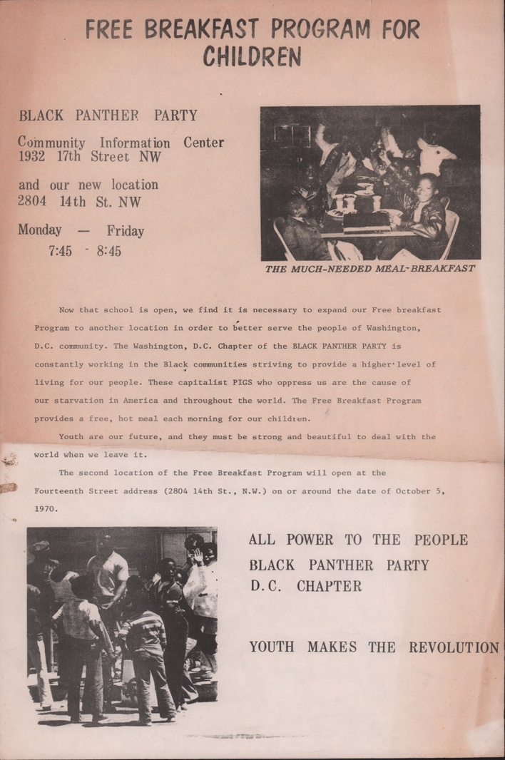
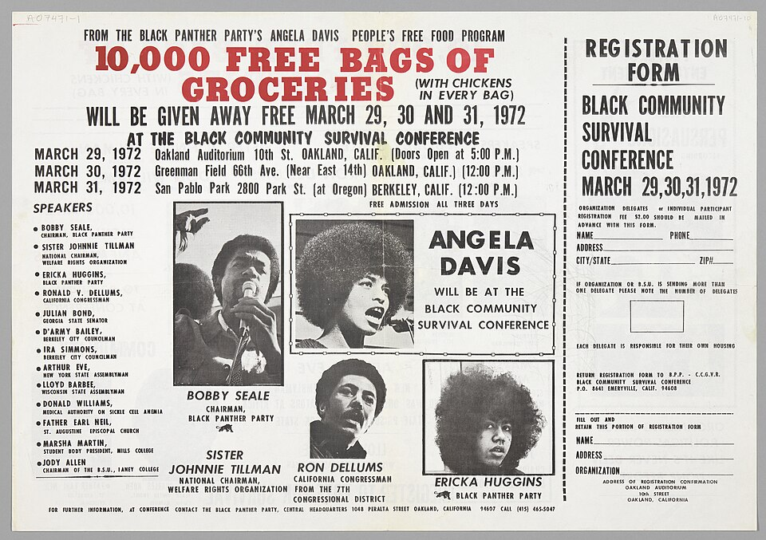
Painting a Picture-Set 1
Notes:
Wikimedia Commons contributors. (n.d.). Flier for the Black Community Survival Conference [Poster]. Wikimedia Commons. https://commons.wikimedia.org/wiki/File:Flier_for_the_Black_Community_Survival_Conference.jpg
Wikimedia Commons contributors. (n.d.). Black Panther Party Free Breakfast [Photograph]. Wikimedia Commons. https://commons.wikimedia.org/wiki/File:Black_Panther_Party_Free_Breakfast.jpg

Slide 11
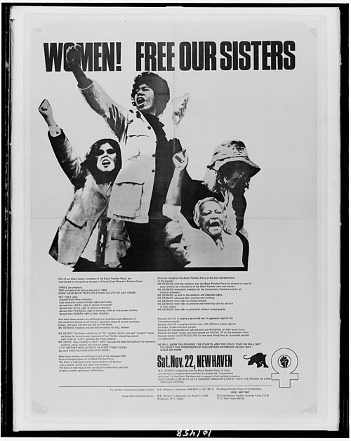
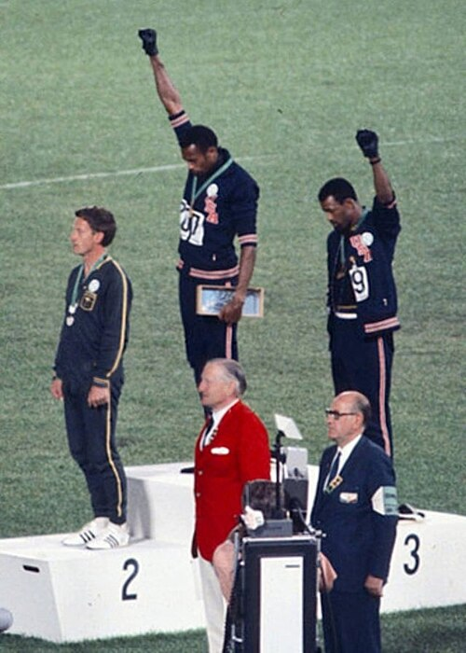
Painting a Picture-Set 2
Notes:
Wikimedia Commons contributors. (n.d.). Women! Free our sisters LCCN2015648047 [Poster]. Wikimedia Commons. https://commons.wikimedia.org/wiki/File:Women!_Free_our_sisters_LCCN2015648047.jpg
Cozzi, A. (1968). John Carlos, Tommie Smith, Peter Norman 1968cr [Photograph]. Wikimedia Commons. https://commons.wikimedia.org/wiki/File:John_Carlos,_Tommie_Smith,_Peter_Norman_1968cr.jpg

Slide 12
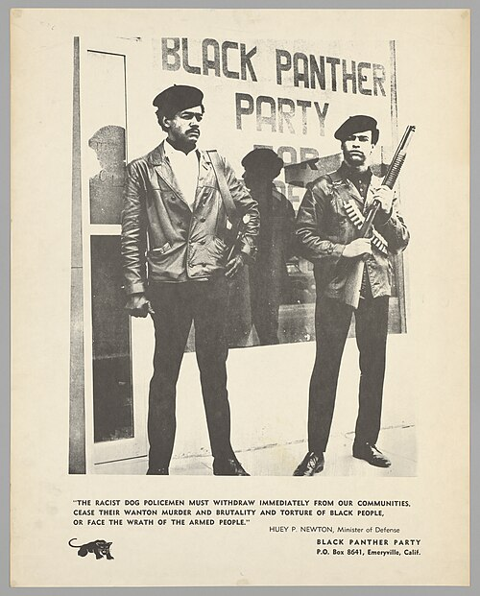
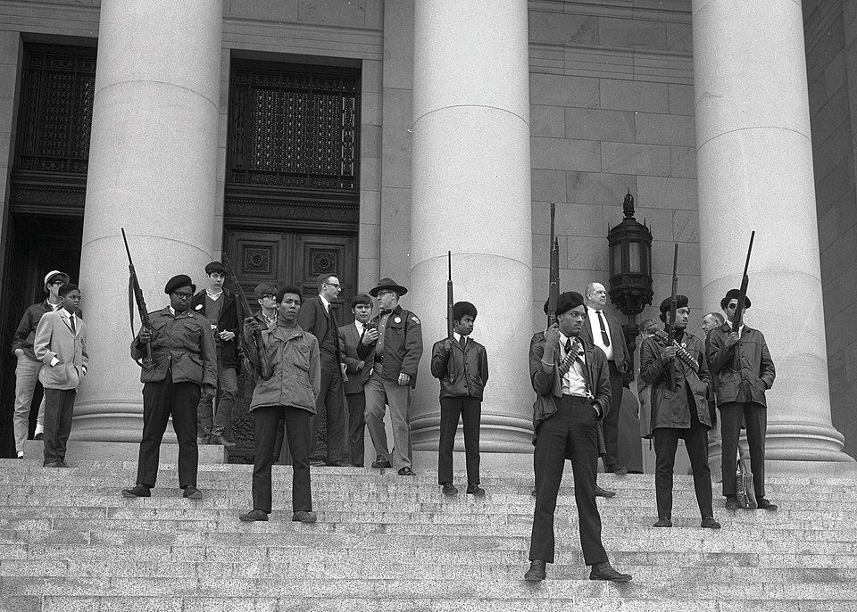
Painting a Picture-Set 3
Notes:
Wikimedia Commons contributors. (n.d.). Black Panther demonstration [Photograph]. Wikimedia Commons. https://commons.wikimedia.org/wiki/File:Black_Panther_demonstration.jpg
National Museum of African American History and Culture. (n.d.). Black Panther Party poster: “Free Em All” [Poster]. Wikimedia Commons. https://commons.wikimedia.org/wiki/File:NMAAHC-2012_46_20_1001.jpg

Slide 13
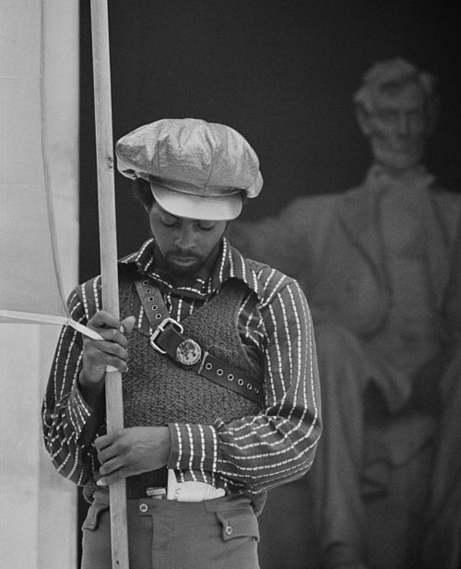
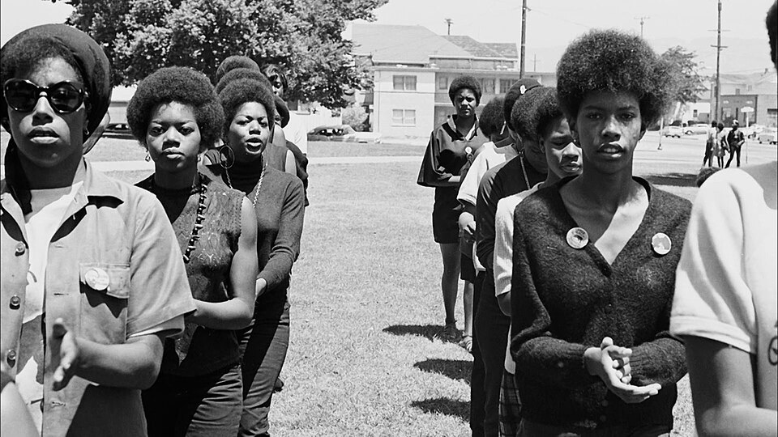
Painting a Picture-Set 4
Notes:
Wikimedia Commons contributors. (n.d.). Black Panther women at a demonstration [Photograph]. Wikimedia Commons. https://commons.wikimedia.org/wiki/File:Black.Panthers.Women.jpg
Wikimedia Commons contributors. (n.d.). Black Panther convention2 [Photograph]. Wikimedia Commons. https://commons.wikimedia.org/wiki/File:Black_Panther_convention2.jpg

Slide 14

Categorical Highlighting
Using two different colored highlighters, you will read the Rise of the Black Panther Party article and highlight sections that answer the questions.
Select a color for answers to each question.
    First color: What led to the rise of the Black Panther Party?
    Second color: How did the Black Panthers advocate for social justice in their communities?
Notes:
K20 Center. (n.d.). Categorical highlighting. Strategies. https://learn.k20center.ou.edu/strategy/192

Slide 15
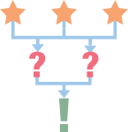
3-2-1
Using the information from your reading, answer the following questions on the 3-2-1 handout:
List three things from the reading or the Ten Point Program that stood out to you and explain why they made an impression on you.
Choose two points from the Ten Point Program you believe are still relevant issues today. Explain why you chose those points.
Give one example from the reading or the Ten Point Program about how the Black Panther Party advocated for social justice in their communities.
Notes:
K20 Center. (n.d.). 3-2-1. Strategies. https://learn.k20center.ou.edu/strategy/117

Slide 16

One-Pager
Reflecting on the Ten Point Program from the reading, create your own version of a program advocating for either a local issue in your community, job, or school.
Your one-pager can be done digitally or on paper and must include the following:
  5 points of advocacy/key issues;
  Explanation as to why each point is important;
  Images/Words/Phrases related to your points.
Notes:
K20 Center. (n.d.). One-pager. Strategies. https://learn.k20center.ou.edu/strategy/72

Slide 17

Gallery Walk
Once your program is completed, find a space around the room to hang it.
Rotate around the programs and visit a minimum of 5 programs.
Jot down any points that stood out to you.
Be prepared to share out why those stood out to you.
Notes:
K20 Center. (n.d.). Gallery walk/carousel. Strategies. https://learn.k20center.ou.edu/strategy/118

Slide 18

Exit-Ticket
How can understanding advocacy help create change?
Notes:
K20 Center. (n.d.). Bell ringers and exit tickets. Strategies. https://learn.k20center.ou.edu/strategy/125

