Slide 2
Slice of Pi
Area and Circumference

Slide 3
Agreement Circles
No matter the size of a circle, the ratio of its measurements is the same.
Move inside the circle if you agree with this statement. Stay outside the circle if you disagree.
With a partner, discuss why you agree or don’t agree with the statement. Use mathematical reasoning in your discussion.

Slide 4
Essential Question
How can one part of a circle help determine the measure of another part?

Slide 5
Lesson Objective
Apply the area and circumference of a circle to solve real-world scenarios.

Slide 6
What’s the Ratio?
Create a CER (Claim, Evidence, Reasoning) Statement about the situation.
Write a 1-2-sentence claim based on the statement: “No matter the size of a circle, its ratio is the same.”
Show your evidence and work from the measurements at each station.
Write a 3-4-sentence conclusion, providing explanations for why the data you chose counts as evidence and supports your claim.
C
E
R

Slide 7
Discussion
No matter the size of a circle, the ratio of its measurements is the same.
Does your CER statement support or not support this statement?
What ratio did you get with your measurements? Is it a number you recognize?

Slide 8
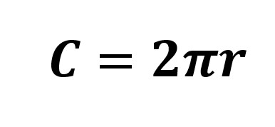
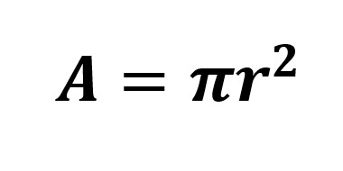
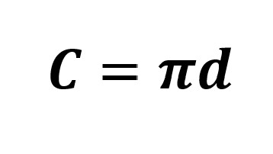
Circle Formulas
Circumference | Area

Slide 9
Which Pizza Is the Better Deal?
You and your friends are hungry, so you decide to stop at a pizza parlor. Even though you are hungry, you are also trying not to spend too much money.
Which pizza is the better deal?
Small, 10″ pizza for $8
Medium, 12″ pizza for $10

Slide 10
Another Pizza Problem
Lucy and Harry ordered two different sized pizzas. What fraction of Lucy’s 6″ diameter pizza contains the same amount of pizza as one slice of Harry’s 12″ diameter pizza of the same thickness cut into 12 equal slices?

Slide 11
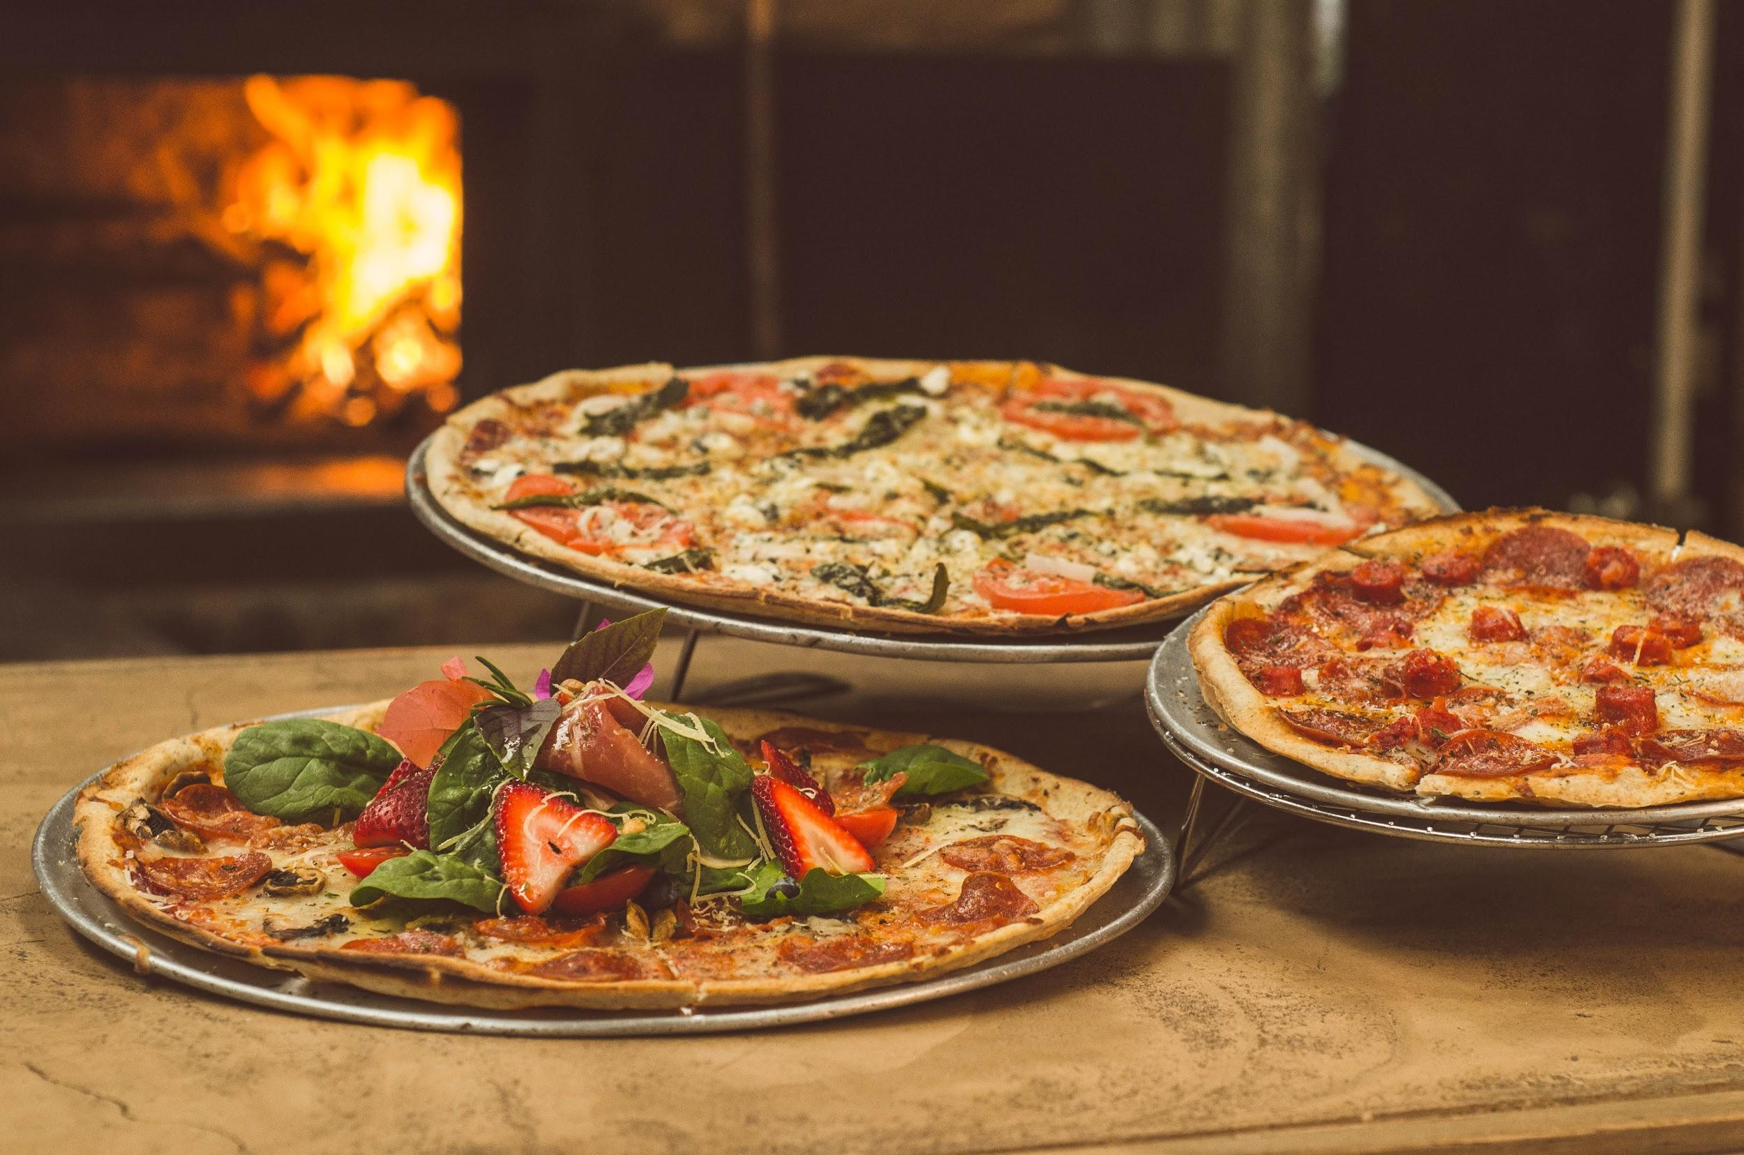
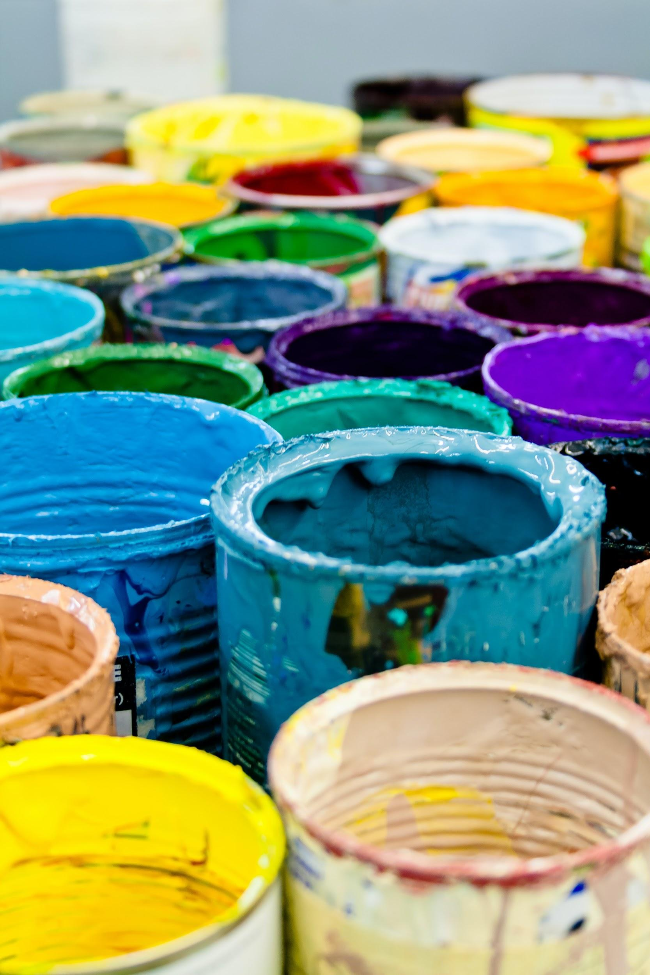
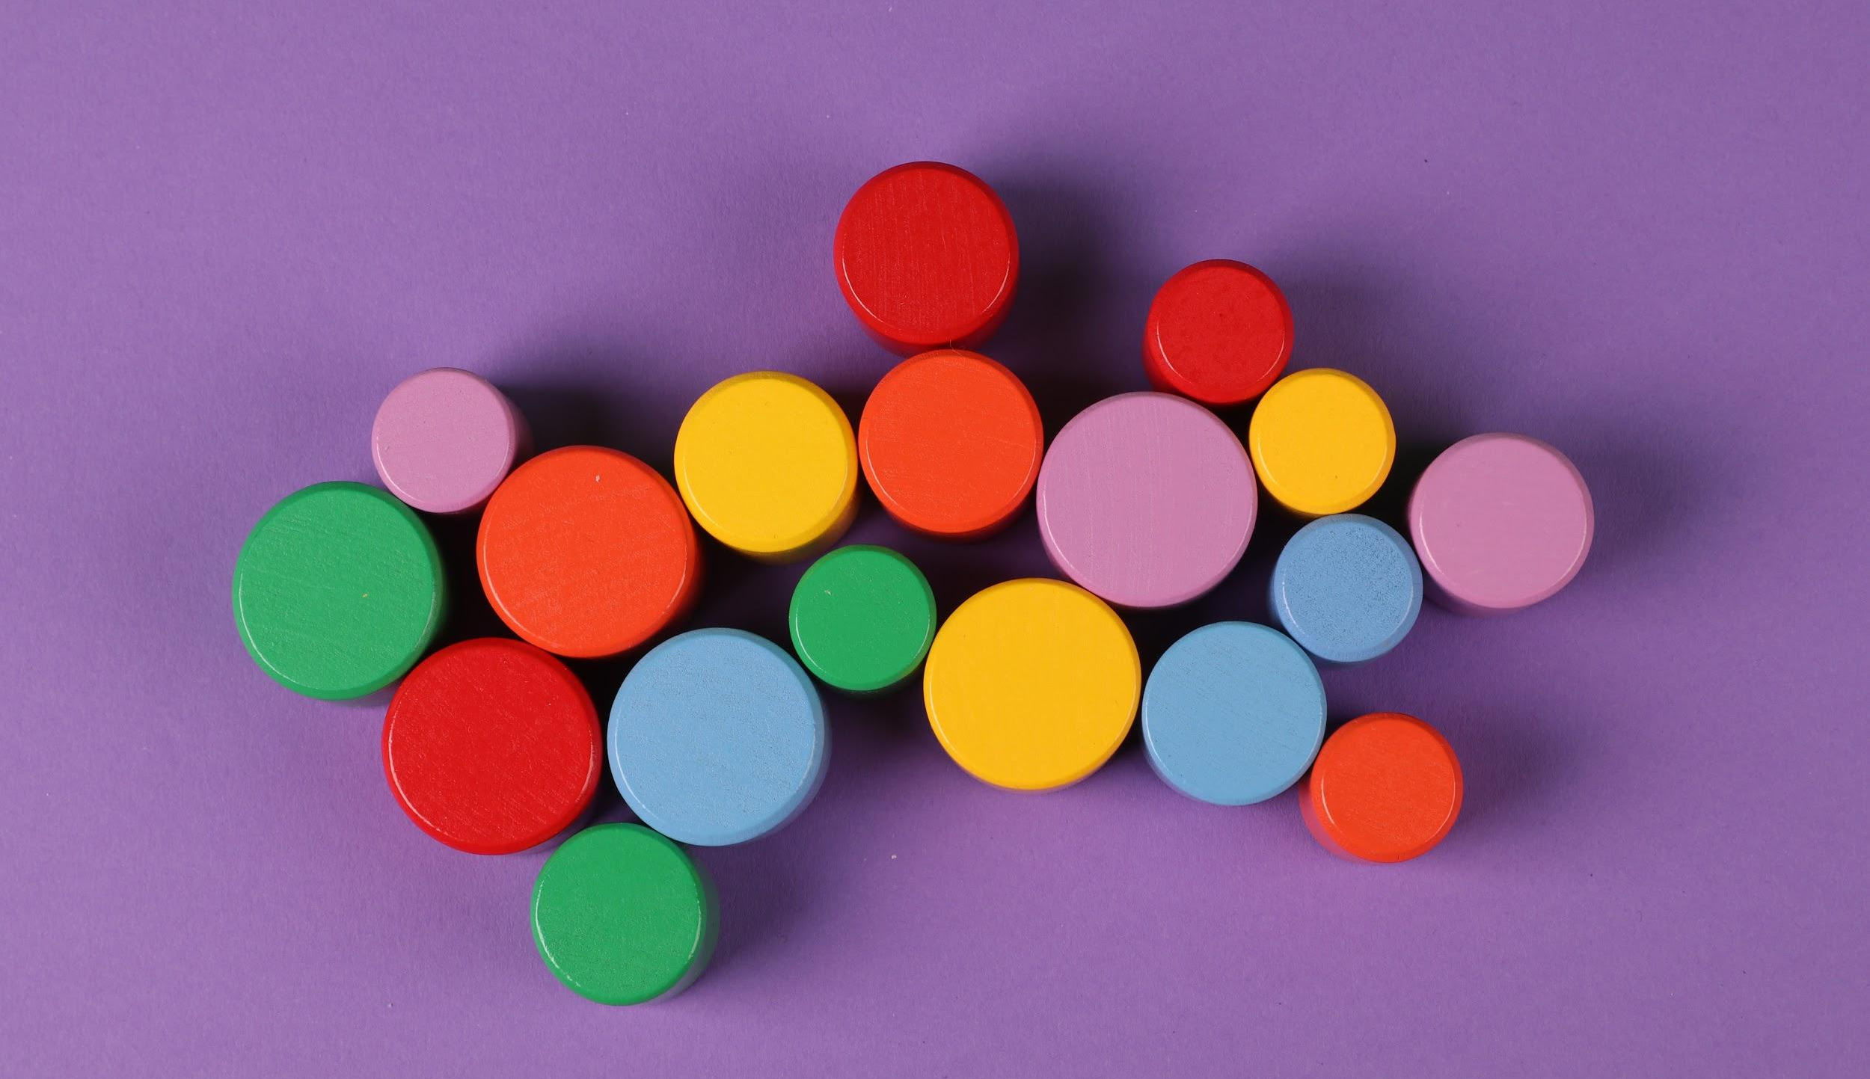
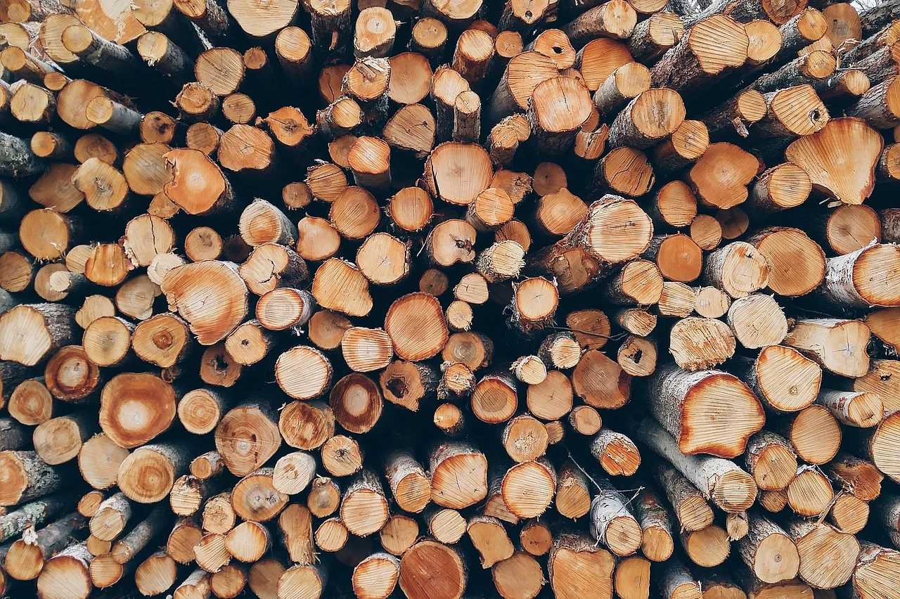
A
C
B
D
Notes:
Image Sources:
Yescas, N. (2018, April 16). Shallow focus photography of several pizzas [Image]. Pexels. https://www.pexels.com/photo/shallow-focus-photography-of-several-pizzas-1566837/
[Ann H]. (2020, December 14). Green orange and yellow round plastic toy [Image]. Pexels. https://www.pexels.com/photo/art-abstract-design-creativity-6188056/
Waschbüsch, D. (2019, February 9). Assorted-color paint buckets [Image]. Pexels. https://www.pexels.com/photo/assorted-color-paint-buckets-1887946/
Pexels. (2016, November 29). Batch dry firewood [Image]. Pixabay. https://pixabay.com/photos/batch-dry-firewood-forestry-logs-1868104/

