Slide 2
Woody Guthrie:
A Better World a Comin’
Contributions of Influential Oklahomans

Slide 3
Think-Group-Share
Consider the following questions:
What purposes can music have?
Why do people create and perform music?

Slide 4
Essential Questions
What purposes can music have?
How can music inspire change?

Slide 5
Lesson Objectives
Identify and explain Woody Guthrie’s purpose for writing and performing music.
Describe the political and social commentary that Woody Guthrie contributed through his songs.

Slide 6
Woody Guthrie: The Early Years
Born in Okemah, Oklahoma in 1912
Learned music from family and friends
Grew up as the Great Depression and the Dust Bowl devastated Oklahoma and the surrounding region
Moved from Oklahoma to Texas as a teenager after his father lost everything
From Texas, followed the many migrants moving to California

Slide 7
Gallery Walk
Visit each station and begin to develop an answer to the following question based on your observations and inferences from the quote and photo:
Why did Woody Guthrie create and perform music?
Record your inferences and evidence on the handout.

Slide 8
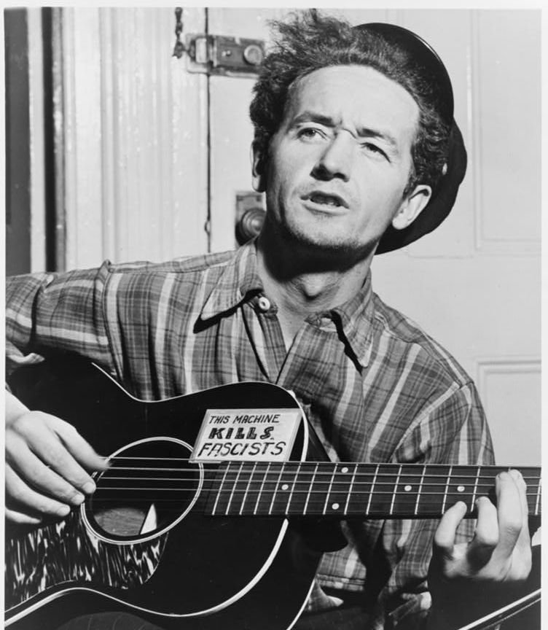
Station 1
“Wherever little children are hungry and cry, wherever people ain’t free. Wherever men are fightin’ for their rights, that’s where I’m a-gonna be.”
—Woody Guthrie, 1940
Notes:
Photo - Aumuller, A., photographer. (1943) Woody Guthrie, half-length portrait, facing slightly left, holding guitar / World Telegram photo by Al Aumuller. , 1943. [Photograph] Retrieved from the Library of Congress, https://www.loc.gov/item/95503348/.
Quote - Woody Guthrie Publications, Inc. (n.d). “Tom Joad.” Retrieved March 11, 2021, from https://www.woodyguthrie.org/Lyrics/Tom_Joad.htm

Slide 9
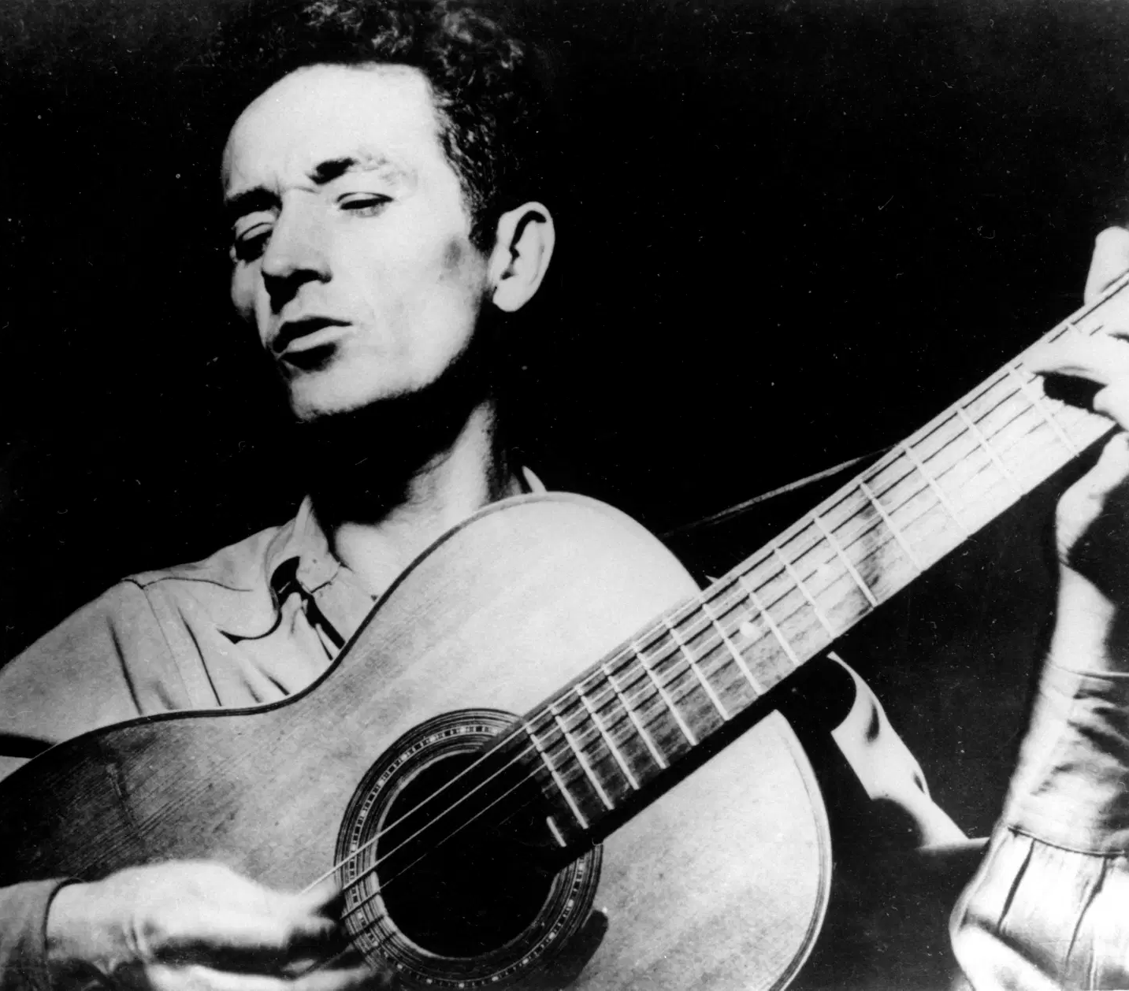
Station 2
“There's several ways of saying what's on your mind. And in states and countries where it ain't any too healthy to talk too loud, speak your mind, or even vote like you want to, folks have found other ways of getting the word around... One of the mainest ways is by singing… If the fight gets hot, the songs get hotter. If the going gets tough, the songs get tougher."
—Woody Guthrie, 1942
Notes:
Photo - (1965) Woody Guthrie, half-length portrait, facing left, singing and playing guitar. , 1965. [Photograph] Retrieved from the Library of Congress, https://www.loc.gov/item/98505476/.
Quote - Guthrie, W. (1990). Pastures of plenty: A self-portrait (D. Marsh & H. Leventhal, Eds.). HarperCollins.

Slide 10
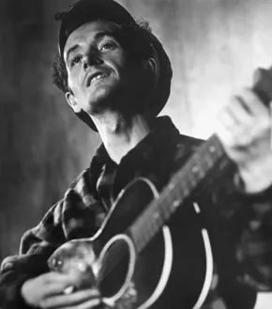
Station 3
“A folk song is what’s wrong and how to fix it or it could be whose hungry and where their mouth is or whose out of work and where the job is.”
—Woody Guthrie, 1940
Notes:
Photo - (1943) Woody Guthrie, half-length portrait, facing front, playing guitar. , 1943. [Photograph] Retrieved from the Library of Congress, https://www.loc.gov/item/98505517/.
Quote - Guthrie, W. (1990). Pastures of plenty: A self-portrait (D. Marsh & H. Leventhal, Eds.). HarperCollins.

Slide 11
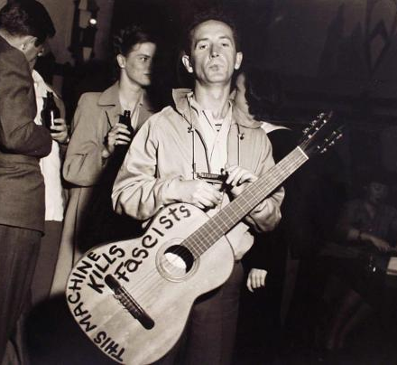
Station 4
“This Machine Kills Fascists.”
— Woody Guthrie, 1941
Fascism: a political ideology in which political power is held by one person and promotes the superiority of one group of people, typically based on race or ethnicity, over others. As a result, many people lack basic freedoms and forms of opposition are often violently suppressed.
Notes:
Photo + Quote - Balog, Lester, photographer. (1941) Woodie Guthrie, 1941. [photograph] Retrieved from The Museum of Fine Arts, Houston, https://emuseum.mfah.org/objects/50216/woodie-guthrie;jsessionid=466DF8BD335E1E47965D0A72A5BE9762.

Slide 12
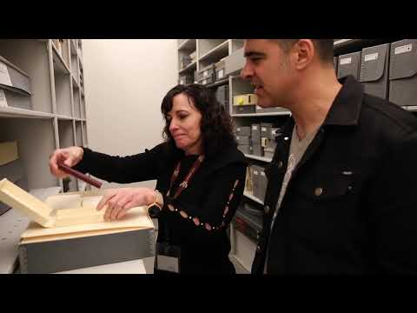
Why did Woody Guthrie Create and Perform Music?
Notes:
The Road to Now. (2018, May 1). This episode kills fascists: The life and legacy of Woody Guthrie (promo video) [Video]. YouTube. https://www.youtube.com/watch?v=X7Jt_Nd96AY&t=1s

Slide 13
Woody Guthrie
While living in California, Guthrie began co-hosting a radio show, which provided him with a platform to develop his ability to use music as a form of social and political commentary.
For Guthrie, his songs were not purely entertainment, but a tool for speaking out against social, economic, and political injustices and advocating for change.

Slide 14
Why-Lighting
Using the Woody Guthrie song lyrics assigned to your group, highlight any words or phrases that help answer this question:
  What political or social issue or issues is Woody Guthrie addressing in this song?
In the margins explain “why” you highlighted what you did.

Slide 15
Sentence-Starter Summary
In his song (song title), Woody Guthrie highlights (issue(s) that Guthrie addresses in this song) in an effort to create a more just society. The song does this by (provide text evidence and reasoning).

Slide 16
Issues Woody Guthrie Highlights in His Music
{List issues here.}

Slide 17
Issues Woody Guthrie Highlights in His Music
Social inequality Economic inequality Political inequality Abuse of policing power Racial oppression and injustice Workers’ rights Exploitation of labor | Civil rights Poverty/unemployment Union organization Redistribution of wealth and land Equality Fascism

Slide 18
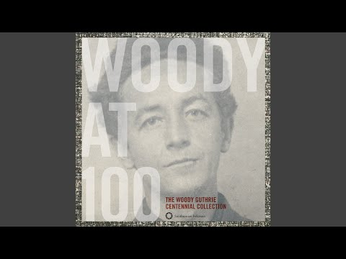
This Land Is Your Land, Revisited
What is Guthrie’s purpose for writing this song?
What political or social issue does he address with this song?
Notes:
Woody Guthrie - Topic. (2017, February 18). This land is your land (alternate version) [Video]. YouTube. https://youtu.be/t9C6XG6wkNY

Slide 19
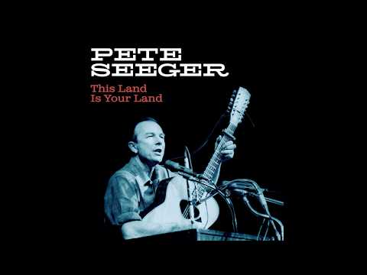
This Land Is Your Land, Revisited
What do you notice about Seeger’s lyrics compared with Guthrie’s original lyrics?
Notes:
Smithsonian Folkways. (2019, February 27). Pete Seeger - “This land is your land” (Unreleased) [Video]. YouTube. https://www.youtube.com/watch?v=rYKaLs7A4zM

Slide 20
This Land Is Your Land, Revisited
Why do you think Pete Seeger included these new verses in his performance of This Land Is Your Land?

Slide 21
Blackout Poetry
Using Woody Guthrie’s lyrics, create a Blackout Poem that reflects Woody’s social and political commentary.
When you have finished your poem, write a 3-5 sentence response explaining how your poem conveys Guthrie’s messages regarding the social and political issues of his time.

