Slide 2
AI vs Human:
The Turing Test
Station Activity

Slide 3
Station 1
Art

Slide 4
Directions:
There are two pictures for each letter group. For each letter group, discuss with your group which piece of art was created by AI, either 1 or 2. Then, decide which piece of art was created by an AI (1 or 2) and put your guess into the poll individually.
Poll:
Notes:
TEACHERS: Create a poll using either mentimeter or choose to make a copy of the google form for this station here: https://docs.google.com/forms/d/1mX5zEX_mf4YtRKVVD_CioWFio8ubWTgrtxBcWjFlynM/copy . Then place the link for the poll in the slide above.

Slide 5
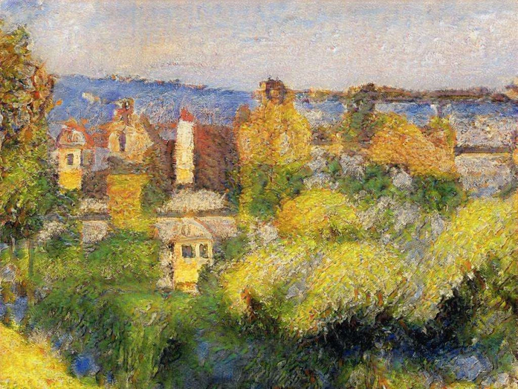
1A

Slide 6
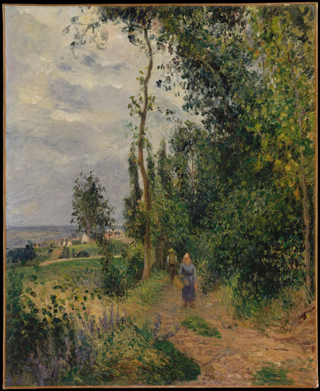
2A

Slide 7
2A
1A

Slide 8
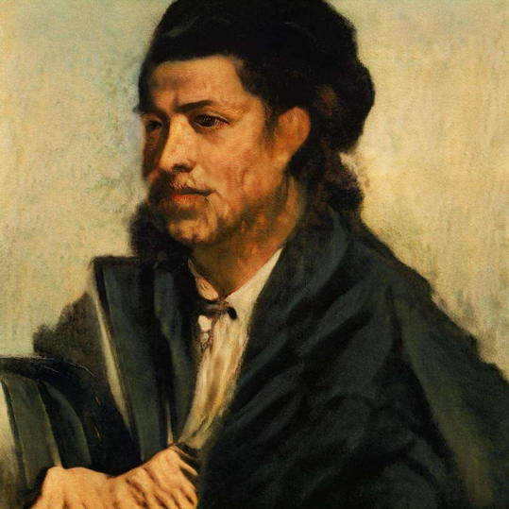
1B

Slide 9
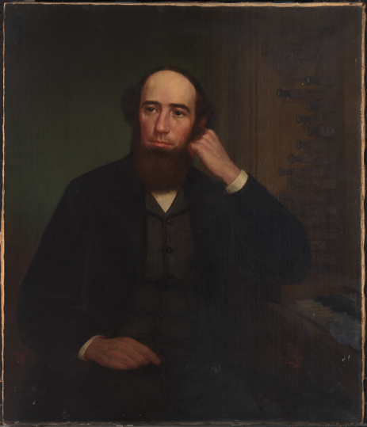
2B

Slide 10
2B
1B

Slide 11
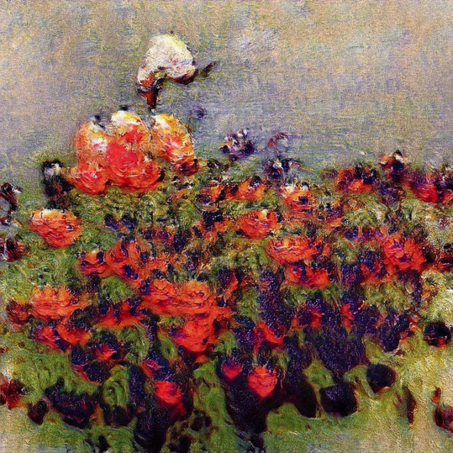
1C

Slide 12
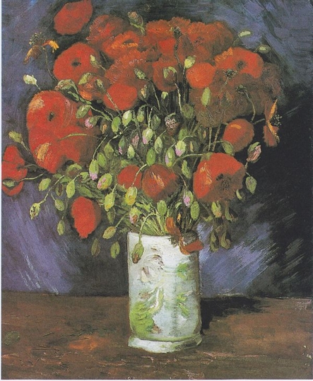
2C

Slide 13
2C
1C

Slide 14
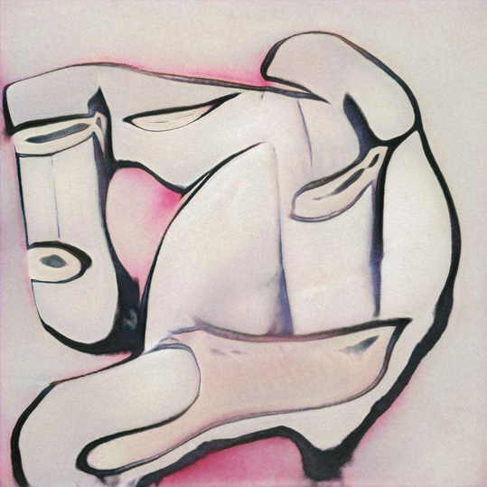
1D

Slide 15
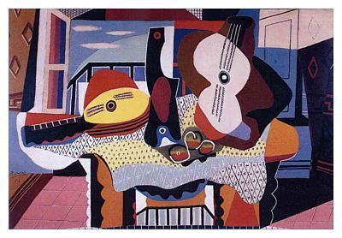
2D

Slide 16
1D
2D

Slide 17
Station 2
Inspirational Quotes

Slide 18
Directions:
There are ten quotes to review for this station. For each quote, discuss with your group if you think it was written by a human or an AI. Then, decide if each was created by an AI or a human and put your guess into the poll individually.
Poll:
Notes:
TEACHERS: Create a poll using either mentimeter or choose to make a copy of the google form for this station here: https://docs.google.com/forms/d/1Gqd_cTyIMRC3mIabR-8XTcyrSQHcZGiKm0WopY_ZqdI/copy. Then place the link for the poll in the slide above.

Slide 19
1
Happy endings will someday fill your life with brains.

Slide 20
2
Taking joy in living is a woman’s best cosmetic.

Slide 21
3
You can ignite equality by destroying society.

Slide 22
4
If you don’t risk anything, you risk even more.

Slide 23
5
Betrayed is as betrayed does.

Slide 24
6
Doubt kills more dreams than failure ever will.

Slide 25
7
Let’s make the truth mandatory.

Slide 26
8
There is no secret to success.

Slide 27
9
You can deny artistic expressions.

Slide 28
10
It’s better to be a pirate than to join the navy.

Slide 29
Station 3
Song Lyrics

Slide 30
Directions:
There are two songs for each letter group. For each letter group, read the lyrics and discuss with your group which song you think was written by an AI. Then, decide for each letter group which you think was written by an AI (1 or 2) and put your guess into the poll individually.
Poll:
Notes:
TEACHERS: Create a poll using either mentimeter or choose to make a copy of the google form for this station here: https://docs.google.com/forms/d/1jnb4nyoWb0_xiaIw5YEnEe_TtAJxJU9ipDVkJiYTJDU/copy. Then place the link for the poll in the slide above.

Slide 31
Cause I Need Your Love
1A
Verse 1
Cause I need your love
Cause I need your love
In this world we all feel alone
And not worth the pain
But you are my friend
You are my friend
Chorus
Just call me
I'm never gonna make it home again
So pretend that you're the only one
Never called out my name
Verse 2
Never thought that it would only get more absurd
The more is more
And the stronger two can say it
There's one thing I can say
And it's this
Never thought that I'd fall in love
Chorus
Just call me
I'm never gonna make it home again
So pretend that you're the only one
Never called out my name

Slide 32
Cause I Need Your Love
2A
Verse 3
So tell me what's the deal. I will risk it all. All for you.
I hope you will believe the things i try to say to you.
All I dream of is you. Why do I love you like i do.
If you leave me now. You always be inside of me.
Chorus: Cause I need your love
Verse 4
You came into my room and saw.
Saw me there standing all alone.
Please forgive me. My love is true.
It's never to late.
Chorus: Cause I need your love
Verse 1
I want you to hold my hand I want you to understand.
Time and space will never ever be the reason why.
In my mind i believe. Will you forgive the things that you see.
If you leave me now. You always be inside of me.
Chorus: Cause I need your love.
Verse 2
Baby you're the one for me.
Can you see i'm always there.
I wanna hold your hand.
Baby please come back to me.

Slide 33
But In Reality
1B
Verse 1
My heart
Is filled with fear
This is my last chance to show my love
I will move on
Some people find it easier than they do
Some people dream
Chorus
Hard to face tomorrow
You finally found the time
And the joy of life
Someday I'm gonna live on
Verse 2
Some people find it easier than others
Some people are calm
But in reality
Some of them can see
That nothing's wrong
Hard to deal with
Chorus
Hard to face tomorrow
You finally found the time
And the joy of life
Someday I'm gonna live on

Slide 34
Edge of Reality
2B
Verse 1
I walk along a thin line darling
Dark shadows follow me
Here's where life's dream lies disillusioned
The edge of reality
Verse 2
Oh I can hear strange voices echo
Laughing with mockery
The border line of doom I'm facing
The edge of reality
Chorus
On the edge of reality she sits there tormenting me
The girl with the nameless face
On the edge of reality where she overpowers me
With fears that I can't explain
She drove me to the point of madness
The brink of misery
If she's not real then I'm condemned to
The edge of reality
Chorus
On the edge of reality she sits there tormenting me
The girl with the nameless face
On the edge of reality where she overpowers me
With fears that I can't explain
She drove me to the point of madness
The brink of misery
If she's not real then I'm condemned to
The edge of reality

Slide 35
Station 4
Ad Slogans

Slide 36
Directions:
There are two ad slogans for each product in the number group. For each number group, read the ad slogan and discuss with your group which ad slogan you think was written by an AI. Then, decide for each number group which you think was written by an AI (A or B) and put your guess into the poll individually.
Poll:
Notes:
TEACHERS: Create a poll using either mentimeter or choose to make a copy of the google form for this station here: https://docs.google.com/forms/d/1pUK_RS0J3bu8cB1B0VSiA2qeCbwiZ7KNPLgDePni6hU/copy. Then place the link for the poll in the slide above.

Slide 37
1A
Underoos
Children’s most important underwear

Slide 38
1B
Underoos
The underwear that’s fun to wear

Slide 39
2A
Legos
They’re building stories

Slide 40
2B
Legos
Rebuild the world

Slide 41
3A
Barbie
For all girls

Slide 42
3B
Barbie
We can do anything, right, Barbie?

Slide 43
4A
Snuggie
So many others

Slide 44
4B
Snuggie
Wrapped in warmth

Slide 45
5A
Milk
Healthier from the inside out

Slide 46
5B
Milk
Got milk?

Slide 47
Station 5
Faces

Slide 48
Directions:
There are eight faces in this station. Look at each face and discuss with your group which face you think was created by an AI. Then, decide for each number which you think was created by an AI and put your guess into the poll individually.
Poll:
Notes:
TEACHERS: Create a poll using either mentimeter or choose to make a copy of the google form for this station here: https://docs.google.com/forms/d/1Doh3QKKd5B4T0U5GjStDAUrFpQKKaRZ1AwbwlvQVfJs/copy. Then place the link for the poll in the slide above.

Slide 49
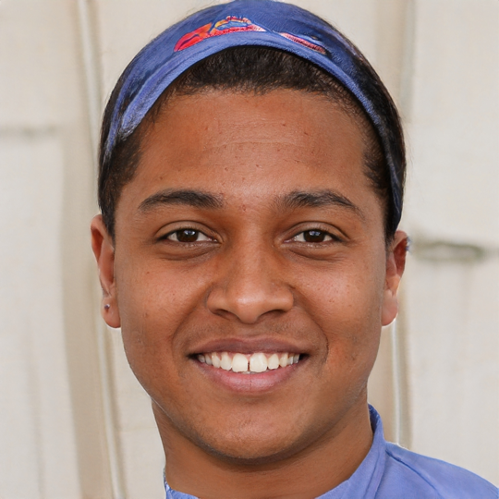
1

Slide 50
2

Slide 51
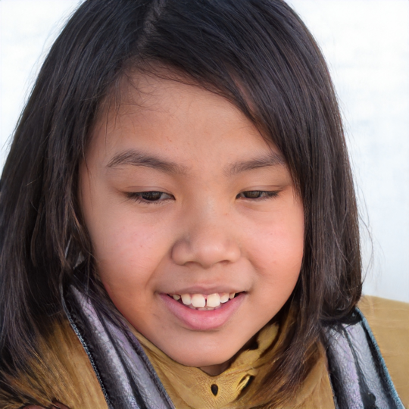
3

Slide 52
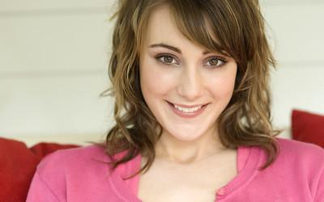
4

Slide 53
5

Slide 54
6

Slide 55
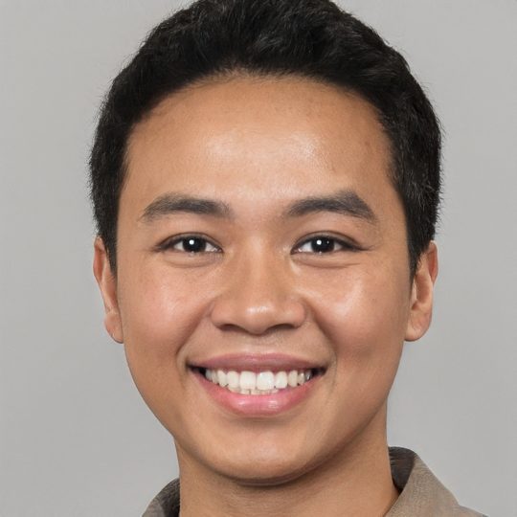
7

Slide 56
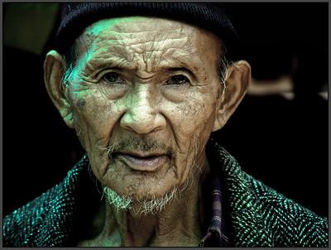
8

