Slide 2
Tulsa Burning:
Flash Points of Change
The Tulsa Race Massacre
Notes:
Image source: https://www.si.edu/sidedoor/ep-9-confronting-past

Slide 3
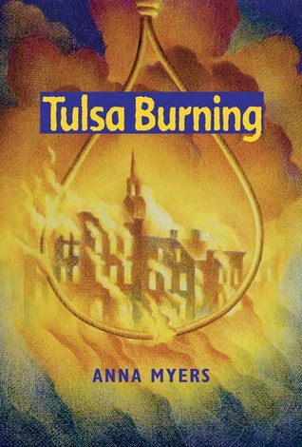
I Notice, I Wonder
Record in the “I Notice” column your observations about the cover.
Record in the “I Wonder” column any questions you have about the cover.
Notes:
Myers, A. (2018). Tulsa burning. Oklahoma City, OK: The RoadRunner Press.

Slide 4
Essential Question
What roles do people, places, and power play in historical events?

Slide 5
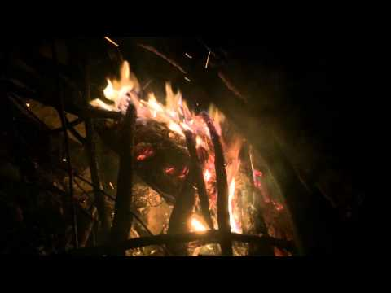
Notes:
Play from 7:18-7:40, during which there the fire flares up after a poke or stick falling in. Ask students, “what caused this sudden flash where the fame grew larger?”
Source: EJ Travels. (November 2015). Campfire, Stoking the Flames. YouTube. https://www.youtube.com/watch?v=GteLCF_1Ipc

Slide 6

A flash point is a moment in time when there is a rapid rise in the intensity of a fire.
Moment in time of perfect conditions = flash point

Slide 7
Tulsa Burning: Flash Points of Change 3-2-1
A flash point is a rapid rise in the intensity of a fire.
3-2-1: How can the three Ps may cause a rapid change?
3 emotions that might cause people to make a rapid change.
2 events that might cause places to change rapidly.
1 way/reason power may make a rapid change.

Slide 8
Tulsa Burning: Flash Points of Change
What are some historical events that you have learned about where these conditions of people, places, and power built up to a sudden outburst like the flash point of a fire?
People
Places
Power
Notes:
This can be a homework assignment to research, or you can talk through it with the class and find examples together.
Current Events:
Racial Profiling etc
Historical Events: All of these events are part of 4th/5th grade standards
Boston Massacre
Indian Removal
Civil Rights Movement

Slide 9

A flash point is also a serious situation or area that has the potential of erupting into sudden violence.
Moment in time of perfect conditions = flash point of violence

Slide 10
Essential Question
How do we keep history from repeating itself?

Slide 11
Why is it important to identify flash points? What contributed to flash points in historical events?
Moment in time of perfect conditions = flash point of violence
Notes:
Note to students that, if one of these elements is taken away or changed, there won’t be a flash point.

