Slide 2

The Price of Sameness
“Harrison Bergeron” by Kurt Vonnegut

Slide 3
Essential Question:
If society enforced total social balance, what would we lose – and would it be worth it?
Notes:
Do the amendments to the Constitution ensure that all people living in America are given “socially balanced basic rights?”

Slide 4
Objectives:
Examine the structure of the amendments.
Read and analyze “Harrison Bergeron” for examples of fairness/unfairness.
Write claims and provide supporting evidence for the creation of new amendments.

Slide 5
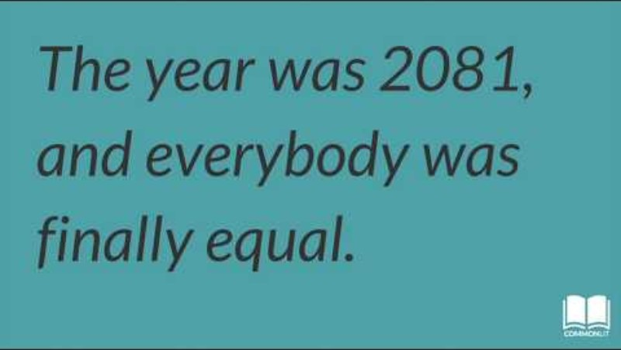
What is social balance?
Notes:
CommonLit, Inc. (2018, Mar. 23). What is equality? [Video]. YouTube. https://www.youtube.com/watch?v=z0sCJdhW5tU

Slide 6

Four Corners
Read the statement and decide whether you:
Strongly Agree
Agree
Disagree
Strongly Disagree
Notes:
K20 Center. (n.d.). Four corners. Strategies. https://learn.k20center.ou.edu/strategy/138

Slide 7
Fairness is more important than freedom.
Write your opinion.
Notes:
“Fairness is defined as "treating people according to their needs, free from self-interest, prejudice, or favoritism."

Slide 8
Fairness is more important than freedom.
In your group, discuss your thoughts on the statement, “Fairness is more important than freedom.”
Keep in mind that everyone should get an opportunity to share their opinions.
Notes:
K20 Center. (n.d.). Four corners. Strategies. https://learn.k20center.ou.edu/strategy/138

Slide 9
Listen…change your mind???
Each group has a representative who shares their group’s thoughts.
If you want to change your corner, move.
Be prepared to explain your choice.

Slide 10

I Notice/I Wonder
With your partner:
Read through the current amendments to the Constitution.
Write on a sticky note: What do you notice about the structure of the amendments?
Write on a sticky note: What do you wonder about the structure of the amendments?
Notes:
Remind students to take a picture of their I Notice, I Wonder or keep their sticky notes for a later activity.
K20 Center. (n.d.). I notice, I wonder. Strategies. https://learn.k20center.ou.edu/strategy/180

Slide 11
CURRENT AMENDMENTS TO THE U.S. CONSTITUTION
Amendment | Explanation | Amendment | Explanation | Amendment | Explanation
1st Amendment | Freedom of religion, speech, petition, and assembly. | 10th Amendment | Reserved powers to the states. | 19th Amendment | Women have the right to vote.
2nd Amendment | Right to bear arms. | 11th Amendment | States are protected from being sued by citizens of another state. | 20th Amendment | President and vice-president’s term of office begins on January 20th, and no longer in March.
3rd Amendment | No quartering of soldiers. | 12th Amendment | Separated balloting procedures for president and vice-president (they are a team). | 21st Amendment | Repeal of prohibition.
4th Amendment | Protection against illegal search and seizure. | 13th Amendment | Abolition of slavery. | 22nd Amendment | President is limited to two (2) terms.
5th Amendment | Protection against self-incrimination, double-jeopardy. Protection of due process and the right to a grand jury. | 14th Amendment | Granted former slaves citizenship and equal protection, established principle of selective incorporation. | 23rd Amendment | D.C. is given presidential electors.
6th Amendment | Right to a speedy and public trial, impartial jury, and right to counsel. | 15th Amendment | African-American men could vote. | 24th Amendment | Poll tax is illegal.
7th Amendment | Right to a trial by jury in common-law cases. | 16th Amendment | Established federal income tax. | 25th Amendment | Established the vice-president as the successor if the president is unable to serve. The president can nominate a vice-president if there is a vacancy.
8th Amendment | Protection against cruel and unusual punishment. No excessive bail imposed. | 17th Amendment | Direct election of US Senators. | 26th Amendment | 18-year olds have the right to vote.
9th Amendment | The enumeration of rights in the Constitution won’t be used against the people. | 18th Amendment | Prohibition. | 27th Amendment | Congressional pay raises will only take effect after the next election.
Notes:
FindLaw. (n.d.). U. S. Constitutional amendments. https://constitution.findlaw.com/amendments.html

Slide 12

I Think/We Think
Use the handout to guide the activity.
Write what you think in the left column.
Then, discuss your answer with a small group of three.
Write notes about what your group thinks in the right column.
Choose a spokesperson to speak for your group.
Is being the same as other people good or bad?
Notes:
K20 Center. (n.d.). I think / we think. Strategies. https://learn.k20center.ou.edu/strategy/141

Slide 13
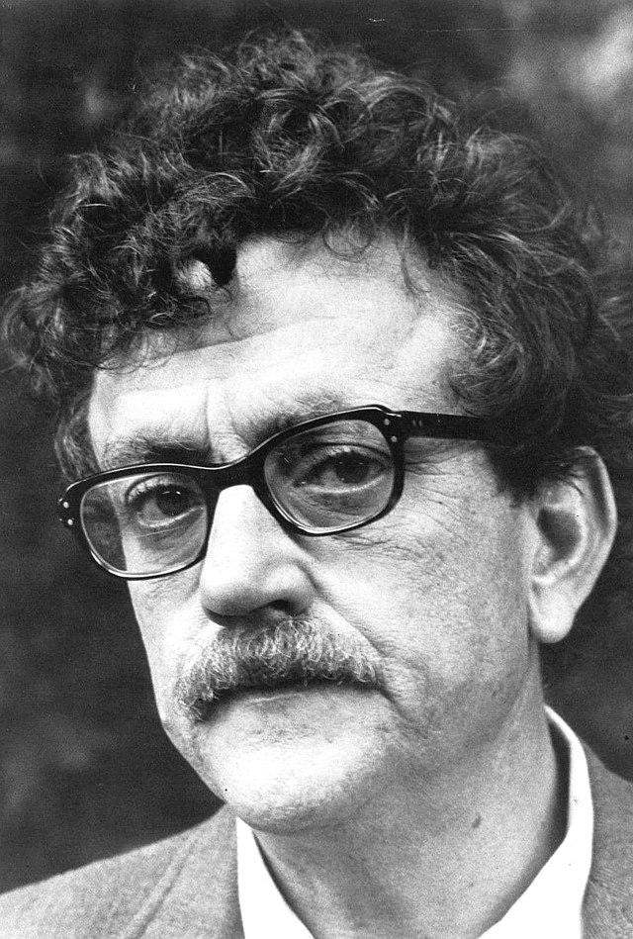
Kurt Vonnegut, Jr.
Born in Indiana
Studied chemistry, engineering, and anthropology
Fought in WWII and was taken prisoner by the Germans
Wrote Slaughterhouse-Five
Known for dark humor, satire, and science fiction
Notes:
WNET-TV/PBS. (2018, July 28). Kurt Vonnegut [Photograph]. https://commons.wikimedia.org/wiki/File:Kurt_Vonnegut_1972.jpg

Slide 14

“Harrison Bergeron” by Kurt Vonnegut, Jr.
Read the first section of the text as you listen to the audio. Notice the sound effects used in this audio version.
Audiobook
Notes:
JedmondFish. (2019, July 26). "Harrison Bergeron" Audiobook - Kurt Vonnegut Jr. [Audio]. YouTube. https://www.youtube.com/watch?v=uP_YwwwIScU&t=11s

Slide 15
CURRENT AMENDMENTS TO THE U.S. CONSTITUTION
Amendment | Explanation | Amendment | Explanation | Amendment | Explanation
1st Amendment | Freedom of religion, speech, petition, and assembly. | 10th Amendment | Reserved powers to the states. | 19th Amendment | Women have the right to vote.
2nd Amendment | Right to bear arms. | 11th Amendment | States are protected from being sued by citizens of another state. | 20th Amendment | President and vice-president’s term of office begins on January 20th, and no longer in March.
3rd Amendment | No quartering of soldiers. | 12th Amendment | Separated balloting procedures for president and vice-president (they are a team). | 21st Amendment | Repeal of prohibition.
4th Amendment | Protection against illegal search and seizure. | 13th Amendment | Abolition of slavery. | 22nd Amendment | President is limited to two (2) terms.
5th Amendment | Protection against self-incrimination, double-jeopardy. Protection of due process and the right to a grand jury. | 14th Amendment | Granted former slaves citizenship and equal protection, established principle of selective incorporation. | 23rd Amendment | D.C. is given presidential electors.
6th Amendment | Right to a speedy and public trial, impartial jury, and right to counsel. | 15th Amendment | African-American men could vote. | 24th Amendment | Poll tax is illegal.
7th Amendment | Right to a trial by jury in common-law cases. | 16th Amendment | Established federal income tax. | 25th Amendment | Established the vice-president as the successor if the president is unable to serve. The president can nominate a vice-president if there is a vacancy.
8th Amendment | Protection against cruel and unusual punishment. No excessive bail imposed. | 17th Amendment | Direct election of US Senators. | 26th Amendment | 18-year-olds have the right to vote.
9th Amendment | The enumeration of rights in the Constitution won’t be used against the people. | 18th Amendment | Prohibition. | 27th Amendment | Congressional pay raises will only take effect after the next election.
Notes:
FindLaw. (n.d.). U. S. Constitutional amendments. https://constitution.findlaw.com/amendments.html

Slide 16

Why-Lighting
Highlight instances of unfairness and violations of rights in the story
In the margin include:
  Which rights are specifically being taken away.
  Why is this unfair?
Notes:
K20 Center. (n.d). Why-lighting. Strategies. https://learn.k20center.ou.edu/strategy/128

Slide 17
Fairness
Fairness means treating people according to their needs, free from self-interest or favoritism.

Slide 18
Why-Lighting Continued
Highlight instances of unfairness and violations of rights in the story
In the margin include:
  Which rights are specifically being taken away.
  Why is this unfair?
Notes:
K20 Center. (n.d). Why-lighting. Strategies. https://learn.k20center.ou.edu/strategy/128

Slide 19
What do you think?
Were the amendments good for the people?
What basic human rights were violated to create a "truly uniform" society?

Slide 20
Essential Question:
“If society enforced total social balance, what would we lose — and would it be worth it?”
Notes:
If society enforced total social balance, what would we lose — and would it be worth it?

Slide 21

Claim Cards
In your group:
Read each claim one at a time.
Discuss the evidence that supports or refutes the claim.
  Use prior knowledge as well as reliable sites to search for evidence.
After all Claim Cards have been discussed, choose the “best claim” to represent the essential question.
Notes:
K20 Center. (n.d). Claim cards. Strategies. https://learn.k20center.ou.edu/strategy/160

Slide 22

Video in Padlet
In a 90-second Padlet video include the following:
Your chosen claim statement.
A brief explanation of why you thought it was the best claim for the essential question.
Evidence supporting the claim.
Notes:
K20 Center. (n.d.). Video in Padlet. Tech Tools. https://learn.k20center.ou.edu/tech-tool/4077

Slide 23
Return to I Notice/I Wonder
Return to your I Notice/I Wonder from earlier in the lesson and read through the observations you made about the structure of the amendments.
Write a summary statement of your observations.
Share with the class.
Notes:
K20 Center. (n.d.). I notice, I wonder. Strategies. https://learn.k20center.ou.edu/strategy/180

Slide 24

Brainstorm
How can the U.S. Constitution be improved?

Slide 25
Write the 28th Amendment
Option 1: CER
Include new amendment.
Include evidence that this amendment is necessary.
Include reasoning for how the amendment is fair and will help society.
Option 2: Multimedia Presentation
Include new amendment.
Create a sixty second presentation that includes pictures, artwork, music, text or video that shows why this amendment is needed and how it will help society.
Notes:
K20 Center. (n.d.) Claim, evidence, reasoning. Strategies. https://learn.k20center.ou.edu/strategy/156

Slide 26
Present Your Projects
Share your project with your group of four.
Listen carefully.
Within your group, vote on the best project.
Your group will present the best project to the class.

Slide 27
Story Extension & Multimodal Presentation
Use the Extension Project handout as a guide.
Part 1: Write your own original extension to the story.
  What do you want to see happen next?
Part 2: Create a multimedia presentation.
  illustrated narrative
  digital slideshow
  audio story/podcast
  short video

Slide 28
Present Your Projects
Share your project with your group of four.
Listen carefully.
Within your group, vote on the best project.
Your group will present the best project to the class.

