Slide 2
Equally Unequal
“Harrison Bergeron” by Kurt Vonnegut

Slide 3
Essential Question
Do the amendments to the U.S. Constitution ensure all people living in America are given the basic rights of equality?

Slide 4
Learning Objectives
Read and analyze “Harrison Bergeron” for examples of fairness/unfairness;
Examine the structure of the Amendments to the U.S. Constitution;
Write claims and provide evidence supporting them in the form of new amendments.

Slide 5
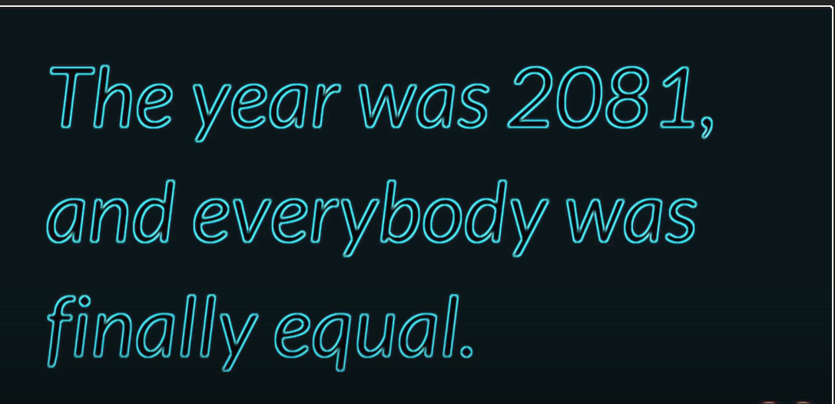
What is equality?
Notes:
Source: Commonlit Inc. (2018, Mar 23). What is equality? [Video].YouTube. https://www.youtube.com/watch?v=z0sCJdhW5tU

Slide 6
Four Corners
Read the statement on the next slide and decide whether you:
Strongly Agree
Agree
Disagree
Strongly Disagree
Notes:
Source: https://learn.k20center.ou.edu/strategy/138

Slide 7
Fairness is more important than freedom.

Slide 8
Is Fairness More Important Than Freedom?
In your groups, discuss your thoughts on the statement, keeping in mind that everyone should get an opportunity to share their opinions.

Slide 9
Where Do You Stand?
After your groups have shared initial opinions, decide if you still support your initial stance.
Anyone who feels differently after groups have shared their opinions may change their groups.
If you feel differently, explain your reasons for changing.

Slide 10
I Notice, I Wonder
With your partner:
Read through the current Amendments to the Constitution.
What do you notice about the structure of the Amendments?
What do you wonder about the structure of the Amendments?
Notes:
Source: https://learn.k20center.ou.edu/strategy/180

Slide 11
I Notice, I Wonder Jamboard
Examine the structure of the 27 Amendments.
What do you notice?
What do you wonder?
With your partner, write your responses on sticky notes, either on the jamboard or on your sticky note pad.
Notes:
https://constitution.findlaw.com/amendments.html
https://jamboard.google.com/d/1Kij0nxvfCt7xRN3-5wAUk2E5gSufNr8vo1D2oIMGe7g/viewer?ts=60770c26

Slide 12
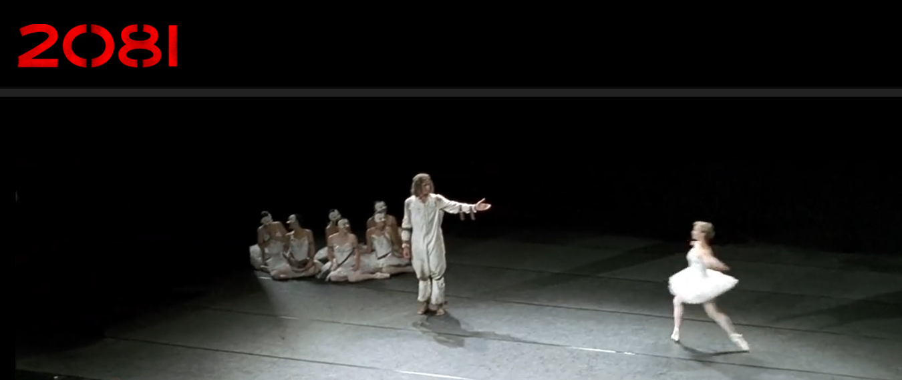
2081, An Adaptation of “Harrison Bergeron
Notes:
Source: Tuttle, C. & Halvorssen, T. (2021). 2081. Moving picture institute and Passing lane films. [Video]. https://www.teaching2081.org/watch-the-film

Slide 13
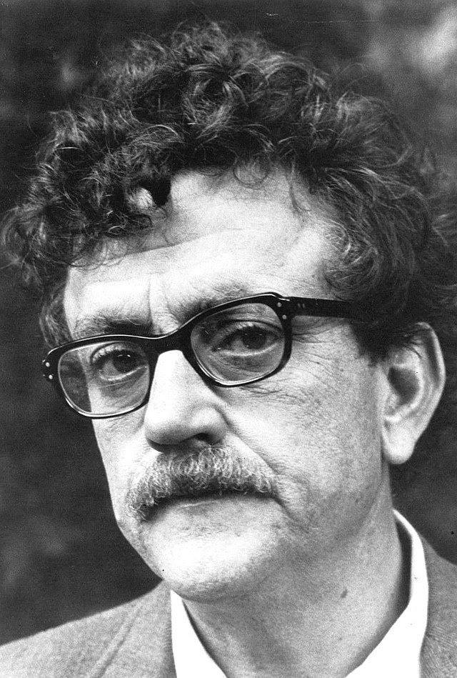
Kurt Vonnegut, Jr.
Born in Indiana
Studied chemistry, engineering, and anthropology
Fought in WWII and was taken prisoner by the Germans
Wrote Slaughterhouse-Five
Known for dark humor, satire, and science fiction
Notes:
Source: WNET-TV/ PBS. (2018, July 28). Kurt Vonnegut 1972 [Digital image]. https://commons.wikimedia.org/wiki/File:Kurt_Vonnegut_1972.jpg

Slide 14
“Harrison Bergeron” by Kurt Vonnegut
Read the first few paragraphs of the text as you listen to the audio.
Notice the sound effects used in this audio version.
Notes:
https://www.youtube.com/watch?v=uP_YwwwIScU&t=11s

Slide 15
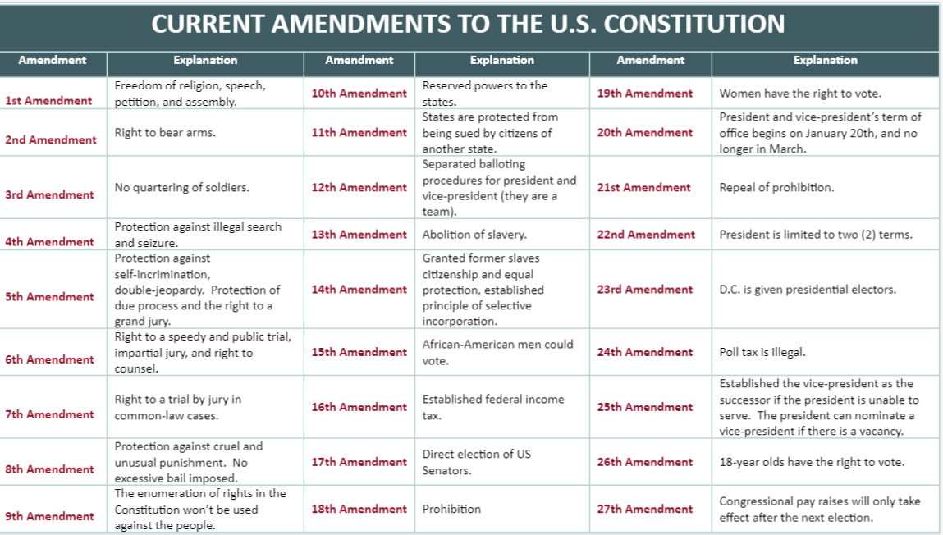

Slide 16
Why-Lighting
Highlight instances of unfairness and violations of rights in the story.
In the margin include:
What rights are specifically being taken away?
Is it unfair for a government to take away citizen rights?
Why or why not?

Slide 17
Violations of rights?
Resume audio presentation.
As you listen, think about the concept of “fairness.”
When you’ve completed the story, discuss the following questions:
Were the amendments good for the citizens?
What basic human rights were violated to create a “truly equal” society?

Slide 18
Rights and Fairness
In your copy of the story, highlight examples of unfairness and violations in the story.
Write in the margin your feelings about the two questions below:
What rights are specifically being taken away?
Why is it unfair to take away rights in the effort to make everyone “equal?”

Slide 19
Essential Question
Do the amendments to the U.S. Constitution ensure all people living in America are given the basic rights of equality?

Slide 20
Claim Cards
In your group, complete the following:
Read each Claim Card, one at a time.
Discuss the evidence that supports or refutes the claim.
Use prior knowledge and reliable sites to search for evidence.
After all Claim Cards have been discussed, choose the “best claim” to represent the essential question.
Notes:
Source: https://learn.k20center.ou.edu/strategy/160

Slide 21
Peacefully protesting in America is legal and safe.

Slide 22
States in America provide all people with the same rights.

Slide 23
People in America have a voice regarding political decisions.

Slide 24
The Constitution is not used against people.

Slide 25
Citizens are protected from cruel and unusual punishment.

Slide 26
Flipgrid
In a 90-second Flipgrid, include the following:
Your chosen claim statement;
Why you thought it was the best claim for the essential question;
Evidence supporting the claim.

Slide 27
Jamboard: I Notice, I Wonder Review
Return to your Jamboard from earlier in the lesson and read through the observations you made about the structure of the amendments.
Notes:
https://en.wikipedia.org/wiki/Jamboard
https://jamboard.google.com/d/1Kij0nxvfCt7xRN35wAUk2E5gSufNr8vo1D2oIMGe7g/viewer?ts=60770c26

Slide 28
Brainstorm
How can the US Constitution be improved?
Brainstorm in groups.
Choose a change you feel is important.
Draft an amendment you would like to see added to the Constitution.

Slide 29
Writing the 28th Amendment
Option 1: C-E-R
Include new amendment;
Include evidence that this amendment is necessary;
Include reasoning explaining how the amendment is fair and will help society.
Option 2: Multimedia
Include new amendment;
Create a sixty-second presentation that includes pictures, artwork, music, text, or video that shows why this amendment is needed and how it will help society.
Notes:
Source: https://learn.K20center.ou.edu/strategy/160

