Slide 2
Let’s Settle Down
Characteristics of Civilization

Slide 3
Essential Questions
Why do civilizations develop in certain locations?
What are the characteristics of a civilization?
How do modern civilizations compare to ancient civilizations?

Slide 4
Lesson Objectives
Explain how the environment influences human settlement.
Identify the elements of civilization.

Slide 5
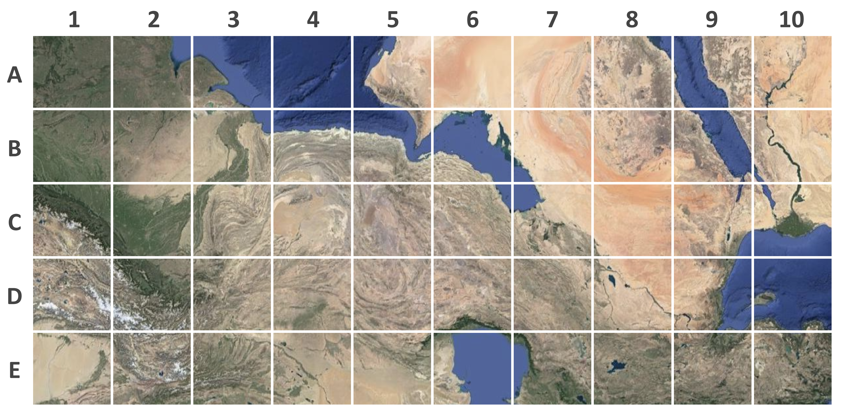
Pick a Place to Settle
Notes:
Source: Google. (n.d.). Egypt and surrounding countries. [Map]. https://www.google.com/maps/@30.1301925,47.823879,2665957m/data=!3m1!1e3. Grid overlay added by K20 Center.

Slide 6
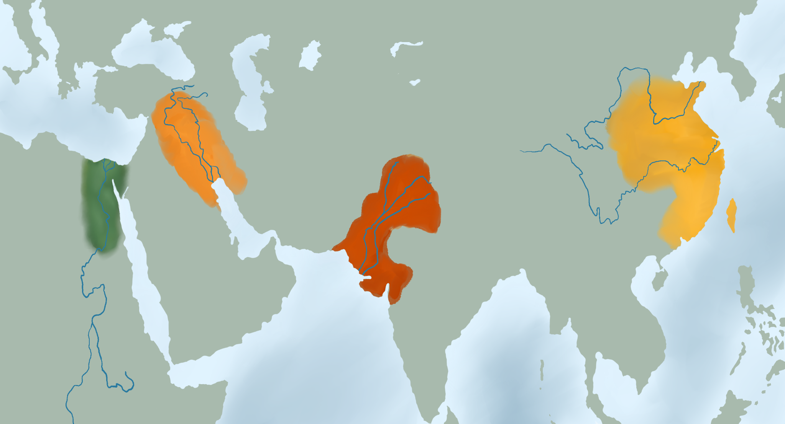
Locations of Ancient Civilizations
Notes:
Source: K20 Center. (n.d.). Locations of Ancient Civilizations. [Map]. https://docs.google.com/document/d/1eDfyG8qo1IS9MDgZAo1S5YEfMKzQcEzD/

Slide 7
Examining Ancient Civilizations
Look at the map of the locations of ancient civilizations.
Answer the following questions in your groups:
What do the locations of each civilization have in common?
What natural resources supported these civilizations?
In addition to fresh water, what other resources would people need to settle in a location?
Be prepared to share out your answers with the whole class.

Slide 8
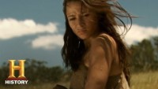
The Birth of Farming
As you watch the video about the birth of farming, consider the following questions:
How do the locations of the river valley civilizations support farming?
How does the video suggest that farming leads to creating a civilization?
Notes:
Source: https://www.youtube.com/watch?v=bhzQFIZuNFY

Slide 9
What is Civilization?
Think of the word “civilization.”
How would you define “civilization”?
Develop a definition for the word “civilization.”

Slide 10
What are Characteristics of Civilization?
Civilization is generally described as a place that has the following characteristics:
Stable food supply;
System of government;
Written language;
Technological developments;
Religion.
Look for these characteristics as you explore the four ancient civilizations.

Slide 11
PERSIA - Characteristics of Ancient Civilizations
Read about your group’s assigned river valley civilization.
As you read, fill in your group’s assigned PERSIA categories on the group PERSIA Graphic Organizer.
After filling in your categories, add the information to the PERSIA chart at the front of the class. Include the name of your civilization.
Notes:
Source: K20 Center. (n.d.). Ancient River Valley Civilizations Packet. [Infographic]. http://k20.ou.edu/rivercivs.

Slide 12
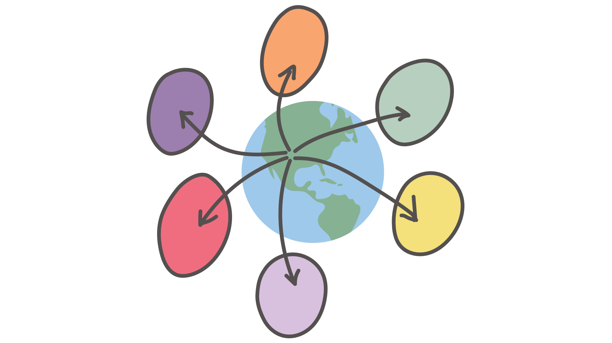
PERSIA - Characteristics of YOUR Civilization
Use a blank PERSIA Graphic Organizer to complete information about the civilization you live in today.
After you complete the PERSIA Graphic Organizer, compare your responses with your group.
What information is similar?
What is different?

Slide 13
Exit Ticket
Compare the characteristics of the four ancient civilizations to your own civilization.
How have civilizations changed over time?
Use the ancient civilization PERSIA graphic organizer and your current civilization PERSIA graphic organizer to respond to the question.
Notes:
Source: K20 Center. (n.d.). Bell Ringers and Exit Tickets. Strategy. https://learn.k20center.ou.edu/strategy/125

