Slide 2
Who was Henrietta Lacks?
Ethics in Scientific Research

Slide 3
Essential Question
Should scientists be able to use the tissues or cells of a person for research without the person’s consent?

Slide 4
Inside Out
In the innermost circle answer the following question:
Should scientists be able to use the tissues or cells of a person for research without the person’s consent?

Slide 5
Notes:
TEDEducation (Director). (2016, February 08). The immortal cells of Henrietta lacks - robin bulleri [Video file]. Retrieved March 26, 2021, from https://www.youtube.com/watch?v=22lGbAVWhro&list=RDCMUCsooa4yRKGN_zEE8iknghZA&start_radio=1

Slide 6
Lesson Objectives
Use evidence to support and defend your position on the use of tissues or cells of a person for research without the person’s consent.

Slide 7
Jigsaw
In your group of four you will split up the articles.
There are four types articles to choose from:
Legal
Family
Society
Medical
Keep in mind that you will be using the Jigsaw strategy and become an “expert” about your article.

Slide 8
S-I-T
After you have read your article, record the following information on each of your 3x5 cards:
S: Identify one surprising fact or idea.
I: Identify one interesting fact or idea.
T: Identify one troubling fact or idea.

Slide 9
Inside Out
Write at least three questions or things you wondered about in the middle circle.

Slide 10
Jigsaw
Connect with those who read the same article as you and discuss what you wrote in the middle circle of the Inside Out handout.

Slide 11
Jigsaw
In your original group of four, each person should share the what they wrote in the middle circle of their Inside Out handout.
What you learned from the reading.
New discoveries from peers.

Slide 12
Inside Out
In the outermost circle answer include the following:
Most important information you learned from your group. (This should come from the articles you DID NOT read).

Slide 13
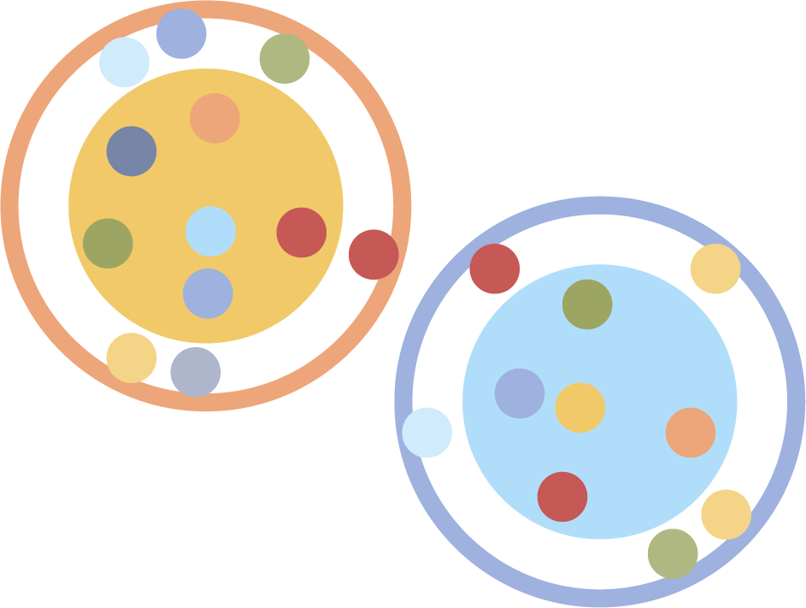
Socratic Seminar
You will be carefully analyzing the text through discussion, observation, interpretation, and consensus seeking.
With your small group, decide on one question you believe to be the most important question that you still want to discuss.

Slide 14
Establishing Norms with Padlet
Using the [QR Code/Link], access the padlet. Work through the sections of the padlet one at a time.
This will be used to Establish Norms for the Socratic Seminar activity, helping create an environment that encourages participation.
[Insert QR Code or Link to Padlet here]

Slide 15
Socratic Seminar
Divide into two groups:
Inner Circle- answering the questions and having a group discussion over one of the questions.
Outer Circle- quietly record observations of the speakers.

Slide 16
Discussion

Slide 17
Activity Reflection
When reflecting on the Socratic Seminar and your own engagement, consider the following questions:
At any point, did the seminar revert to something other than a dialogue? If so, how did you handle this?
What evidence did you see of people actively listening and building on others' ideas?
How has your understanding of the text been affected by the ideas explored in this seminar?
What parts of the discussion did you find most interesting? In what parts were you least engaged?
What would you like to do differently as a participant the next time you are in a seminar?

Slide 18
Notes:
Crashcourse (Director). (2018, April 18). Henrietta lacks, the Tuskegee experiment, and ethical data collection: Crash course STATISTICS #12 [Video file]. Retrieved March 26, 2021, from https://www.youtube.com/watch?v=CzNANZnoiRs

Slide 19
Notes:
NewsyHub (Director). (2016, August 25). The unknowns about the Tuskegee syphilis study [Video file]. Retrieved March 26, 2021, from https://www.youtube.com/watch?v=J3tQ93fQf8U

Slide 20
Inverted Pyramid
With your partner, discuss the following:
The implications of the Tuskegee Institute and the damage it has done to African Americans.
Your feelings about scientific research on human subjects.

Slide 21
Inverted Pyramid
With your partner move to pair up with another group to discuss the following:
The implications of the Tuskegee Institute and the damage it has done to African Americans.
Your feelings about scientific research on human subjects.

Slide 22
Inverted Pyramid
Did your perspective change after watching the videos?

Slide 23
I Used to Think...But Now I Know
Write a personal reflection based on the essential question:
Should scientists be able to use the tissues or cells of a person for research without the person’s consent?
Consider using what you originally wrote in the innermost circle of your Inside Out handout to get you started on your reflection.

