Slide 2
Understanding Asthma
Connecting Social Issues & Human Health Gaps Unit, Lesson 1

Slide 3

I Notice, I Wonder
While watching the video, write down the following:
Your observations (things you notice)
Your questions (things you wonder about)

Slide 4
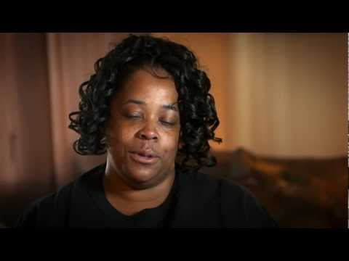
Notes:
Have students begin by watching a segment of the video (2:53-6:24): https://youtu.be/fMufgnJId58?t=173
Source: Children’s National Hospital. (March 2013). Health Disparities, Focus on Asthma | Children's National Medical Center. YouTube. https://youtu.be/fMufgnJId58?t=173

Slide 5

Elbow Partners
With your Elbow Partner, discuss what is similar and different about what your recorded. Add any new questions or observations.

Slide 6

Driving Question Board
Based on your conversation with your Elbow Partner, what are some questions you have that we can add to the Driving Question Board?

Slide 7
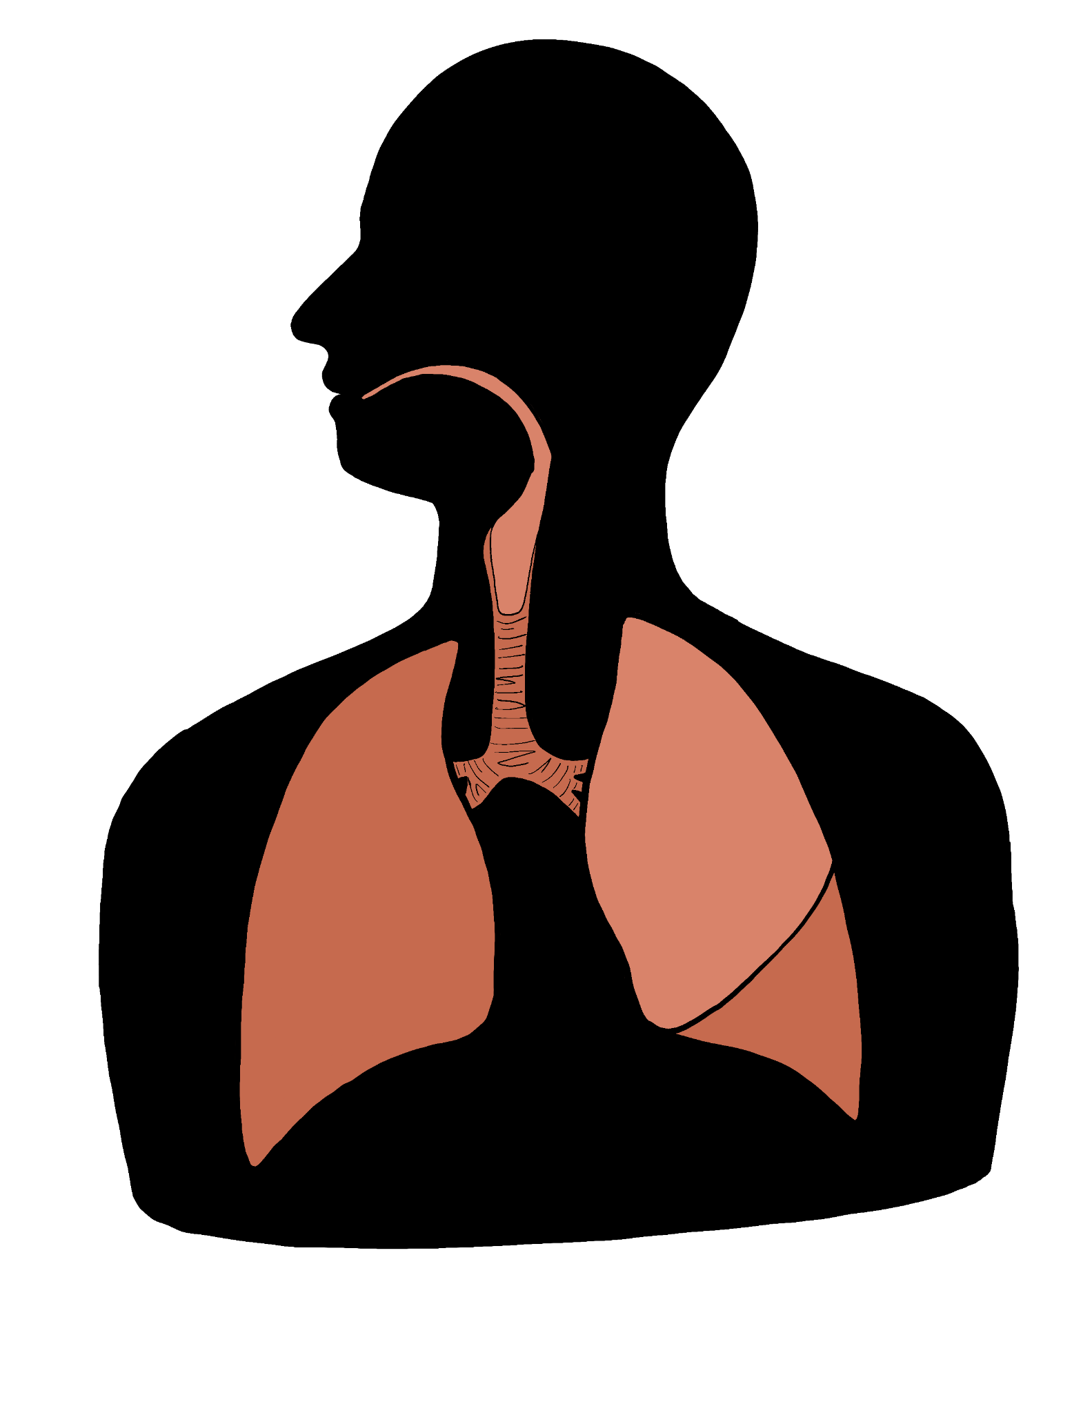
The Respiratory System
What happens to the respiratory system before, during, and after an asthma attack?
Create an initial model of the respiratory system that shows what you think happens during these times.

Slide 8
Elbow Partners
With your Elbow Partner:
Compare your models of the respiratory system before, during, and after an asthma attack.
Explain what you think occurs during an asthma attack, using your model as a visual aid.

Slide 9
Essential Question
How do environmental factors affect human health?

Slide 10
Lesson Objectives
We will apply the meaning of homeostasis to the respiratory system.
We will be able to model what happens to the respiratory system before, during, and after an asthma attack.

Slide 11
Station Description
Station | Description
Build a Lung | Discover how your lung functions with and without asthma.
Asthma Demonstration | Learn what it feels like to have asthma.
How Does Asthma Work? | Watch “How Does Asthma Work?”
Asthma in Oklahoma’s Children | Read through the 2013 fact sheet that has been published by the Oklahoma Department of Health.
How an Asthma Attack Occurs | Watch “How an Asthma Attack Occurs.”
The Chemistry of Inhalers | Study the two images.

Slide 12


Slide 13
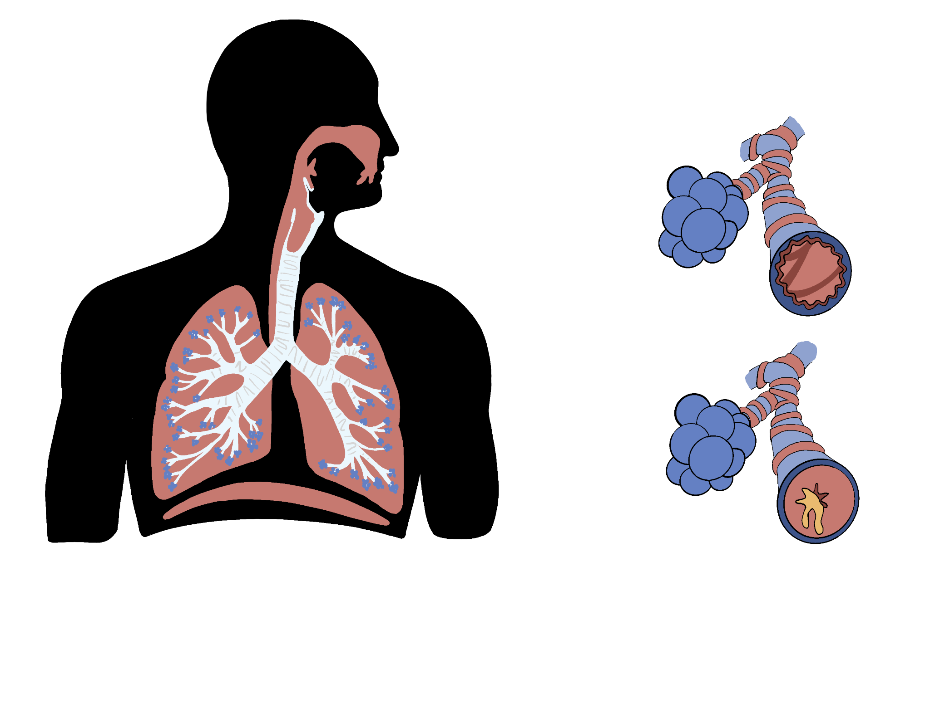
Station Debrief
What did you figure out that you didn’t know before?
Which station did you get the most benefit from? Why?
Which station surprised or interested you? Why?

Slide 14
Driving Question Board
Are there any questions on the Driving Question Board that we can answer right now?

Slide 15

CUS and Discuss
C: Circle any words that you don’t know.
U: Underline any information that helps you understand the word “homeostasis.”
S: Star any information that helps you answer the question “Why do humans have asthma attacks?”

Slide 16
The Respiratory System
Revise or create a new model of the respiratory system that shows what happens before, during, and after an asthma attack.
Include any new information you learned throughout the lesson.

