Slide 2
The Role of Green Spaces
Connecting Social Issues and Health Inequities

Slide 3
Essential Question
How do inequitable environmental factors affect human health?

Slide 4
Lesson Objectives
Calculate the percentage of forested and urbanized areas from the satellite images of two locations.
Connect the differences between the two locations that would influence human health.
Write a proposal that will improve air quality and raise awareness of environmental racism.

Slide 5
Photo Deconstruction
Compare the two images.
Record and describe exactly what you see:
People
Places
Objects
What evidence from the image supports your inferences?
Notes:
K20 Center. (2020, September). Photo or Picture Deconstruction. Strategies. https://learn.k20center.ou.edu/strategy/140.

Slide 6
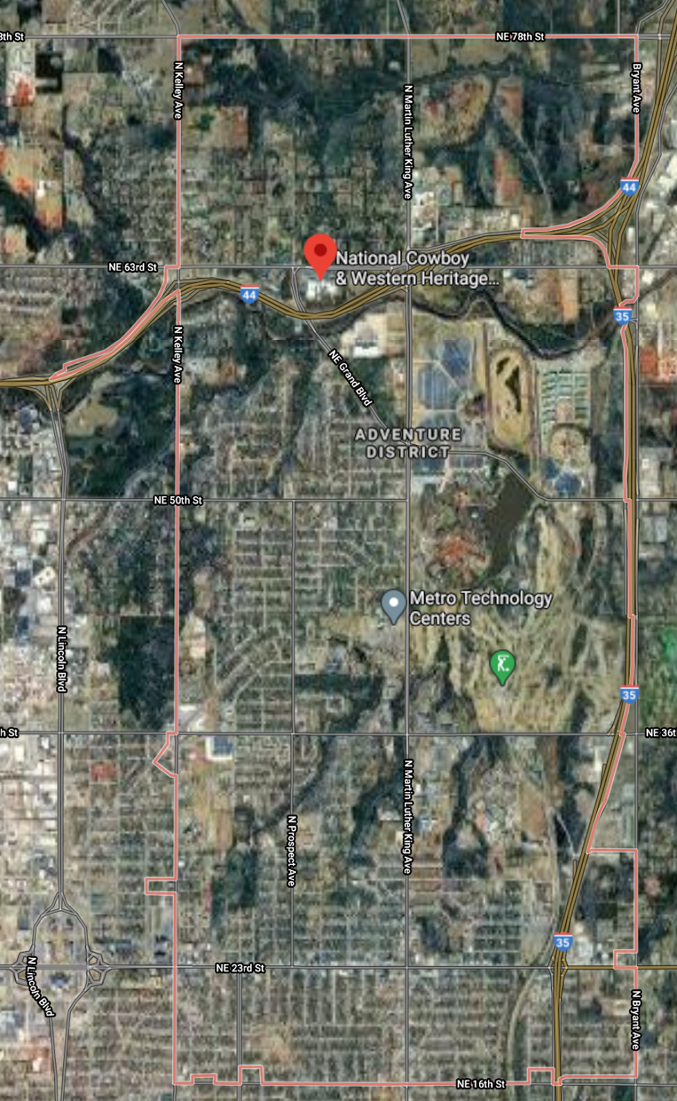
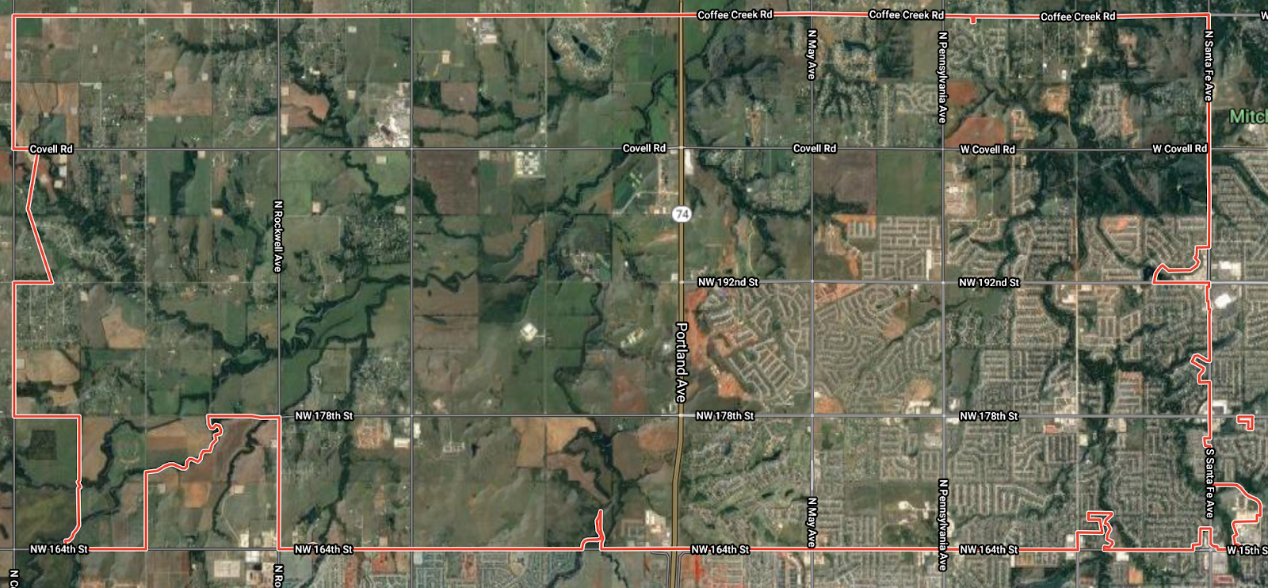
Aerial Photos of OKC
Notes:
Google maps satellite. (n.d.). Oklahoma City, OK. https://earth.google.com/web/@35.48264792,-97.4791978,363.52415431a,121151.59788577d,35y,0h,0t,0r

Slide 7
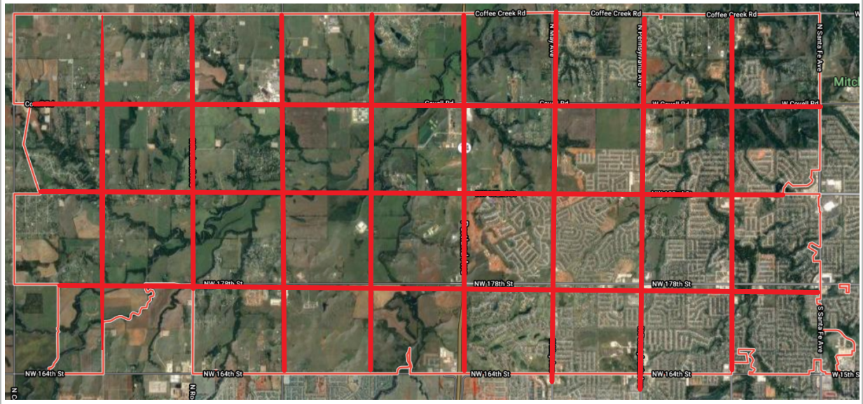
Forested versus Urbanized
Create a grid over the top of the photo.
Calculate the percentage of squares that are mostly forested.
Calculate the percentage of squares that are mostly urbanized.

Slide 8
Group Discussion
What similarities do you notice between the two images?
What differences do you notice between the two images?
What does this mean?
What evidence do you have to support your claim?

Slide 9
Notes:
https://www.flickr.com/photos/182229932@N07/48187656411

Slide 10
Driving Question Board
Are there any questions on the Driving Question Board that you can answer right now?
Notes:
K20 Center. (2021, July). Driving Question Board. Strategies. https://learn.k20center.ou.edu/strategy/1511?rev=8567

Slide 11
Claim-Evidence-Reasoning
Write a claim related to differences between the two locations on the maps that influence human health.
Use the information you have learned from past lessons as evidence or reasoning.
Notes:
K20 Center. (2020, September). Claim, Evidence, Reasoning (CER). Strategies. https://learn.k20center.ou.edu/strategy/156.

Slide 12
Project Proposal
Review the guidelines for creating a community proposal.
Create a proposal that you can present to community members, city council members, family, and peers.
What is the problem?
What do you know about the problem that other people should know?
What evidence can you provide to support what you are claiming?
What are some possible solutions to this problem?
Notes:
Community Project Proposal—Student Instructions. https://learn.k20center.ou.edu/lesson/1452/Community-Project-Proposal-Student-Instructions.docx?rev=9357

