Slide 2
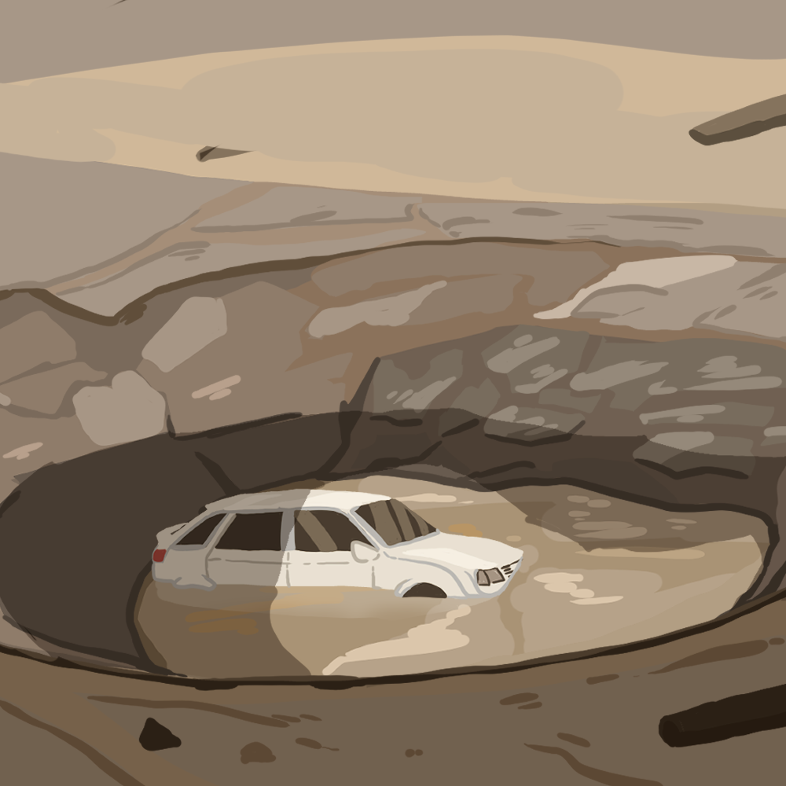
Let It Sink In!
Earth’s Systems

Slide 3
Essential Question
How do Earth’s materials cycle through living and nonliving components?

Slide 4
Learning Objectives
Explore the different stressors that affect rock formation.
Construct models that illustrate the cycling of materials in Earth’s system.

Slide 5
Always, Sometimes, Never True
Read each statement carefully and decide whether it is one of the following:
Always True
Sometimes True
Never True
Be prepared to discuss your reasons for your response.
Notes:
K20 Center. (n.d.). Always, sometimes, or never true. Strategies. https://learn.k20center.ou.edu/strategy/145

Slide 6
Always, Sometimes, Never True
All rocks are hard.
Notes:
K20 Center. (n.d.). Always, sometimes, or never true. Strategies. https://learn.k20center.ou.edu/strategy/145

Slide 7
Always, Sometimes, Never True
Rocks have the ability to change form.
Notes:
K20 Center. (n.d.). Always, sometimes, or never true. Strategies. https://learn.k20center.ou.edu/strategy/145

Slide 8
Always, Sometimes, Never True
Rocks make up the entire earth.
Notes:
K20 Center. (n.d.). Always, sometimes, or never true. Strategies. https://learn.k20center.ou.edu/strategy/145

Slide 9
Always, Sometimes, Never True
All rocks are the same.
Notes:
K20 Center. (n.d.). Always, sometimes, or never true. Strategies. https://learn.k20center.ou.edu/strategy/145

Slide 10
Always, Sometimes, Never True
It’s hard to tell how rocks originated.
Notes:
K20 Center. (n.d.). Always, sometimes, or never true. Strategies. https://learn.k20center.ou.edu/strategy/145

Slide 11
Always, Sometimes, Never True
Rocks and minerals are the same thing.
Notes:
K20 Center. (n.d.). Always, sometimes, or never true. Strategies. https://learn.k20center.ou.edu/strategy/145

Slide 12
Always, Sometimes, Never True
Humans are the cause of rock formations.
Notes:
K20 Center. (n.d.). Always, sometimes, or never true. Strategies. https://learn.k20center.ou.edu/strategy/145

Slide 13
Always, Sometimes, Never True
Minerals are not important to my life.
Notes:
K20 Center. (n.d.). Always, sometimes, or never true. Strategies. https://learn.k20center.ou.edu/strategy/145

Slide 14
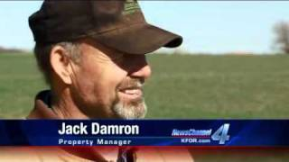
Massive Oklahoma Sinkhole appears overnight
Notes:
Sister Christian. (2011, November 30). Massive Oklahoma Sinkhole appears overnight [Video]. YouTube. https://www.youtube.com/watch?v=Pz6EFS1fu1A

Slide 15
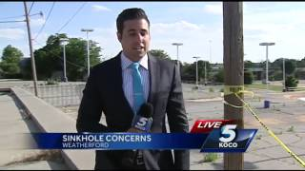
Weatherford building about to be swallowed by sinkhole
Notes:
KOCO TV. (2015, June 05). Weatherford building about to be swallowed by sinkhole [Video]. YouTube. https://www.youtube.com/watch?v=HCUthn8Z_KY

Slide 16
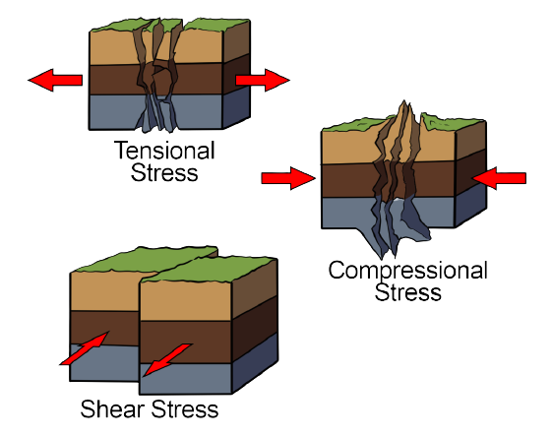
You’re Stressing Me Out Lab
Today we are going to explore what happens to rocks under different types of stressors. In a group of three, each member will perform one of the three following stressors:
Tensional stress
Compressional stress
Shear stress

Slide 17
The Rock Cycle
Take a few minutes to read the Minerals, Rocks, and the Rock Cycle article.
As you read, highlight any information about the rock cycle you deem important.
You will use the information you gather in the next activity.

Slide 18
The Rock Cycle
After you’ve read your article, connect with your group to complete the following:
Choose a rock (igneous, sedimentary, or metamorphic) to:
Write a short description
Draw an illustration of that rock going through the rock cycle
Each student in your group is responsible for illustrating one of the phases, with a short description of what is occurring at that stage of the rock cycle.

Slide 19
Rock Cycle Song
Notes:
ParrMr. (2011, April 03). Rock cycle song [Video]. YouTube. https://www.youtube.com/watch?v=53lMdHzvGCQ

Slide 20
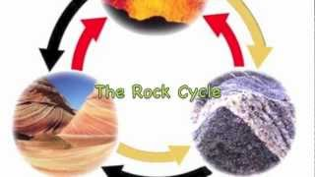
WE WILL ROCK YOU!
Notes:
Emily B. (2012, October 29). WE WILL ROCK YOU! (The rock cycle) [Video]. YouTube. https://www.youtube.com/watch?v=r68iEwYdbh4

Slide 21
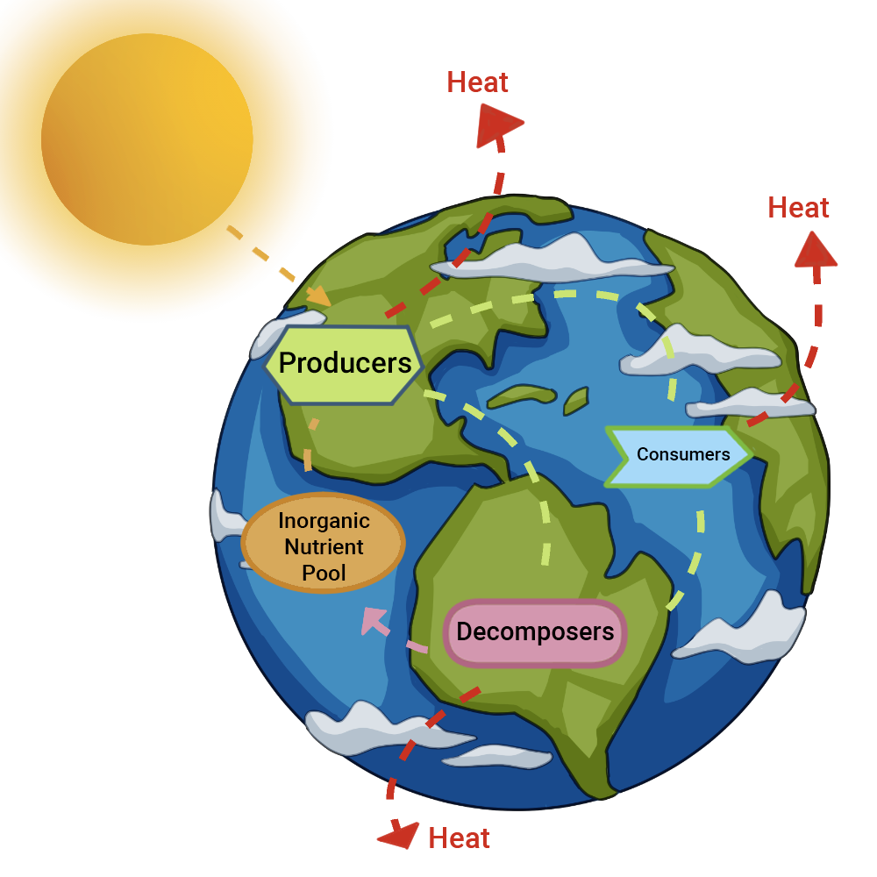
Biogeochemical Cycles
With your Group:
Research facts about at least three (3) different stages of a given cycle (water, carbon, nitrogen) and what drives the movement of the element to each part of the cycle.
Be prepared to draw your cycle.
Notes:
Image credit: Biogeochemical cycles: Figure 1 by Eva Horne and Robert A. Bear; source article is CC BY 4.0

Slide 22
Careers in the Rock Cycle Field
With your group, sort your cards into categories.
Use the QR codes for each career to gather information as you sort.
Each career should have:
Career title
Required education level
Years of education needed
Salary range
Notes:
K20 Center. (n.d.). Card sort. Strategies. https://learn.k20center.ou.edu/strategy/147

Slide 23
Careers Card Sort Solutions
Career | Degree/Certification | Time Required | Salary
Chief Sustainability Officer | Doctorate Degree | 8+ years | $80,980–$239,200+
Geologist | Master’s Degree | 6 years | $52,500–$172,600
Emergency Management Director | Bachelor’s Degree | 4 years | $50,340–$151,560
Sculptor | Associate Degree | 2 years | $28,390–$135,420
Stone Mason | Technical/Vocational School | 1–2 Years | $36,530–$80,850

Slide 24
Gallery Walk
Walk around, view the cycles that were researched and drawn by your classmates, and collect data on your Biogeochemical Cycles handout while keeping the essential question in mind:
How do Earth’s materials cycle through living and nonliving components?
Notes:
K20 Center. (n.d.). Gallery walk / carousel. Strategies. https://learn.k20center.ou.edu/strategy/118

Slide 25
Essential Question
How do Earth’s materials cycle through living and nonliving components?

Slide 26
Career Reflection
Choose the career that interests you most from the choices on your handout.
Once you have chosen a career option, answer the questions on your handout.
Use the QR codes from the Card Sort to help you research your answers.

