Slide 2

Look Up: Discovering Lines
Parallel, Perpendicular, Vertical, and Horizontal Lines

Slide 3
Essential Question
How can lines build great structures?

Slide 4
Lesson Objective
Define, recognize, and create structures using perpendicular, parallel, vertical, and horizontal lines.

Slide 5

Look Up: What do you see?
What does an architect do?
What skills does an architect need to be successful?
Celebrating Architecture
Notes:
AIANational. (2014, December 12). Celebrating Architecture: Look Up [Video]. YouTube. https://www.youtube.com/watch?v=JLhbTGzE6MA

Slide 6

Connection to Architecture
Do you know what and where this building is?
What type of lines do you see?
What would happen if the lines were not perpendicular?
Notes:
Classical Music by BBC Music Magazine. (2020, November 22). Westminster Abbey [Image]. Immediate Media Company. https://www.classical-music.com/features/articles/the-best-cathedral-and-abbey-choirs-across-the-uk/

Slide 7

Honeycomb Harvest
Categorize the pictures, definitions, and line equations into four honeycombs:
  Perpendicular, parallel, vertical, and horizontal
With the four blank hexagons, create your own example for each honeycomb.
Justify why you placed the hexagons where you did.
Notes:
K20 Center. (n.d.). Honeycomb Harvest. Strategies. https://learn.k20center.ou.edu/strategy/61

Slide 8
Discussion
Where did you place your hexagons and why?
  Share only one honeycomb scenario.
What did you create on the blank hexagon for the honeycomb scenario you just shared? Why?

Slide 9
How do you know what type of line it is?
Parallel | Perpendicular | Vertical | Horizontal

Slide 10
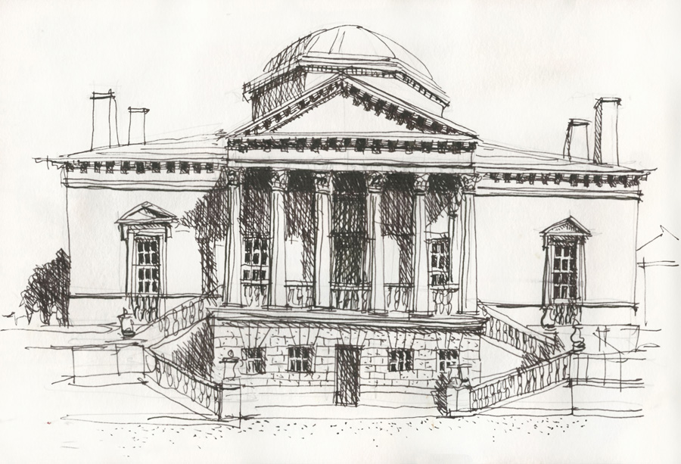
The Architect is YOU!
Where would you want to leave your mark?
Criteria for your structure:
  Two sets of perpendicular lines
  Two sets of parallel lines
  Two vertical lines
  Two horizontal lines
  Location
  Function
Why does the community need the building?
Notes:
Steel, L. (2016, January 19). Can I still do neat? Part 1 [Image]. Liz Steel. https://www.lizsteel.com/can-i-still-do-neat-part-1/

Slide 11
Architecture Beyond the Lines
The role of an architect to define what the stakeholder wants to build, present options they might not have considered, and help them get the most out of their current investment.
Keep in mind that your building will be more than just four walls—it will be an exciting place to work or live.

Slide 12
Pitch Your Design
Pretend you are talking to a potential client who wants to invest in a new property. What would you say to assure them your design is right for them?
Using Padlet, give a two-minute elevator speech.
  Highlight the benefits of your design and include your mathematical reasoning for why the building will be safe and secure.

