Slide 2

Two Worlds Collide,
Part 1
Systems of Linear Equations:
Graphing

Slide 3
Essential Question
How can systems of equations be used to represent situations and solve problems?

Slide 4
Learning Objectives
Identify and write systems of linear equations.
Solve systems of linear equations using graphing.

Slide 5

Always, Sometimes, or Never True
With a partner, discuss the following statement:
“Two lines cross at only one point.”
Decide if the statement is always true,
sometimes true, or never true.
  Give counterexamples if you
  select sometimes or never true.
Notes:
K20 Center. (n.d.). Always, sometimes, or never true. Strategies. https://learn.k20center.ou.edu/strategy/145

Slide 6

Amplify Classroom: Solution to Systems
Go to student.amplify.com/join.
Enter the session code.
Complete each screen.
  Analyze the relationship between points and the solution to the system of equations.
  Focus on the process and take notes on how you approached each screen and equation.
  Be ready to discuss the activity as a class.

Slide 7
Definitions
Consistent: having at least something in common
Inconsistent: having nothing in common
Dependent: it is possible to algebraically make one equation the same as the other equation
Independent: it is not possible to algebraically make
one equation the same as the other equation

Slide 8
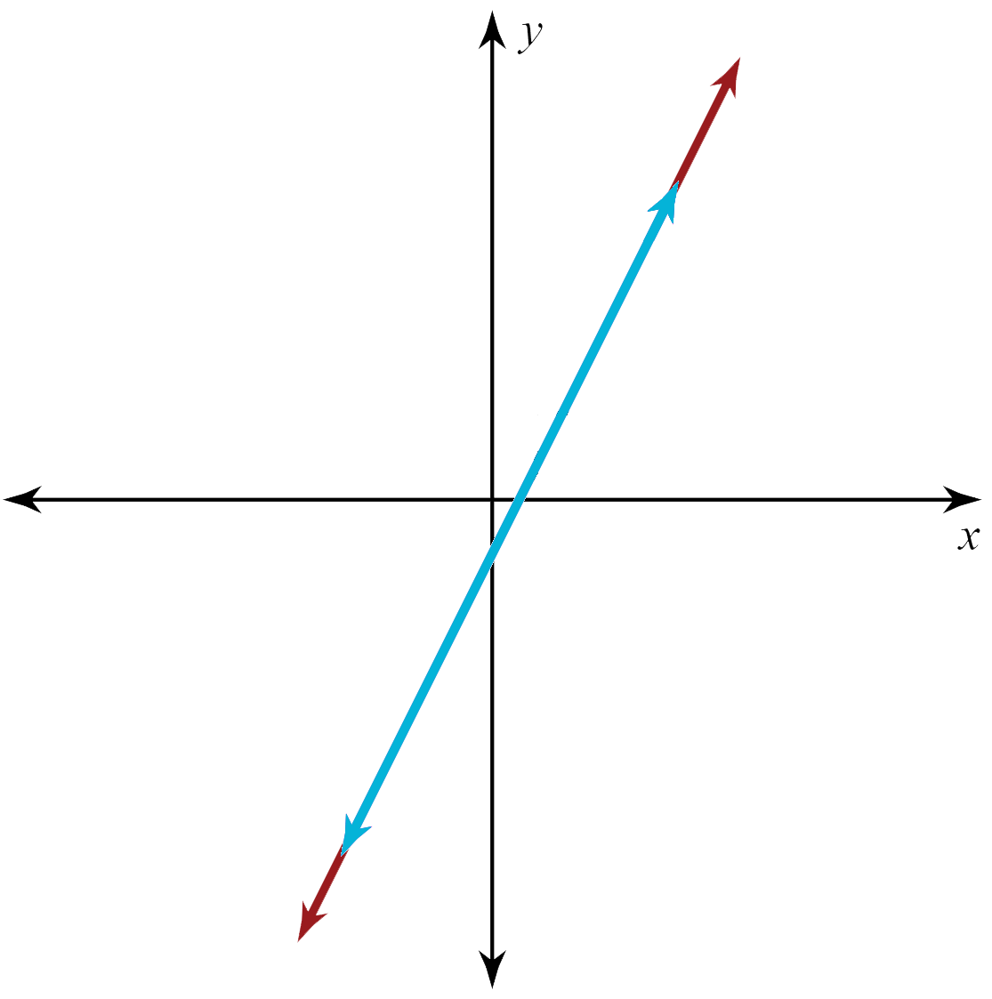
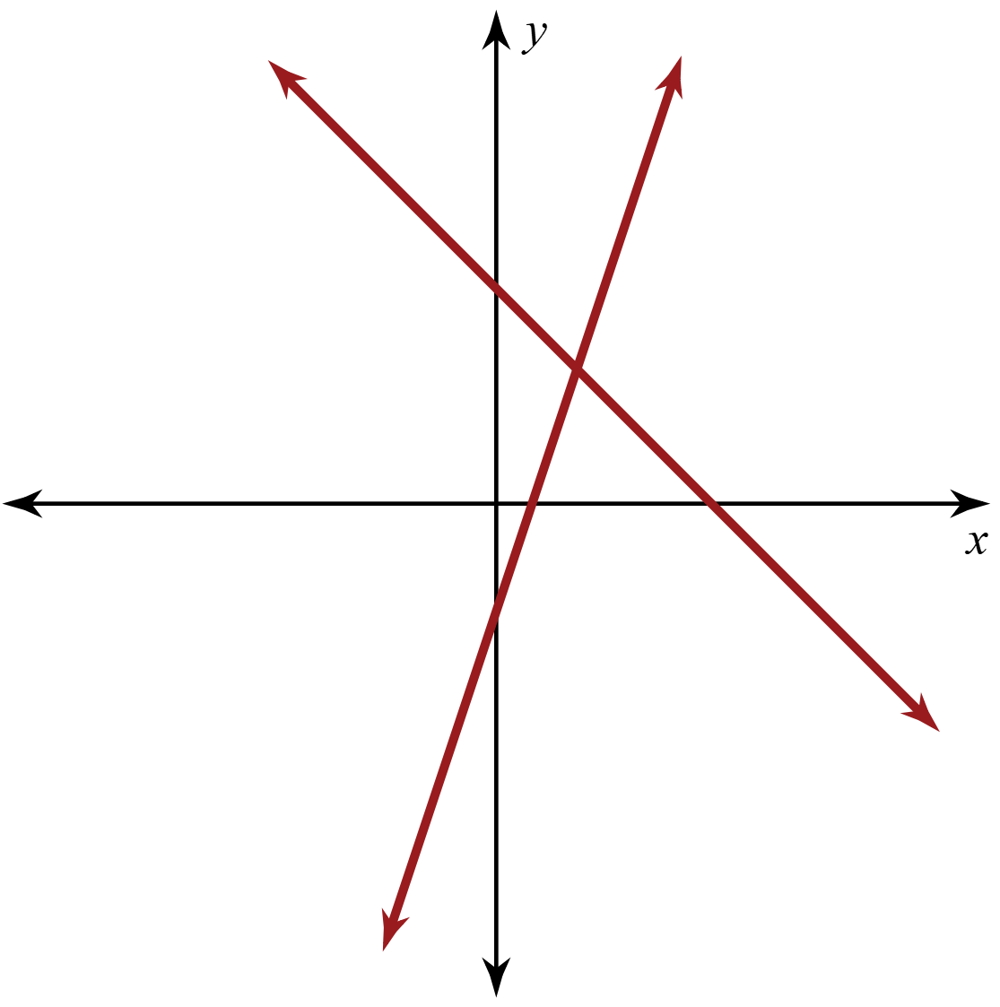
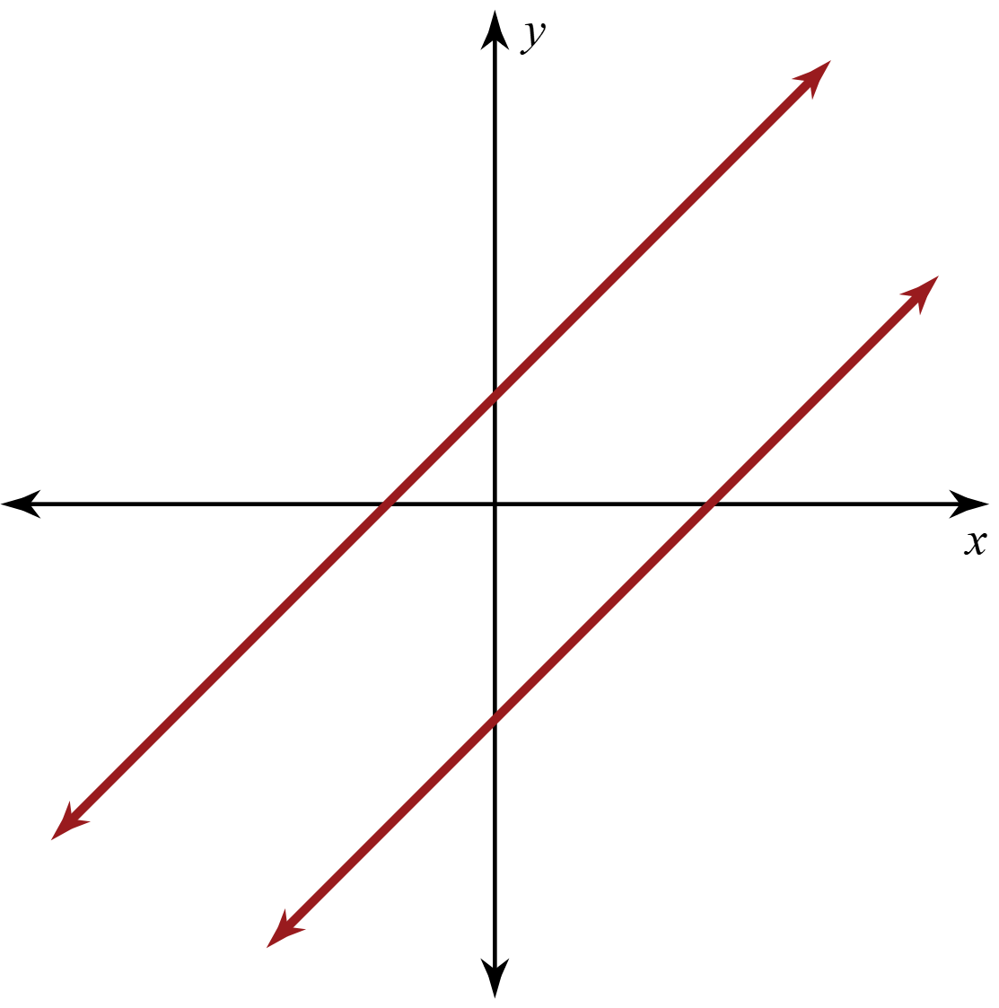
Types of Systems of Equations
Consistent & Independent | Consistent & Dependent | Inconsistent
Determine where each graph belongs in the table.
Record your answers on your Note Catcher handout.

Slide 9
Making the Connection
On your Note Catcher handout, describe each type of system of linear equations:
Consistent and Independent
Consistent and Dependent
Inconsistent

Slide 10
Types of Systems of Equations:
Consistent and Independent
The lines have one point in common: the point of intersection.
There is one solution.

Slide 11
Types of Systems of Equations:
Consistent and Dependent
The lines have all the same points.
They are the same line.
There are infinitely many solutions.

Slide 12
Types of Systems of Equations:
Inconsistent
The lines never intersect.
The lines are parallel.
There is no solution.

Slide 13

A Trip to the Skate Park
You and your friend want to go to a skate park this weekend. There are two skate parks in the area, Scissortail and Silverstone. The pricing for each park is below:
Scissortail: $3 to enter and $1 for every hour you stay
Silverstone: $5 to enter and 50 cents for every hour you stay
Which skate park will you and your friend attend?
Explain your reasoning.

Slide 14
A Trip to the Skate Park
Which skate park did you choose and why?
Is one park always cheaper than the other?
Is there any scenario in which the parks cost the same, so it doesn’t matter where you go?

Slide 15

How Am I Feeling? What Am I Thinking?
Create a table on the back of your Skate Park handout.
How Am I Feeling? | What Am I Thinking?
Notes:
K20 Center. (n.d.). How am I feeling? What am I thinking? Strategies. https://learn.k20center.ou.edu/strategy/187

Slide 16
How Am I Feeling? What Am I Thinking?
How Am I Feeling? | What Am I Thinking?
Draw or write a description of how you feel about the content you just explored.
Write a sentence that explains what you understand or think now.
(You can write a question or a comment.)
Notes:
K20 Center. (n.d.). How am I feeling? What am I thinking? Strategies. https://learn.k20center.ou.edu/strategy/187

