Slide 2
Two Worlds Collide, Part 1
Systems of Linear Equations: Graphing

Slide 3
Essential Question
How can systems of equations be used to represent situations and solve problems?

Slide 4
Lesson Objectives
Identify and write systems of linear equations.
Solve systems of linear equations using graphing.

Slide 5
Always, Sometimes, or Never True
With a partner, discuss the statement: “Two lines cross at only one point.”
Decide if the statement is always true, sometimes true, or never true.
Give counterexamples if you select sometimes or never true.
Notes:
K20 Center. (n.d.). Always, Sometimes, or Never True. Strategies. https://learn.k20center.ou.edu/strategy/145
K20 Center. (n.d.). Elbow partners. Strategies. https://learn.k20center.ou.edu/strategy/116

Slide 6
Desmos: Solution to Systems
Go to student.desmos.com. Enter the session code.
Complete each slide. Through discovery, analyze the relationship between points and the solution to the system of equations.
As you work through each slide, focus on the process at hand and take notes on how you approached each slide and equation.
Be ready to discuss the activity as a class.
Notes:
Before beginning this activity, you will need to sign in or create an account on https://teacher.desmos.com
Access the Desmos activity here: https://teacher.desmos.com/activitybuilder/custom/564a325345d9115d06270607?collections=5da6485a83c0877d4b5708dd
To share the Desmos activity with students, click the “Assign” button to create a session code. Type the code on this slide or write it on the board. Have students go to https://student.desmos.com and have them use the session code to access the activity.

Slide 7
Definitions
Consistent: having at least something in common
Inconsistent: having nothing in common
Dependent: it is possible to algebraically make one equation the same as the other equation
Independent: it is not possible to algebraically make one equation the same as the other equation

Slide 8
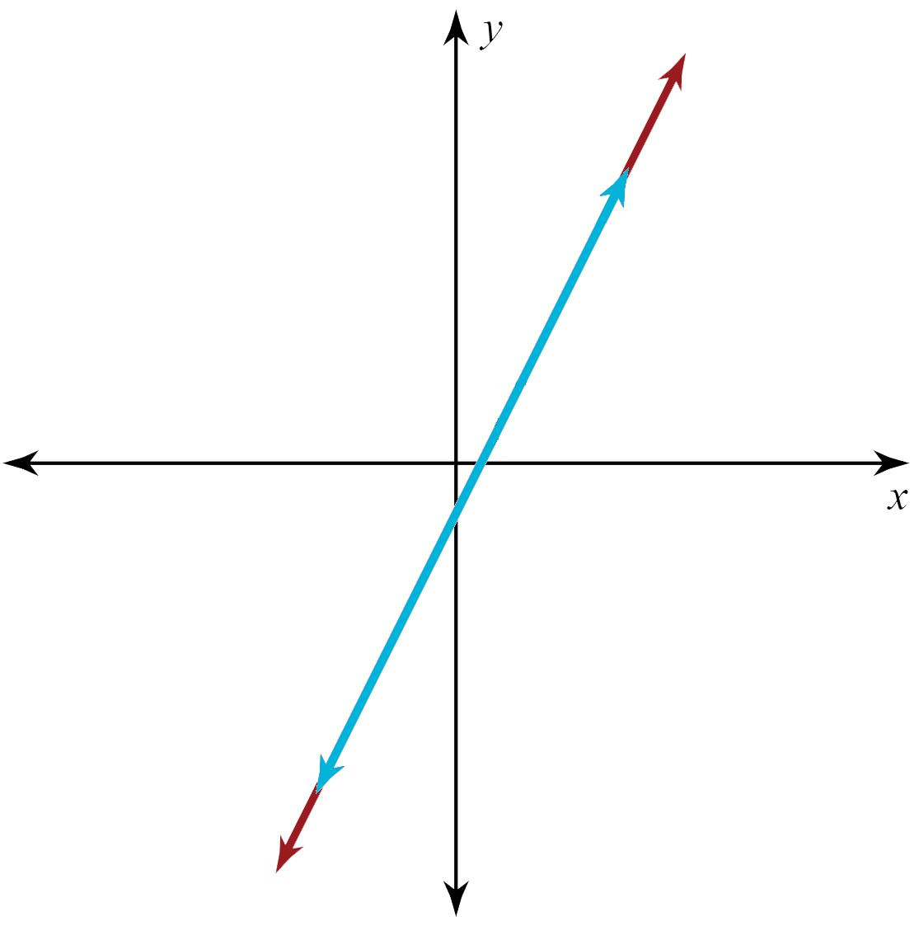
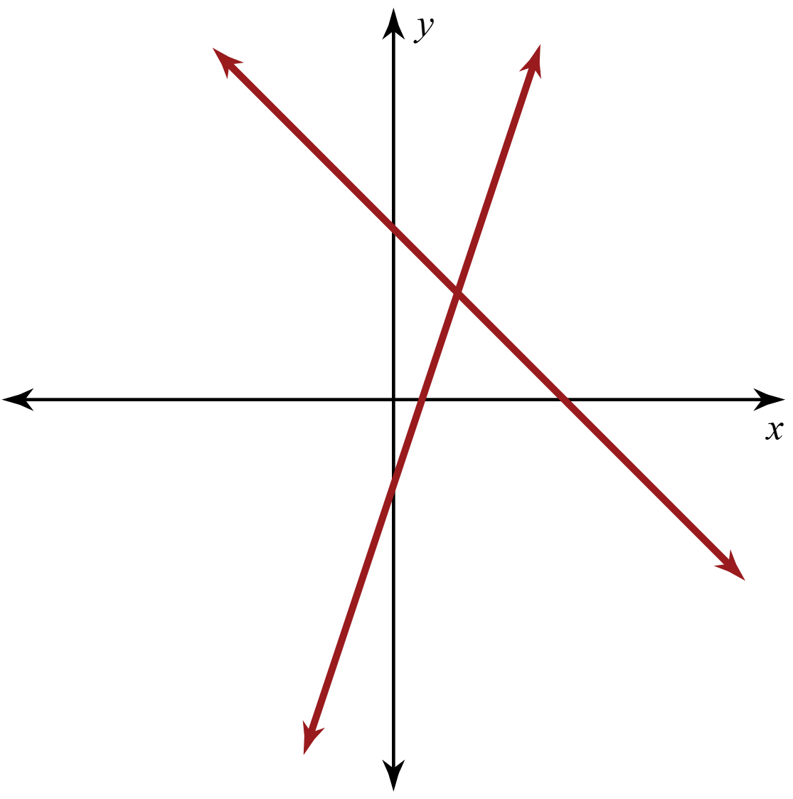
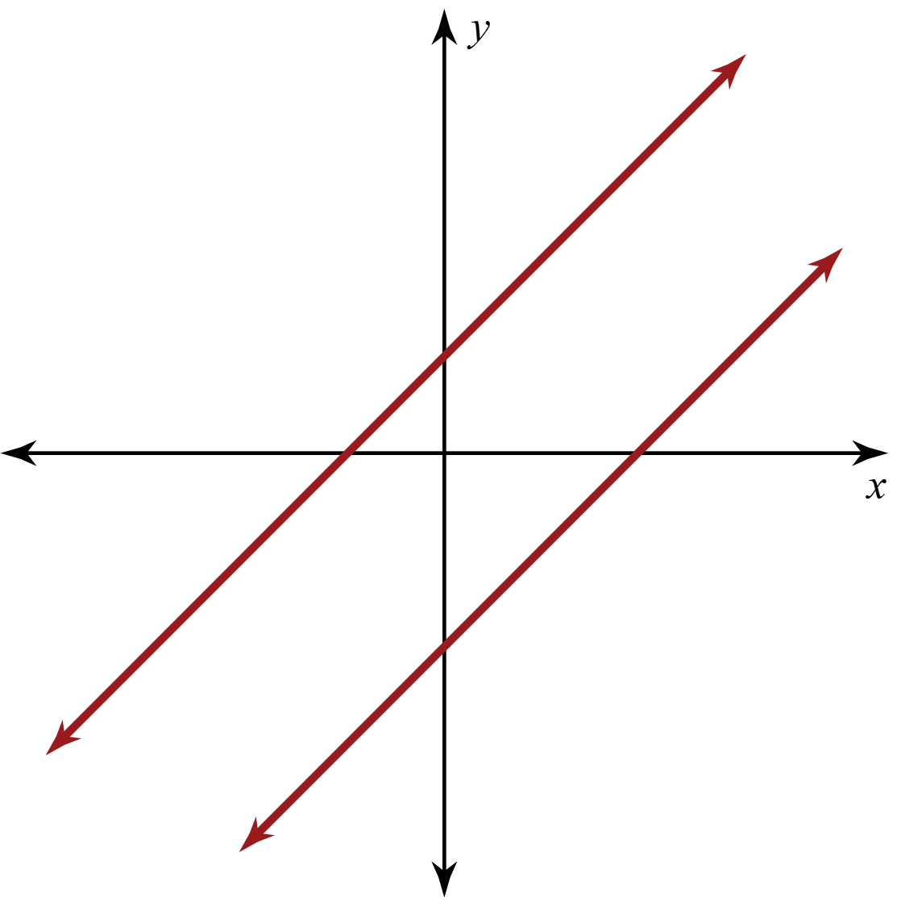
Types of Systems of Equations
Consistent and Independent | Consistent and Dependent | Inconsistent
Determine where each graph belongs in the table.
Record your answers on the Note Catcher handout.

Slide 9
Making the Connection
On your Note Catcher handout, describe each type of system of linear equations:
Consistent and Independent
Consistent and Dependent
Inconsistent

Slide 10
Types of Systems of Equations
Consistent and Independent
The lines have one point in common: the point of intersection.
There is one solution.

Slide 11
Types of Systems of Equations
Consistent and Dependent
The lines have all the same points.
They are the same line.
There are infinitely many solutions.

Slide 12
Types of Systems of Equations
Inconsistent
The lines never intersect.
The lines are parallel.
There is no solution.

Slide 13
A Trip to the Skate Park
You and your friend want to go to a skate park this weekend. There are two skate parks in the area, Scissortail and Silverstone.
The pricing for each park is below:
Scissortail: 3 dollars to enter and 1 dollar for every hour you stay
Silverstone: 5 dollars to enter and 50 cents for every hour you stay
Which skate park will you and your friend attend? Explain your reasoning.

Slide 14
A Trip to the Skate Park
Which skate park did you choose and why?
Is one park always cheaper than the other?
Is there any scenario in which the parks cost the same, so it doesn’t matter where you go?

Slide 15
How Am I Feeling? What Am I Thinking?
Create a table on the back of the Skate Park handout.
How Am I Feeling? | What Am I Thinking?
Notes:
K20 Center. (n.d.). How Am I Feeling? What Am I Thinking?. Strategies. https://learn.k20center.ou.edu/strategy/187

Slide 16
How Am I Feeling? What Am I Thinking?
How Am I Feeling? | What Am I Thinking?
In the left column, draw or write a description of how you feel about the content you just explored.
In the right column, write a sentence that explains what you understand or think now.
You can write a question or a comment.

