Slide 1
No Imitations, Please!
An Interdisciplinary Lesson on Avoiding Plagiarism

Slide 2
Essential Question
What is plagiarism, and how do I avoid it to ensure that my writing is authentic?

Slide 3
Magnetic Statements
As you arrive, read the statements posted around the room.

Slide 4
Magnetic Statements
Choose one of the statements that interests you the most or that you believe in the most to “join.”
Discuss the statement with your group for three minutes.

Slide 5
Magnetic Statements
Now, “join” the statement that repels, confuses, or annoys you the most.
Discuss with your group for three minutes.

Slide 6
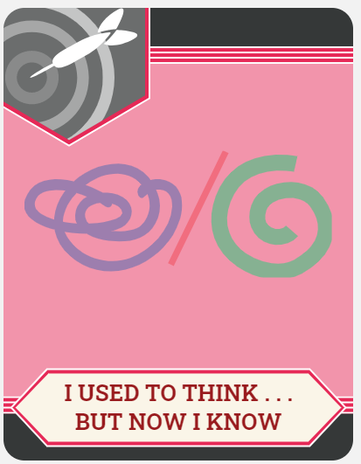
I Used to Think…
On the left side of your chart, write down thoughts, ideas, and words that you know about plagiarism.
Consider the Magnetic Statements as you write.

Slide 7
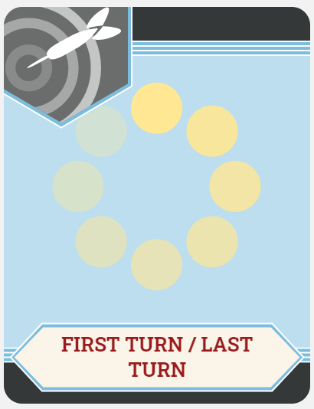
First Turn/Last Turn
Read your assigned article silently.
As you read, highlight four items that you feel are most important.
Take turns sharing one highlighted item with the group.
Take turns commenting on why you chose the items.

Slide 8
But Now I Know
Share out what you have learned about plagiarism from the readings.
While your classmates are sharing, add notes under the “And Now I Know” heading.

Slide 9
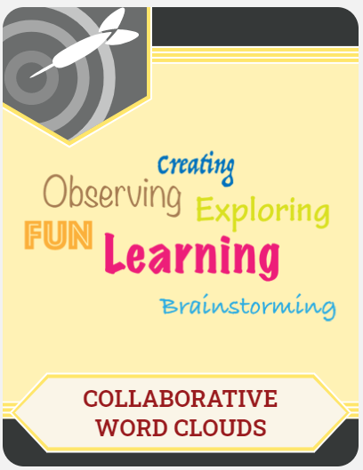
Collaborative Word Clouds
Write down as many single words or short phrases that you can think of relating to what you learned about plagiarism and how to avoid it.
In small groups, select the best words from your brainstorms, and use them to create a colorful word cloud on the butcher paper provided.

Slide 10
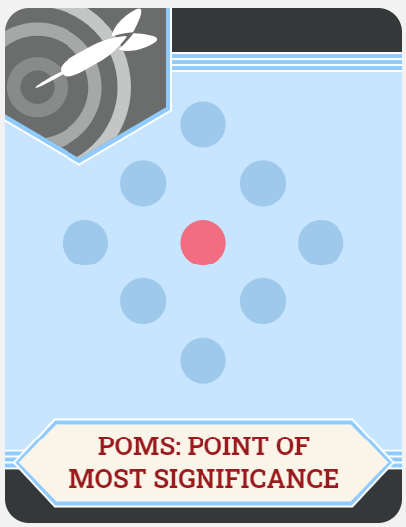
POMS: Point of Most Significance
On your index card, complete this prompt:
“The most important point I learned today about avoiding plagiarism is …”

