Slide 2
No Imitations, Please!
Avoiding Plagiarism

Slide 3
Essential Question
What is plagiarism, and how do I avoid it to ensure that my writing is authentic?

Slide 4
Lesson Objectives
Students will be able to define and identify plagiarism.
Students will understand how to avoid plagiarism in their own writing.

Slide 5

Magnetic Statements
Read the statements posted around the room
Move to the one that interests you the most or that you believe in the most

Slide 6
Magnetic Statements
Take 3 minutes to discuss the statement you chose.
Discussion starters
Why you chose the statement
Why you think this statement is important
Why this statement interests you the most

Slide 7
Magnetic Statements
Now move to the statement that repels, confuses, or annoys you the most
Discuss your statement for 3 minutes
Discussion starters
Why you chose the statement
Why you think this statement is important
Why this statement interests you the most

Slide 8

I Used To Think…
On the left side of your paper, write down things you already know related to plagiarism
Things to include
Thoughts
Ideas
Words

Slide 9

First Turn/Last Turn
Read your group’s article silently to yourself
As you read, highlight or write down the four items in the article that you feel are the most important

Slide 10
First Turn/Last Turn
Take turns reading items you highlighted one at a time
After everyone has read their four items to the group, take turns explaining why you chose each item

Slide 11
…But Now I Know
Now fill out the right side of your paper by writing down what you have learned about plagiarism
Include things you learned in your group and things other groups share

Slide 12
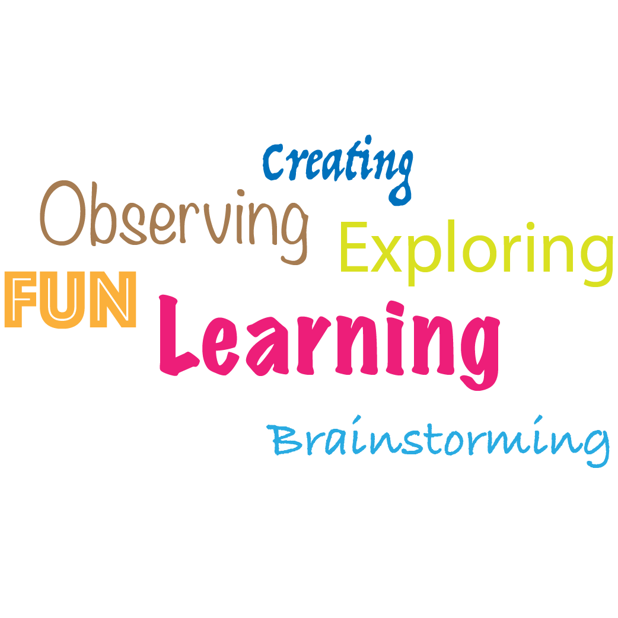
Collaborative Word Clouds
On your own paper, list out as many words or phrases you can think of that relate to plagiarism and how to avoid it

Slide 13
Collaborative Word Clouds
As a group, choose the strongest and most important words from each of your lists
Write these words on your poster paper
If you like, emphasize some words by making them bigger on your poster

Slide 14

Point Of Most Significance
Complete this statement on your card:
“The most important point I learned today about avoiding plagiarism is…”

