Slide 2
Space Justification Jam
Intro to Proofs Using Spatial Reasoning
Essential Question: How does spatial awareness help us to be confident in our geometric knowledge?

Slide 3
Lesson Objectives
We will be able to:
utilize undefined terms, definitions, postulates, and theorems as justifications of thought process; and
apply the distance, midpoint, and slope formulas to increase the accuracy of the coordinate geometry artifacts.

Slide 4
Quick Draw
You will see an image for 3 seconds.
Your job is to capture as much of the image as possible on your coordinate grid.

Slide 5
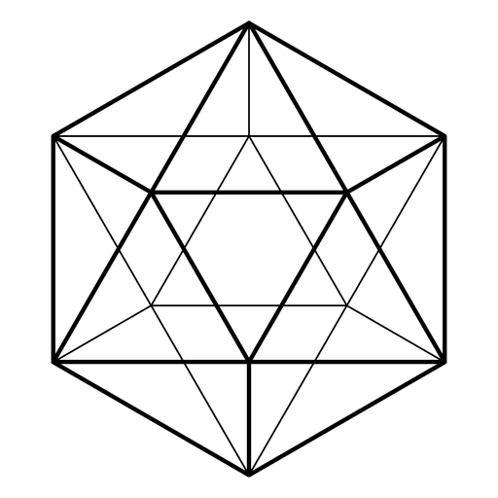
Replicate as much of the image as you can!

Slide 6
How I Know It
On your handout, answer the following two questions:
What did I look for to help me? (inside the circle)
How do I know this is something I should look for? (outside the circle with a line connecting it to what you looked for)

Slide 7
Replicate as much of the image as you can!

Slide 8
How I Know It (Again…)
On your handout, answer the following two questions:
What did I look for to help me? (inside the circle)
How do I know this is something I should look for? (outside the circle with a line connecting it to what you looked for)

Slide 9
Quick Draw Image Clues
E is the center of ▭ABCD
J is (-8, -4) and I is (10, 12)
F is the midpoint of BC, G is the midpoint AD
Use any of the formulas or math tools you know if you think they apply.
Look back at your How I Know It. Which ones did you measure, calculate, or use a formula for?

Slide 10
Spacial Reasoning Notes
Looking at an image and seeing it mathematically can sometimes be interpreted as one of those “you either have it or you don’t” talents.
But in reality, it's a skill that can be improved with practice. One of the ways to improve this skill is to know what to look for and why that's what we look for.

Slide 11
Definitions
Undefined term: The building blocks of geometry—points, lines, planes, and sets
Defined term: Anything that uses undefined terms to define them; examples include _________
Postulate: A simple statement accepted as true without proof; an example is “all right angles are congruent”
Theorem: A statement that can be proven using undefined terms, defined terms, and postulates; such as Pythagorean theorem
Given: Components of the problem that are known before solving begins; needed to solve the problem

Slide 12
Classifying by Term
Classify all the things you looked for on your How I Know It as either undefined, defined, postulate, or theorem.

Slide 13
Practicing
Look at each of the problems.
You are not going to ‘solve’ any of them.
Rather, you’re looking for what is given, what that means, and what else you can figure out from what you have.

Slide 14
Metacognitive Geometry Plan
Metacognitive means thinking about your thinking.
On your Metacognitive Geometry Plan handout, reflect on your learning during the lesson and make a plan for how you are going to look at geometric figures throughout the school year.

