Slide 2
Call Me Maybe
Physical Science

Slide 3
Essential Question
How dangerous are electromagnetic waves to humans?
Should we be concerned with the new technological advances of today?

Slide 4
Lesson Objectives
We will correctly identify the advantages and disadvantages of different types of radiations.
We will explore a career in the field of electromagnetic radiation.
We will connect the length of a wavelength to its potential energy and harm.
We will be able to evaluate and defend claims regarding the impact of cell phones.

Slide 5
Certify Your Thinking
On your handout, write your claim and provide evidence for the following question:
Do you believe the radiation emitted by cell phones can cause harm to the human body?

Slide 6
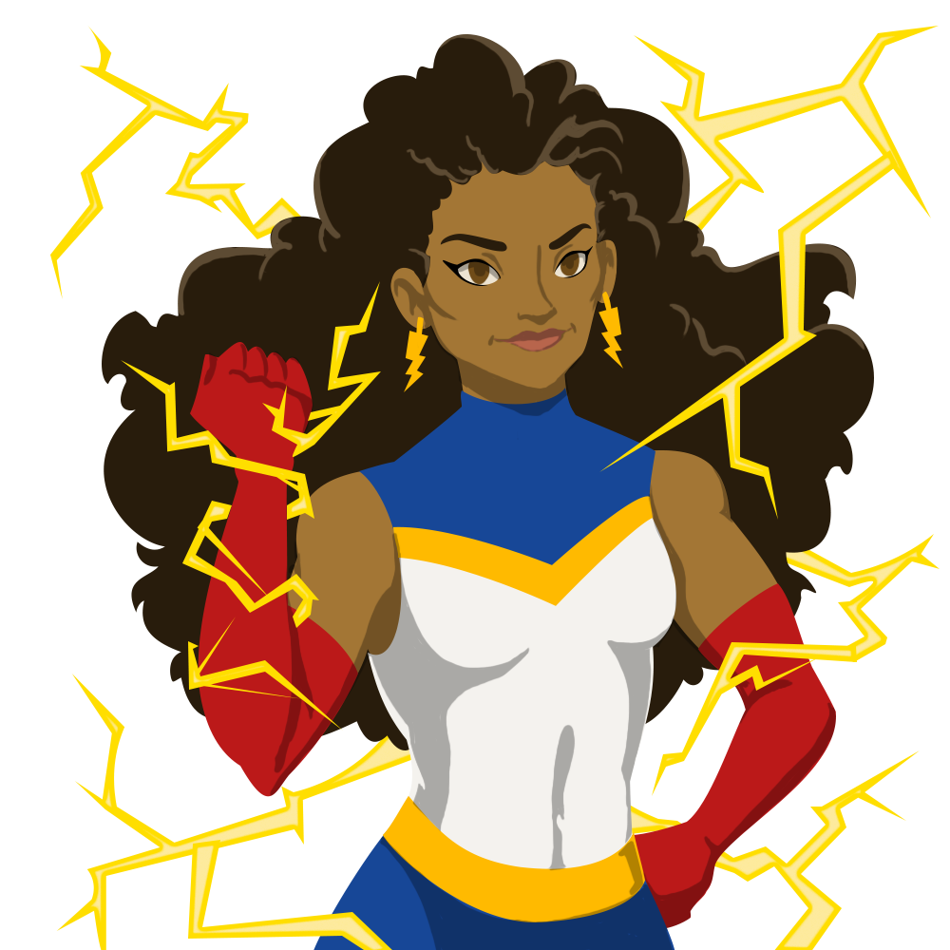
Electromagnetic Radiation Superheros
In a group of seven, divide out the seven rays to each group member.
Create a superhero of your ray.
Review all of your group's drawings and record what you discover in your EMR Notes.
Organize your group’s superheroes from from the least(longer wavelength) to most harmful(shorter wavelength).

Slide 7
Electromagnetic Spectrum Article
Read CK-12 20.3 Electromagnetic Spectrum Article.
As you read the article complete the questions at the end of your EMR Notes.

Slide 8
Director of Medical Imaging
ICAP Video Placement
Notes:
Open discussion for students to answer the three questions listed in the extend on LEARN or provide the questions in Mentimeter for students to answer.

Slide 9
Medical Imaging Equipment
Images Placement
Notes:
Open discussion for students to answer the three questions listed in the extend on LEARN or provide the questions in Mentimeter for students to answer.

Slide 10
Medical Imaging Equipment
Images Placement
Notes:
Open discussion for students to answer the three questions listed in the extend on LEARN or provide the questions in Mentimeter for students to answer.

Slide 11
Fist to Five
Rate your level of understanding to the following statements by holding up your hand with the appropriate number of fingers.
Closed Fist=no understanding
One Finger=Little Understanding
Two Fingers= understand but need some support
Three Fingers=basic knowledge about this
Four Fingers= know what to do and don't need any help.
Five Fingers=understand and can also help or explain this to someone else.

Slide 12
Fist to Five
Evaluate and defend claims regarding the impact of cell phones.
Closed Fist=no understanding
One Finger=little understanding
Two Fingers= understand but need support
Three Fingers=basic knowledge
Four Fingers= know what to do and don't need any help.
Five Fingers=understand and can help or explain this to someone else.

Slide 13
Fist to Five
Correctly identify the advantages and disadvantages of different types of radiations.
Closed Fist=no understanding
One Finger=little understanding
Two Fingers= understand but need support
Three Fingers=basic knowledge
Four Fingers= know what to do and don't need any help.
Five Fingers=understand and can help or explain this to someone else.

Slide 14
Fist to Five
Longer wavelengths are absorbed as heat.
Closed Fist=no understanding
One Finger=little understanding
Two Fingers= understand but need support
Three Fingers=basic knowledge
Four Fingers= know what to do and don't need any help.
Five Fingers=understand and can help or explain this to someone else.

Slide 15
Fist to Five
Different waves have different energies that can impact human health.
Closed Fist=no understanding
One Finger=little understanding
Two Fingers= understand but need support
Three Fingers=basic knowledge
Four Fingers= know what to do and don't need any help.
Five Fingers=understand and can help or explain this to someone else.

Slide 16
Certify Your Thinking
Recall your claim on cell phones in the beginning of the lesson. Consider all that you have learned about EM so far, as you view two published works of opposing viewpoints about cell phones.

Slide 17
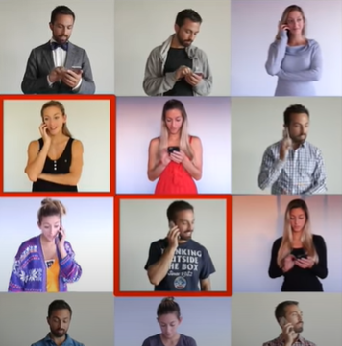
Do Cell Phones Cause Brain Tumors?
While watching this video consider the claim you made.
Notes:
Read the Electro Schematics’s Mobile Cell Phone Radiation article before watching the video.
Veritasium. (2015, February 3). Do Cell Phones Cause Brain Tumors?. [Video]. YouTube. https://www.youtube.com/watch?v=wU5XkhUGzBs.

Slide 18
Certify Your Thinking
After reading the article, and watching the video based on your knowledge about EM, determine if you still agree with your original claim? Why or why not, using evidence from the activities completed for this lesson?”

