Slide 2
My Imaginary Friend, Part 1
Understanding and Simplifying Imaginary Numbers

Slide 3
Essential Question
What are imaginary numbers?

Slide 4
Lesson Objectives
Simplify the square root of a negative number.
Simplify to a power.

Slide 5
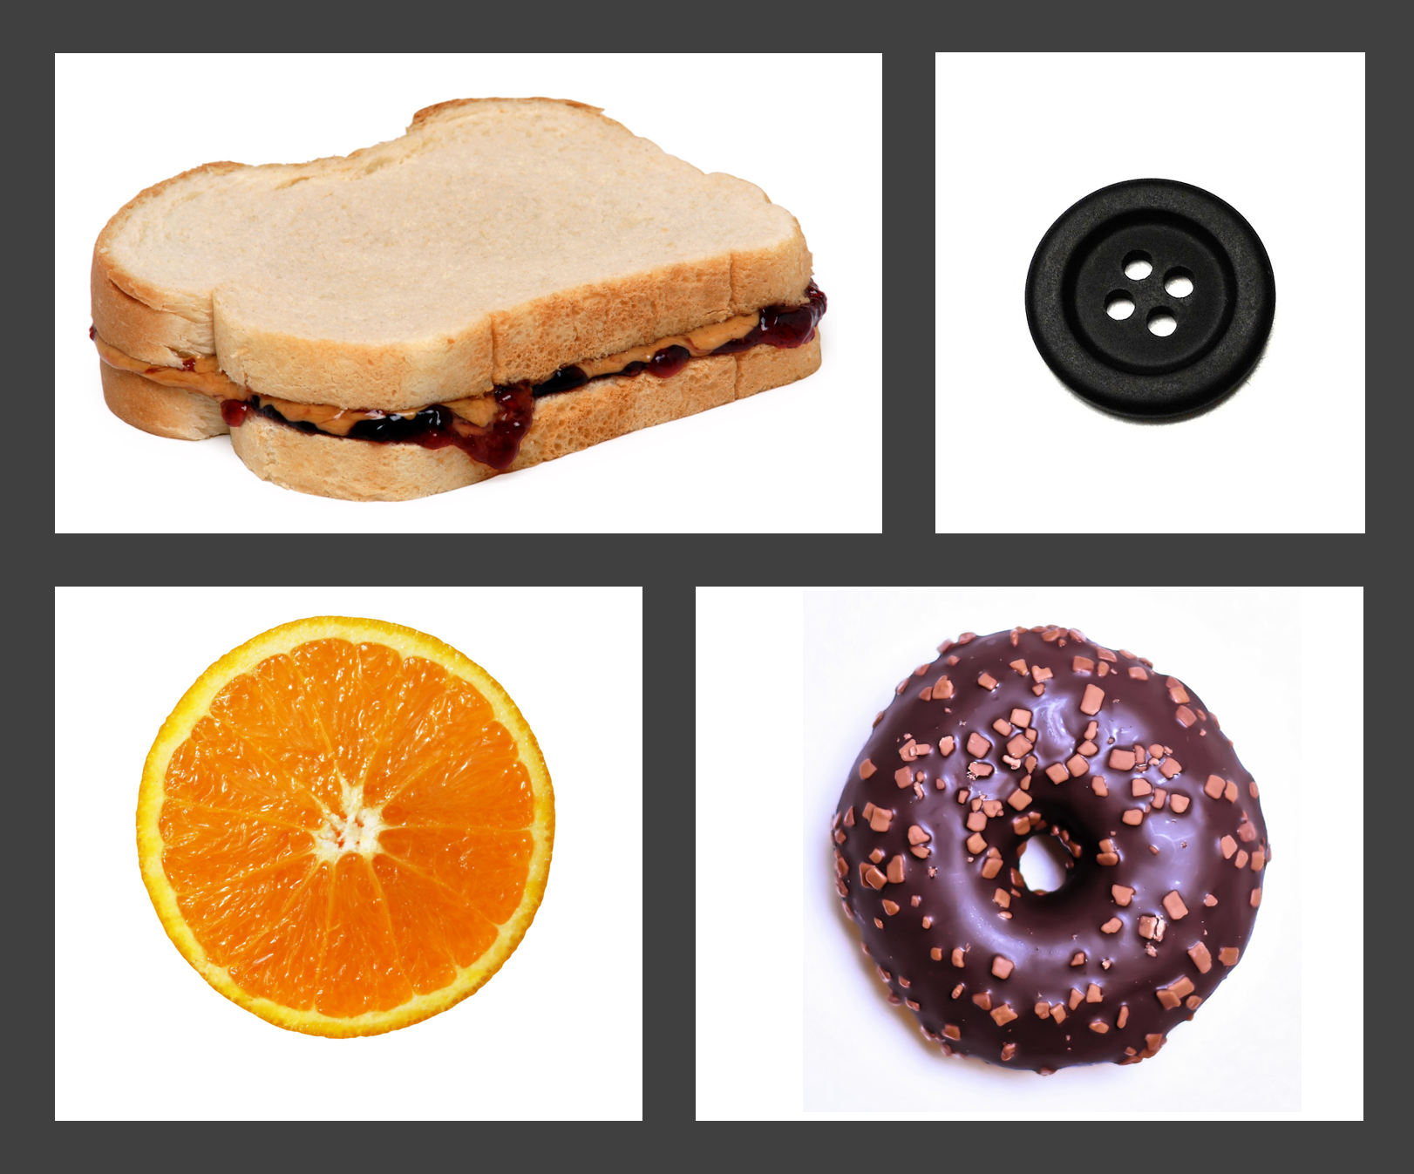
Engage: Not Like the Others
Look at the Engage portion at the top of the Complex Numbers handout.
From the pictures on the right, select which item is not like the others. Explain your reasoning.
Notes:
Strategy: K20 Center. (n.d.). Not Like the Others. Strategies. https://learn.k20center.ou.edu/strategy/77
Image sources:
Alexas_Fotos. (2019, November 16). Donuts. [Photograph]. Pixabay. https://pixabay.com/photos/donuts-pastries-kringel-cake-candy-4633071/
Nataliaaggiato. (2012, May 24). Orange [Photograph]. Pixabay. https://pixabay.com/photos/orange-slice-juice-vitamin-fruit-473781/
PublicDomainPictures. (2012, February 10). Button [Photograph]. Pixabay. https://pixabay.com/photos/button-round-holes-black-four-21256/
WikimediaImages. (2010, November 10). Sandwich [Photograph]. Pixabay. https://pixabay.com/photos/food-eat-diet-peanut-butter-jelly-2202381/

Slide 6
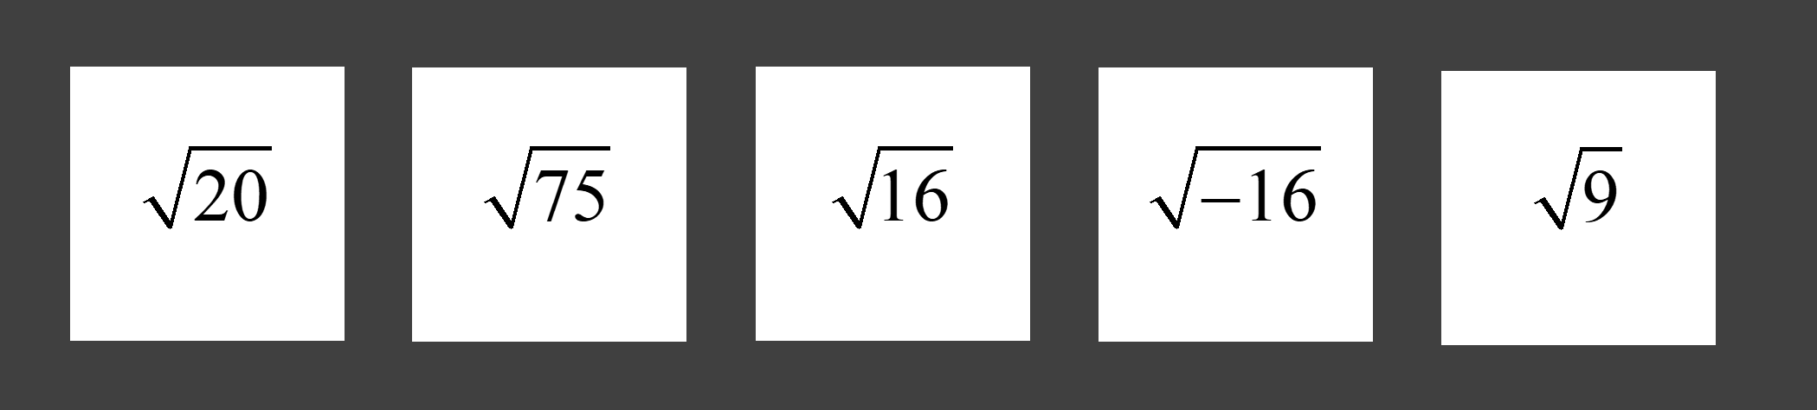
Engage: Not Like the Others
Look at the radicals below and select which one is not like the others. Explain your reasoning on the handout.
Notes:
Teacher’s Note: Use the Complex Numbers (Sample Responses) document throughout this lesson to see possible student responses and answers for the Complex Numbers handout.

Slide 7
Explore: Simplify and Justify
Work with your partner to complete questions 3–6.
  Be sure to show your thinking.
  How do you know what the answer is?
  How do you know what the answer is not?
Use your reasoning on #3 to help with #4.
Use your reasoning on #5 to help with #6.
Notes:
Teacher’s Note: Purpose
The purpose here is for students to activate their prior knowledge of simplifying radicals. Students likely will notice that -4 is not the answer to the square root of -16. Students should notice there is not a real number that can be squared and have a negative result. Remember, at this point, real numbers are the only numbers most students have had experience with.

Slide 8

Explore: I Notice, I Wonder
Work with your partner to reflect on
questions 3–6.
What do you notice about simplifying those radicals?
What do you wonder about simplifying those radicals?
  Write down what you notice (true statements).
  Write down what you wonder (questions you have).
Notes:
Teacher’s Note: Process
Use this time to check for misunderstandings of prior knowledge. Students should apply the process they used to simplify the square root of 20 to simplify the square root of -16, as follows: sqrt(-16) = sqrt(16)·sqrt(-1) = 4·sqrt(-1). The goal is for students to observe that they do not have a way to simplify the square root of -1.
Strategy: K20 Center. (n.d.). I Notice, I Wonder. Strategies. https://learn.k20center.ou.edu/strategy/180

Slide 9
Discussion
Share what you noticed and wondered.

Slide 10
Explore: Simplify and Justify (Key)
.
.
.
.

Slide 11
History of Imaginary Numbers
There are more than just real numbers in our world.
Take 5 minutes to read the History of Imaginary Numbers Infographic.
Notes:
Teacher’s Note: Oklahoma Process Standards
The content in this infographic helps support the Oklahoma Mathematical Actions and Processes: Develop a Productive Mathematic Disposition by showing students that, with perseverance, new mathematics can be developed and be useful. During the Extend portion of the lesson, this standard is supported again by having students look for and apply patterns.

Slide 12
Explain
How do we simplify the square root of a negative number?

Slide 13

Video: How to Simplify
Notes:
To play the video, click the image on the slide or copy and paste the following link into your web browser: https://youtu.be/pj3S6X-b5Yc
Video source:
K20 Center. (n.d.). My Imaginary Friend, Part 1 [Video]. YouTube. https://www.youtube.com/watch?v=pj3S6X-b5Yc

Slide 14
Explain: Practice
Work with your partner to complete questions 7 and 8 on the Explain portion of the handout.
  Be sure to show your thinking.
  Be sure to use mathematical notation and reasoning.

Slide 15
Extend: Simplify and Justify
Work with your partner to complete the table.
  Be sure to show your thinking.
Notes:
Teacher’s Note: Scaffolding
If students are struggling to get started, recommend that students rewrite i³ as i²·i and i⁴ as i²·i² and use the given information to replace i² with -1 and simplify. Students should continue using properties of exponents and their previous results to complete the table.

Slide 16
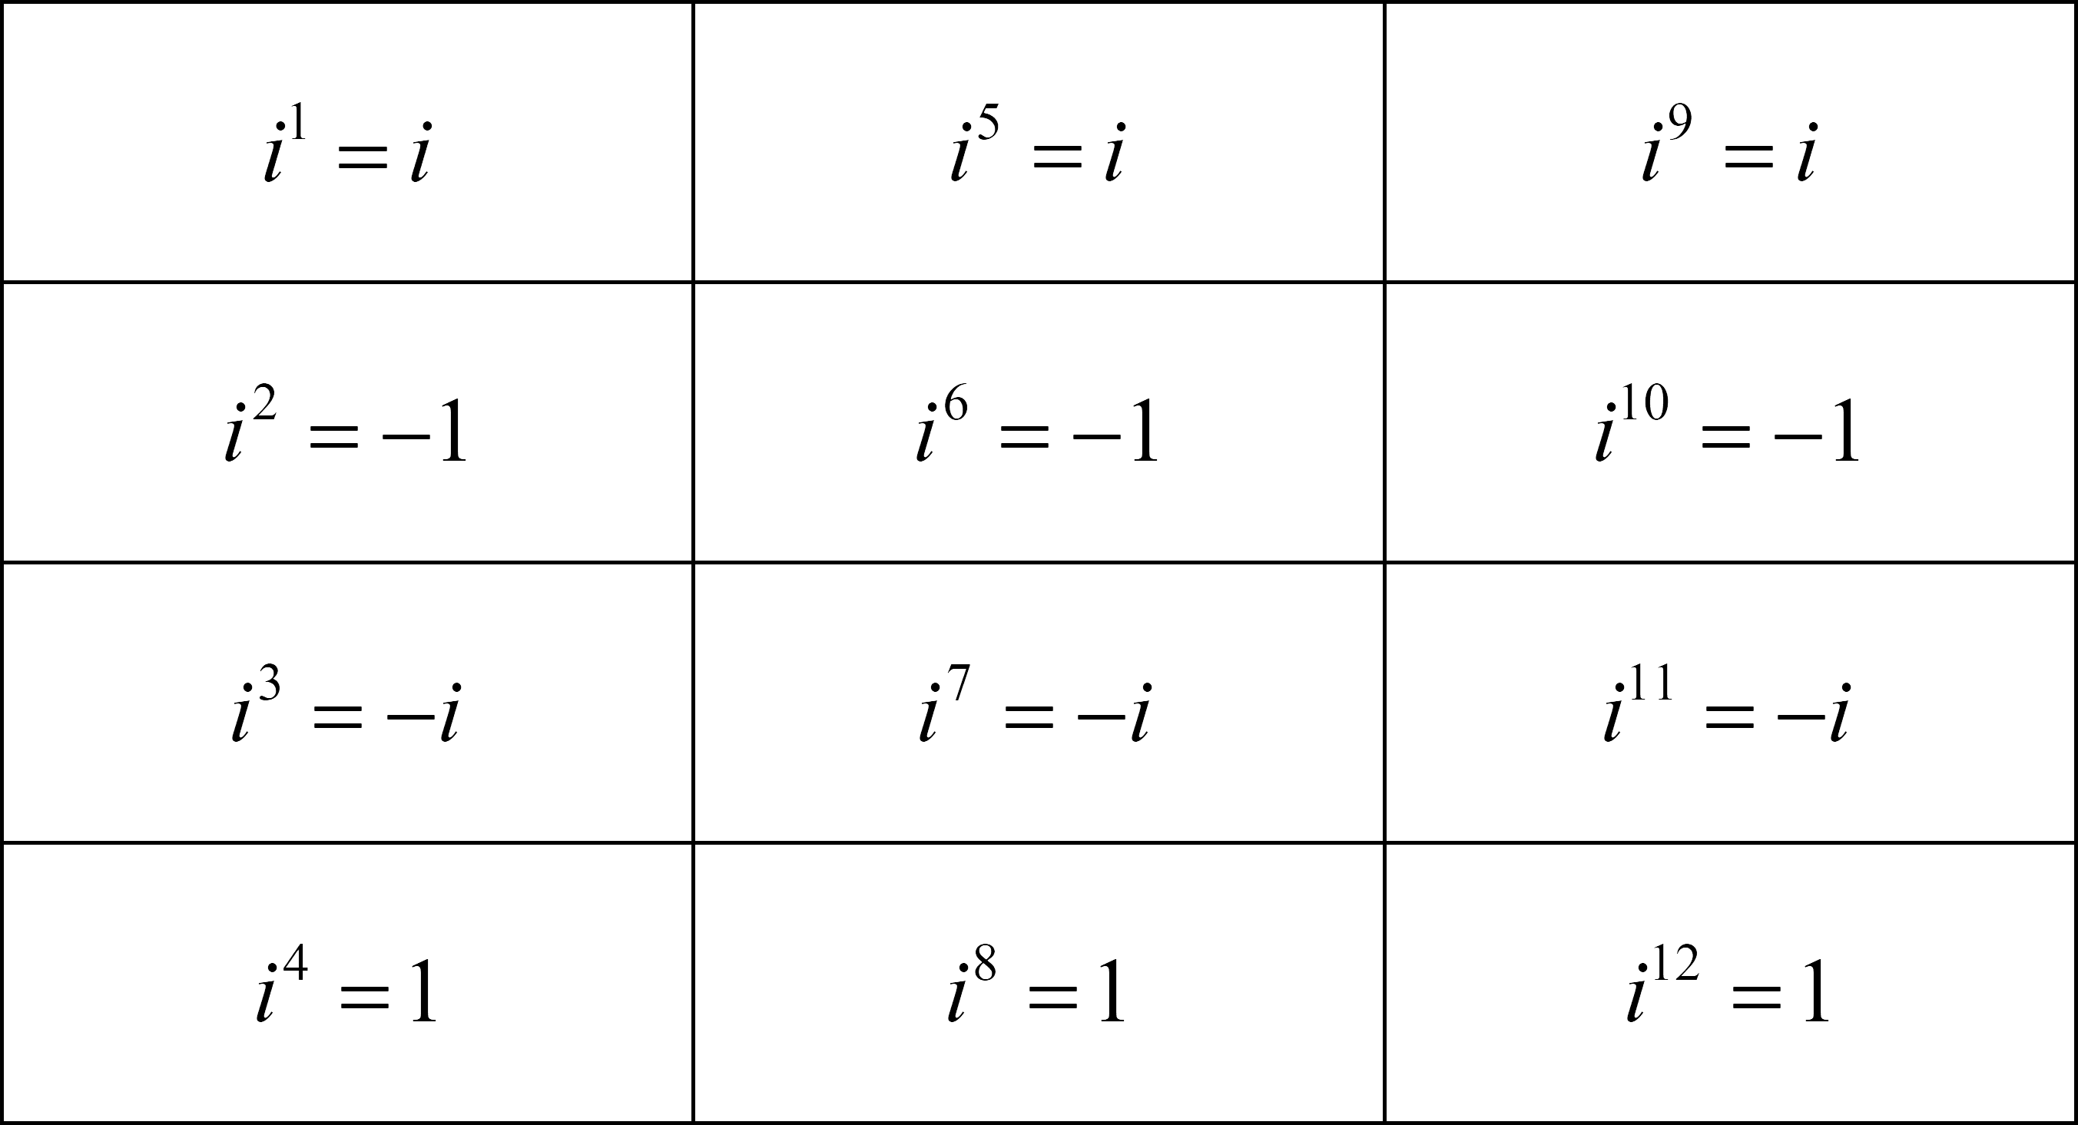
Extend: Simplify and Justify (Key)

Slide 17
Extend: I Notice, I Wonder
With your partner, reflect on the table.
What do you notice?
What do you wonder?
  Write down what you notice (true statements).
  Write down what you wonder (questions you have).
Notes:
Strategy: K20 Center. (n.d.). I Notice, I Wonder. Strategies. https://learn.k20center.ou.edu/strategy/180

Slide 18
Discussion
Share what you noticed about the table.
  How did you complete the table?
  What patterns did you find?
Share what you wondered about the table.
  Could this table continue forever?
  Is there a faster way to complete the table?
Notes:
Teacher’s Note: Guiding the Lesson
If students are struggling to see a pattern, suggest that they compare each row or have students try to predict the results of the next column, if the table were to continue. Many of students’ generalizations likely will come from how students approached completing the table. Guide students to see the benefits of different approaches.
Some students may notice a cyclical pattern; some may notice the last row is always +1. Some may observe that when i is taken to a multiple of four power, i^{(multiple of 4)}, the result is +1. Some students may look at the exponent and write it with as many factors of i² as possible. For example, a student might write: i²³ = i²²·i = (i²)¹¹·i = (-1)¹¹·i = -i; in that case, a student only needs to remember the math fact of i² = -1.

Slide 19
Extend: Practice
Work with your partner to complete questions 9–11.
  Be sure to show your thinking.
Notes:
Teacher’s Note: ACT Prep
Simplifying i to a large power is a common and quick question on the ACT. Help students be mindful of the fact that these types of questions are on the ACT and that there is no need to memorize the whole table to quickly arrive at the answer.

Slide 20
Extend: Practice (Key)
.
.
.
Notes:
Alternative Method
If students struggle with using properties of exponents, one alternative approach is to look at the remainder after dividing the exponent by 4. Write the remainder as the new exponent for i and simplify. This method works because of the properties of exponents and the fact that i⁴ = 1. For example, i¹¹ => 11÷4 = 2R3 => i¹¹ = i³ = -i, and i²⁶ => 26÷4 = 6R2 => i²⁶ = i² = -1.

Slide 21

Always, Sometimes, or Never True
On the following slide, how often is
each statement true?
  You will decide whether each statement is
  “always,” “sometimes,” or “never” true.
Notes:
Teacher’s Note: Activity Preparation
Decide if you want to assess students individually, in pairs, or as a whole class. If you want to assess students individually, have each student number their paper 1–7 and then write their answer and reasoning for each statement. You may do the same thing with student pairs.
Alternatively, you may assign each statement to a pair of students, then have each pair explain the word they chose for their assigned statement and their reasoning to the whole class.
If you prefer to assess the class as a whole, you may ask students to vote on the most appropriate word for each statement, discuss, then have the class come to an agreement. Discussing as a class will take more time, but it can help students deepen their understanding.

Slide 22
Always, Sometimes, or Never True
is a real number.
to an even power is –1.
to an odd power is or .
to a multiple of 4 power is +1.
to a power simplifies to a complex number.
to a power simplifies to a real number.
to a power simplifies to an imaginary number.
Notes:
Strategy: K20 Center. (n.d.). Always, Sometimes, or Never True. Strategies. https://learn.k20center.ou.edu/strategy/145

Slide 23
Always, Sometimes, or Never True (Key)
Never true
Sometimes true
Always true
Always true
Always true
Sometimes true
Sometimes true

