Slide 2
Share the Wealth: Mansa Musa’s Legacy
Trade and Religion in West Africa

Slide 3
Essential Question
How does trade contribute to the spread of religion?

Slide 4
Lesson Objectives
Analyze the relationship between trade and the spread of religion.
Assess the impact of Mansa Musa’s reign in West Africa.

Slide 5
Who was the wealthiest?
Think of the richest people ever to live.
Make a list of who you think are the wealthiest people in history, both living and dead.
Share your list with a partner.
Notes:
K20 Center. (n.d.) Think-Pair-Share. Strategies. https://learn.k20center.ou.edu/strategy/139

Slide 6
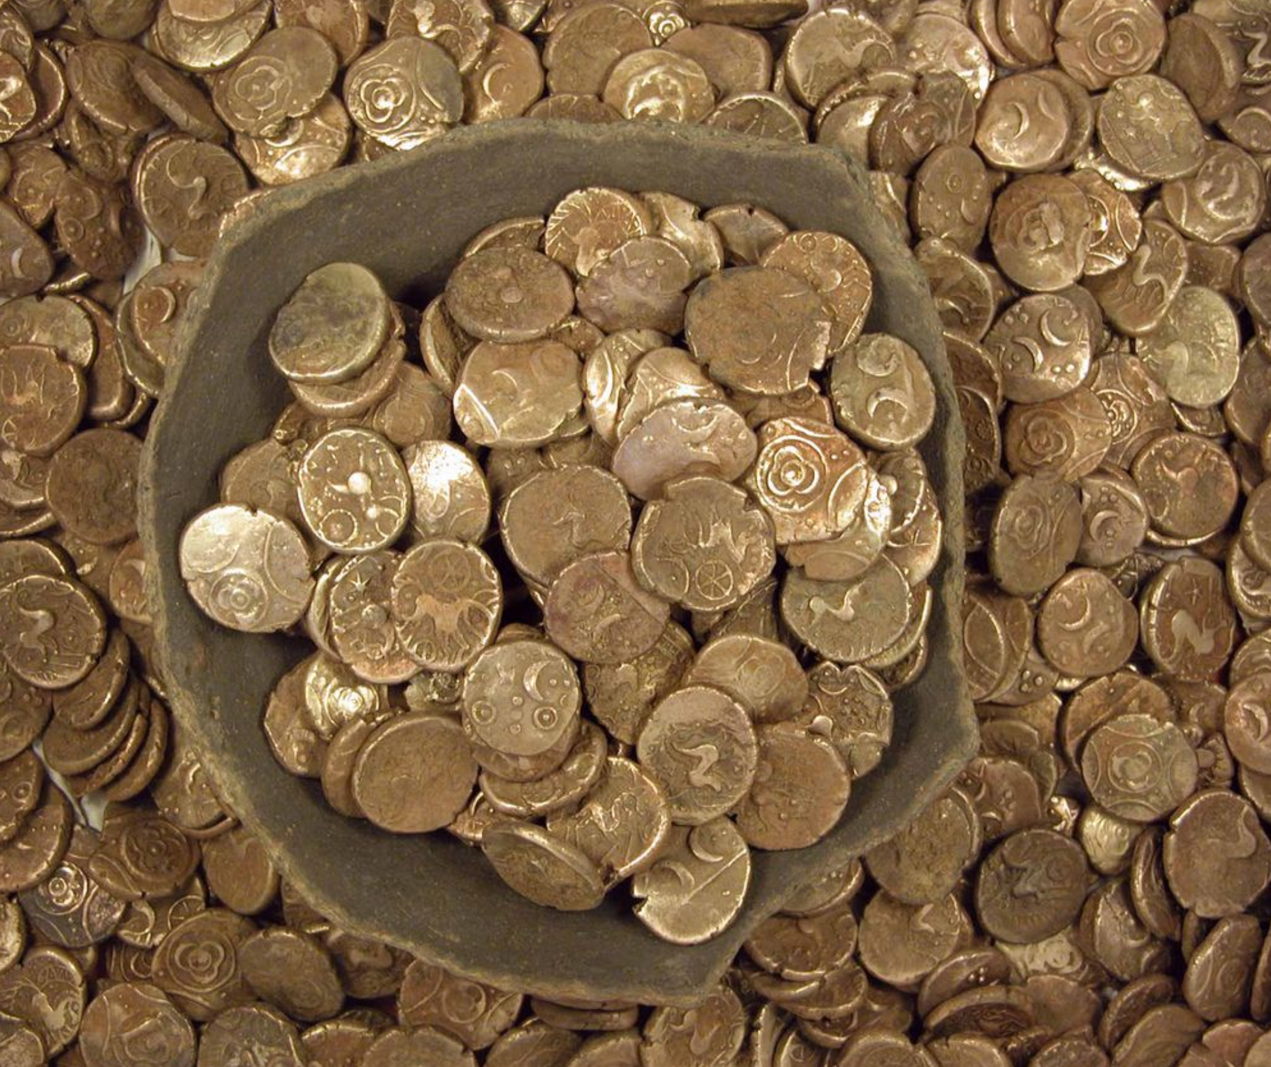
Who was the wealthiest?
As you read the Huffington Post article, look for answers to the following questions:
Who was the richest person in history?
How did this person gain their wealth?
Notes:
Griggs, M. B. (2014). Iron age coin hoard. [Digital image]. Smithsonian Magazine. https://www.smithsonianmag.com/smart-news/hoard-gold-coins-found-california-180949900/

Slide 7
Painting a Picture
Examine the images related to Mansa Musa.
As you look at each image, record your observations on the left side of the Painting a Picture Chart.
Record your inferences about Mansa Musa’s legacy on the right side of the chart.
Notes:
K20 Center. (n.d.) Painting a Picture. Strategies. https://learn.k20center.ou.edu/strategy/1331

Slide 8
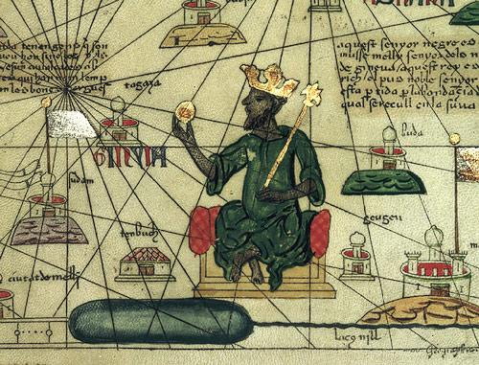
The Catalan Atlas is featured above. An up-close image of the bottom of the second panel is copied below.
Notes:
Teacher’s Note: A digital version of the Catalan Atlas can be found at the link below if you wish to zoom in on the atlas for students to see. There is nudity in the atlas so please be aware when showing certain panels to the students. https://earthlymission.com/wp-content/uploads/2019/03/medieval_catalan_world_map.jpg

Slide 9
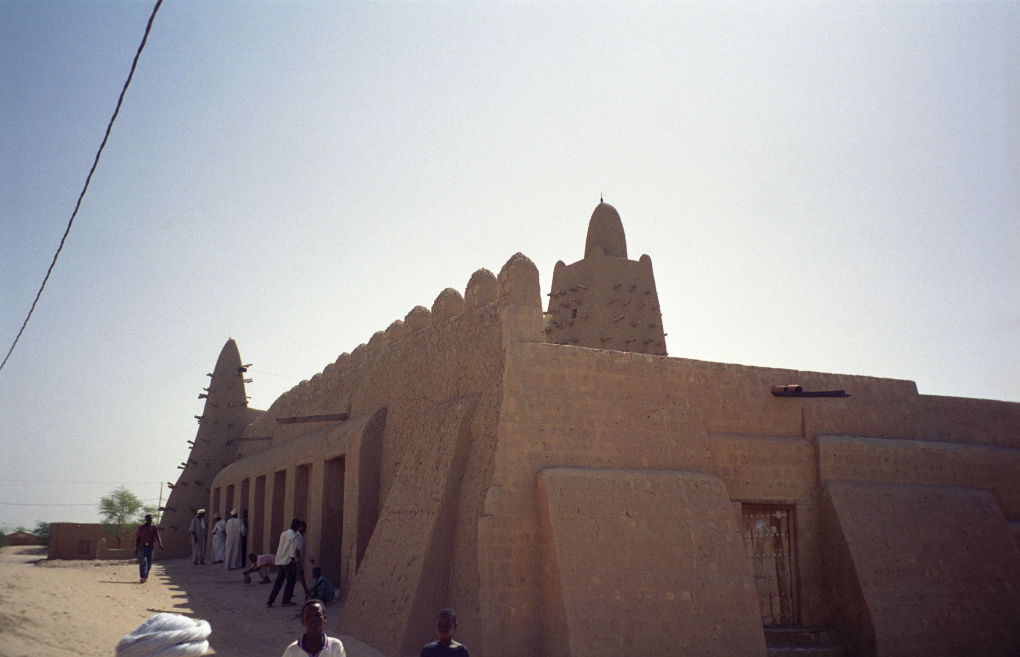
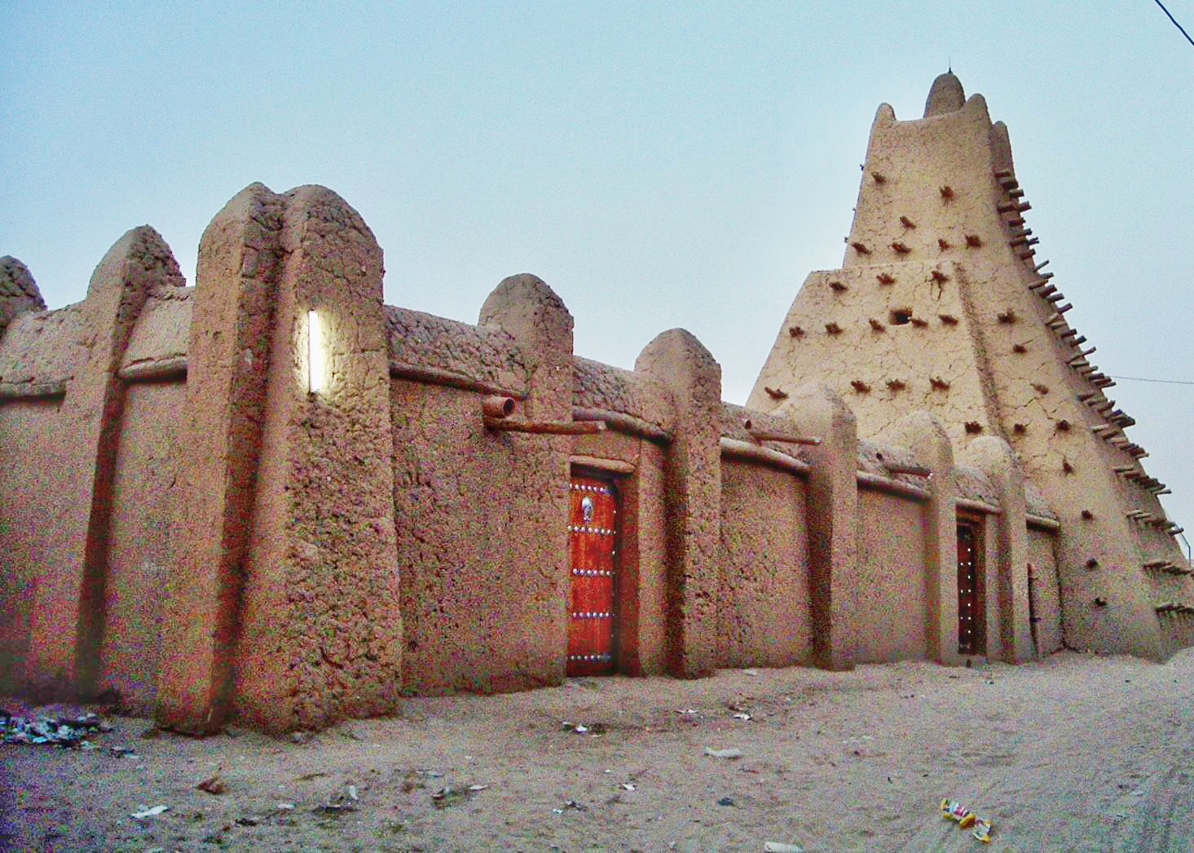
The Djinguereber Mosque
Sankore Mosque
(Previously Sankore University)

Slide 10
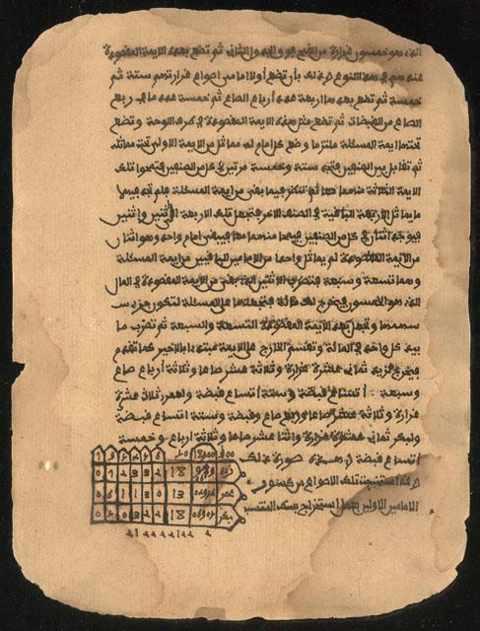
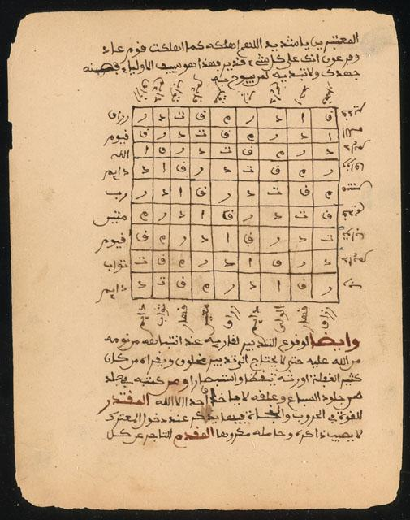
Manuscript that discusses the history and development of math and the rules of addition, subtraction, multiplication, and division.
Manuscript that discusses diagnosing and treating illnesses.

Slide 11
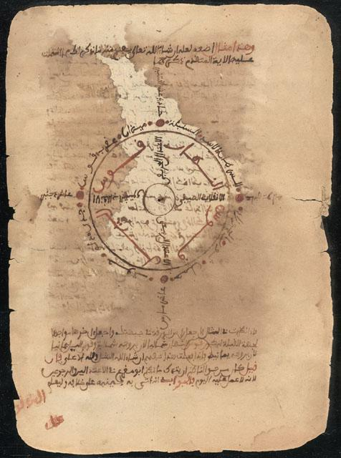
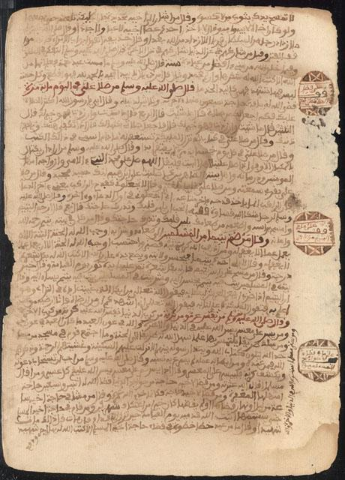
Manuscript that discusses astronomy and how to use the stars to calculate the seasons.
Manuscript that discusses the benefit of trades, craftwork, and agriculture to society.

Slide 12
Paired Texts H-Chart
Watch the biographical video about Mansa Musa.
Read the attached essay about Mansa Musa.
Summarize the video on the left side of your H-Chart and the essay on the right side.
Use the following prompt as your guiding principle: How did Mansa Musa contribute to the spread of Islam?
Notes:
Video: Smith, J. (2015). Mansa Musa. One of the wealthiest people who ever lived. [Video]. Ted-Ed. YouTube. https://www.youtube.com/watch?v=O3YJMaL55TM&t=232souTube
Essay: K20 Center. (2021). Mansa Musa: Essay Overview. Share the Wealth. https://learn.k20center.ou.edu/lesson/1500/Mansa-Musa-Essay-Overview-Share-the-Wealth.docx?rev=10057
K20 Center. (n.d.). Paired Texts H-Chart. Strategies. https://learn.k20center.ou.edu/strategy/132

Slide 13
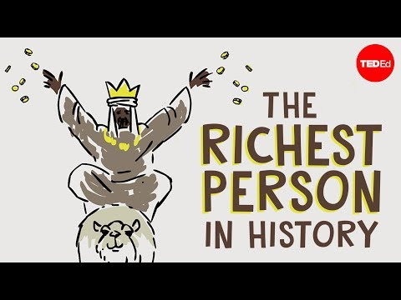
Mansa Musa Video
Notes:
Smith, J. (2015). Mansa Musa. One of the wealthiest people who ever lived. [Video]. Ted-Ed. YouTube. https://www.youtube.com/watch?v=O3YJMaL55TM&t=232souTube

Slide 14
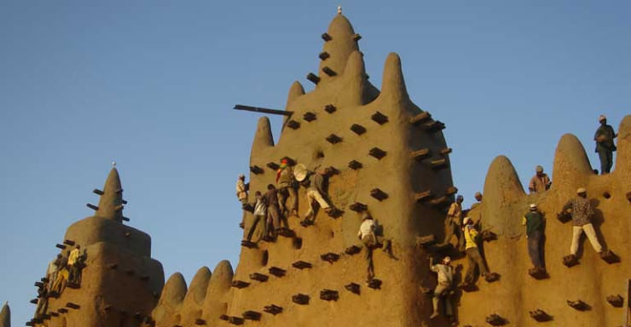
Re-Plastering of the Great Mosque
As you watch the video about replastering the mosque, think about the following questions:
What is the importance of re-plastering the mosque for people in Mali?
What does the upkeep of the mosque today say about Mansa Musa’s legacy?
Notes:
PBS. (2020). The great mosque is replastered. [Video]. https://www.pbs.org/video/great-mosque-replastered-ickx10/BS

Slide 15
Paired Texts H-Chart
Use the information on the left and right sides of your H-Charts to write a response to the prompt: How did trade and Mansa Musa's reign contribute to the spread of Islam in West Africa?
Write your one-paragraph response in the middle of the H-Chart.

