Slide 2

Two Worlds Collide,
Part 2
Systems of Linear Equations:
Substitution and Elimination

Slide 3
Essential Question
How can systems of equations be used to represent situations and solve problems?

Slide 4
Learning Objectives
Identify and write systems of linear equations.
Solve systems of linear equations using substitution and elimination.

Slide 5

Tell Me Everything
Write everything you know about the words
substitution and elimination.
You may write or draw—brainstorm!
Substitution | Elimination
What do you know about substitution? | What do you know about elimination?
Notes:
K20 Center. (n.d.). Tell me everything. Strategies. https://learn.k20center.ou.edu/strategy/107

Slide 6

Amplify Classroom: Line Zapper
Go to student.amplify.com/join.
Enter the session code.
Complete each screen.
  Examine why a single “zap” can capture multiple lines at once.
  Show your work on the “Line Zapper” portion of your handout.
  Be ready to discuss the activity as a class.

Slide 7
Amplify Classroom: Unpacking
In your group, discuss:
How can you determine the exact solution to a system of equations?
What did you feel was the most challenging part of the activity?
What became easier as you progressed through the activity?

Slide 8

Substitution: 3-2-1
You are about to watch a video and
learn how to algebraically solve a
system of linear equations using
the method of substitution.
As you watch, complete the “Substitution: 3-2-1” portion of your handout.
Notes:
K20 Center. (n.d.). 3-2-1. Strategies. https://learn.k20center.ou.edu/strategy/117

Slide 9
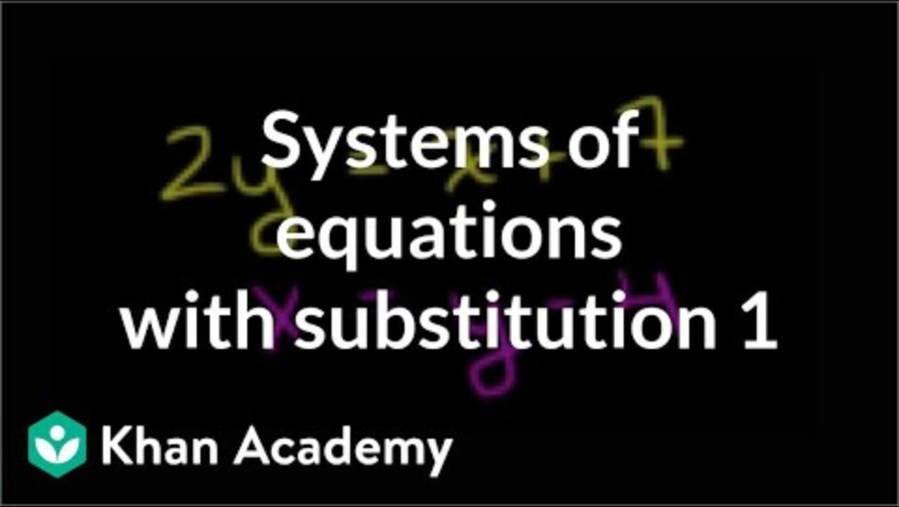
The Substitution Method
Notes:
Khan Academy. (2011, March 10). The substitution method [Video]. YouTube. https://www.youtube.com/watch?v=uzyd_mIJaoc

Slide 10
Substitution: 3-2-1
What are three things you learned?
What are two questions you have?
What is one thing you found interesting?
Notes:
K20 Center. (n.d.). 3-2-1. Strategies. https://learn.k20center.ou.edu/strategy/117

Slide 11
Elimination: 3-2-1
You are about to watch a video and
learn how to algebraically solve a
system of linear equations using
the method of elimination.
As you watch, complete the “Elimination: 3-2-1” portion of your handout.
Notes:
K20 Center. (n.d.). 3-2-1. Strategies. https://learn.k20center.ou.edu/strategy/117

Slide 12
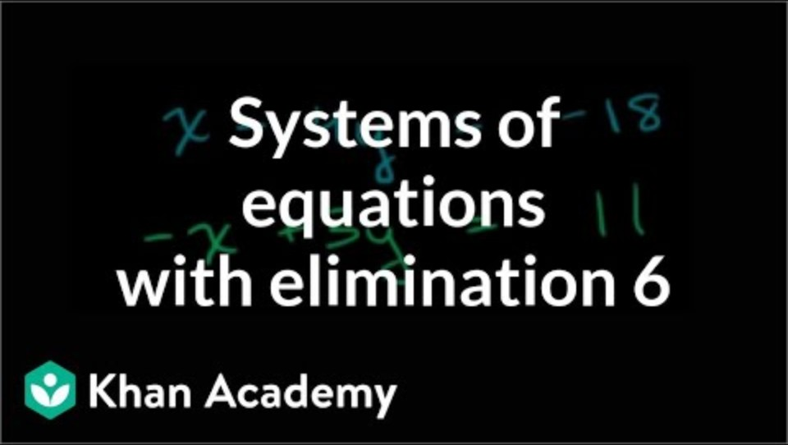
Solving With Elimination
Notes:
Khan Academy. (2016, October 28). Solving system with elimination [Video]. YouTube. https://www.youtube.com/watch?v=NPXTkj75-AM

Slide 13
Elimination: 3-2-1
What are three things you learned?
What are two questions you have?
What is one thing you found interesting?
Notes:
K20 Center. (n.d.). 3-2-1. Strategies. https://learn.k20center.ou.edu/strategy/117

Slide 14
Amplify Classroom: Wafers and Crème
Go to student.amplify.com/join.
Enter the session code.
Complete each screen to find the number of calories in each pack of wafer-and-crème cookies.
  Show your work on the “Wafers and Crème” portion of your handout.
  Be ready to discuss the activity as a class.

Slide 15
Which Method?
Write which method you should use to solve each of the following systems of equations. For each system, explain why you made your selection:

Slide 16
Which Method? (Sample Responses)
System | Which Method? Why?
 | I should use elimination because isolating a variable in either equation will create fractions, which is extra work.
 | I should use substitution because I can isolate x without creating fractions. I should use elimination because the coefficients for y are already the same.
Using either method for this problem is a great choice for different reasons.

Slide 17
Which Method? (Sample Responses)
System | Which Method? Why?
 | I should use substitution because y is already isolated.
 | I should use substitution because y is already isolated

