Slide 2

Two Worlds Collide,
Part 3
Systems of Linear Equations:
Applications

Slide 3
Essential Question
How can systems of equations be used to represent situations and solve problems?

Slide 4
Learning Objective
Write and solve systems of linear equations based on real-world scenarios.

Slide 5
Breaking Down the Menu
As you watch the video on the next slide, consider the following questions:
How does the video relate to a system of equations?
What math components do you see in the video?

Slide 6
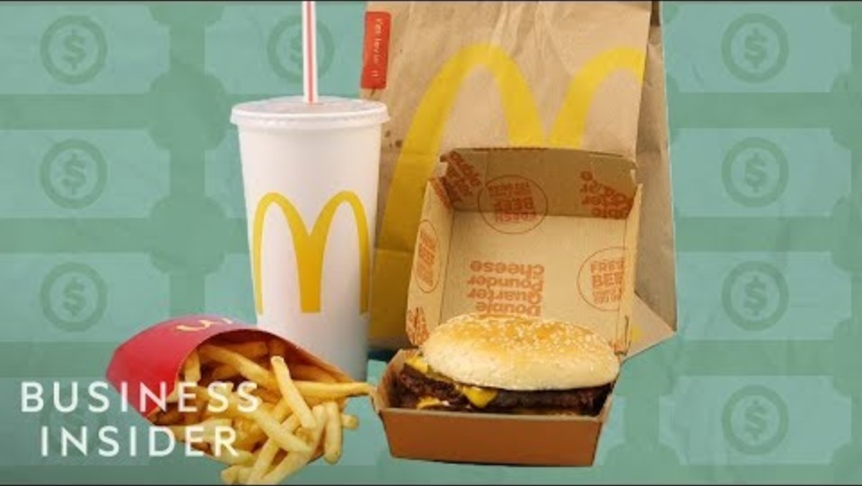
Sneaky Ways Fast Food Restaurants Get You To Spend Money
Notes:
Business Insider. (2019, March 18). Sneaky ways fast food restaurants get you to spend money [Video]. YouTube. https://www.youtube.com/watch?v=VooHiweb1sw

Slide 7
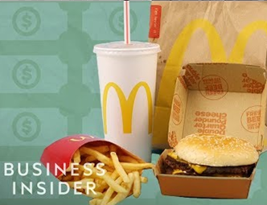
Breaking Down the Menu
How did the video relate to a system
of equations?
What math components
did you see in
the video?

Slide 8



Cost Conundrum
You and a friend go to Pat’s Burgers. You’re not that hungry, so you just want to order a couple items. However, the menu lists only the prices of combos—not any single items.

Slide 9
Cost Conundrum
Use the combo prices on your handout to determine the prices of each of the following single items:
Fries
Drink
Burger

Slide 10
Cost Conundrum
With a partner, compare and contrast your findings.
  What is the cost of the fries?
  The drink?
  The burger?
How did you determine the cost of each item?

Slide 11

Understanding an Equation: Row #1
$6.00
Equation
Statement
One burger and two orders of fries cost 6 dollars.
  B = cost of one burger
  F = cost of one order of fries

Slide 12

Understanding an Equation: Row #2
$5.00
Equation
Statement
One burger and two drinks cost 5 dollars.
  B = cost of one burger
  D = cost of one drink

Slide 13

Understanding an Equation: Row #3
$5.50
Equation
Statement
One burger, one drink, and one fry order cost 5 dollars and 50 cents.
  B = cost of one burger
  D = cost of one drink
  F = cost of one order of fries

Slide 14

Column #1
Statement
One drink and two orders of fries cost
4 dollars and 75 cents.
  D = cost of one drink
  F = cost of one order of fries
$4.75
Equation

Slide 15

Column #2
Statement
Two burgers and one drink cost
6 dollars and 25 cents.
  B = cost of one burger
  D = cost of one drink
$6.25
Equation

Slide 16
Column #3
Statement
One burger, one drink, and one order of fries cost 5 dollars and 50 cents.
  B = cost of one burger
  D = cost of one drink
  F = cost of one order of fries
$5.50
Equation

Slide 17

Cost Conundrum (Solution)
B = 2.5 , D = 1.25 , F = 1.75
One burger costs $2.50.
One drink costs $1.25.
The cost of one order of fries is $1.75.

Slide 18
Create Your Own Combos
You recently bought a food truck—but what will you sell? On your Food Truck Planner handout, include:
Your food truck’s name
A description of your restaurant
3 different items you plan to sell and the cost of each item
6 different combos and the cost of each combo
Make sure each item (shake, chips, etc.) always costs
the same, no matter what combo it’s in.

Slide 19
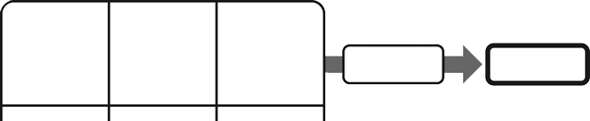
Create Your Own Combos
Every individual item you sell must
have the same cost in each combo.
Use an equation to check your work.
Put the total cost of the combo here.
Put the item and its cost in each space.

Slide 20
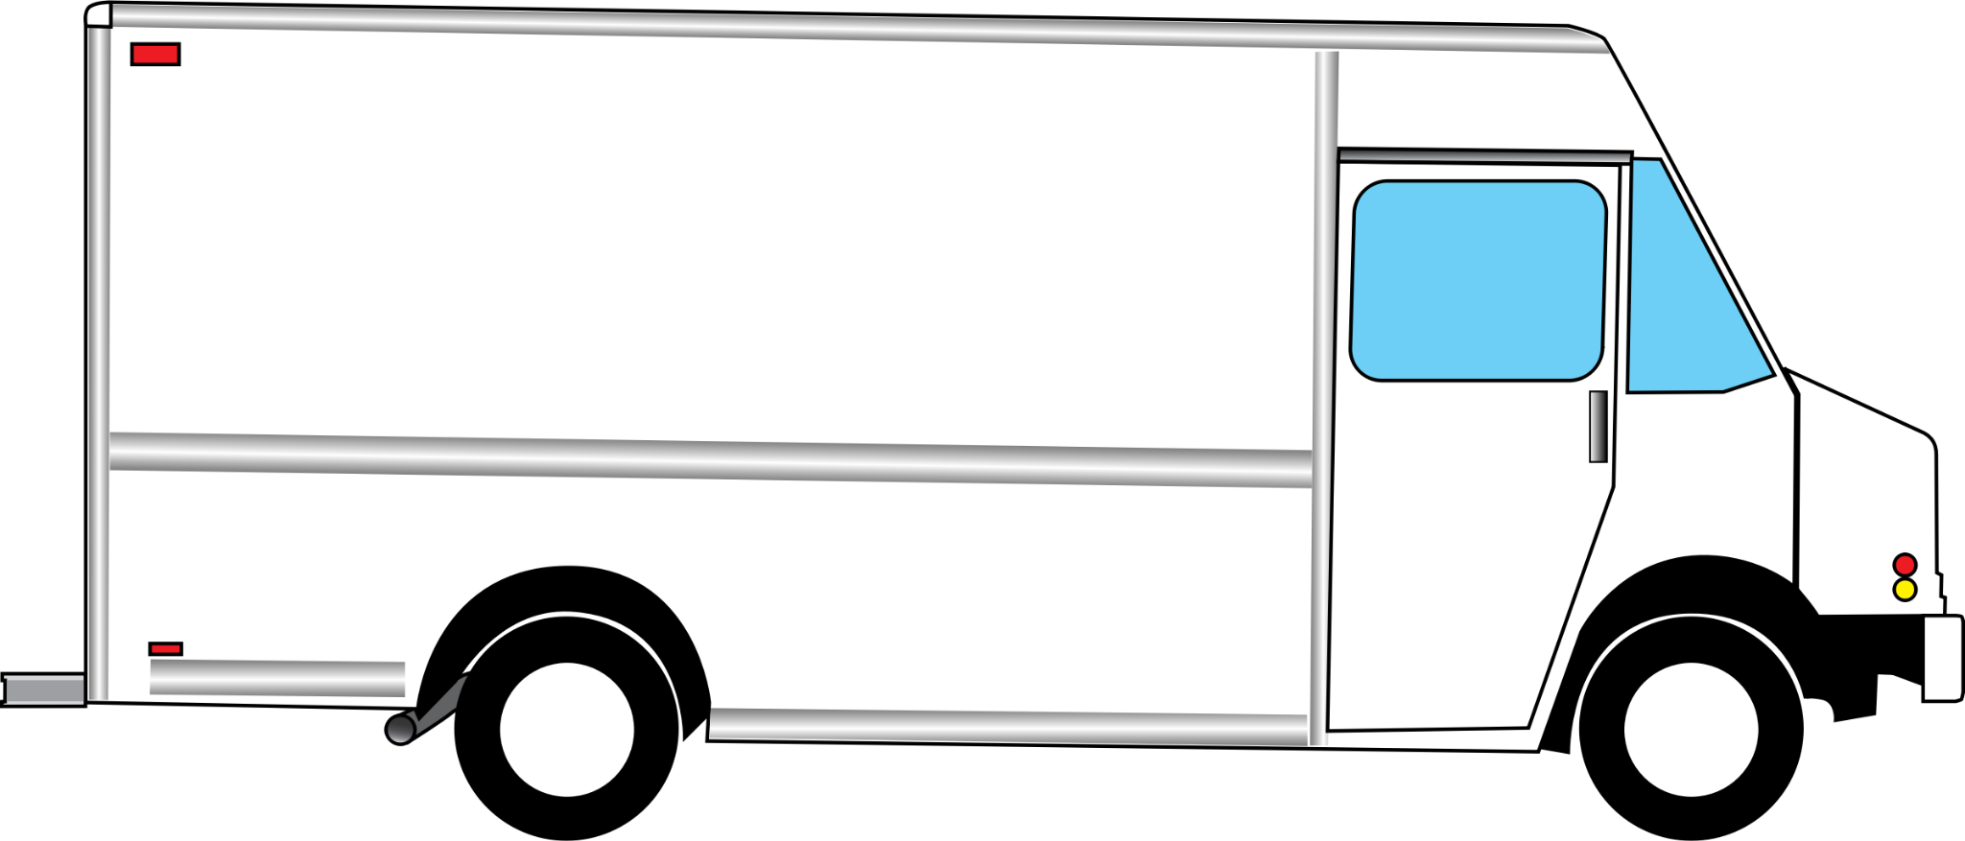
Design Your Food Truck
On the Food Truck Design handout, include:
  Your food truck’s name
  Your 6 combos with prices
Decorate your food truck and
promote your brand.
Do NOT list the prices of
each individual item.
Notes:
Image source: ClipartMax. (n.d.). Food Truck Clip Art [Image]. ClipartMax. https://www.clipartmax.com/max/m2i8G6m2i8i8d3m2/

Slide 21
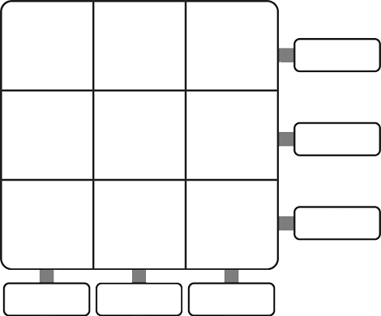
Design Your Food Truck
Decorate to Match Your Theme
List Combos With Prices
Add Food Truck Name
Notes:
Image source: ClipartMax. (n.d.). Food Truck Clip Art [Image]. ClipartMax. https://www.clipartmax.com/max/m2i8G6m2i8i8d3m2/

Slide 22
Food Truck Gallery Walk
Once a month, your town puts on a festival with live music and food trucks. Many of the trucks come to town just for this event. It’s time for your foodie heart to go wild!
You want to sample food from as many trucks as possible, so stay away from those combos. Use your math skills to find the individual prices for each item you want to try.
Can you be a Bargain Shopper and spend the least money?
Can you be a Super Foodie and visit the most trucks? It’s up to you!
Notes:
K20 Center. (n.d.). Gallery Walk/Carousel. Strategies. https://learn.k20center.ou.edu/strategy/118
Image source: ClipartMax. (n.d.). Food Truck Clip Art [Image]. ClipartMax. https://www.clipartmax.com/max/m2i8G6m2i8i8d3m2/

