Slide 2
Use Your Noodle
Avoiding Comma Blunders

Slide 3
Essential Question
How does sentence structure and punctuation impact an author’s words?

Slide 4
Learning Objective
Compose sentences with correct comma usage based on mentor text.

Slide 5
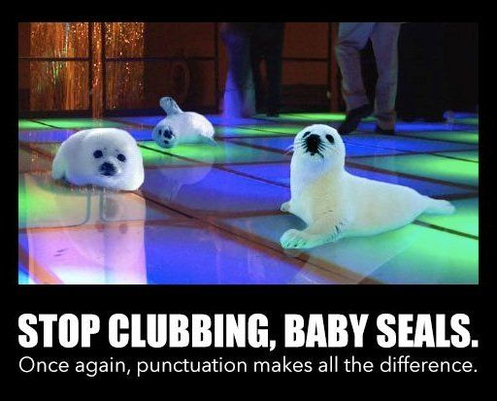
What makes this image funny?
Notes:
STOP clubbing baby SEALS once Again punctuation makes all the Difference Funniest puns in the history of the internet gallery: Internet meme ON ME.ME. (n.d.). Retrieved May 13, 2021, from https://me.me/i/stop-clubbing-baby-seals-once-again-punctuation-makes-all-the-08ad309f23cb41e09c253f5709d3826a

Slide 6
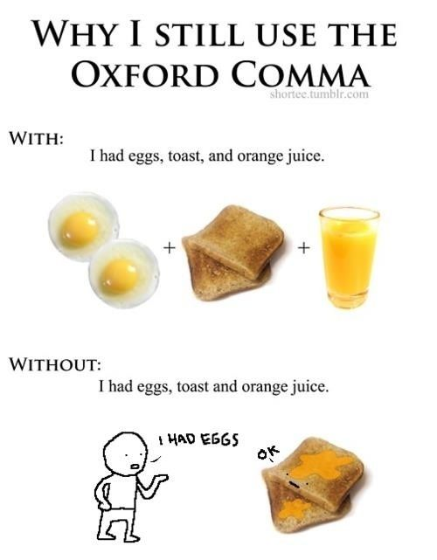
What makes this image funny?
Notes:
Imgur. (2012, January 22). Why i still use the oxford comma. Retrieved May 13, 2021, from https://imgur.com/gallery/kdPHY

Slide 7
What makes this image funny?
Notes:
Whytock, K. (2014, March 2). Punctuation saved grandma's life [Digital image]. Retrieved May 13, 2021, from https://www.flickr.com/photos/kenwhytock/12895615423/in/photostream/

Slide 8
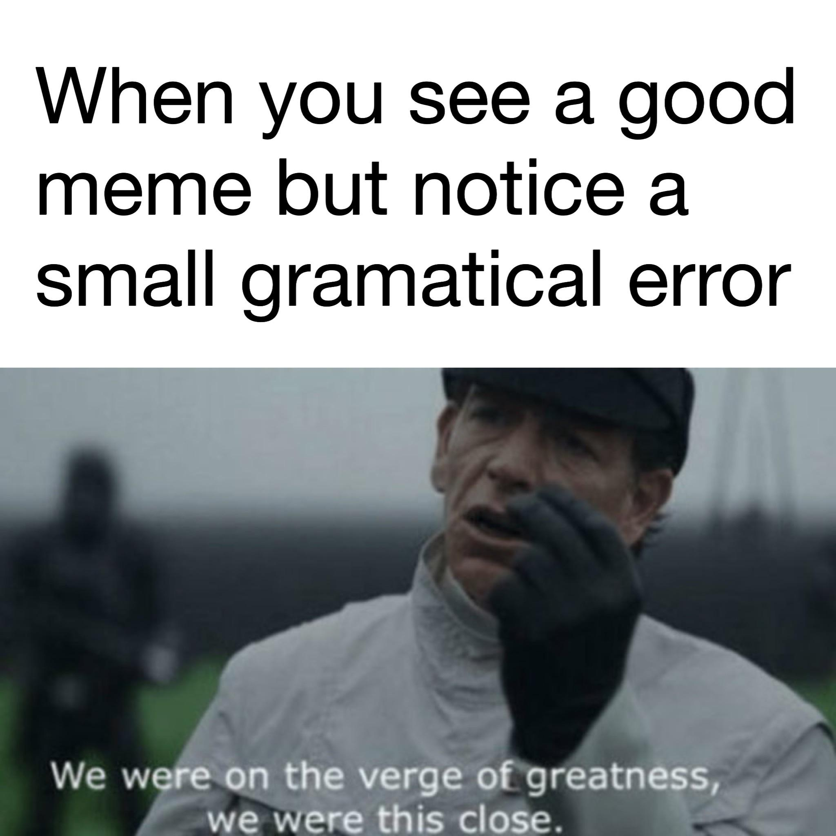
What makes this image funny?
Notes:
Chimrichaldsphd. (2019, February 22). Refreshing Friday MORNING DUMP. Retrieved May 13, 2021, from https://imgur.com/gallery/aqoG1Aa

Slide 9
What makes this image funny?
Notes:
Joki, K. (2019, May 21). 3 Punctuation Mistakes That Can Make You Look Like A Cannibal [Web log post]. Retrieved May 13, 2021, from https://www.grammarly.com/blog/3-punctuation-mistakes-that-can-make-you-look-like-a-cannibal/

Slide 10
Elbow Partners
What makes these images funny?
What are they saying about grammar/punctuation?
What common themes do you notice in the images?
Notes:
https://learn.k20center.ou.edu/strategy/116

Slide 11
Macaroni Noodle Commas
Use the provided macaroni noodles to place the commas where you feel they should go in each sentence.
Do all the sentences require commas?
What do you notice about where the commas should go?
Notes:
https://learn.k20center.ou.edu/strategy/116
https://jamboard.google.com/d/1CFRNBvBr3qggS2dJfXt5OPCH_PU5iGfsGGstb0M5PdM/viewer?f=0

Slide 12
Shopping List Editing: Mentor Text
"Not knowing why he left Reyna nags at me like when you're almost finished with a jigsaw puzzle but discover you're missing a couple of pieces. You overturn the box, search under the furniture, and look everywhere else you can think of, but they don't turn up. Of course, you can still see 99 percent of the puzzle's image, but the inability to click those last pieces into place irks the soul." (Patron Saints of Nothing, Randy Ribay, pg 217)

Slide 13
I Notice, I Wonder
After reading the mentor text, complete the following:
I notice…
I wonder…
Focus on what you notice or wonder about the sentences.
Notes:
https://learn.k20center.ou.edu/strategy/180

Slide 14
Paragraph Writing
Complete a paragraph writing, following the instructions of your teacher.

Slide 15
Mentor Text: Comma Usage
"Not knowing why he left Reyna nags at me like when you're almost finished with a jigsaw puzzle but discover you're missing a couple of pieces. You overturn the box, search under the furniture, and look everywhere else you can think of, but they don't turn up. Of course, you can still see 99 percent of the puzzle's image, but the inability to click those last pieces into place irks the soul." (Patron Saints of Nothing, Randy Ribay, pg 217)
Notes:
The subject of the sentence is a gerund that is completed with a noun clause.

Slide 16
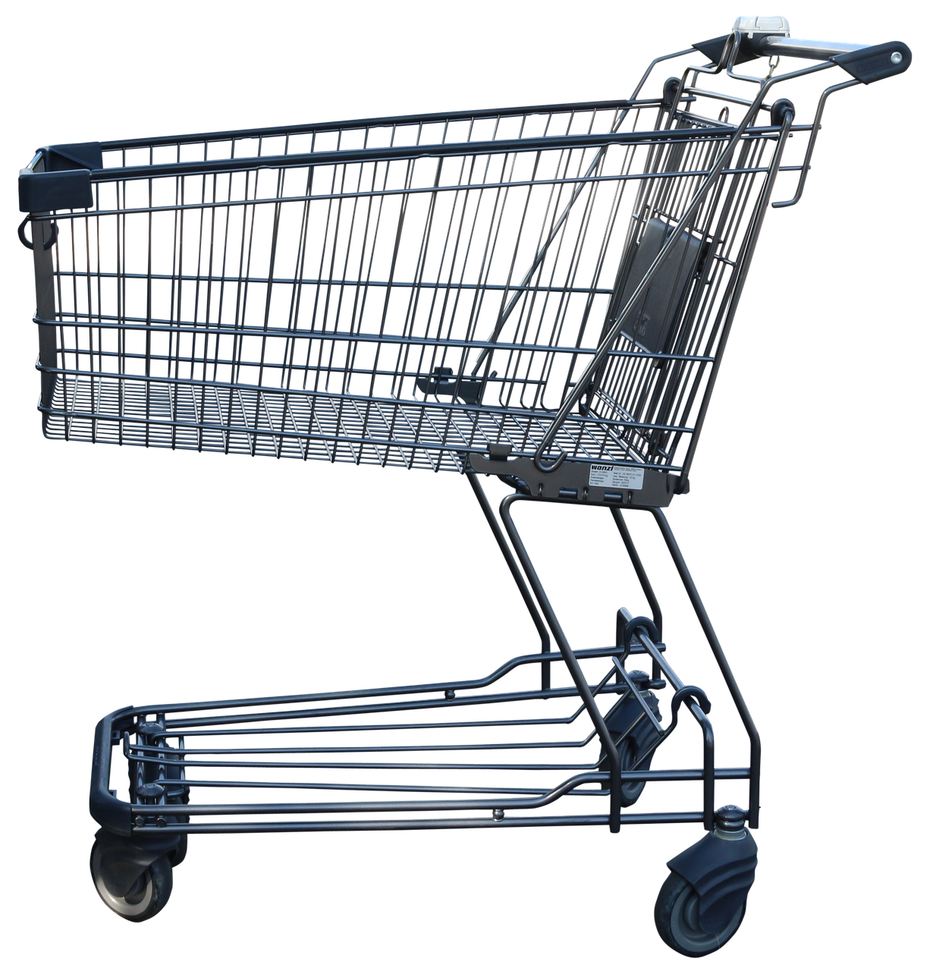
Shopping List Editing
The first Sentence:
Not knowing why he left Reyna nags at me like when you're almost finished with a jigsaw puzzle but discover you're missing a couple of pieces.
Notes:
Susannehs. (2017, October 23). [Shopping Cart]. Retrieved May 12, 2021, from https://pixabay.com/illustrations/shopping-cart-shopping-2879172/

Slide 17
Shopping List Editing
Why are there no commas in this sentence?
The first Sentence:
Not knowing why he left Reyna nags at me like when you're almost finished with a jigsaw puzzle but discover you're missing a couple of pieces.
Notes:
Susannehs. (2017, October 23). [Shopping Cart]. Retrieved May 12, 2021, from https://pixabay.com/illustrations/shopping-cart-shopping-2879172/

Slide 18
Shopping List Editing
Why are there no commas in this sentence?
Independent Clause
Not knowing why he left Reyna nags at me . . .
Dependent Clause
. . . like when you’re almost finished with a jigsaw puzzle but discover you're missing a couple of pieces.
Notes:
Susannehs. (2017, October 23). [Shopping Cart]. Retrieved May 12, 2021, from https://pixabay.com/illustrations/shopping-cart-shopping-2879172/

Slide 19
Independent Clause
An independent clause is a group of words with a subject and a predicate. It expresses a complete thought.
Not knowing why he left Reyna nags at me like when you’re almost finished with a jigsaw puzzle but discover [that] you’re missing a couple of pieces.
Note: There are two dependent clauses in this predicate.
Notes:
Susannehs. (2017, October 23). [Shopping Cart]. Retrieved May 12, 2021, from https://pixabay.com/illustrations/shopping-cart-shopping-2879172/

Slide 20
Dependent Clauses
A dependent clause is a group of words with a subject and a predicate, but it cannot express a complete thought. Here are TWO dependent clauses from our mentor sentence:
. . . when you’re almost finished with a jigsaw puzzle but discover [that] you’re missing a couple of pieces.
Dependent clauses are introduced by either a stated or implied subordinate conjunction.
Notes:
Susannehs. (2017, October 23). [Shopping Cart]. Retrieved May 12, 2021, from https://pixabay.com/illustrations/shopping-cart-shopping-2879172/

Slide 21
Shopping List Editing
Why are there no commas in this sentence?
The first dependent clause is an adverb clause and comes after the main clause. No comma is required:
. . . when you’re almost finished with a jigsaw puzzle but discover . . .
The second dependent clause is a NOUN clause. It actually completes one of the verbs in the first dependent clause:
. . . [that] you’re missing a couple of pieces.
No comma is required because the second clause is actually the DIRECT OBJECT for the verb discover:
What did you discover?
Rules tell us that a direct object is never separated by one comma from the verb it completes.
Notes:
Susannehs. (2017, October 23). [Shopping Cart]. Retrieved May 12, 2021, from https://pixabay.com/illustrations/shopping-cart-shopping-2879172/

Slide 22
Shopping List Editing
The Second Sentence:
Why are there commas in this sentence?
You overturn the box, search under the furniture, and look everywhere else you can think of, but they don't turn up.
Notes:
Susannehs. (2017, October 23). [Shopping Cart]. Retrieved May 12, 2021, from https://pixabay.com/illustrations/shopping-cart-shopping-2879172/

Slide 23
Shopping List Editing
Why are there commas in this sentence?
Authors use commas to separate items in a series.
You overturn the box, search the furniture, and look everywhere else. . .
Authors use commas to separate two independent clauses when combined with a FANBOYS coordinating conjunction.
You overturn the box, search under the furniture, and look everywhere else you can think of, but they don't turn up.
Notes:
Susannehs. (2017, October 23). [Shopping Cart]. Retrieved May 12, 2021, from https://pixabay.com/illustrations/shopping-cart-shopping-2879172/

Slide 24
Shopping List Editing
You overturn the box, search under the furniture, and look everywhere else [that] you can think of, but they don't turn up.
Subject Predicate FANBOYS
Note: The dependent clause you can think of is a dependent adjective clause. It describes everywhere else (which is an adverb functioning as a noun– called an adverbial noun).
Notes:
Susannehs. (2017, October 23). [Shopping Cart]. Retrieved May 12, 2021, from https://pixabay.com/illustrations/shopping-cart-shopping-2879172/

Slide 25
FANBOYS - Coordinating Conjunctions
For
And
Nor
But
Or
Yet
So
Notes:
Susannehs. (2017, October 23). [Shopping Cart]. Retrieved May 12, 2021, from https://pixabay.com/illustrations/shopping-cart-shopping-2879172/

Slide 26
Shopping List Editing
The Third Sentence:
Why are there commas in this sentence?
Of course, you can still see 99 percent of the puzzle's image, but the inability to click those last pieces into place irks the soul.
Notes:
Susannehs. (2017, October 23). [Shopping Cart]. Retrieved May 12, 2021, from https://pixabay.com/illustrations/shopping-cart-shopping-2879172/

Slide 27
Shopping List Editing
Why are there commas in this sentence?
Authors often use commas after introductory phrases to “set the stage” for the rest of the sentence.
The introductory phrase is nonessential to the rest of the sentence.
Of course,
We also have another sentence where two independent clauses are joined by a FANBOYS “but” to combine them.
Notes:
Susannehs. (2017, October 23). [Shopping Cart]. Retrieved May 12, 2021, from https://pixabay.com/illustrations/shopping-cart-shopping-2879172/

Slide 28
Shopping List Editing
Of course, you can still see 99 percent of the puzzle's image, but the inability to click those last pieces into place irks the soul.
Subject Predicate FANBOYS
Predicate=Verb+Completer
Notes:
Susannehs. (2017, October 23). [Shopping Cart]. Retrieved May 12, 2021, from https://pixabay.com/illustrations/shopping-cart-shopping-2879172/

Slide 29
Shopping List Editing
Your turn!
It’s time for you to use our shopping list and “go shopping” in your own writing.
Notes:
Susannehs. (2017, October 23). [Shopping Cart]. Retrieved May 12, 2021, from https://pixabay.com/illustrations/shopping-cart-shopping-2879172/

Slide 30
Shopping List Editing
Read through the paragraph you wrote.
Do you have the following items in your writing?
Commas after items in a series;
Comma separating two independent clauses connected by FANBOYS;
Comma after introductory words, phrases, or clauses.
Don’t have one of these items in your writing? No problem! Just “substitute” it by revising or editing your writing and adding it to your paragraph.
Notes:
Susannehs. (2017, October 23). [Shopping Cart]. Retrieved May 12, 2021, from https://pixabay.com/illustrations/shopping-cart-shopping-2879172/
Geralt. (2015, July 20). [Shopping List]. Retrieved May 12, 2021, from https://pixabay.com/illustrations/search/shopping%20list/

Slide 31
Shopping List Editing
Once you have revised and edited your writing, explain what you did in the items/substitutions column of your Shopping List.
Notes:
Susannehs. (2017, October 23). [Shopping Cart]. Retrieved May 12, 2021, from https://pixabay.com/illustrations/shopping-cart-shopping-2879172/

Slide 32
Two Stars and a Wish
Share your writing with your partner.
As you read your partner’s writing, complete a Two Stars and a Wish:
Two things the author did well;
One thing the author could improve on for next time.
Notes:
https://learn.k20center.ou.edu/strategy/83

Slide 33
Shopping List Editing - Reflection
After reading your partner’s feedback, complete the reflection at the bottom of your shopping list. What did you learn about using commas?
Notes:
Susannehs. (2017, October 23). [Shopping Cart]. Retrieved May 12, 2021, from https://pixabay.com/illustrations/shopping-cart-shopping-2879172/

