Slide 2

The Gift of Life
Biology

Slide 3
Essential Questions
What are the benefits and risks of organ donation?
How does one determine if two people are match?

Slide 4
Learning Objectives
Identify contributing factors and solutions for organ donations.
Determine that parents contribute to their offspring’s makeup by predicting the probability of inherited traits using simple Punnett Squares.
Explore real-world issues and problems.

Slide 5

Preflection
On a piece of paper, write for two minutes everything you know about organ donations.

Slide 6
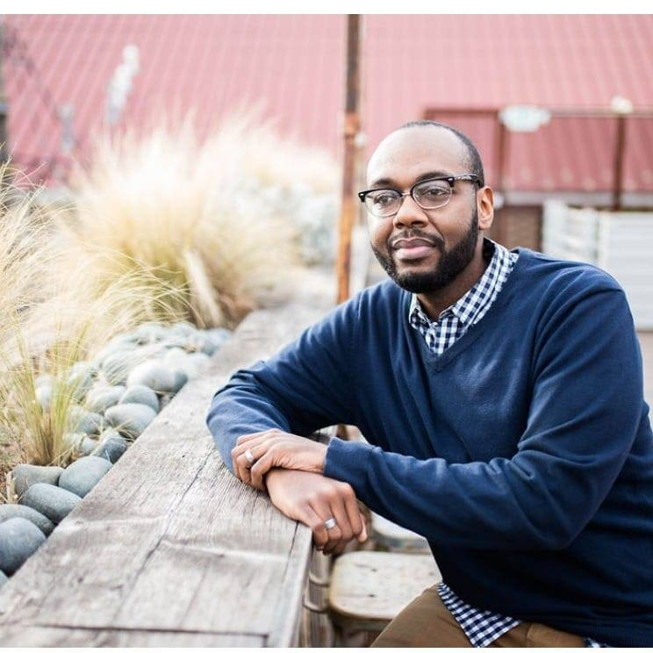
My Little Kidney
Notes:
K20 ICAP - The Gift of Life - My Little Kidney

Slide 7

True or False Statement
Indicate if the following statements are true or false. Explain your reasoning.

Slide 8
True or False?
Organs, eyes, and tissues cannot be given to different ethnic groups or the opposite sex.
Notes:
Adapted from: LifeShare. (n.d.). Student Quiz. LifeShare Transplant Donor Services of Oklahoma. https://www.lifeshareuniversity.org/lesson-plan-1.html

Slide 9
True or False?
When you get your driver’s license, you are automatically registered as an organ, eye, and tissue donor.
Notes:
Adapted from: LifeShare. (n.d.). Student Quiz. LifeShare Transplant Donor Services of Oklahoma. https://www.lifeshareuniversity.org/lesson-plan-1.html

Slide 10
True or False?
Anyone can register to be an organ, eye, and tissue donor, regardless of their medical history or age.
Notes:
Adapted from: LifeShare. (n.d.). Student Quiz. LifeShare Transplant Donor Services of Oklahoma. https://www.lifeshareuniversity.org/lesson-plan-1.html

Slide 11
True or False?
One organ donor can save up to eight lives and one tissue donor can enhance the lives of up to 75 people.
Notes:
Adapted from: LifeShare. (n.d.). Student Quiz. LifeShare Transplant Donor Services of Oklahoma. https://www.lifeshareuniversity.org/lesson-plan-1.html

Slide 12
True or False?
Most major religions do not permit organ, eye, and tissue donation.
Notes:
Adapted from: LifeShare. (n.d.). Student Quiz. LifeShare Transplant Donor Services of Oklahoma. https://www.lifeshareuniversity.org/lesson-plan-1.html .

Slide 13
True or False?
When you are admitted to the hospital, the number one priority is to save your life.
Notes:
Adapted from: LifeShare. (n.d.). Student Quiz. LifeShare Transplant Donor Services of Oklahoma. https://www.lifeshareuniversity.org/lesson-plan-1.html

Slide 14
True or False?
Celebrities and wealthy people on the waitlist receive priority for receiving an organ.
Notes:
Adapted from: LifeShare. (n.d.). Student Quiz. LifeShare Transplant Donor Services of Oklahoma. https://www.lifeshareuniversity.org/lesson-plan-1.html

Slide 15
True or False?
It is against federal law to sell organs, eyes, and tissues.
Notes:
Adapted from: LifeShare. (n.d.). Student Quiz. LifeShare Transplant Donor Services of Oklahoma. https://www.lifeshareuniversity.org/lesson-plan-1.html

Slide 16
True or False?
The donor family must pay for organ, eye, and tissue donation.
Notes:
Adapted from: LifeShare. (n.d.). Student Quiz. LifeShare Transplant Donor Services of Oklahoma. https://www.lifeshareuniversity.org/lesson-plan-1.html

Slide 17
True or False?
An open casket funeral is possible for organ, eye, and tissue donors.
Notes:
Adapted from: LifeShare. (n.d.). Student Quiz. LifeShare Transplant Donor Services of Oklahoma. https://www.lifeshareuniversity.org/lesson-plan-1.html

Slide 18

Say Something
Today we are going to watch a video on blood typing.
The video will be paused at certain points. At these points, you will be able to say something about what you just learned.

Slide 19

A Match Made in DNA

Slide 20
The Blood Connection
Access the game using the following link: https://k20.ou.edu/8o
Answer the questions on your handout as you complete the game.

Slide 21
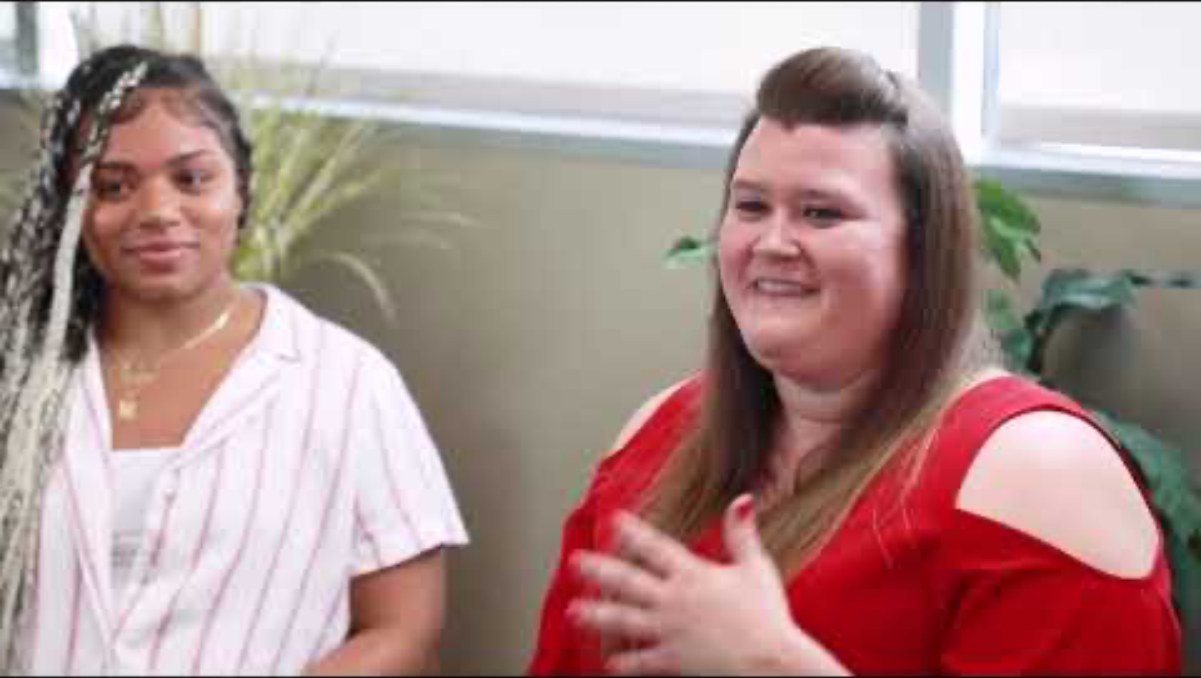
LifeShare: Community Outreach
While watching the video, complete your LifeShare handout.
  One surprising fact or idea
  One interesting fact or idea
  One troubling fact or idea

Slide 22
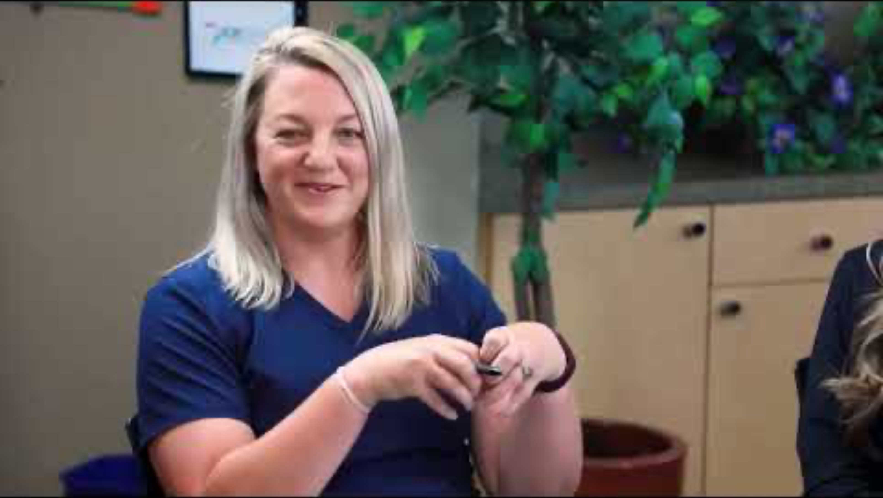
LifeShare: Organ Recovery
While watching the video, complete your LifeShare handout.
  One surprising fact or idea
  One interesting fact or idea
  One troubling fact or idea

Slide 23
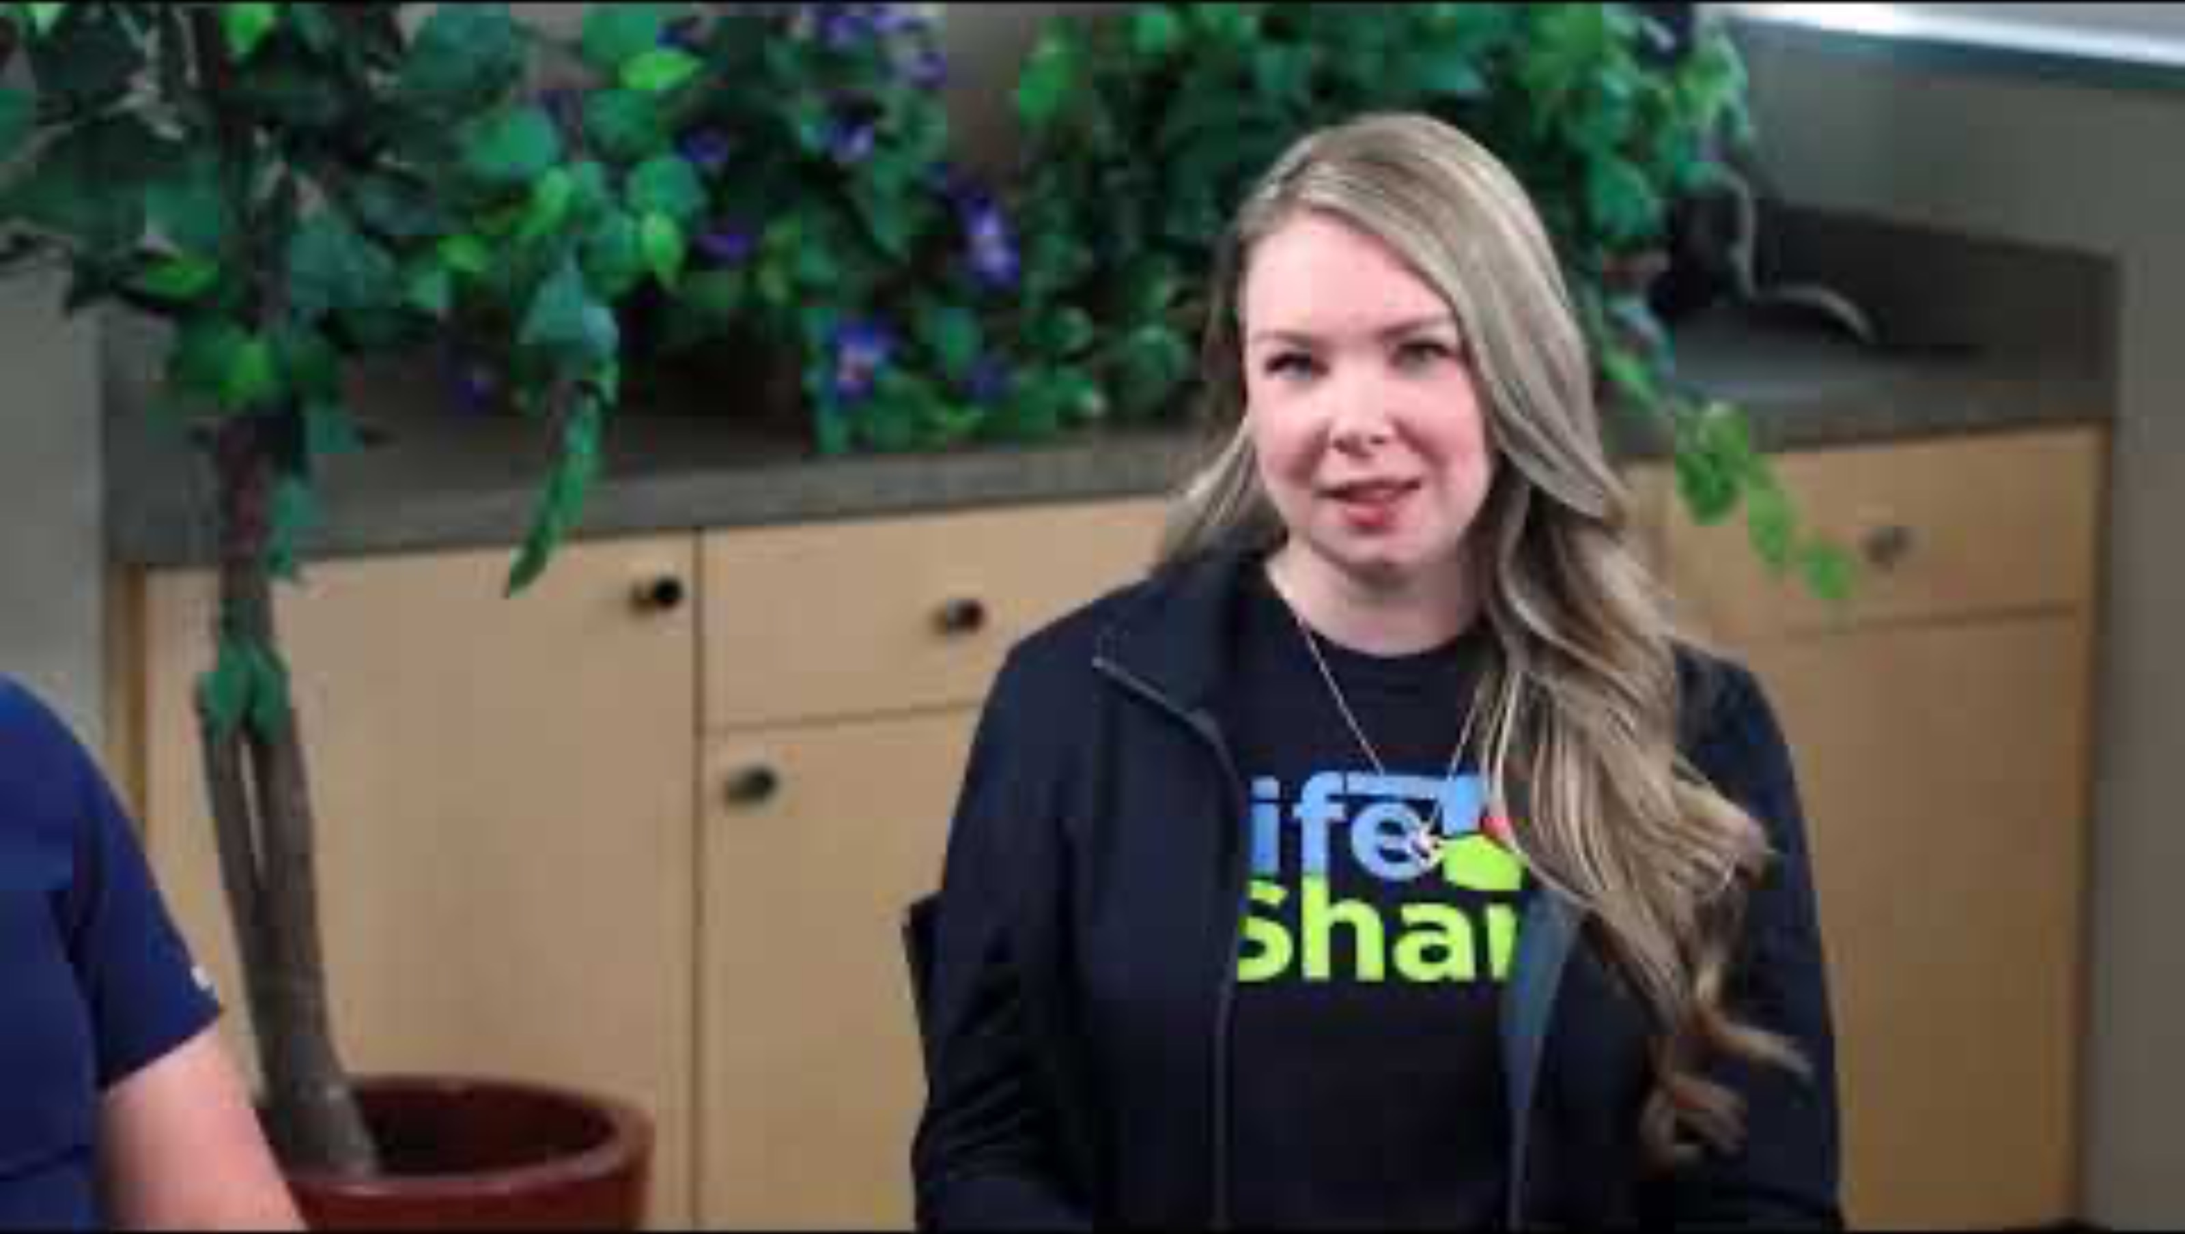
LifeShare: Surgery Coordinator
While watching the video, complete your LifeShare handout.
  One surprising fact or idea
  One interesting fact or idea
  One troubling fact or idea

Slide 24
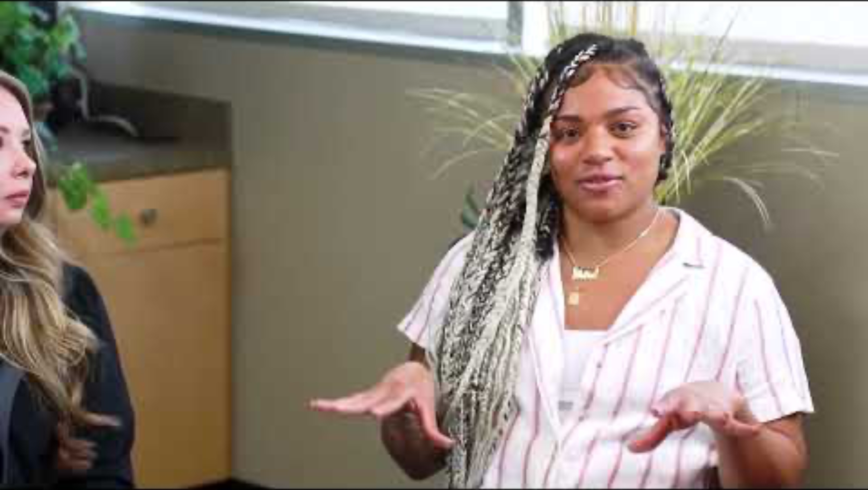
LifeShare: Tissue Recovery
While watching the video, complete your LifeShare handout.
  One surprising fact or idea
  One interesting fact or idea
  One troubling fact or idea

Slide 25

Chain Notes
Rotate your papers within your group and add any of the following to your peer’s list:
  one additional fact
  one comment
  one correction
  an image to extend the ideas present.

Slide 26
Chain Notes
Once your original paper has been returned to you, read through the added comments.
Work with your group to create a summary reflecting the main points regarding organ donation that you learned from the video.

Slide 27
PSA Poster
Create a Public Service Announcement (PSA) Flyer to encourage others to learn more about organ donation and how to register to be an organ donor. Include the following in your flyer:
  Research information about organ donation.
  Include your knowledge of how matchings are determined.

Slide 28
Gallery Walk
With your group, walk around the room and observe your classmates’ work. Use your sticky notes to leave at least one comment and one question for each poster.

