Slide 2
My Imaginary Friend, Part 2
Operations With Complex Numbers

Slide 3
Essential Question
Why do we perform operations with complex numbers?

Slide 4
Lesson Objectives
Analyze and perform operations with complex numbers.
Understand real-world applications of complex numbers.

Slide 5
Directions
You are about to begin an escape room game. Listen carefully, read the story, and follow the directions to escape. You will need a pencil to be successful.
Navigate through the escape room by answering questions and trading correct answers with your teacher for more clues.

Slide 6
Story: Page 1
***Starlog 0019438: Quiet, no change***
For three months, your daily report has been the same every day. The quiet of space leaves you and your crewmates wishing for the excitement of other quadrants. Instead, your captain has you cruising along in the most boring corner of the galaxy, shuttling parts to far-off sectors.
Just as you are logging off, something hits the ship and knocks you to your knees. You jump to your feet and exchange a panicked glance with your crewmates. What was it? Where did it come from?

Slide 7
Story: Page 2
You check the scanners, but they are dark. Everything is dark, except for the flashing of the emergency lights, and a wailing siren warns you that the cabin is losing air pressure and oxygen. You’re already starting to feel the effects of the cabin’s gravity well steadily losing power.
You and your team scramble to the control room, where you find the captain unconscious on the floor. Beside him is a small battery pack—it appears he was using it to restart the system’s control panel. The panel is flashing red, waiting for the captain’s 3-letter passcode.

Slide 8
Story: Page 3
You and your crewmates look around for some clues as to what his passcode might be. His birthdate? A favorite food?
That’s when you notice a small journal clutched in his hand. It is opened to a page with a series of symbols and letters, along with a note: “Go with the flow.”

Slide 9
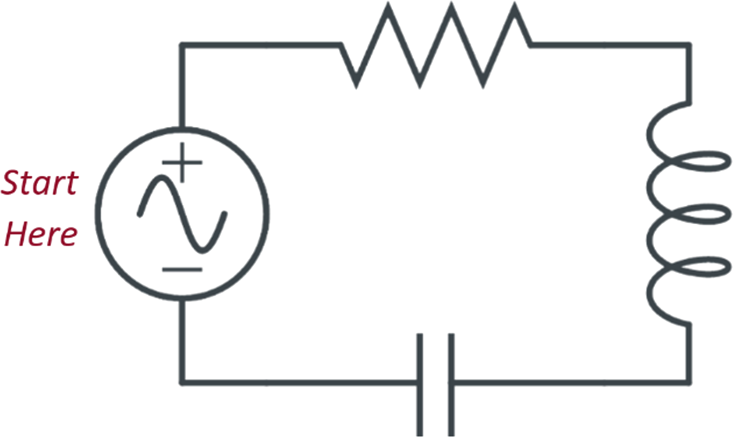
Go With the Flow
One of your crew points out some of the symbols are drawn on the battery pack. You compare the image with the captain’s journal and discover…
You will have to rely on the clues you have to determine the 3-letter passcode.

Slide 10
Go With the Flow
Passcode: R L C

Slide 11
Story: Page 4
The control panel comes to life. With the alarm continuing to warn of oxygen loss, your team knows the first thing that needs to happen is to run a diagnostic on the extent of the damage and its cause. You open the program and see it is asking for current power levels. You want to just yell at the computer, “None! We have no power!”
You know that isn’t true, though. The alarm and emergency lights are pulling power from the reserves, and many systems may have battery power stored as well.

Slide 12
Story: Page 5
Then, one of your crewmates remembers there is a user manual housed in the control room. It should be able to help you determine the current power reserves for each system. You retrieve the manual and open it…

Slide 13
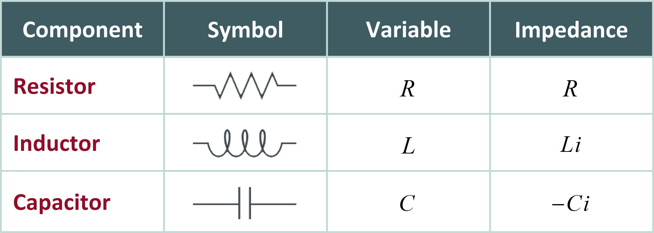
User Manual—Definitions
Read the user manual.

Slide 14
Calculating Total Impedance: Example 1
Read the given circuit diagram clockwise, starting with the power source.
Voltage (Power) Source

Slide 15
Calculating Total Impedance: Example 1
Identify the value of each variable.

Slide 16
Calculating Total Impedance: Example 1
Identify which symbol has which impedance.

Slide 17
Calculating Total Impedance: Example 1
Go around the circuit and find the sum of the resistance of all components.

Slide 18
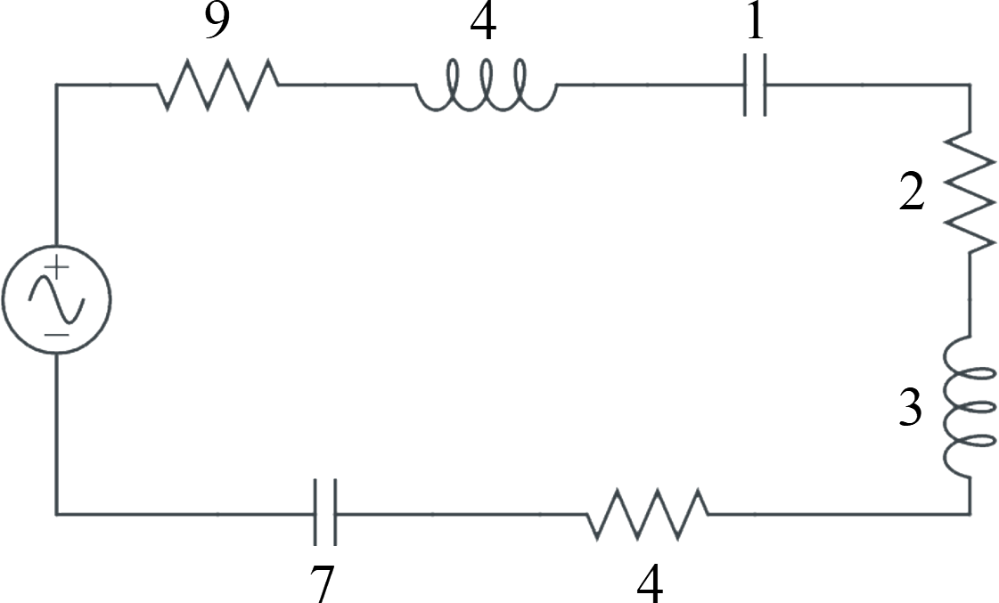
Calculating Total Impedance: Example 2
With your partner, discuss how to find the total impedance.
.

Slide 19
User Manual—Calculations: Impedance
Work with your partner on the User Manual— Calculations handout to find the total impedance for questions 1 and 2.

Slide 20
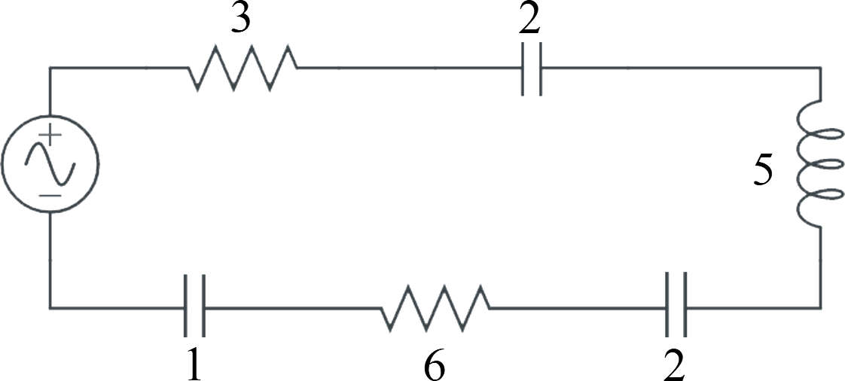
User Manual—Calculations: Question 1

Slide 21
User Manual—Calculations: Question 2

Slide 22
User Manual—Calculations: Voltage
Work with your partner on the User Manual— Calculations handout to find the voltage for questions 3 and 4.

Slide 23
User Manual—Calculations: Question 3

Slide 24
User Manual—Calculations: Question 4

Slide 25
User Manual—Calculations: Current
Work with your partner on the User Manual— Calculations handout to find the current for question 5.
What operation do you notice we need?

Slide 26
Video: How to Divide Complex Numbers

Slide 27
User Manual—Calculations: Question 5

Slide 28
User Manual—Calculations: Current
Work with your partner on the User Manual— Calculations handout to find the current for question 6.

Slide 29
User Manual—Calculations: Question 6

Slide 30
Story: Page 6
The results show you the worst-case scenario—it was an asteroid that hit the ship from out of nowhere. The ship is beyond repair, but the escape pods remain unharmed. You can take the pods to the nearest outpost if you successfully divert the ship’s remaining power reserves to the pod batteries.

Slide 31
Story: Page 7
With your crew’s help, you pick up the captain and head toward the escape pods. To send the ship’s remaining power to the pods, you have to make your way down the hall and find the Power Control Hub. You need to use the hub’s calibration dial to get the 3-letter code you will input to confirm the transfer of power.

Slide 32
Power Control Hub: Time to Escape
Read the directions on the Power Control Hub handout and use what you’ve learned to get to the escape pods.
On your way, you will need to figure out 2 codes.
All directions will be on your handouts for the rest of this activity.
Be sure to read the story AND the directions.
Work as a team to escape!

Slide 33
Success! You’ve escaped!
The locking mechanism for the pods creaks open. You and your team enter the pods and begin to navigate away from the ship. You’ve made it!
According to your calculations, you’re just a few hours away from landing in a friendly port—and you’re starting to reconsider your career choices. It might be time to give up on a life in space and choose something more grounded. Maybe after all the experience you’ve just gained with circuits, you could find a job as an electrical engineer…

Slide 34
Self-Assessment
How would you rate your level of understanding when adding and subtracting complex numbers?
I understand a little.
I understand but still need some help.
I have basic knowledge about this.
I know what to do and do not need any help.
I understand and can help or explain this to someone else.
Notes:
Strategy: K20 Center. (n.d.). Fist to Five. Strategies. https://learn.k20center.ou.edu/strategy/68
Image source: OpenClipart-Vectors. (2013, July 13). Hand counting fingers [Images]. Pixabay. https://pixabay.com/vectors/hand-counting-fingers-one-two-162127/

Slide 35
Self-Assessment
How would you rate your level of understanding when multiplying complex numbers?
I understand a little.
I understand but still need some help.
I have basic knowledge about this.
I know what to do and do not need any help.
I understand and can help or explain this to someone else.
Notes:
Strategy: K20 Center. (n.d.). Fist to Five. Strategies. https://learn.k20center.ou.edu/strategy/68
Image source: OpenClipart-Vectors. (2013, July 13). Hand counting fingers [Images]. Pixabay. https://pixabay.com/vectors/hand-counting-fingers-one-two-162127/

Slide 36
Self-Assessment
How would you rate your level of understanding when dividing complex numbers?
I understand a little.
I understand but still need some help.
I have basic knowledge about this.
I know what to do and do not need any help.
I understand and can help or explain this to someone else.
Notes:
Strategy: K20 Center. (n.d.). Fist to Five. Strategies. https://learn.k20center.ou.edu/strategy/68
Image source: OpenClipart-Vectors. (2013, July 13). Hand counting fingers [Images]. Pixabay. https://pixabay.com/vectors/hand-counting-fingers-one-two-162127/

