Slide 2
Mistaken for the Enemy
The Internment of Japanese Americans During World War II

Slide 3
“The Upward Trail”
With your groupmates, consider the following questions as you read the poem:
      What do you think the author was feeling as she wrote the poem?
      What would you guess was the age of the author?
      Where do you think she lived?
      What are your impressions of the place the author is describing?
Notes:
Matsuda, J. (1944). The upward trail. Special Collections, University of Arkansas Libraries. https://digitalcollections.uark.edu/digital/collection/Civilrights/id/1549/

Slide 4
Essential Questions
Why were Japanese Americans imprisoned during World War II?
How did internment alter their lives?

Slide 5
Lesson Objectives
Analyze the circumstances that led to the internment of Japanese Americans during World War II.
Identify ways in which internment affected the lives of Japanese Americans.

Slide 6
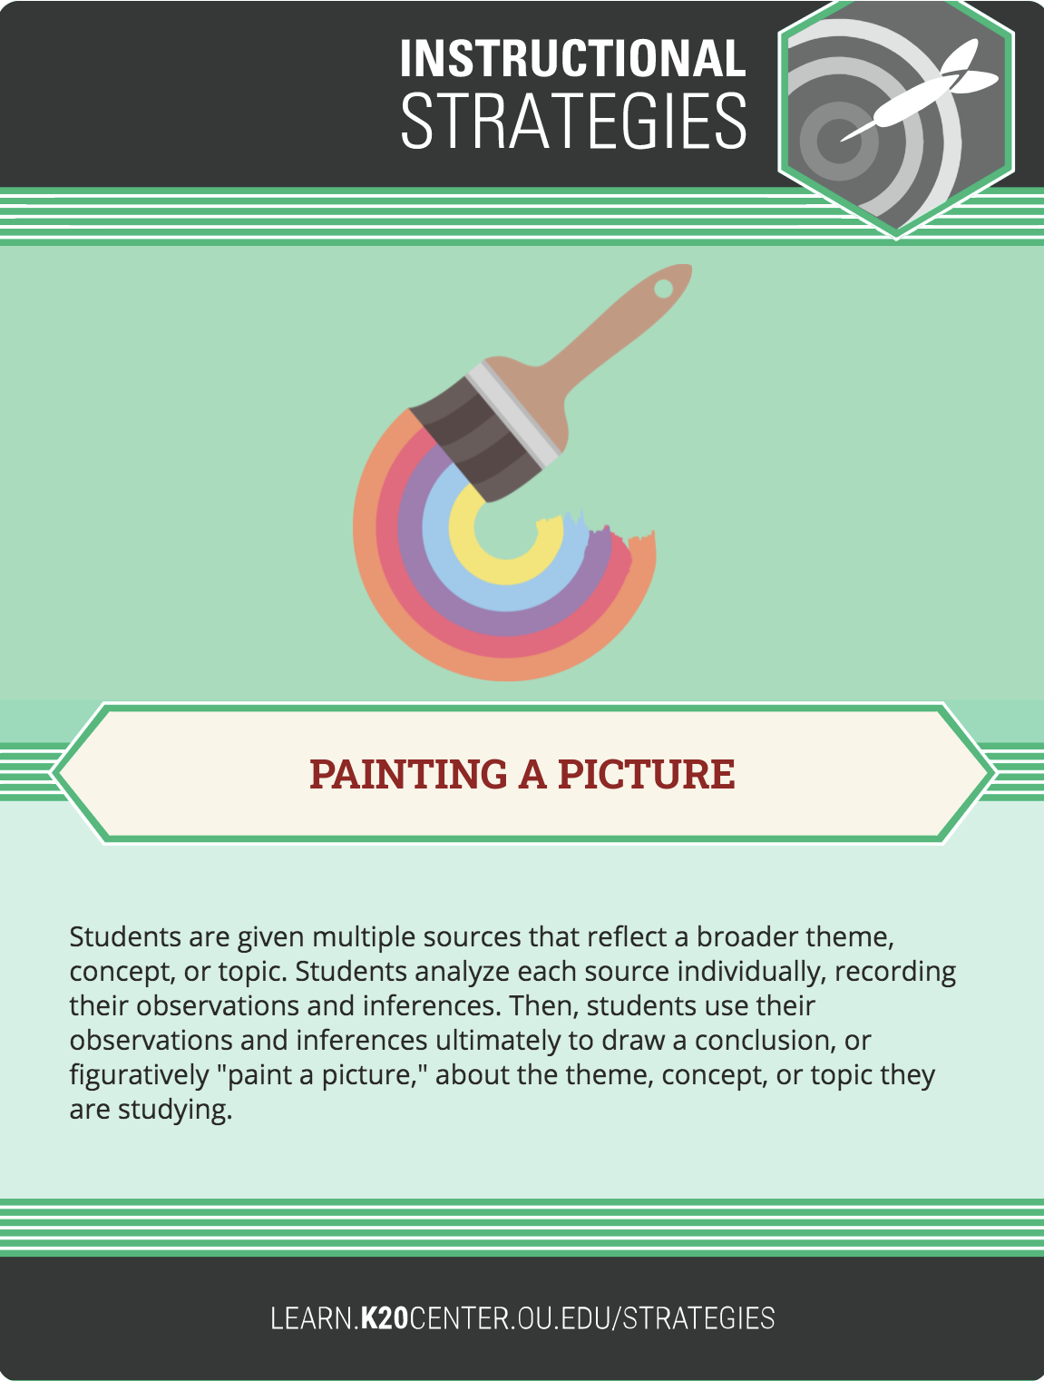
Painting a Picture
Examine the images relating to Japanese-American internment.
As you look at each photo, record your observations on the left side of the Paint a Picture Chart.
Write your inferences on the right side of the chart about what is happening in the photo.
Notes:
K20 Center. (2021, May 6). Painting a picture. Strategies. https://learn.k20center.ou.edu/strategy/1331

Slide 7
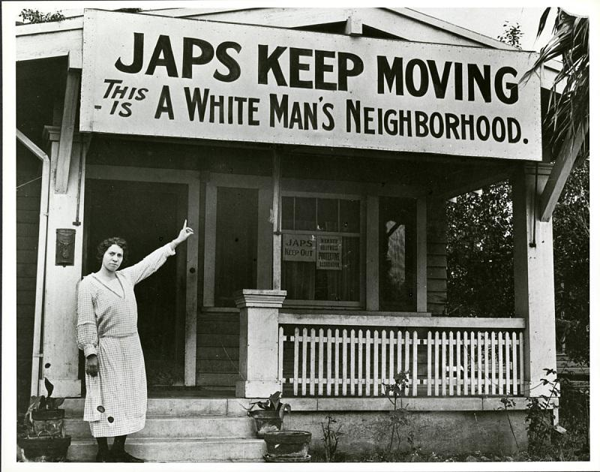
Image 1
Notes:
Source: National Japanese American Historical Society. (c. 1923). A resident of Hollywood, California, makes clear her sentiments to any Japanese looking for housing in her neighborhood, around 1923. ​Smithsonian Institution. https://americanhistory.si.edu/righting-wrong-japanese-americans-and-world-war-ii/racism

Slide 8
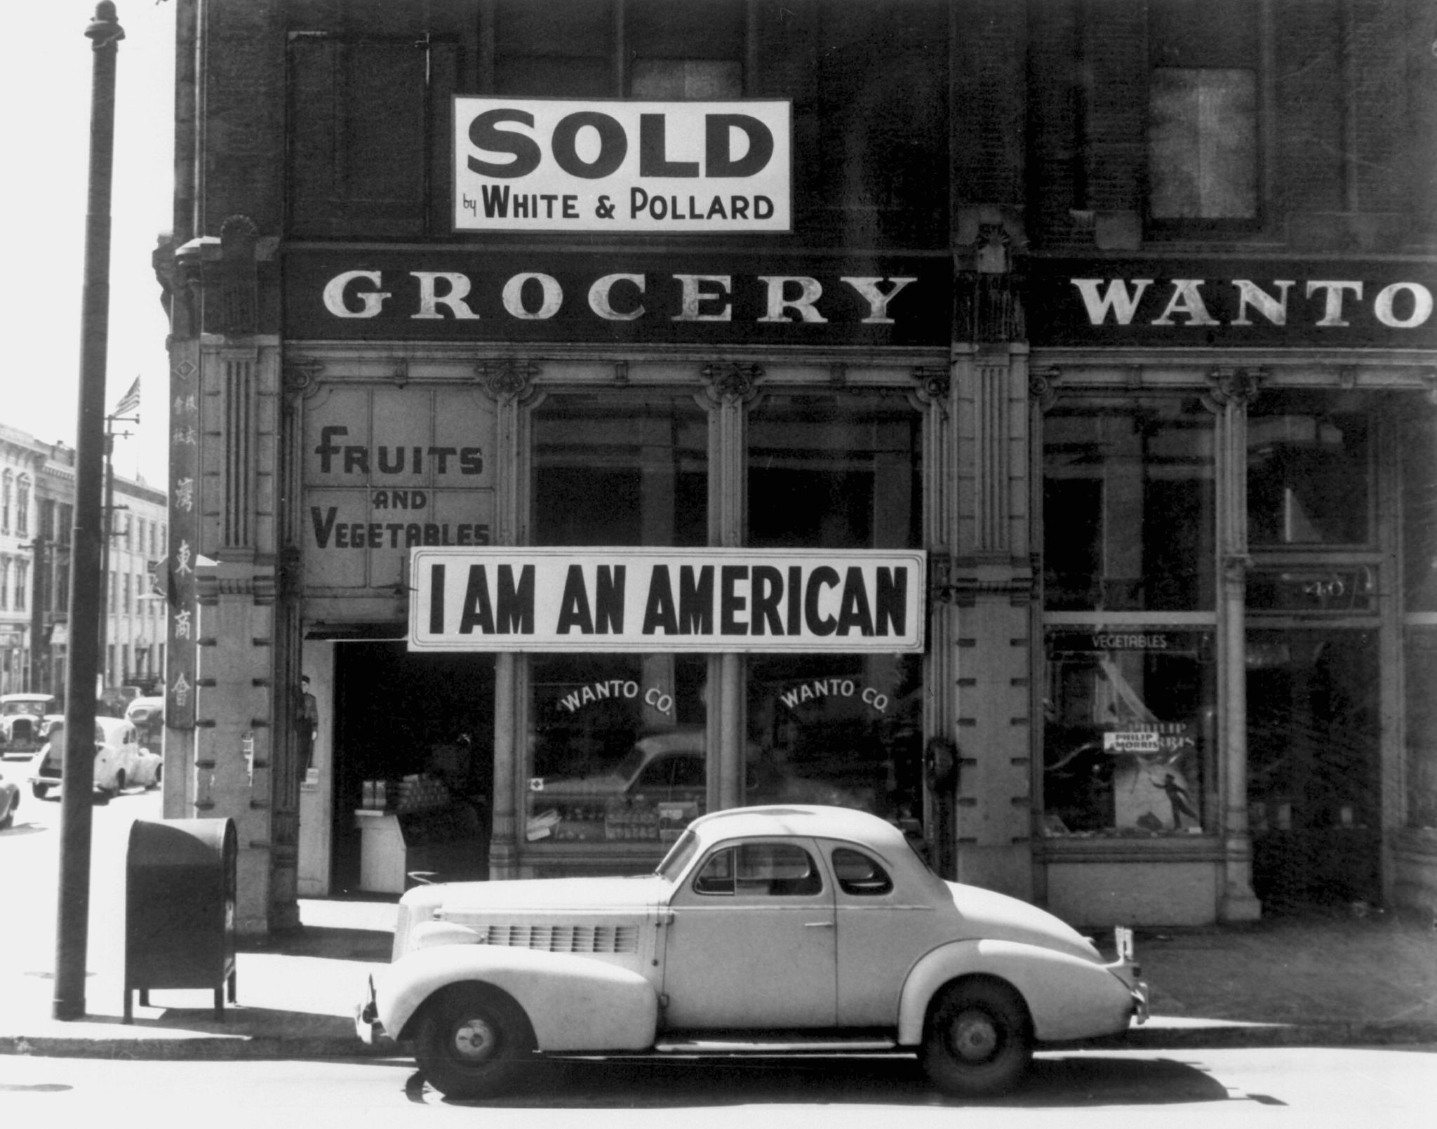
Image 2
Notes:
Source: Lange, D. (1942, March 1). A large sign reading “I Am an American” placed in the window of a store, at 13th and Franklin streets, on December 8, the day after Pearl Harbor. The store was closed following orders to persons of Japanese descent to evacuate from certain West Coast areas. The owner, a University of California graduate, will be housed with hundreds of evacuees in War Relocation Authority Centers for the duration of the war. Oakland, California. Library of Congress Prints and Photographs Division. https://en.wikipedia.org/wiki/Internment_of_Japanese_Americans#/media/File:JapaneseAmericanGrocer1942.jpg

Slide 9
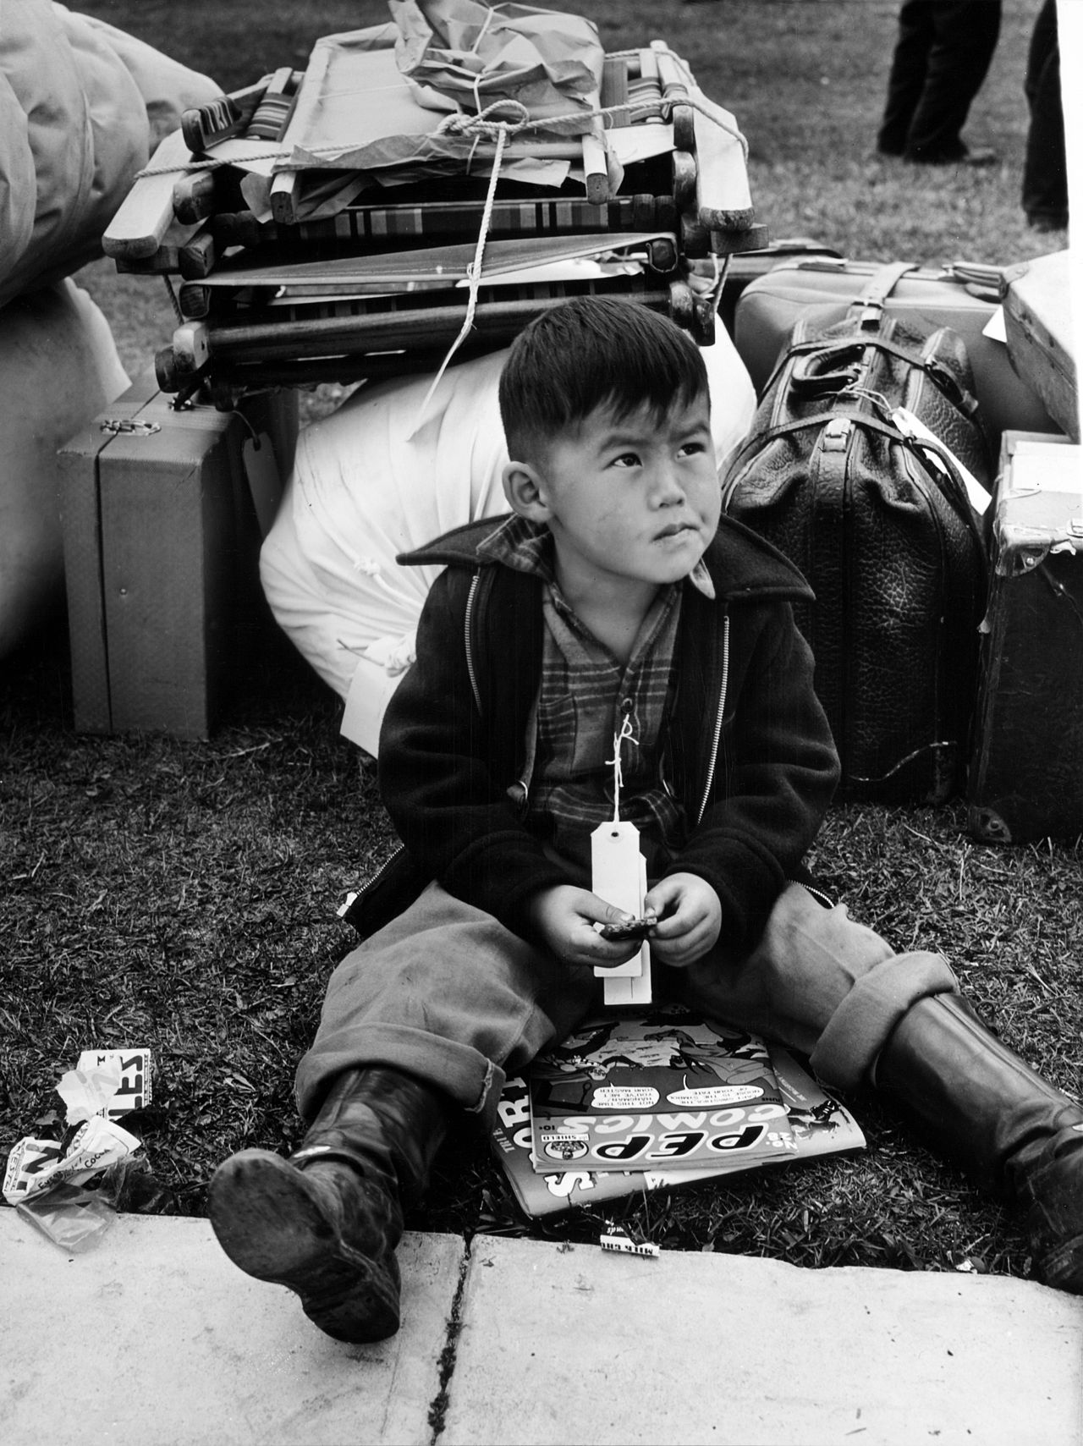
Image 3
Notes:
Lee, R. (1942, May 1). A child is “Tagged for evacuation,” Salinas, California, May 1942. Library of Congress Prints and Photographs Division. https://en.wikipedia.org/wiki/Internment_of_Japanese_Americans#/media/File:Russell_Lee,_Tagged_for_evacuation,_Salinas,_California,_May_1942.jpg

Slide 10
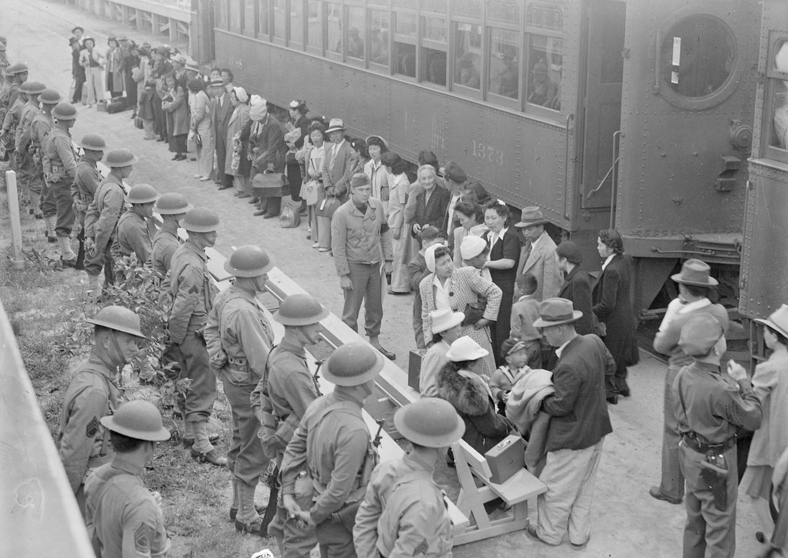
Image 4
Notes:
Albers, C. (1942, April 5). Persons of Japanese ancestry arrive at the Santa Anita Assembly Center from San Pedro. Evacuees lived at this center at the former Santa Anita race track before being moved inland to relocation centers, U.S. National Archives and Records Administration. https://www.archives.gov/research/japanese-americans/wra

Slide 11
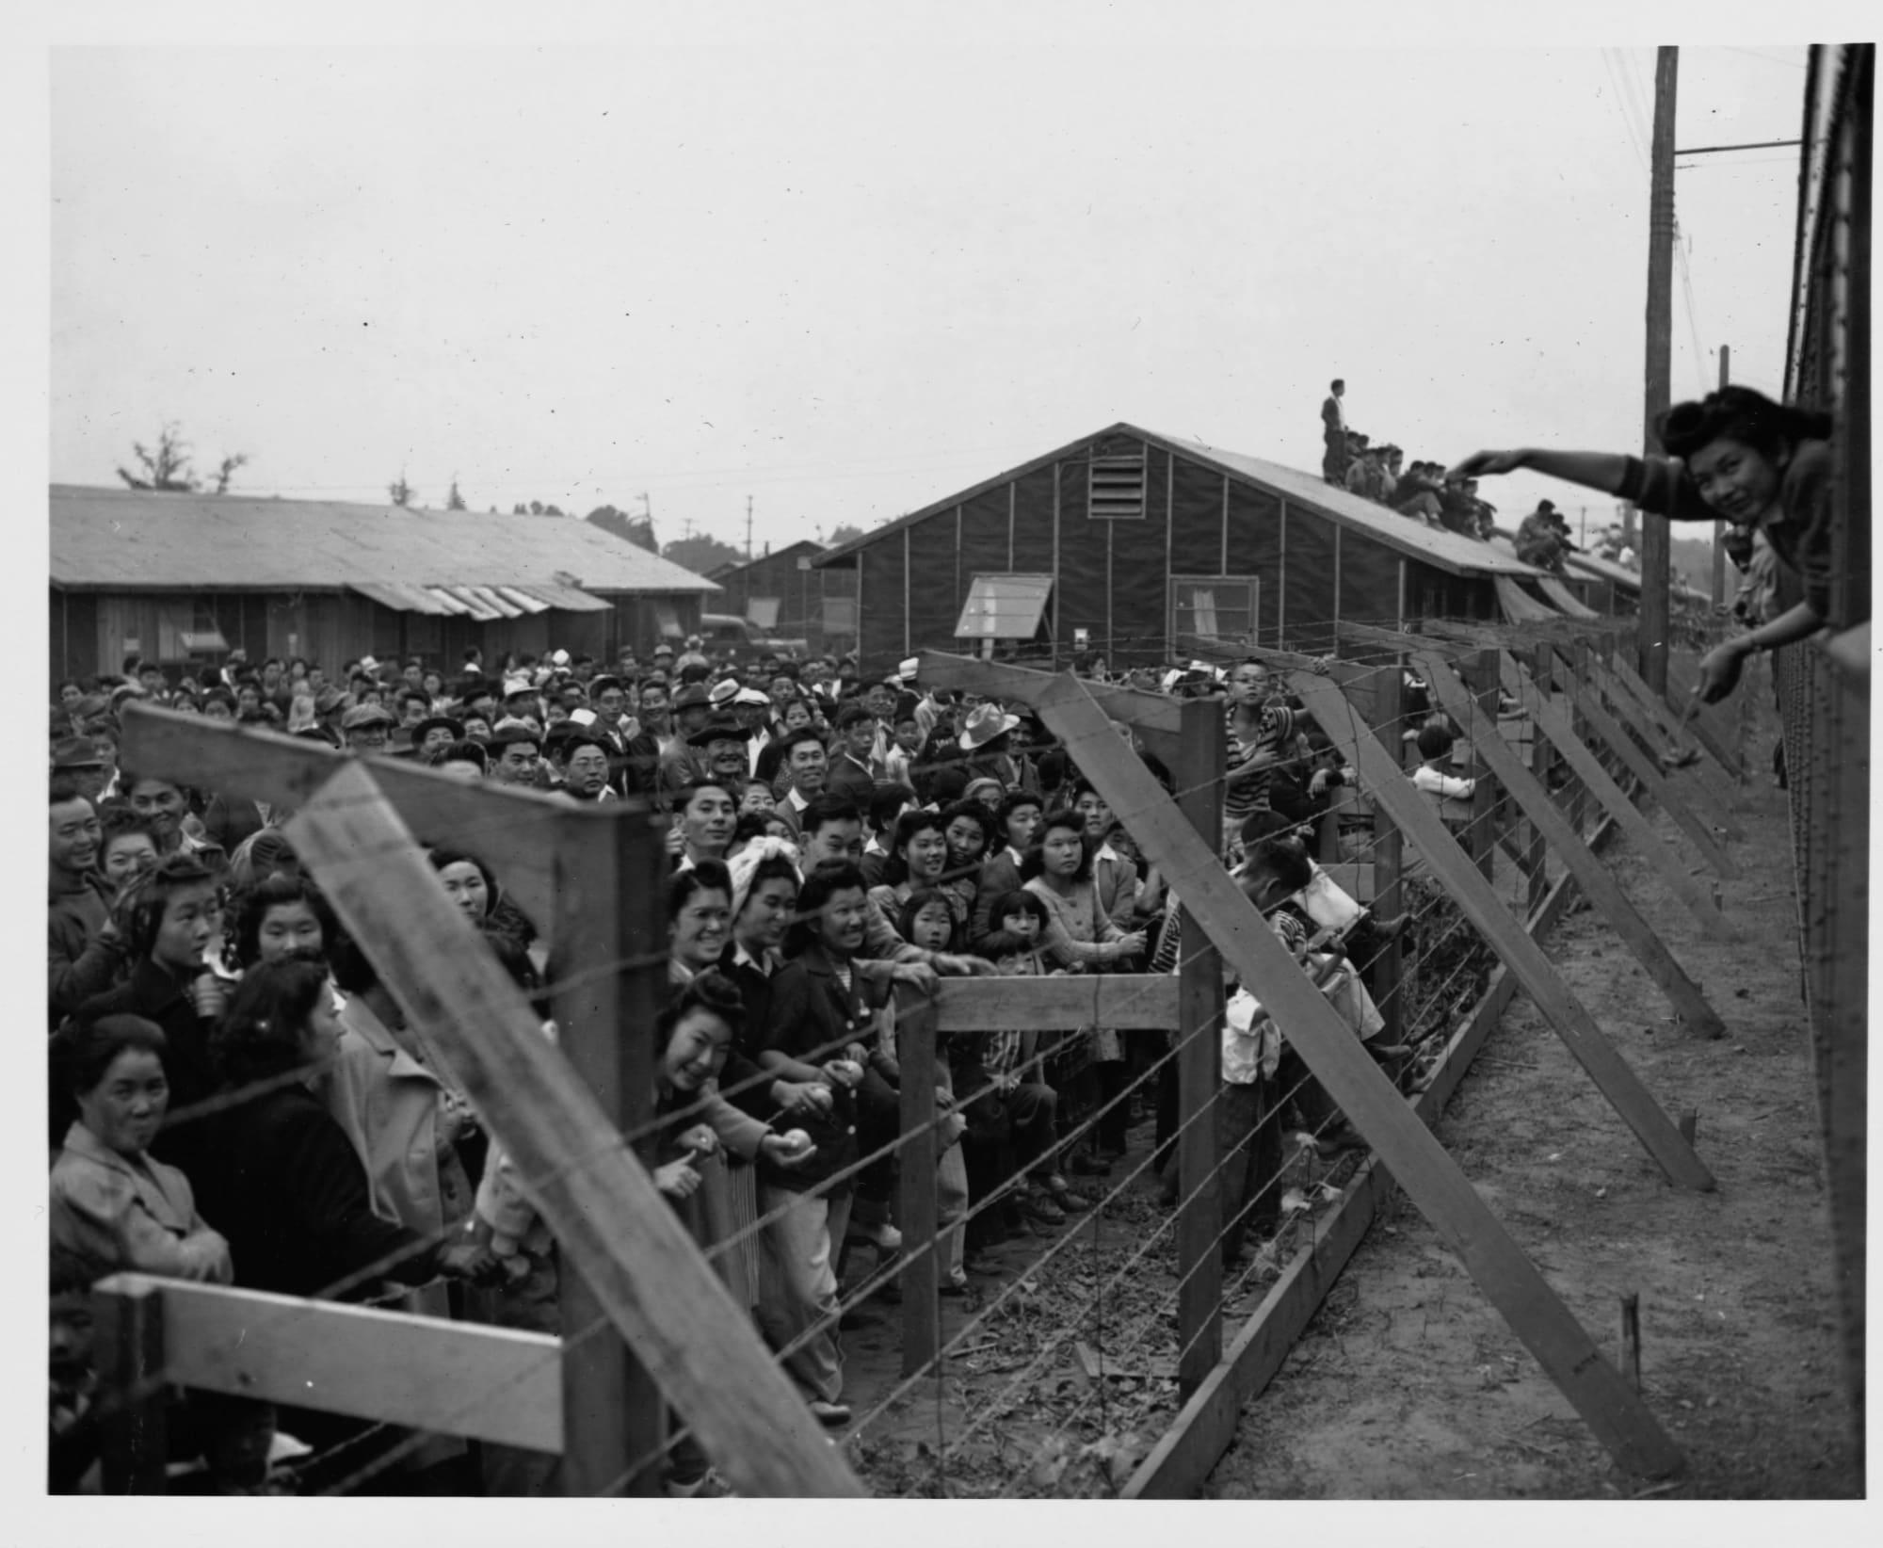
Image 5
Notes:
Fowlkes, J.F. (c. 1942). Crowd behind barbed wire fence waving to departing friends on train. Library of Congress Prints and Photographs Division. https://www.loc.gov/item/2004679931/

Slide 12
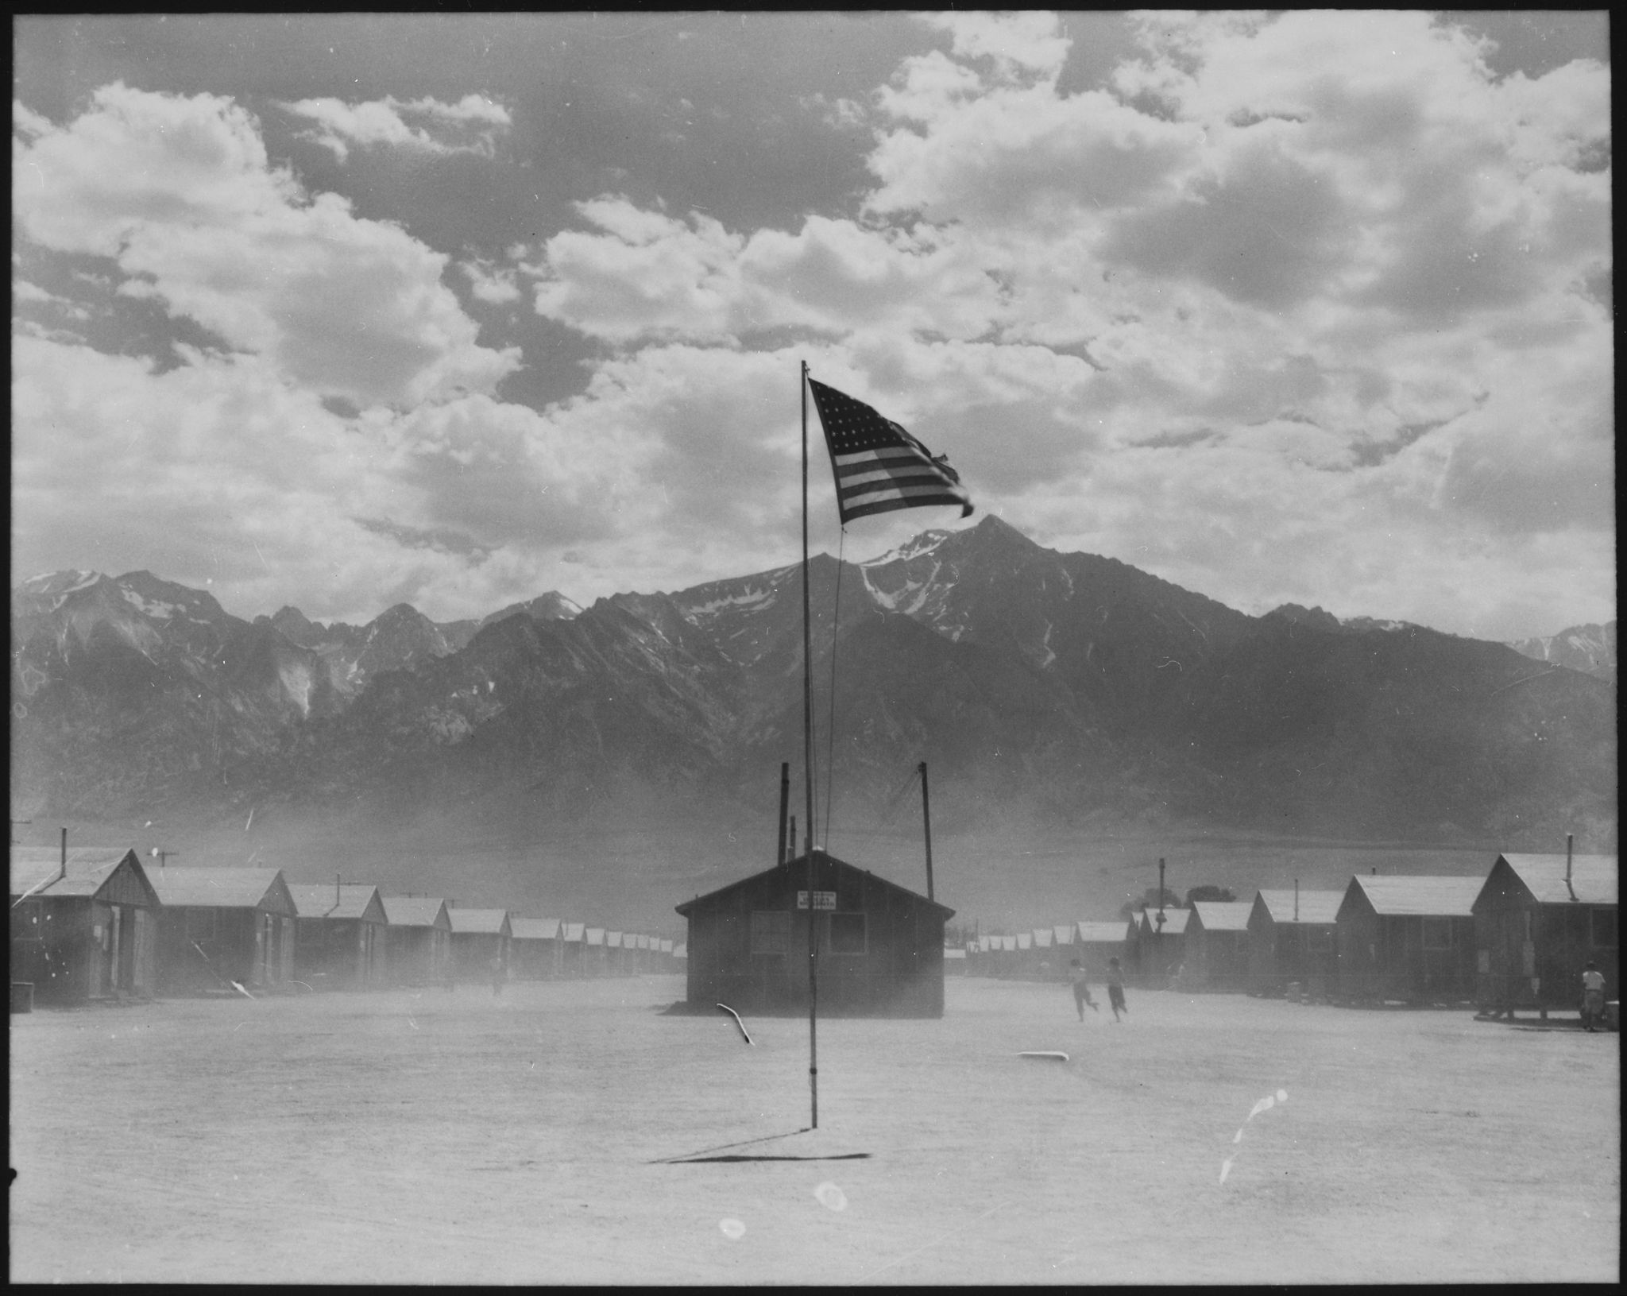
Image 6
Notes:
Unknown author. (1942, April 5). Dust storm at the Manzanar War Relocation Center. U.S. National Archives and Records Administration. https://en.wikipedia.org/wiki/Internment_of_Japanese_Americans#/media/File:%22Persons_of_Japanese_ancestry_arrive_at_the_Santa_Anita_Assembly_Center_from_San_Pedro._Evacuees_lived_at_this_center_at_-_NARA_-_539960.jpg

Slide 13
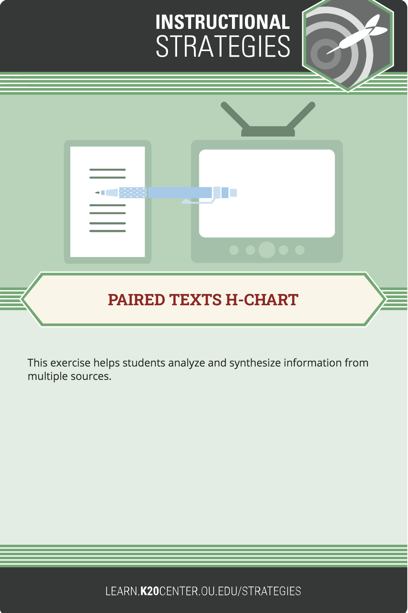
Paired Texts H-Charts
Watch the short video about Japanese American Incarceration Camps.
As you watch, make notes in the left column of the H-Chart to answer the following questions:
  What were the circumstances faced by Japanese Americans?
  How did they react to those circumstances?
Notes:
K20 Center. (2020, September 16). Paired texts H-chart. Strategies. https://learn.k20center.ou.edu/strategy/132

Slide 14
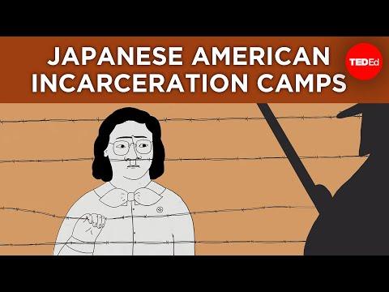
Ugly History: Japanese American Incarceration Camps
Notes:
Ikeda, T. (2019, October). Ugly history: Japanese American incarceration camps. TED-Ed. https://www.ted.com/talks/densho_ugly_history_japanese_american_incarceration_camps?language=en

Slide 15
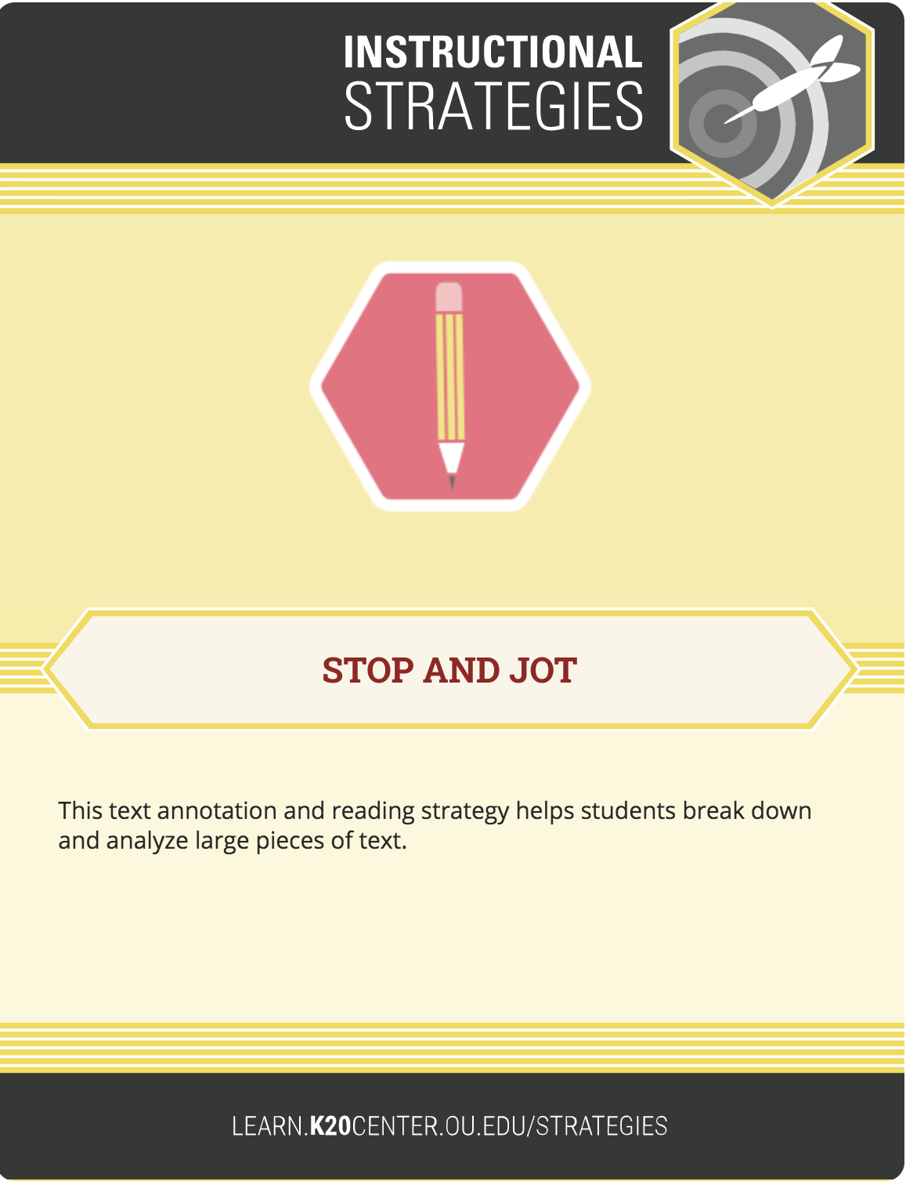
Stop and Jot
Read “The Internment of Japanese Americans during World War II.”
As you read, stop at the end of each paragraph to jot brief answers to the questions on the right side of the article handout.
When you’re finished, enter your most important observations into the right column of the H-chart.
Notes:
K20 Center. (2020, September 16). Stop and jot. Strategies. https://learn.k20center.ou.edu/strategy/168

Slide 16
Paired Texts H-Charts
With your group members, fill in the center of your H-chart.
Write a “third text” that answers the following question: How did Japanese Americans cope with the hardships they faced before, during, and after internment?

Slide 17
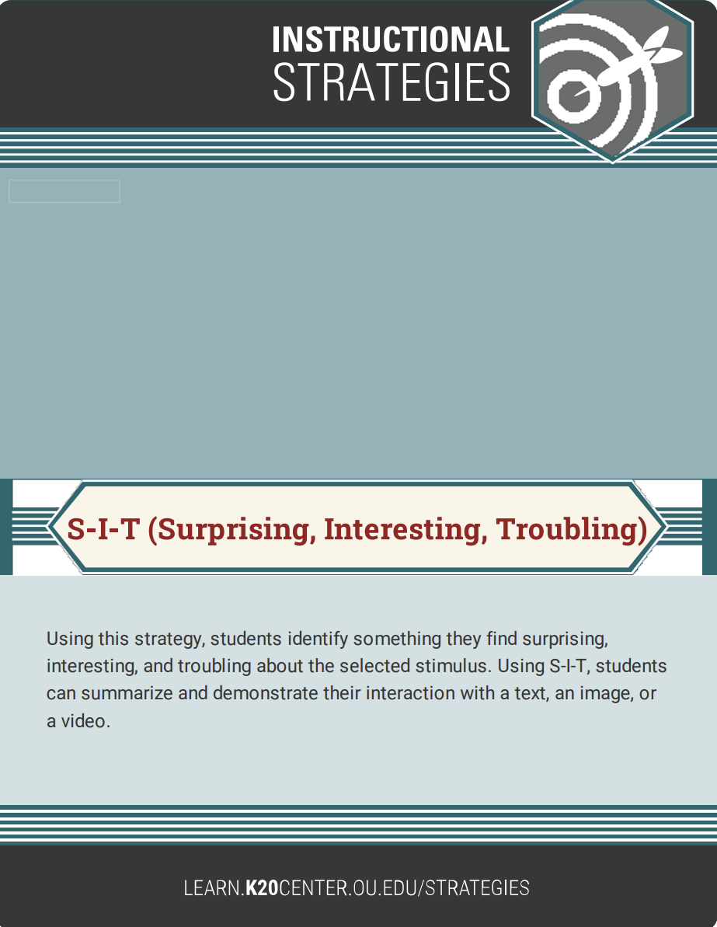
S-I-T (Surprising, Interesting, Troubling)
Take a look at the quotes in the S-I-T handout.
As you read each quote, discuss with your group whether you are surprised, interested, or troubled by what you are reading.
Explain why you feel the way you do.
Notes:
K20 Center. (2021, February 12). S-I-T (Surprising, interesting, troubling). Strategies. https://learn.k20center.ou.edu/strategy/926

Slide 18
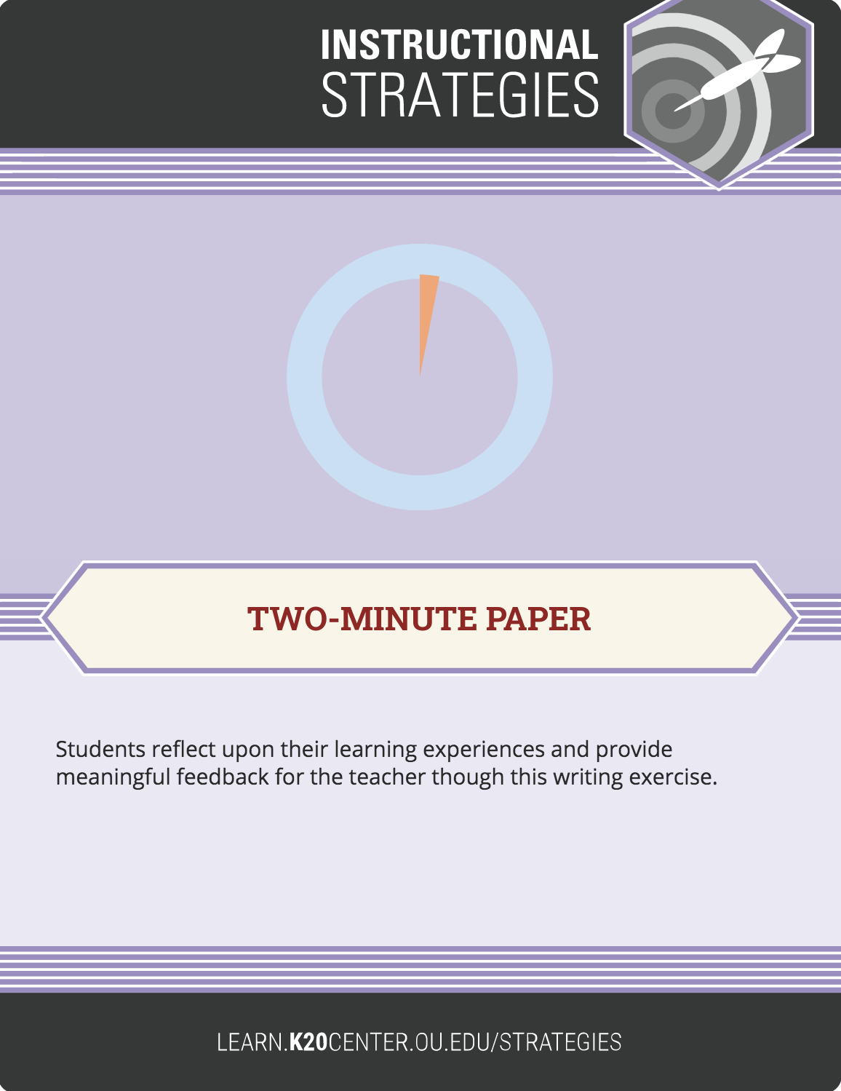
Two-Minute Paper
On a sheet of paper, answer the following two questions to the best of your ability:
  Why were Japanese Americans imprisoned during World War II?
  How did internment alter their lives?
Complete your answer in two minutes.
Notes:
K20 Center. (2020, September 16). Two-minute paper. Strategies. https://learn.k20center.ou.edu/strategy/152

