Slide 2
Oh, MRSA Me!
Biology

Slide 3
Essential Question
What impact does a changing environment have on an organism’s adaptation?

Slide 4
Lesson Objectives
Interpret the correlation between the success of one species having an adverse effect on another species.
Carry out an investigation to detect microorganisms.
Construct an explanation based on evidence for how natural selection leads to adaptation of populations.

Slide 5

Chain Notes
On your sheet of paper write three things you know about bacteria and/or antibiotics.
Notes:
K20 Center. (n.d.). Chain Notes. Strategies. https://learn.k20center.ou.edu/strategy/52

Slide 6
Chain Notes
Choose one of the three points made by your peer, draw an arrow down and add an additional fact, idea, or correction through words or a drawing.
Continue to pass and add to each paper until the paper gets back to the original writer.

Slide 7
Chain Notes
Take 5 minutes to review the comments you received on your paper.
Take another 5 minutes as a group to come up with a summary of what your group knows about bacteria/antibiotics.
Be prepare to share out :)

Slide 8
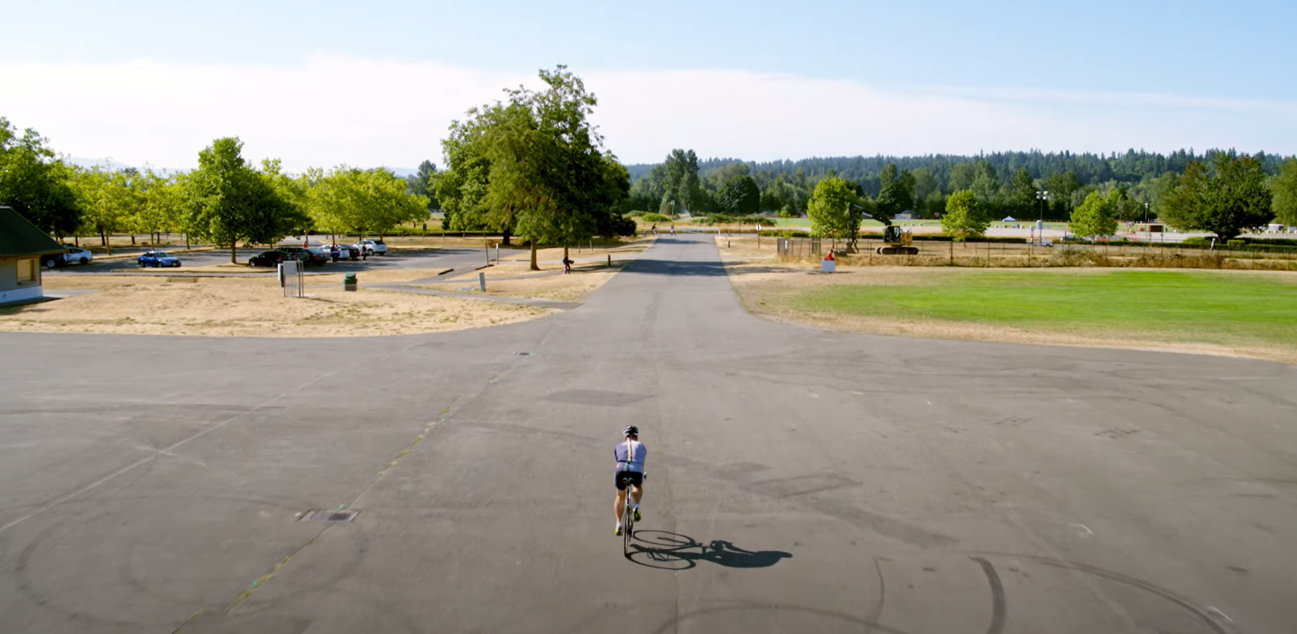

S-I-T: A Superbug Survivor Shares His Struggle with Antibiotic Resistance
Notes:
Pew. (2017). A Superbug Survivor Shares His Struggle with Antibiotic Resistance [Video]. YouTube. https://www.youtube.com/watch?v=2PYY7thzdeM&t=293s

Slide 9

Genes in Space Lab
Complete the lab using the handout
Collect data.
Answer the analysis questions from the handout.

Slide 10
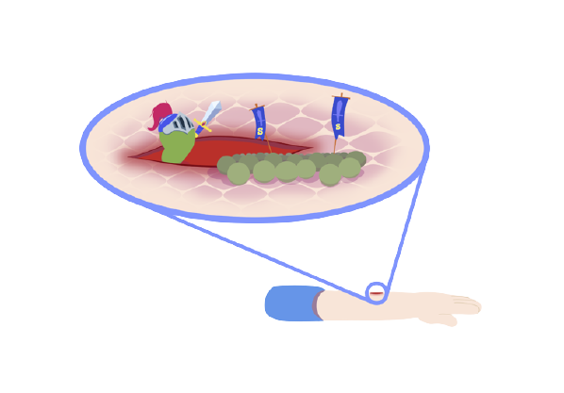
Determining the Effectiveness of Handwashing Lab
Complete the lab using the handout
Collect data.
Answer the analysis questions from the handout.
Notes:
Rokach, W. (1999). Determining the Effectiveness of Handwashing. Summer Research Program for Science Teachers. https://www.scienceteacherprogram.org/biology/Rokach99.html

Slide 11

Telephone
The instructor will pull a student aside to whisper a phrase.
That student will be asked to whisper that same phrase only one time to the next student.
Students will continue to pass the message along until it reaches the last student.
The last student will announce to the whole class what the original phrase was.

Slide 12
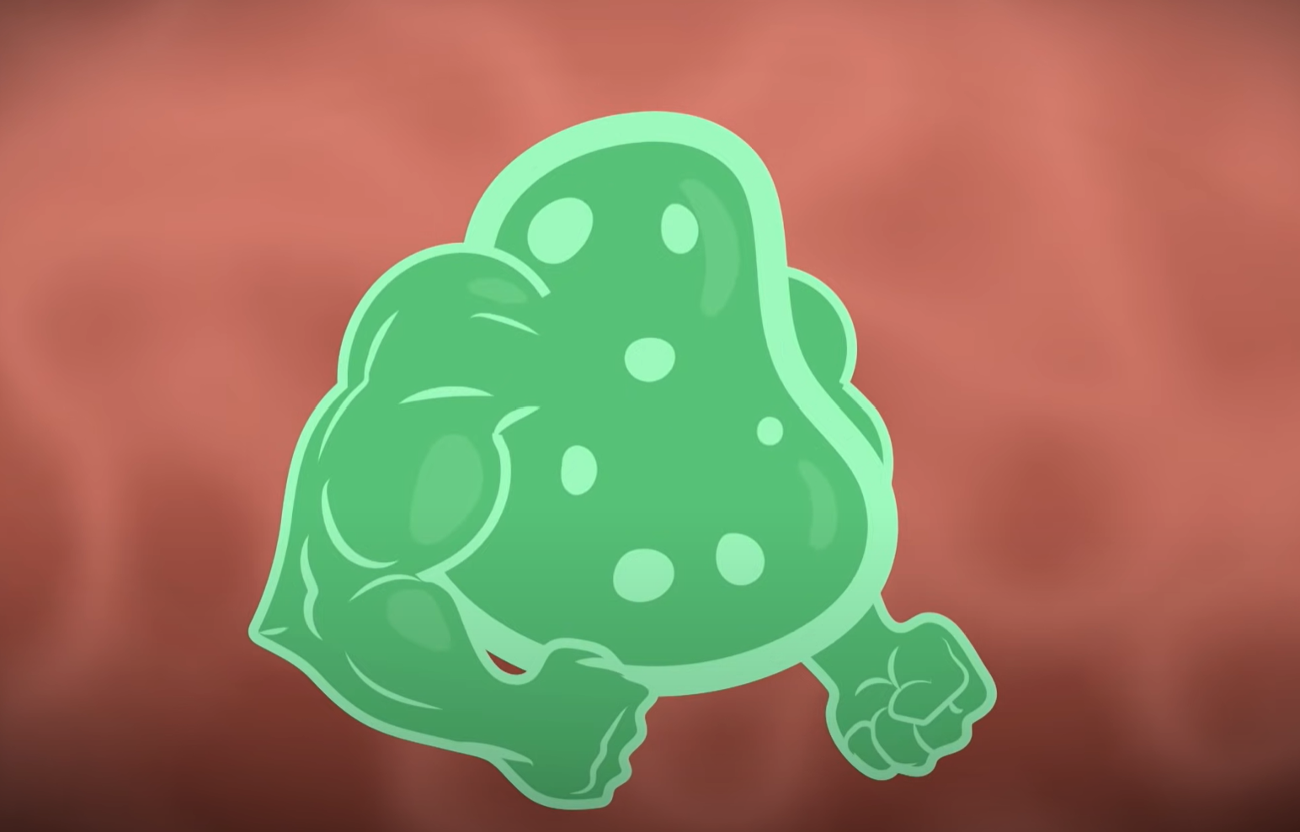
S-I-T
On a sheet of paper, identify the following:
  Two surprising facts or ideas;
  Two interesting facts or ideas;
  Troubling facts or ideas from the video.
Notes:
Be Smart. (2015). Antibiotic Resistance and the Rise of Superbugs [Video]. YouTube. https://www.youtube.com/watch?v=fyRyZ1zKtyA

Slide 13
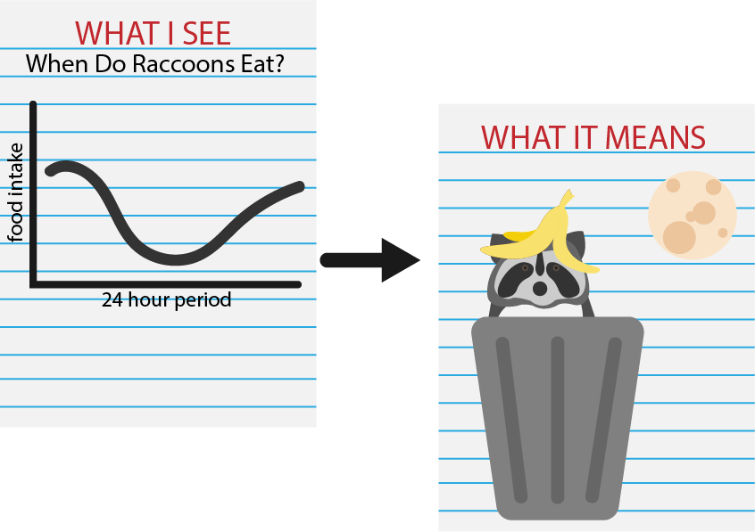
WIS WIM
Today you will be split off into groups to do a WIS-WIM over a graph.
For WIS(What I See)- write three things that you guys' notice.
For WIM(What It Means)- write what those three points mean.
Last create a summary of what is occurring in the graph.
Notes:
Beforehand, read the Biological Sciences Curriculum Study’s teacher instructions for WIS-WIM. Pass out the student instructions on WIS-WIM and walk students through the steps. Next split students off into groups of 3-4 and hand them the graph, butcher paper/4 sheets of copy paper, and tape. Have students tape the graph at the center of the butcher paper or tape the 4 sheets of copy paper together to make a bigger sheet and add the graph to the center. This allows for students to draw arrows out from graph and provide more space to write their WIS-WIM and summary.

Slide 14

Exit Ticket
Write an Exit Ticket over the following question:
What impact does a changing environment have on an organism's adaptation?

