Slide 2
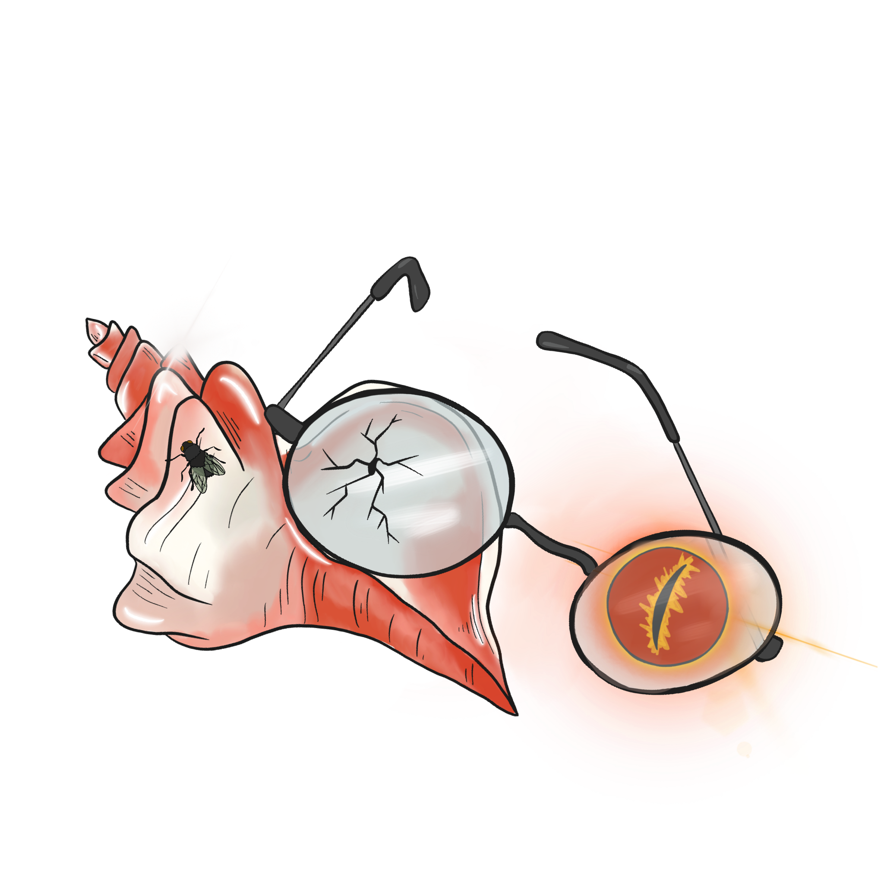
Bad to the Bone
Lord of the Flies Unit Lesson 4

Slide 3
Essential Question:
How does the author use symbolism to develop characterization and theme?

Slide 4
Lesson Objectives
Evaluate character descriptions to answer the question: Are humans inherently good or evil?

Slide 5

Four Corners
Review the quotes posted in the four corners of the room.
Choose which of the quotes you most identify with.
Stand by the quote that resonates with you.
Notes:
https://learn.k20center.ou.edu/strategy/138

Slide 6
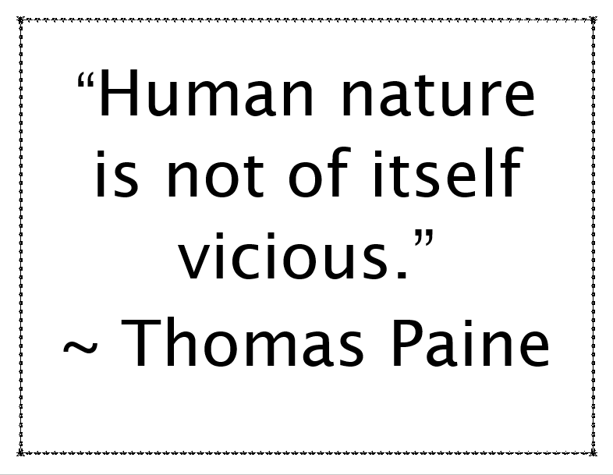

Slide 7
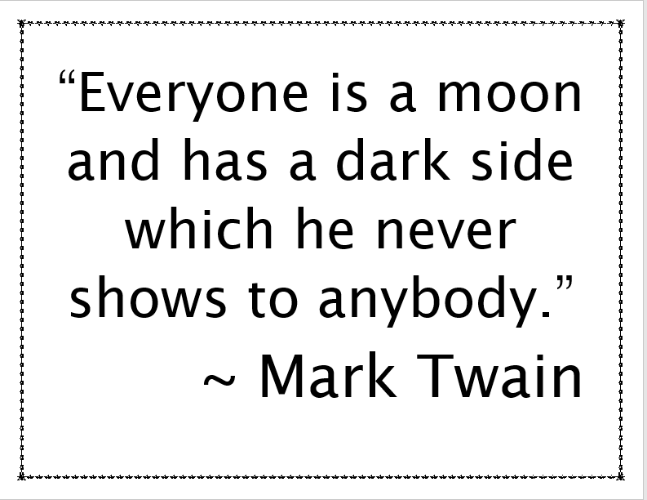

Slide 8
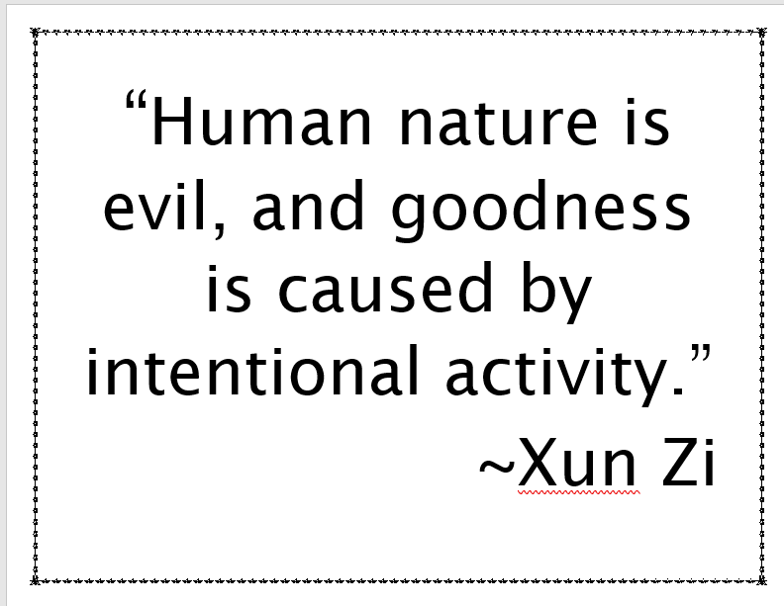

Slide 9
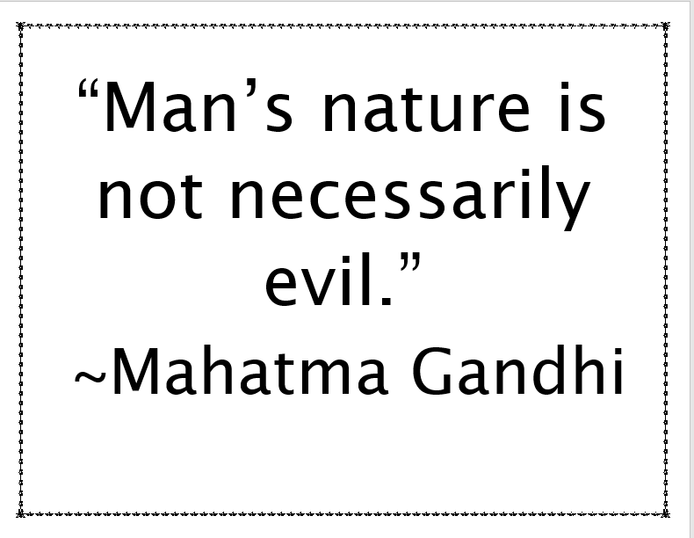

Slide 10
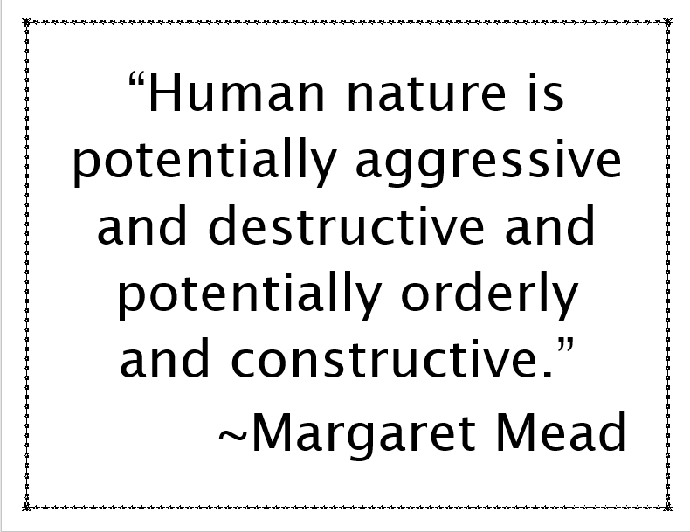

Slide 11
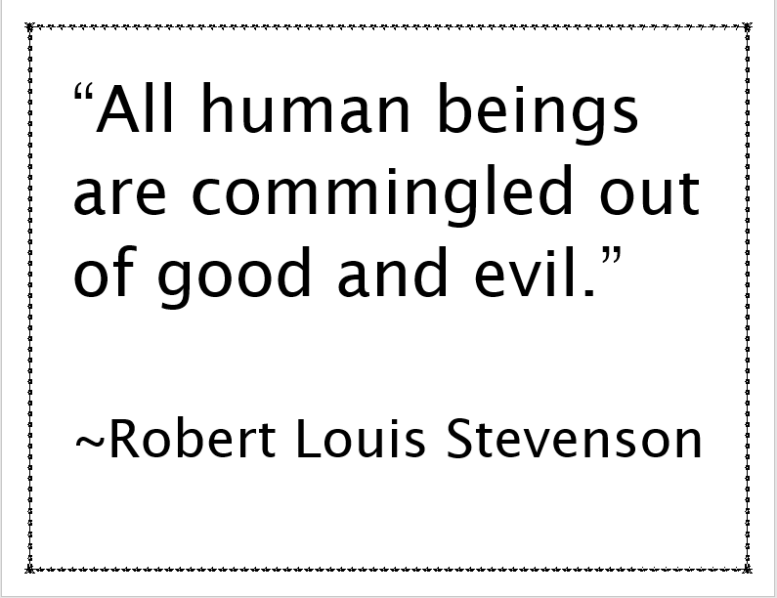

Slide 12
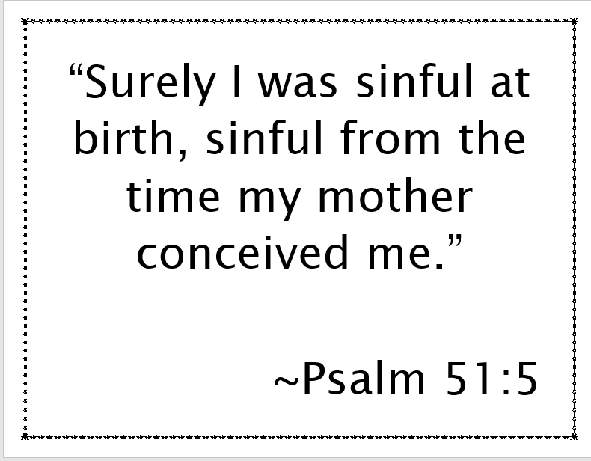

Slide 13
Four Corners
Discuss your reasons for choosing your quote with classmates who selected the same quote.
Be prepared to share out with the whole class.

Slide 14

Why-Lighting
Keeping in mind the Four Corners quotation you selected, read “Behind a Halloween Mask, Even ‘Good Kids’ Can Turn into Candy Thieves.”
As you read, highlight sentences that support your quotation in one color.
Highlight sentences that disprove or disagree with your quotation in a different color.
Notes:
https://learn.k20center.ou.edu/strategy/128)

Slide 15

Four Corners - Debriefing
With your new partners, discuss the following:
Your point of view about your quotation;
Your reasons for choosing that particular quotation;
Evidence you found to support (or disprove) your quotation.
Notes:
debriefing.jpg (151×161) (sqspcdn.com) http://static1.1.sqspcdn.com/static/f/387594/3815206/1249893806443/debriefing.jpg?token=vuKIZF9InOhRvpVGMldJww1wn6M%3D

Slide 16

Four Corners - Debriefing
After reading the article, do you want to select a different quotation?
  If yes, which quote do you want to switch to?
  If yes, why did you choose that quotation over the others?
  If no, why do you want to remain with your original choice?

Slide 17
Human Nature Chart
Analyze the Close Reading excerpts from Lord of the Flies to answer the following questions:
What behavior did the character(s) demonstrate?
What is the context of the behavior?
  Where was the encounter?
  Who was around?
  What is the situation?
What does this tell us about human nature?

Slide 18
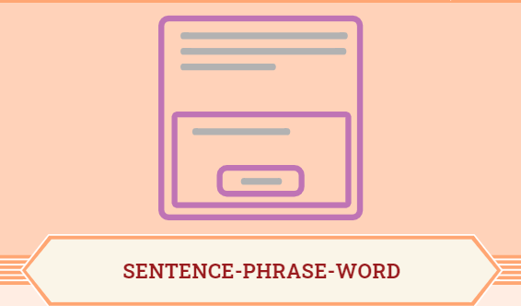
SENTENCE—PHRASE—WORD
Sentence: Share one sentence that describes how you see the characters and events of the novel applied in the real world or in your life?
Phrase: Share one phrase that sticks out to you from either of the two texts you have read:
  Article
  Book
Word: Share one word that captures your conclusion to the question “Are humans inherently good or evil?”

Slide 19

SENTENCE—PHRASE—WORD
Use the Video or Audio Recording option to create a Padlet post sharing your Sentence—Phrase—Word.
Notes:
K20 Center. (n.d.) Padlet. Tech Tools. https://learn.k20center.ou.edu/tech-tool/1077

