Slide 2
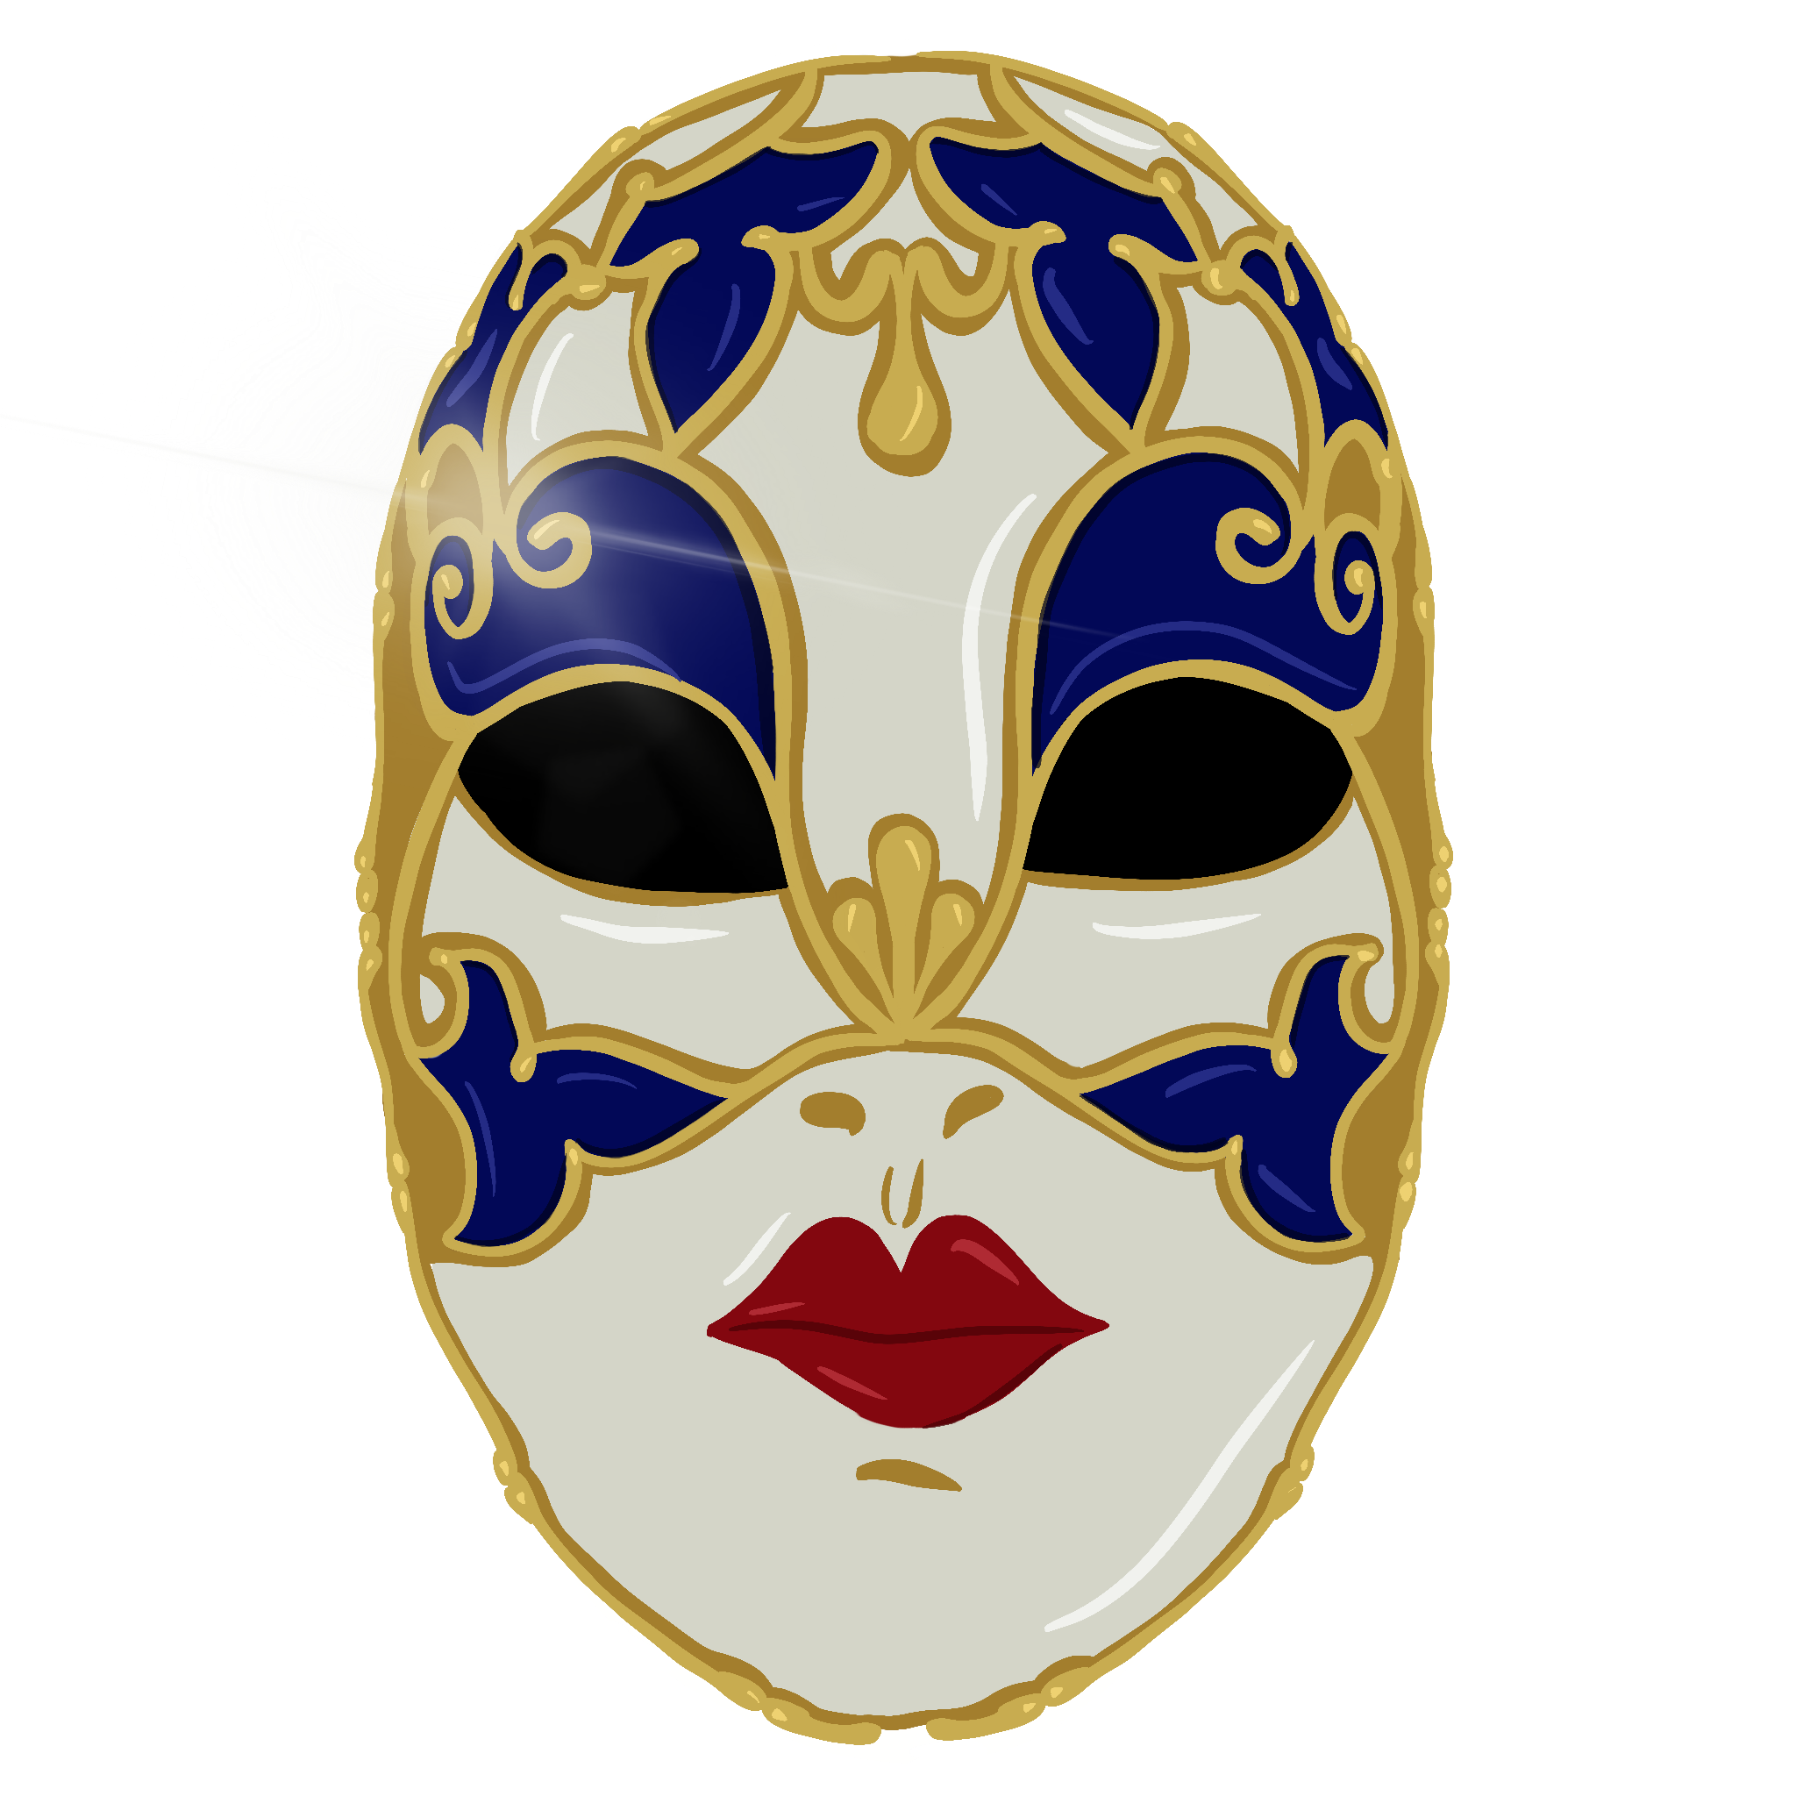
Behind the Mask
Lord of the Flies Unit Lesson 3

Slide 3
Essential Question:
How does the author use symbolism to convey characterization and theme?

Slide 4
Lesson Objectives
Students will be able to research the history of masks across cultures.
Students will be able to create a mask that will represent a character from the text, using textual evidence to support their choices.

Slide 5
I Notice/I Wonder
While watching the video, write down the following:
Observations you make, things that you notice
Questions you still have, things that you wonder about

Slide 7
Elbow Partners
With your elbow partner discuss what is similar and different about what you recorded and add any new questions or observations.

Slide 8
Driving Question Board
Based on your conversation with your elbow partner, what are some questions you have that we can add to the driving question board?

Slide 9
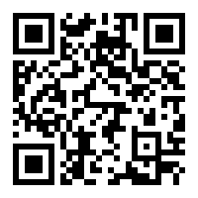
Second Face: Museum of Cultural Masks
Take some time to explore the website Second Face: Museum of Cultural Masks
Continue to add to your I Notice/I Wonder list from earlier, keeping track of your observations
Notes:
https://www.maskmuseum.org/north-american/

Slide 10
Driving Question Research
Choose a driving question and/or mask to research.
Put key information into a Google Slide including:
Image
Where the mask originated
What was the significance of the mask
Answer to the driving question you chose
Links to websites where you found your information

Slide 11
Behind the Mask
Share your Google Slide with your classmates.

Slide 12
Driving Question Board
Are there any questions on the Driving Question Board that we can answer right now?

Slide 13
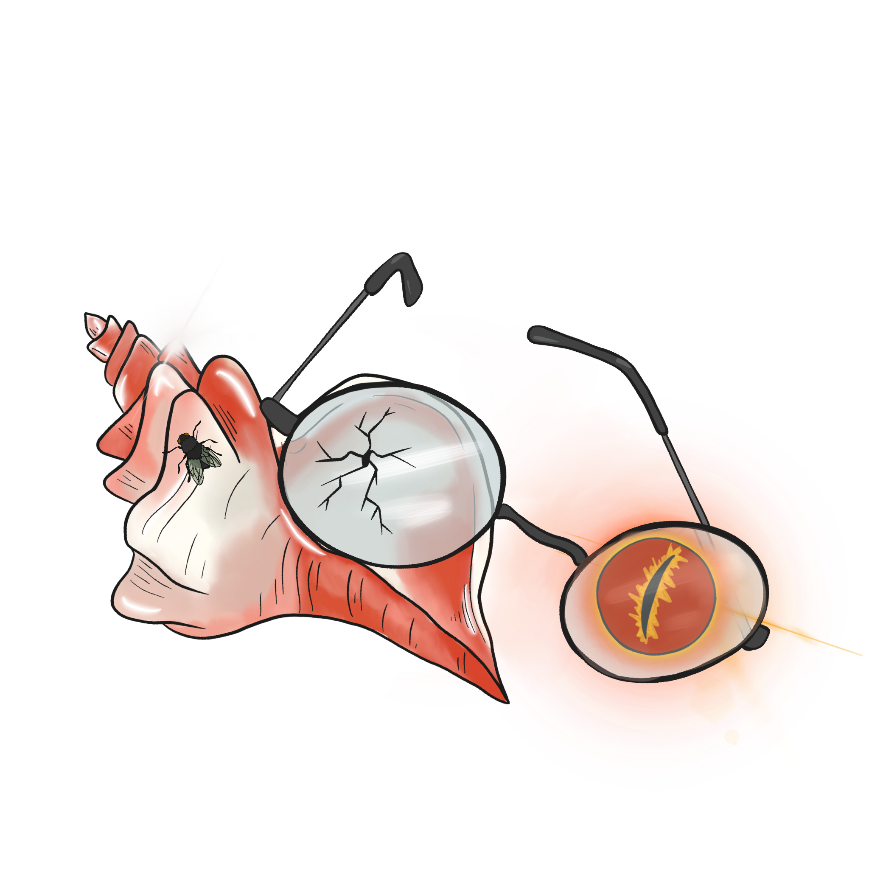
Character Masks
Using the mask template, create a mask for one of the main characters
Make sure to include text based evidence to support your decisions

Slide 14
Personal Masks
Consider how you might decorate a mask for yourself. Write one (1) paragraph and include the following:
Description of how your mask would look
Rationale for why you would include certain elements

