Slide 2
Making Sense With Sequencing
Sequencing of Events

Slide 3
Essential Questions
What happens in the beginning, middle, and end of a story?
Why is sequencing important for comprehension?
How do sequences help us in our everyday lives?

Slide 4
Lesson Objectives
Students will be able to define the term “sequence.”
Students will be able to write a short narrative to describe a procedure using transition words.
Students will understand the importance of sequencing in comprehending a text.

Slide 5

What’s the Order?
Place the story strips in order so the story makes sene to you.
Share your finished story with your Elbow Partner.
  What do you see that is the same? What is different?
  How would you make the stories better?

Slide 6

What helped you put the story in order?
Let’s make an Anchor Chart!
Think about…
What is sequence?
What words help us figure out the sequence of events?

Slide 7
What is a hypothesis?
A prediction or educated guess that can be tested and can be used to guide further study.
Example: When food goes bad, mold can grow on it.
Then, set up a test to see if this is true!

Slide 8


Slide 9
Ada Twist, Scientist
Work with a partner within your team of four.
One pair takes the blue sticky notes, the other pair takes the green sticky notes.
As I read the story, I will stop before turning the page. I will say, “Blue Groups, write an event from this page on your sticky note while the Green Groups listen.”

Slide 10
Ada Twist, Scientist
I will then turn the page and read the next two pages. Then, I will say, “Green Groups, write an event on a green sticky note while the Blue Groups listen.”
Use a new sticky note each time.

Slide 11
Examples
Ada is a baby. She made big messes. She had lots of energy.
Ada was getting bigger but did not talk yet.

Slide 12
Ada Twist, Scientist
With your team of four, mix all the blue and green sticky notes together. Make sure to mix them up well.
Take another sticky note and put everyone’s name on it and place it on the top of the pile.
Use a paper clip to put the pile together.
Give your bundle of sticky notes to me.

Slide 13
Making a Timeline
Choose one person to read the events on the sticky notes out loud.
Place them in order on your desk to make a sequential timeline of the story.
Use 4 or 5 of the small yellow sticky notes using sequence words.
Place the yellow sticky notes within your timelines to help show the order.

Slide 14


Gallery Walk
Walk around the room and look at the other timelines.
Take notes about the differences and similarities.
What sequence words did other teams use?
Notes:
K20 Center. (2021, September 21). K20 Center 10 minute timer [Video]. YouTube. https://youtu.be/9gy-1Z2Sa-c

Slide 15
Class Discussion
How important is the sequence in a story?
Are there any new ideas we should add to our Anchor Chart?
What other sequence words could be helpful when writing a story?

Slide 16
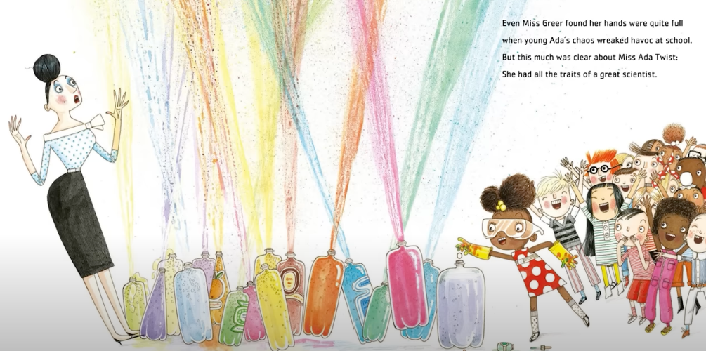
Why do you think doing science can be messy?

Slide 17
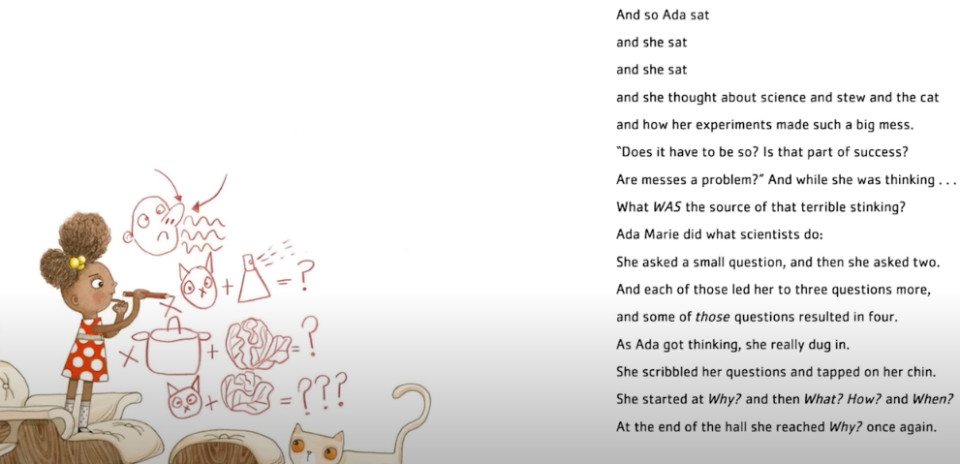
How do you think that writing down ideas and questions might provide Ada with new ways to find answers to her questions?

Slide 18
Engineering Design Process
ASK
What is the challenge?
Are there requirements or limitations?
What do we know already?
IMPROVE
Study the test results.
Modify the design to make it better.
Test it again.
IMAGINE
Brainstorm possible solutions.
Consider design options.
CREATE
Build a solution based on your plan.
Test it out.
PLAN
Choose the best plan.
Draw a picture.

Slide 19
Engineering Challenge
Build the tallest tower to hold an object without falling.
Work in groups of two.
Both cups and sticks must be used (but no more than provided).
_____-minute time limit
The object must stand on top of the tower for at least 15 seconds without falling.

Slide 20
Writing Your Narrative
Using your group’s list of steps, write a narrative to tell someone else how to build your tower.
Make sure to use proper sequence words throughout your narrative.
Now, switch papers and have someone test your building instructions to see how they work.
You can adjust your narrative before handing it in.

