Slide 2
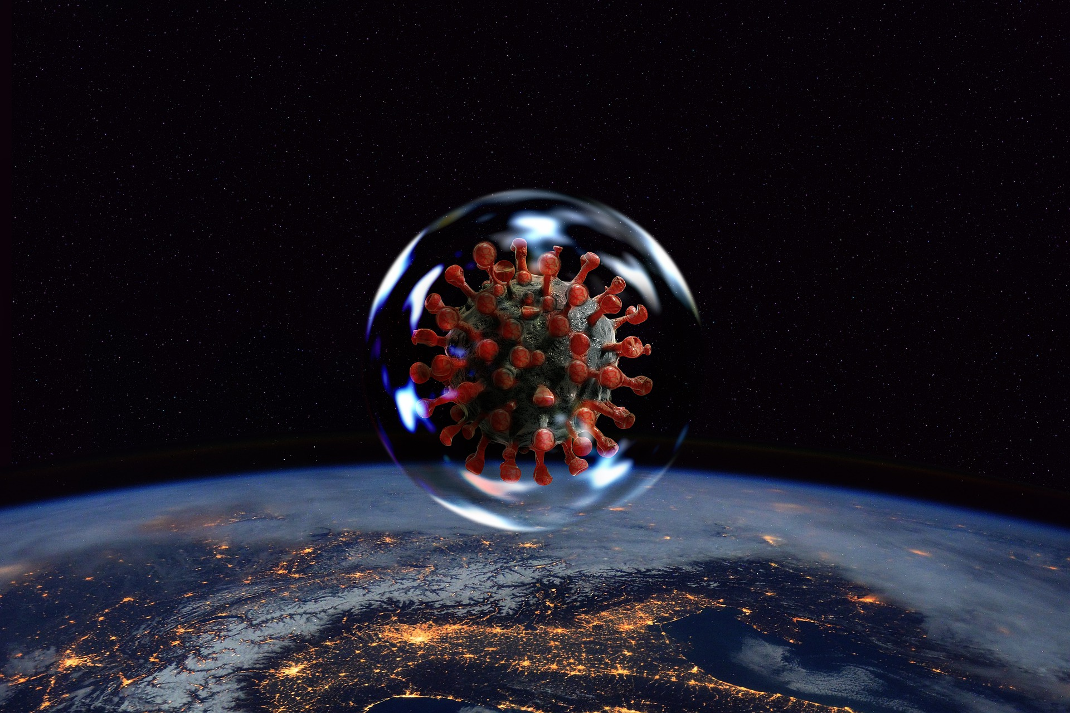
Got Culture?
Zoonotic Diseases

Slide 3

Bell Ringer
Before we begin today’s lesson, answer the following questions to the best of your knowledge:
If there were a pandemic/zombie apocalypse, why should we choose you for our survival team?
What causes diseases?
What diseases can people get from animals?
Notes:
K20 Center. (n.d.). Bell ringers and exit tickets. Strategies. https://learn.k20center.ou.edu/strategy/125

Slide 4
Essential Questions
What are zoonotic diseases?
What factors lead to their spread in human populations?

Slide 5
Learning Objectives
Identify human diseases and their vectors.
Distinguish between bacteria and viruses.

Slide 6

Who is David Quamen?
David Quammen is a science writer and the author of Spillover Animal Infections and the Next Human Pandemic, which was published in 2012.
Listen to the Interview: David Quammen: How Animal-Borne Infections Spill Over To Humans
Notes:
K20 Center. (n.d.). I notice, I wonder. Strategies. https://learn.k20center.ou.edu/strategy/180
Quammen, D. (2020, March 28). David Quammen: How Animal-Borne Infections Spill Over to Humans. (S. Simon, Interviewer) NPR. https://www.npr.org/2020/03/28/823071230/david-quammen-how-animal-borne-infections-spill-over-to-humans

Slide 7

TIP Chart
On the second page of your Breakout handout, document the vocabulary you learn during the Breakout.
In the Information column, define the term.
In the Picture column, paste or draw a picture of the species.
Add any additional terms below the pre-populated terms.
Notes:
K20 Center. (n.d.). TIP chart. Strategies. https://learn.k20center.ou.edu/strategy/185

Slide 8

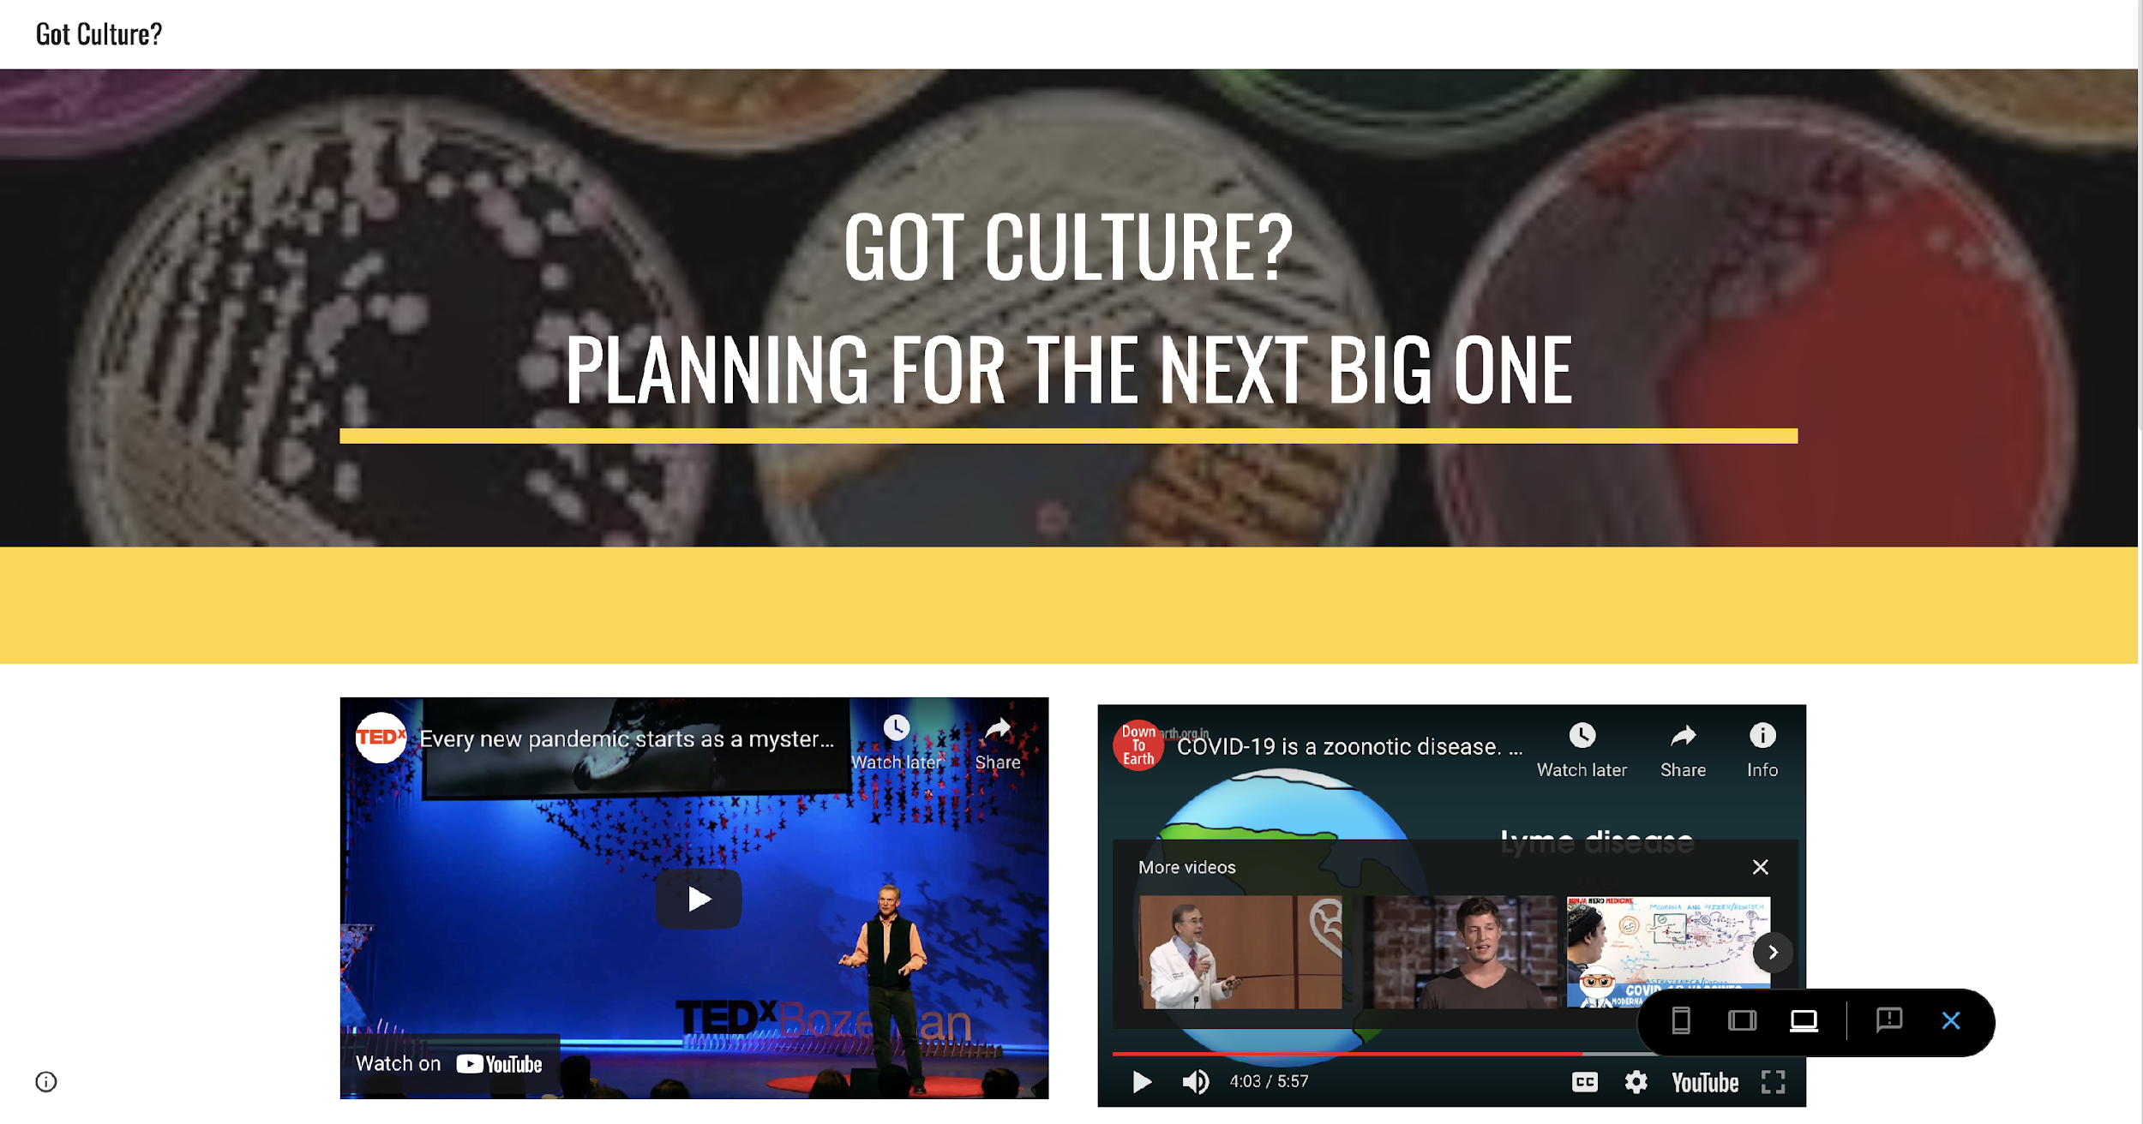
Zoonotic Disease Digital Breakout
k20.ou.edu/fo

Slide 9
TIP Chart Debrief
What definitions will we use for the terms?
After the Breakout, what are you still wondering about?
Notes:
K20 Center. (n.d.). TIP chart. Strategies. https://learn.k20center.ou.edu/strategy/185

Slide 10

Anchor Chart
With a partner, use what you have learned from the breakout and the discussion to create an Anchor Chart.
Use pictures, words, and diagrams to communicate important information about zoonotic diseases.
Notes:
K20 Center. (n.d.). Anchor chart. Strategies. https://learn.k20center.ou.edu/strategy/58

Slide 11
Zoonotic Disease
Research your chosen zoonotic disease and create a webpage about that disease.
Be sure to include the following details:
  History of the first spillover
  Infectious agent and hosts
  Symptoms
  Data points (CFR, R₀, Incubation period, etc.)
  Pictures

Slide 12

Exclaim and Question
Exchange web pages with another pair.
Read through their entire web page.
  Share 2 strengths you have discovered.
  Share 2 questions you have.
Based on the feedback, make final edits to your web page.
Notes:
K20 Center. (n.d.). Exclaim and question. Strategies. https://learn.k20center.ou.edu/strategy/94

