Slide 2
Map It Out
Elements of a Map

Slide 3
Essential Question
What is the purpose of a map?

Slide 4
Lesson Objective
Explain the elements of a map.

Slide 5
I Notice, I Wonder
Examine the map of Oklahoma and think
about the following:
What two things did you notice about the map?
What are two things that you wonder about the map?
Share your thoughts with your partner.
Notes:
K20 Center. (n.d.). I Notice, I Wonder. Strategies. https://learn.k20center.ou.edu/strategy/180

Slide 6
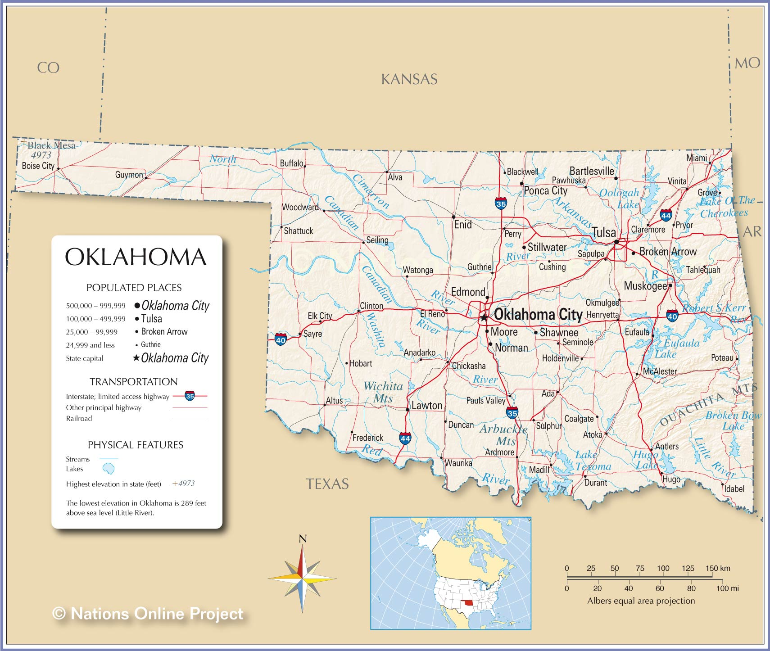

Slide 7
Map Scavenger Hunt
Locate the white box. Discuss the information found there.
Locate two states that border Oklahoma.
Locate one mountainous area.
Locate one lake.
Locate one river.
Locate one interstate.
Locate the highest and lowest elevations.
Locate one city with a population of 24,999 or less.
Explain why the dots beside the city names are different sizes.

Slide 8
Map Vocabulary
Key/Legend: An explanatory list of the symbols on a map or chart.
Map Scale: A ratio which compares a measurement on a map to the actual distance between locations identified on the map.
Compass Rose: A circle or decorative device printed on a map or chart showing the points of the compass measured from true north and usually magnetic north.
Notes:
Merriam-Webster. (n.d.). Legend Definition & Meaning. https://www.merriam-webster.com/dictionary/legend
Collins Dictionary. Definition of "map scale“. https://www.collinsdictionary.com/us/submission/12477/%E2%80%9Cmap+scale%E2%80%9D
The Free Dictionary. Farlex. (n.d.). Compass Rose. https://www.thefreedictionary.com/compass+rose

Slide 9
Map Vocabulary
4. Cardinal Directions: Four chief directions of the compass: north, south, east, and west points.
5. Intermediate Directions: Directions on the compass that are halfway between cardinal points: northeast, southeast, southwest, and northwest.

Slide 10
Mapping the Classroom
Create a map of your classroom and include the following information:
Key: Use symbols and colors to represent objects.
Compass Rose: Include cardinal and intermediate directions.
Title: Give your map an accurate title.
Scale: Create a scale.
Classroom furniture: Include desks, tables, etc.
Other objects: Include anything else important in your classroom.

Slide 11
What Did You Learn Today?
Write down a summary of the information you have learned in today’s lesson.
Think about what is included on maps.
Why is it important to have that information included?

