Slide 1
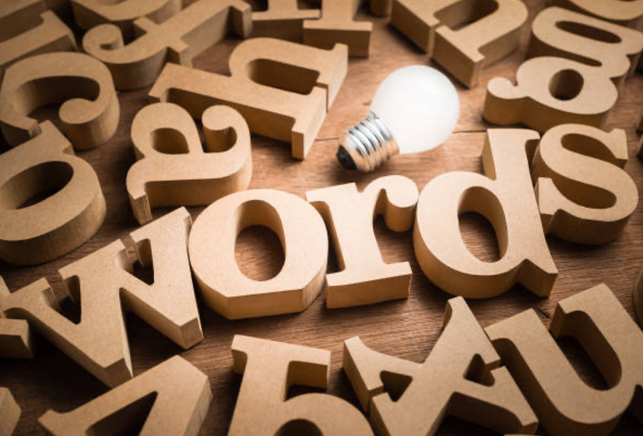
What’s In A Word?
Lesson by Chrissy Waldhoer
Notes:
https://www.istockphoto.com/photo/words-have-power-gm1166859687-321593953

Slide 2
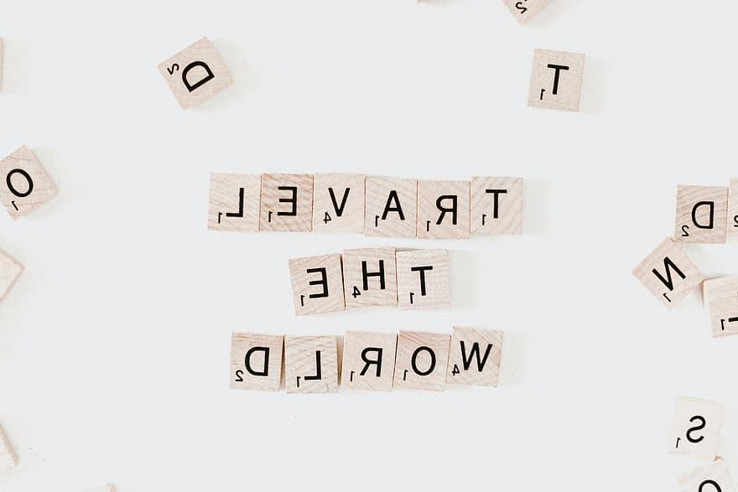
What could it mean?
Word Identification
Check out these words from around the world!
Notes:
https://images.unsplash.com/photo-1561651188-d207bbec4ec3?ixid=MnwxMjA3fDB8MHxwaG90by1wYWdlfHx8fGVufDB8fHx8&ixlib=rb-1.2.1&auto=format&fit=crop&w=2574&q=80

Slide 3
Turn and talk:
What do you notice?
What do you recognize?
What could it mean?
FRENCH
Hyperactif Hypothèse Monopole Mythologie

Slide 4
Turn and talk:
What do you notice?
What do you recognize?
What could it mean?
GERMAN
Auto Mytho Bakterien Biologie

Slide 5
Turn and talk:
What do you notice?
What do you recognize?
What could it mean?
ITALIAN
Paranormale Disapprovare Supereroe qualità

Slide 6
Why did you know the meaning of some of the words?
What did the words have in common?

Slide 7
Word
Parts
Exploration

Slide 8
dentist optometrist
artist therapist
quarterfinalist traditionalist
educationalist biologist
What do these words have in common?
Do they share a similar meaning?

Slide 9
intercept intersection
interstate interconnected
international interim
interactive interject
What do these words have in common?
Do they share a similar meaning?

Slide 10
corrupt abrupt
eruption rupture
disruption bankrupt
interrupt incorruptible
What do these words have in common?
Do they share a similar meaning?

Slide 11
The following two slides are examples that you can use to show students how to break down words. 1. Break down a well-known word 2. Break down a large American word into its word parts 3. Practice in groups breaking down more words
Word Part Breakdown
Notes:
http://www.lifewiththequirkyboys.com/wp-content/uploads/2016/10/Excuse-1024x953.jpg

Slide 12
untouchable
PREFIX ROOT SUFFIX
touch
able
un
“not”
“Come into contact with”
“Capable of”

Slide 13
pneumonoultramicroscopicsilicovolcanoconiosis
pneumo------ lungs
ultra------beyond
micro-----tiny
scop-----see
ic---------relating to
silica(o)-hard colorless compound, main component of many rocks
Volcano-----mountain or hill from which lava erupts
coniosis-----any disease caused by inhalation of dust
*Longest word in most English dictionaries

Slide 14
Common Words to break down
discover
nonviolent
underestimated
hopeless
helpful
microscope
semifinalist

Slide 15
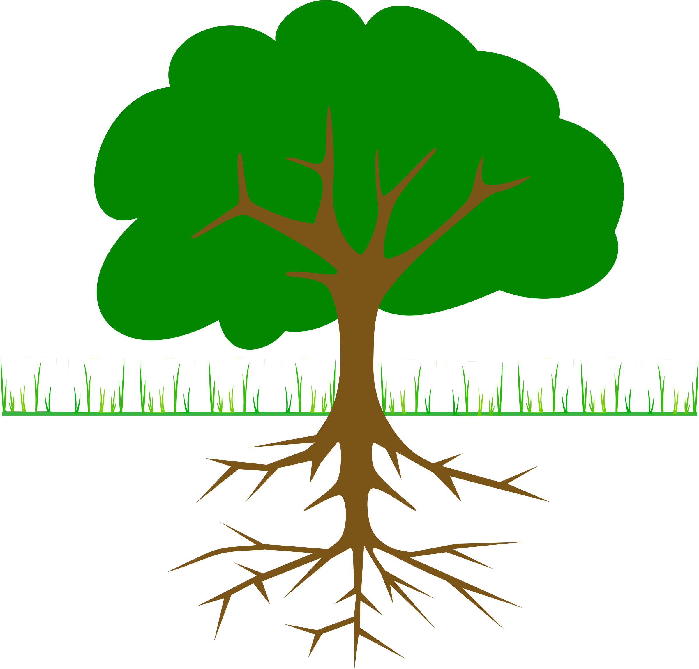
Common Roots and Affixes
Determine the meaning of words using roots and affixes
Notes:
tree https://openclipart.org/image/2400px/svg_to_png/90025/tree-branches-and-root-01r.png

Slide 16
Level 1
anti- against
con- with
dis- not
equi- equal
micro- small
mono- one
pre- before
re- again
sub- below
tri- three
auto self
Chrom color
chron time
geo earth
hydro water
phon sound
rupt break
struct build
tele distant
therm heat
-ed past tense
-er more
-est. most
-for resembling, shape
-ful full of
-less without
-logy study of
-s, -es more than one

Slide 17
Level 2
ambi- both
anti- against
con- with
dis- not
equi- equal
hyper- over
macro- large
micro- small
mono- one
poly- many
pre- before
re- again
sub- below
super- above
tri- three
auto self
bio living
chrom color
chron time
geo earth
hydro water
ject throw
phon sound
photo light
port carry
rupt break
scrib write
spect see
struct build
tele distant
therm heat
-able,-ible can be done
-ed past tense
-en made of
-er more
-est most
-form resembling, shape
-ful full of
-less without
-logy study of
-ment action, process of
-ness condition of
-ous has qualities of
-s, -es more than one
-tion act, process of

Slide 18
Level 3
a-, an-, un- not
ambi- both
anti- against
bi-, di- two
con- with
dis- not
equi- equal
exo-, exter- outside
hyper- over
inter- between
macro- large
micro- small
mis- wrongly
mono- one
poly- many
pre- before
re- again
semi- half
sub- below
super- above
tri- three
auto self
bio living
chrom color
chron time
dict speak
duct lead, pull
geo earth
Graph, gram write
hydro water
ject throw
meter measure
phon sound
photo light
port carry
radio beam, ray
rupt break
scrib write
spect see
struct build
tele distant
therm heat
-able, -ible can be done
-al has qualities of
-ate cause to be
-ed past tense
-en made of
-er more
-est most
-form resembling, shape
-ful full of
-ic like
-ist person who
-less without
-logy study of
-ment action, process of
-ness condition of
-or, -er one who
-ous has qualities of
-s, -es more than one
-tion act, process of

Slide 19
How do we determine the meaning of a word through its word parts?
“I Used to Think, But I Now I Know”
Complete a lesson reflection. Remember to give some examples.

