Slide 2
Conservation 101
Humans Impact the Earth: How students can be part of the solution?

Slide 3
Essential Question
How can we as humans reduce our impact on Earth?

Slide 4
Lesson Objectives
Obtain and combine information about ways individual communities use science ideas to protect the Earth's resources and environment.
Generate and compare multiple possible solutions to a problem based on how well each is likely to meet the criteria and constraints of the problem.

Slide 5
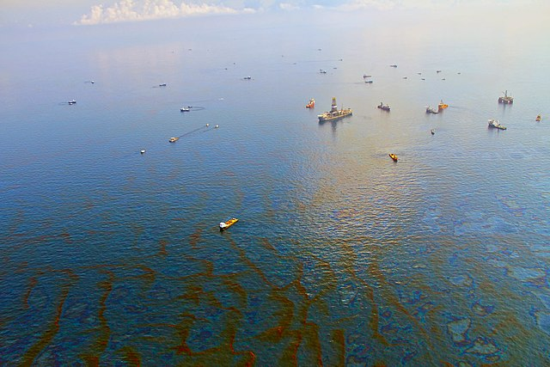
What do you notice? What do you wonder?
Notes:
Kuzey Gunesli. (2021). Deepwater Horizon Oil Spill Aerial Image. Commons. https://commons.wikimedia.org/w/index.php?search=oil+spill&title=Special:MediaSearch&go=Go&type=image. Creative Commons Attribution-Share Alike 4.0.

Slide 6
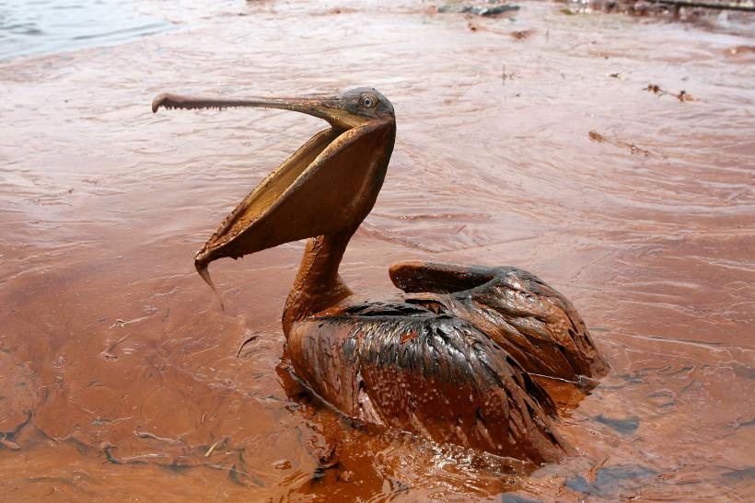
What do you notice? What do you wonder?
Notes:
Sean Gardner. (2016). The massive oil spill off the U.S. coast in 2010 nearly ruined BP, CEO Bob Dudley said in an interview Friday. Pictured: An oil-covered brown pelican sits in a pool of oil along Queen Bess Island Pelican Rookery, Grand Isle, Louisiana, June 5, 2010. [Photograph]. https://www.ibtimes.com/us-gulf-oil-spill-nearly-killed-bp-chief-bob-dudley-says-2246810

Slide 7
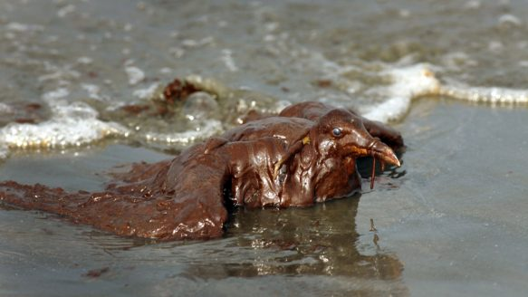
What do you notice? What do you wonder?
Notes:
Carolyn Cole. (2010). Still alive but practically unrecognizable, a sea gull is paralyzed by oil on the beach at East Grand Terre Island in Barataria Bay, Louisiana. Oil continues to pour into the area, which is a breeding area for wildlife. [Photograph]. https://www.thestar.com/photos/from_the_photo_desk/2010/06/gulf-oil-spill-takes-toll-on-wildlife-.html

Slide 8
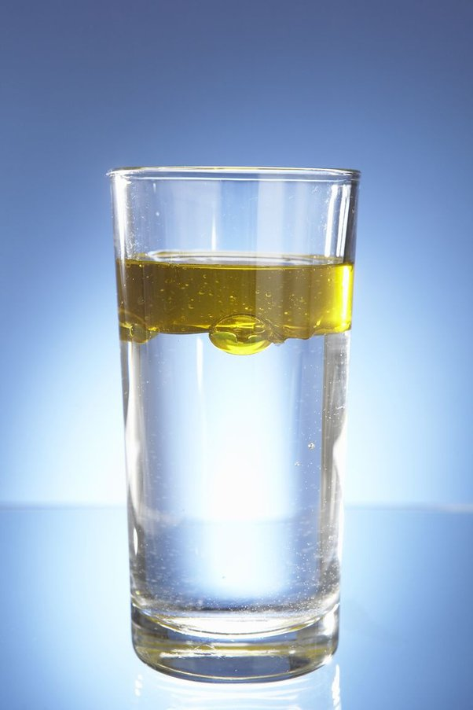
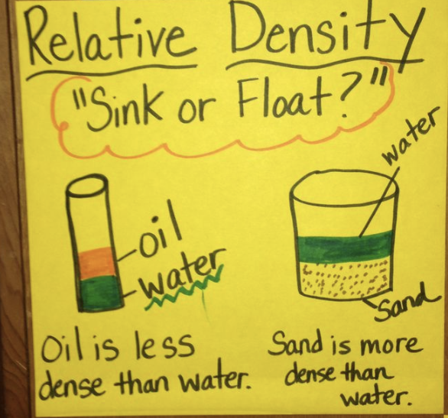
Properties of Oil
Notes:
Adrastea Phelion. (2018). Oil in cup of water [Photograph]. https://www.quora.com/What-will-happen-if-petrol-is-mixed-with-water-and-stirred

Slide 9
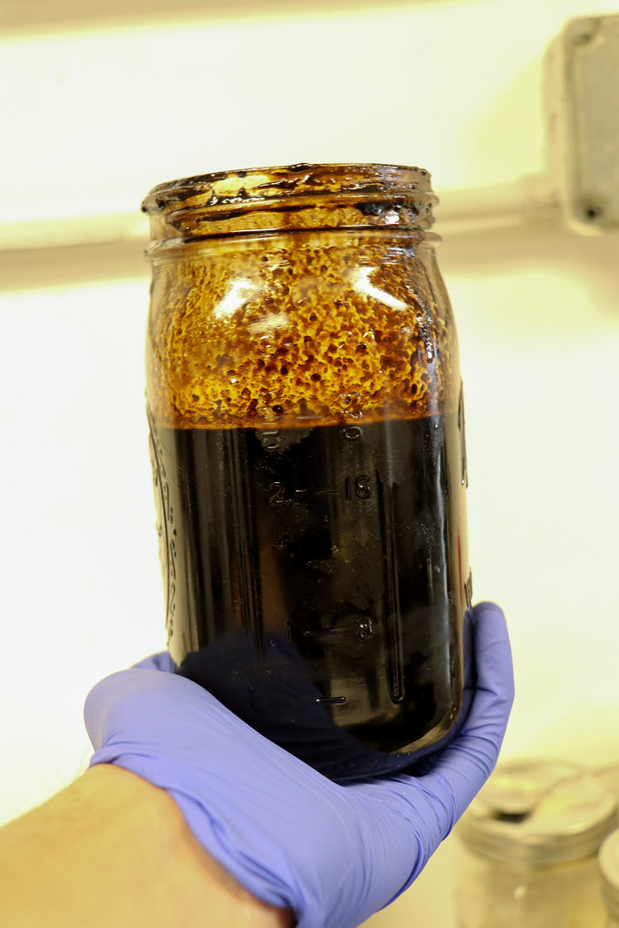
What is Crude Oil?
Crude oil is a thick, dark liquid found deep underground. It is a fossil fuel, formed from the remains of plants and animals from millions of years ago. We pump crude oil out of the ground and use it to make products like gasoline and plastic. Sometimes we pump oil up from under the ocean. Crude oil is very thick and sticky.

Slide 10
Cleaning Up
Think about the properties of oil.
What do you think would be the hardest part of cleaning up an oil spill?

Slide 11
Steps
Fill a pan halfway with water.
Pour about ¼ of a cup of oil into the water. Since crude oil is not safe for us to work with, we will be using cooking oil.
Use a feather(s) to simulate the wildlife. Place the feather into the oil. The feather and water are what you will clean.
Create a plan for your clean-up task. Use the supply list to determine what you need for your plan.
Get your supplies and start to work. Make sure to record on your data sheet what is working and what is not.
Have all supplies in the trash or the clean-up bucket when time is called.
Make sure to leave your ocean and wildlife out to be assessed and for the group discussion.

Slide 12
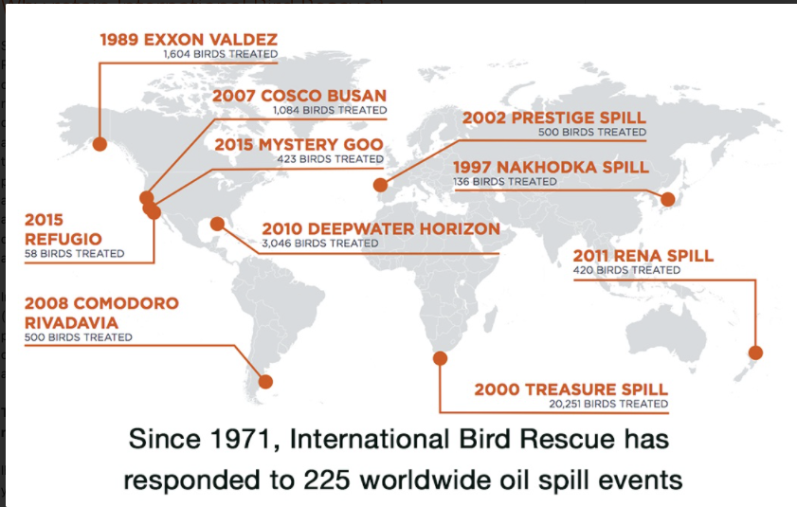
Oil Spills Around the World
Notes:
Bird Rescue. (n.d.). Map of oil spills [Digital Image]. https://www.birdrescue.org/wp-content/uploads/2020/12/bird-rescue-major-response-spill-map.jpg

Slide 13
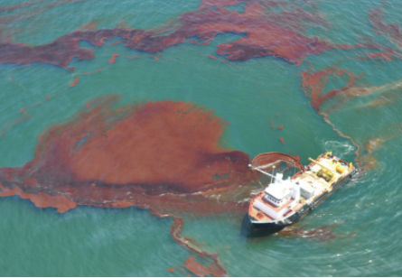
How would you clean this up?
Notes:
EcoWatch. (October 2021). Boat in oil spill [Photograph]. https://www.ecowatch.com/wp-content/uploads/2021/10/738327313-origin-1024x576.jpg

Slide 14
Essential Question: How can we as humans reduce our impact on Earth?
Pollution Problems
Oil spill pollution
Air pollution
?
?
?
?
?
Use a Jigsaw to share information.

Slide 15
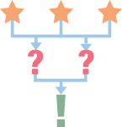
Using a 3-2-1 to record and share your information.
3- things you learned about your topic
2- questions you have about this topic
1- way humans can help prevent this type of pollution

Slide 16
Think about these questions during the class discussion.
How can people prevent damage from oil spills and other types of pollution?
How do you play an important role in the impact on our Earth.
How can we help protect our Earth?

Slide 17
2 Paragraph Summary
1st paragraph
Was there something you would change in your experiment to have a better outcome of cleaning the oil?
Is there a material or tool that you feel would have worked better or one you would have liked to test? Why?
How did this experience relate to a real-life oil spill?
2nd paragraph
Write about how you play an important role in the impact on Earth.
How can you help make things better?

Slide 18
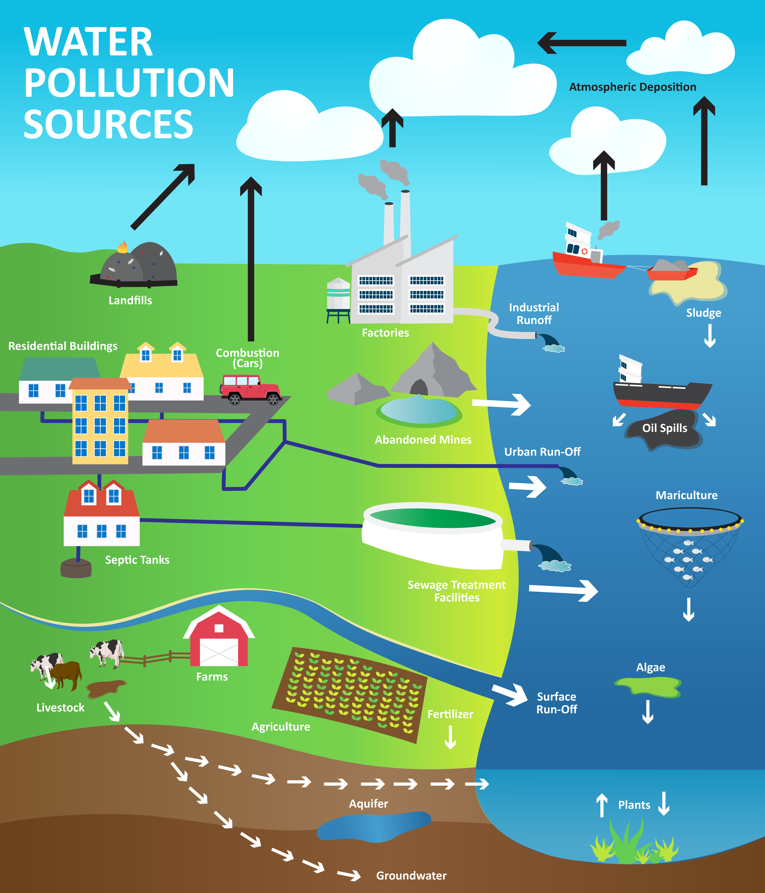
Notes:
K20 Center Graphic

Slide 19
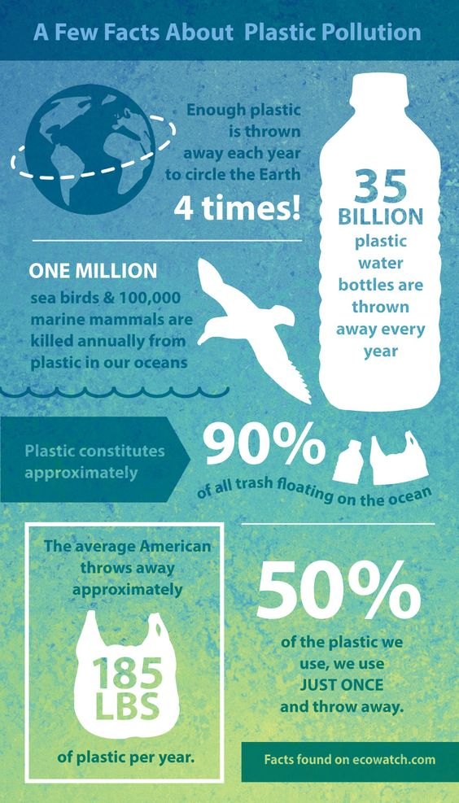
Notes:
PngImg. (n.d.). Plastic Pollution [Infographic]. https://i.pinimg.com/564x/a5/0a/4e/a50a4e54e34dfffe1e23ebf207b15f1e.jpg

Slide 20
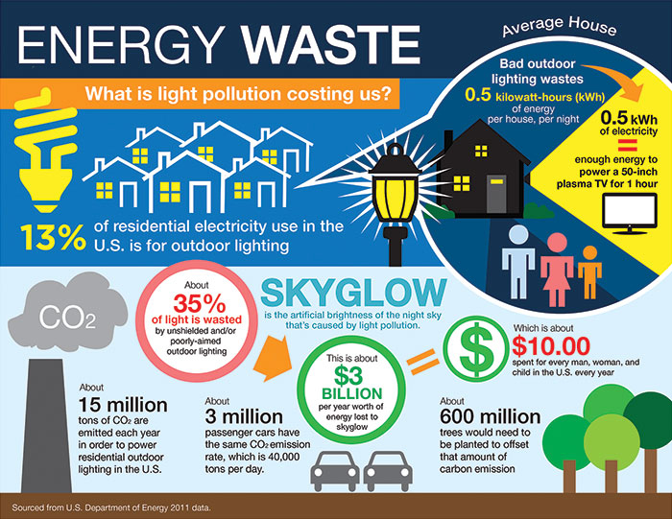
Notes:
International Dark-Sky Association. (n.d.). Energy Waste Facts [Infographic] https://www.darksky.org/our-work/grassroots-advocacy/resources/public-outreach-materials/CC BY-NC-ND

Slide 21
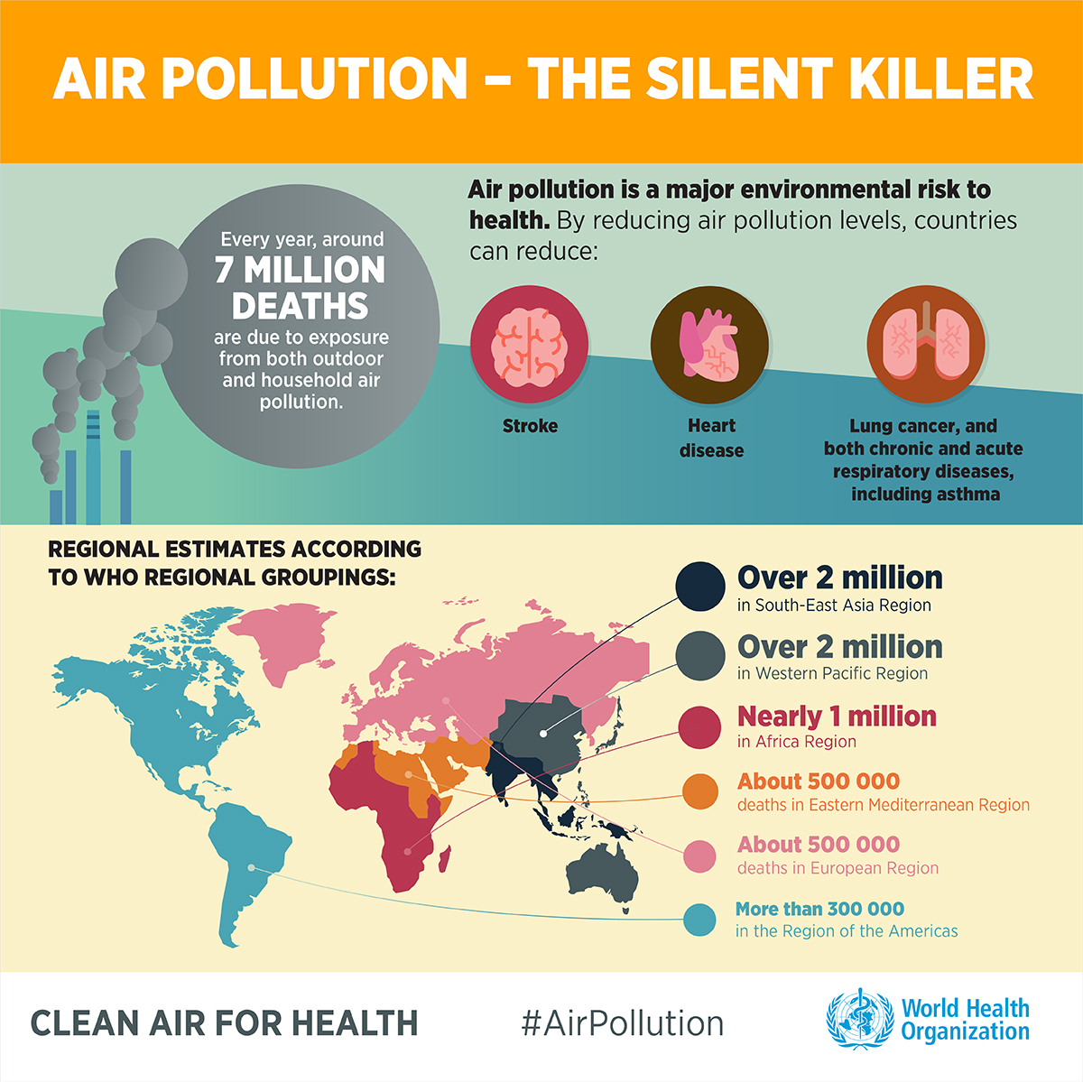
Notes:
GroundUp. (May 8, 2020). Pollution Facts [Infographic]. https://www.groundup.org.za/media/uploads/images/Graphics/lockdown-pollution-20200508/Air-pollution-WHO%20INFOGRAPHICS-English-1.1200px.jpg

