Slide 2
Speak Your Truth
Techniques in Spoken Word Poetry

Slide 3
Essential Question
How does our ability to use language empower us?

Slide 4
Lesson Objectives
Analyze techniques used to engage an audience in spoken word poetry;
Compose and perform a spoken word poem.

Slide 5

Tell Me Everything
Tell me everything you know about Spoken Word Poetry.
Make a list or web.
Write for three minutes.
Share with a partner or small group when the time is up.
Add any new information to your list.
Notes:
https://learn.k20center.ou.edu/strategy/107

Slide 6
Spoken Word Poetry
Watch a performance of at least three of the provided spoken word poets.
Consider the questions on the next slide as you watch the videos.
Take notes on your Note Catcher.

Slide 7
Spoken Word Poetry Note Catcher
What is the subject of the poem?
What tone does the poet convey in the presentation?
What do you notice about the performance techniques that engage the audience?
  Body movements
  Hand gestures
  Dramatic pauses
  Varying volume
  Varying tempo
What do you notice about the words the poet uses?
What literary elements does the poet use?
  Repetition
  Assonance
  Alliteration
  Rhyme
  Wordplay

Slide 8

“If I should have a daughter (Point B)” by Sarah Kay
If I should have a daughter (Point B)
Notes:
https://www.youtube.com/watch?v=0snNB1yS3IE&t=1s

Slide 9

“Power of One” by Brandon Leake
Power of One
Notes:
https://www.youtube.com/watch?v=8DEA0fWgR5Q

Slide 10
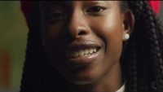
“Earthrise” by Amanda Gorman
Earthrise
Notes:
https://www.youtube.com/watch?v=xwOvBv8RLmo

Slide 11
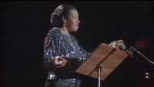
“Still I Rise” by Maya Angelou
Still I Rise
Notes:
https://www.youtube.com/watch?v=qviM_GnJbOM

Slide 12

“Captain America” by William Nu’utupu Giles
Captain America
Notes:
https://www.youtube.com/watch?v=l16HaRJV6xY

Slide 13
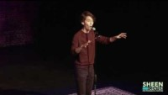
“Dear Santa” by Phil Kaye
Dear Santa
Notes:
https://www.youtube.com/watch?v=QU8PuObxMfI

Slide 14
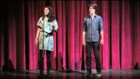
“An Origin Story” by Sarah Kay and Phil Kaye
An Origin Story
Notes:
https://www.youtube.com/watch?v=esgfG3BoAPc

Slide 15

“How to Fight” by Carlos Andres Gomez
How to Fight
Notes:
https://www.youtube.com/watch?v=cKMhp7hpYIs

Slide 16
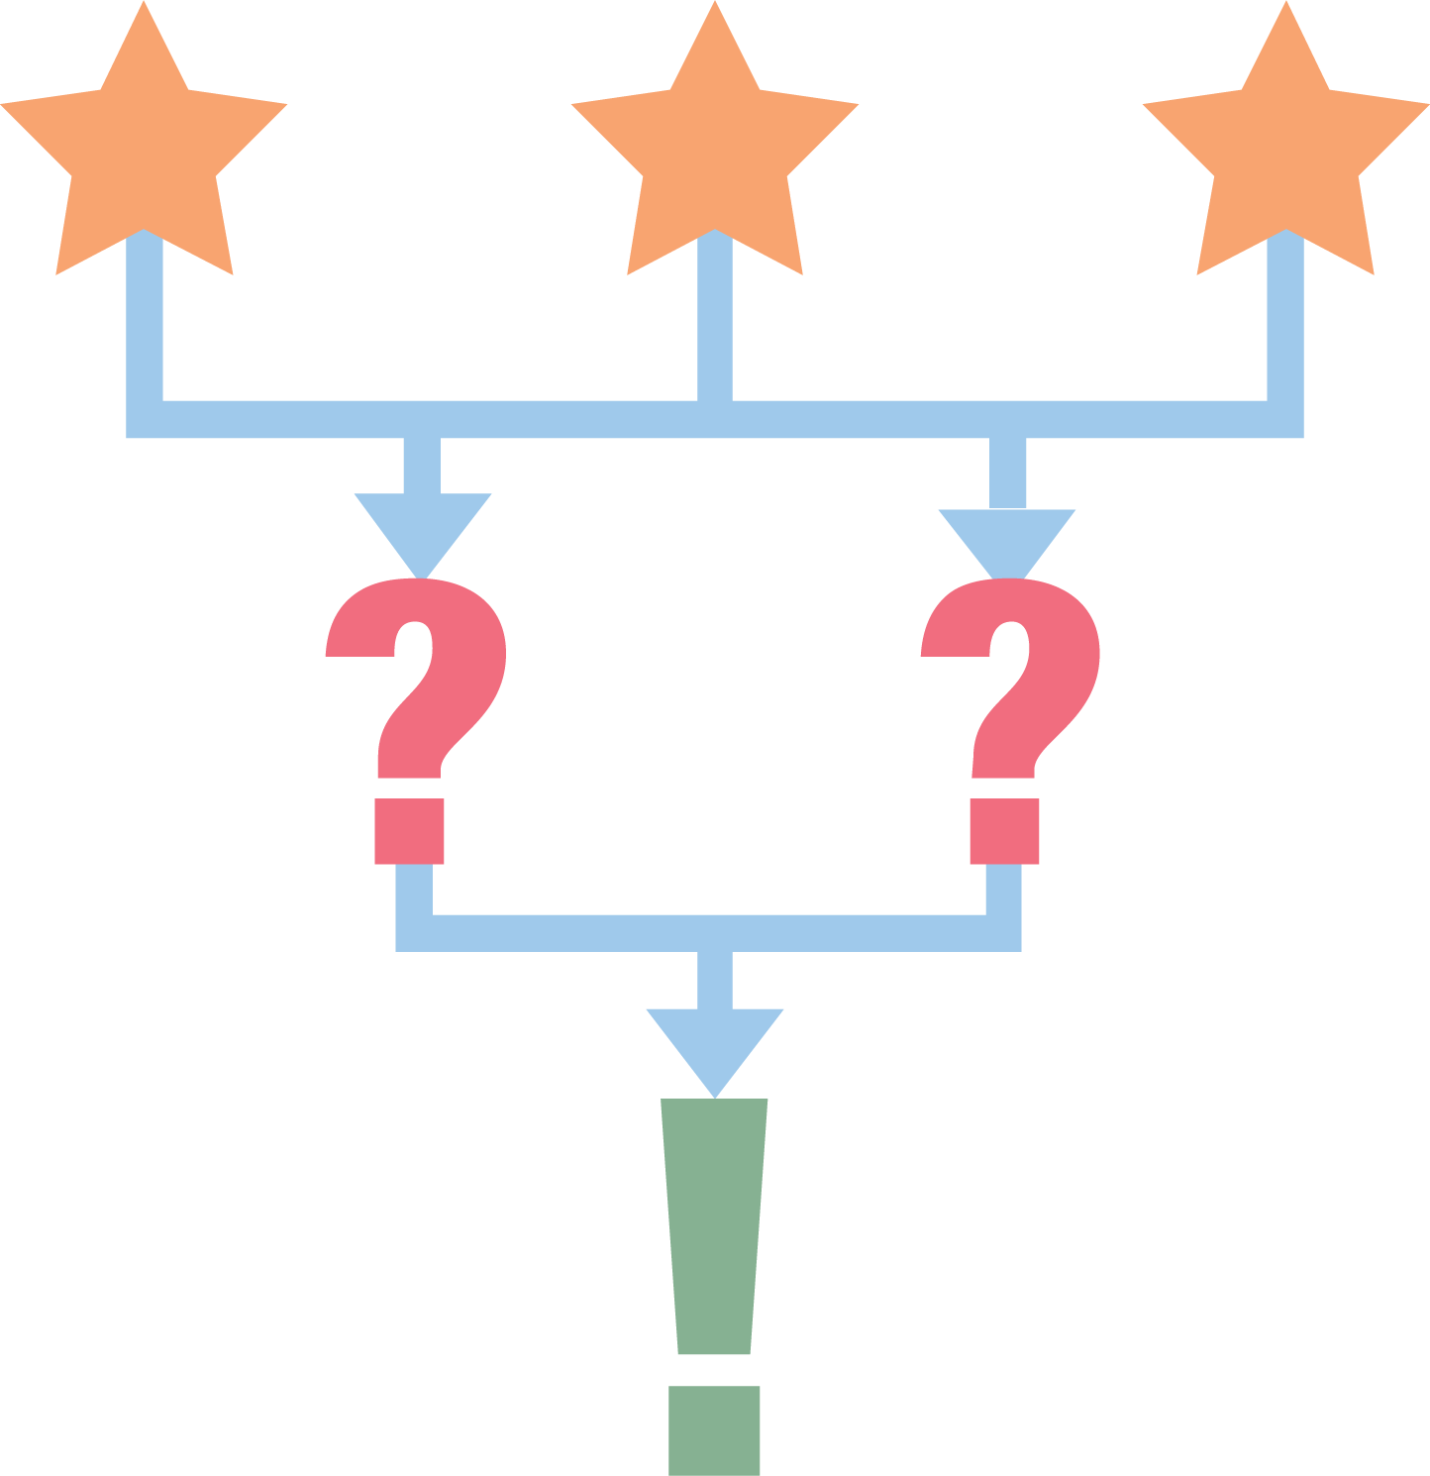
3-2-1
Identify 3 things you noticed about the performance techniques:
    Body movements
    Hand gestures
    Dramatic pauses
    Varying volume
    Varying tempo
Identify 2 things you noticed about literary elements:
    Repetition
    Assonance
    Alliteration
    Wordplay
    Rhyme
Identify 1 thing you noticed about the subject/topic/tone of the poems.
Share your 3-2-1 information with a partner.
Volunteers share their 3-2-1 information with the whole class.
Notes:
https://learn.k20center.ou.edu/strategy/117

Slide 17

“Spoken word: The roots of poetry" by Sarah Kay (optional)
Spoken word: The roots of poetry
Notes:
https://www.youtube.com/watch?v=G9qaVXE30FU

Slide 18

“Writing a Spoken Word Poem in One Hour" by Taz Alam
Writing A Spoken Word Poem In One Hour
Notes:
https://www.youtube.com/watch?v=8PHx2TJHIhE

Slide 19

“Fake Friends" by Taz Alam
Fake Friends
Notes:
https://www.youtube.com/watch?v=gR0gNV7VDHk

Slide 20
It’s time to write your own spoken word poem!
Write about what inspires you. What are you passionate about?
Choose your idea. It can be broad and general (like love or life) or specific and narrow (like respect for a grandparent or another specific person).
Focus on sensory details.
Start with a “gateway” line that lets the audience know what you are going to talk about.
Show your attitude! Feelings and emotions give poetry richness.
Include relatable, figurative language. Keep it simple, but powerful.
Make sure the opening line engages and keeps the audience’s attention.
Be intentional with your words. Tell a story. Paint a picture with words.
Use literary devices like repetition to create emphasis and memorable moments.
Use rhyme to enrich your diction and performance, but don’t focus too much on rhyme scheme. Internal rhyme is golden in spoken word!
Recite the words aloud as you write them. Listen to the sounds. Find the music in the words.
End the poem when it feels right.
Leave your audience with a memorable line or something to think about.

Slide 21
Topic Ideas
What ten things do you know to be true? Choose one.
What matters to you? What would you change if you could?
Who has made an impression on you? Choose a specific person or someone famous.
What is one word that intrigues you? (Peace, Love, Wisdom, Justice, Freedom, Potential, Truth, Perspective, Life & Death, Racism, Sexism, Ageism, Classicism, Feminism)
What borrowed line from a poem or a book inspires you?
What other topic interests you? (Keep it appropriate, please.)

Slide 22
Performance Tips and Tricks!
Memorize your poem. It’s ok if you need to read it, but it’s also ok to go “freestyle.” That’s part of the experience.
Watch other poets perform their work. If you want to shoot better free throws, you watch the best and learn their techniques. Do the same for spoken word poetry.
Practice, practice, practice!
Make eye contact. Don’t stare at the floor. Looking into somebody’s eyes helps you capture their attention and gives you feedback on your performance.
Project your voice. Speak loudly and clearly so your voice can be heard from a distance.
Be aware of your tone. Make sure you are conveying the meaning in your words.
Slow down! If it sounds slow to you, it is probably just right for your audience.
Facial expressions help animate your poem. You are not a statue. Smile if you are happy. Look angry if something angers you. Let your emotions shine through your performance.
Hand gestures and body movements help emphasize different parts of your poem. Don’t be afraid to move around. Use your hands to get your point across.
Don’t let mistakes trip you up. Use a “freestyle" if you need time to get back on track.
Don’t forget to have fun!

Slide 23
Audience Rules to Remember!
Pay full attention to the presenter.
Be respectful.
Do not cause any distractions (for example, moving around, tapping your foot or pencil, moving papers on your desk, digging through your backpack, etc.).
Clap for the presenter. It takes a lot of courage to stand in front of people and perform.
Do not “mean mug” the presenter. In other words, don’t look angry, impatient, or annoyed when a poet is reading.
If you hear something you like, you may snap your fingers as a form of applause as a poem is read.

