Slide 2
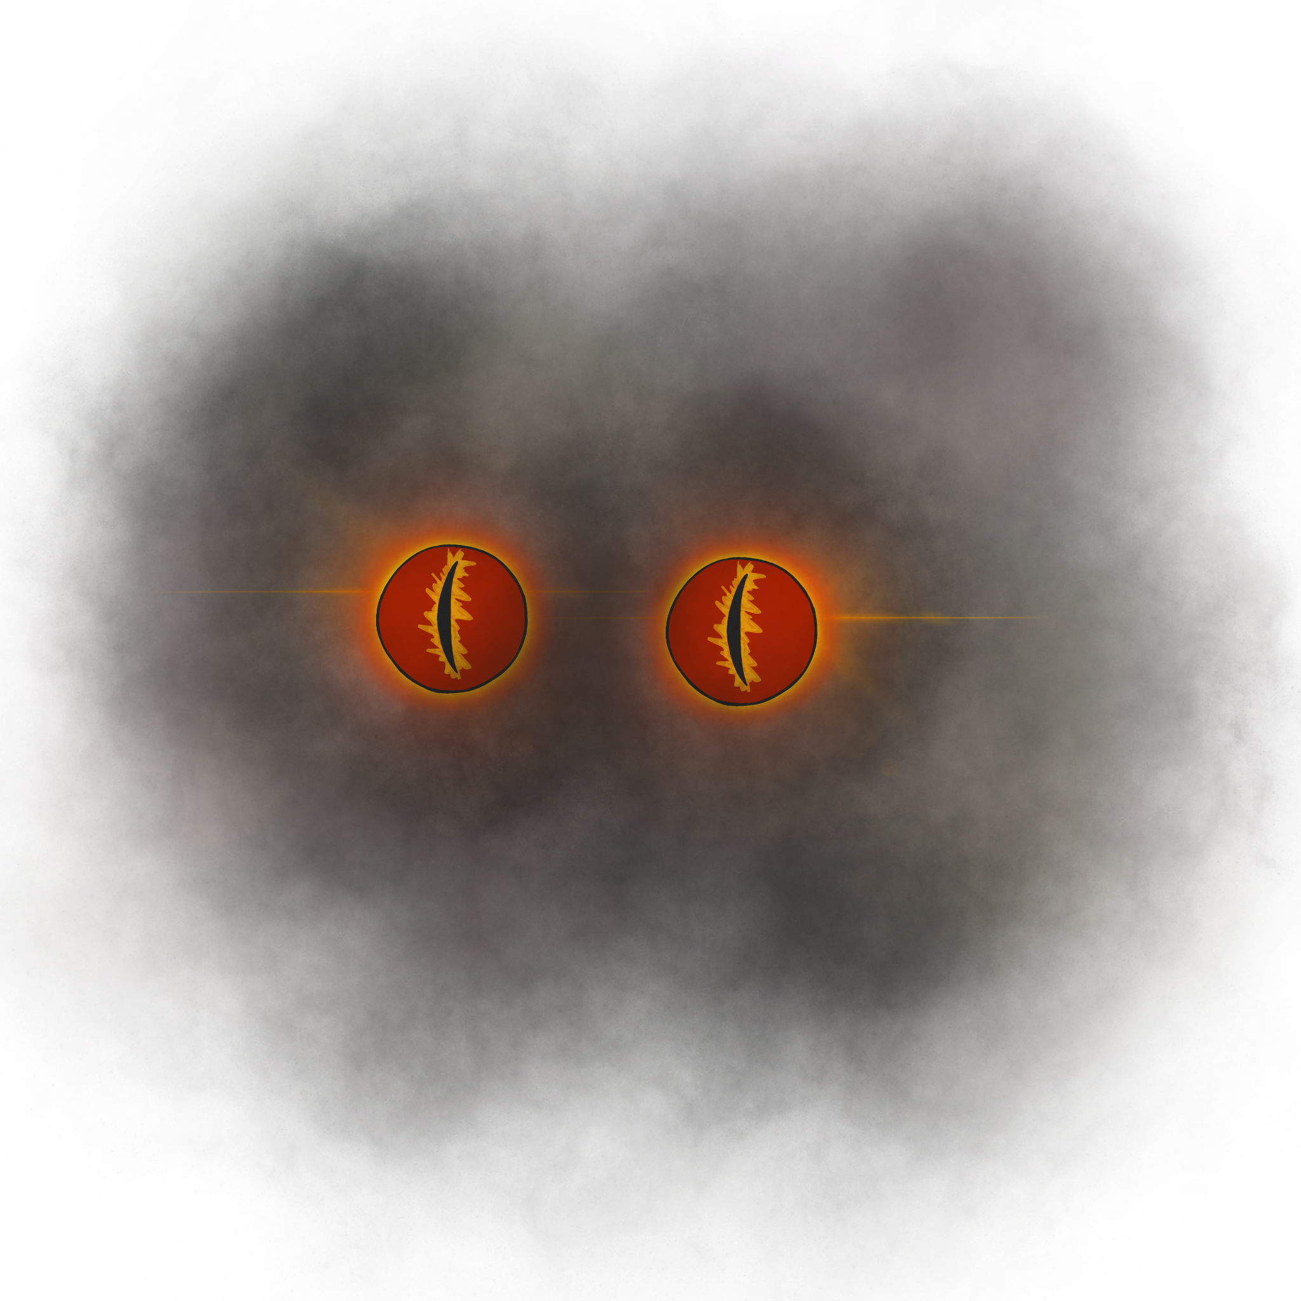
Big Scary Animal
Lord of the Flies Lesson 5

Slide 3
Essential Question:
How does the author use symbolism to develop characterization and theme?

Slide 4
Lesson Objectives:
Analyze the difference between the word choice the author uses to show the characters’ thoughts and actions;
Compare the evolution of the characters in the story to an outside character.

Slide 5

Notes:
Mental Floss. (2020). 22 Cryptids Explained. [Video]. YouTube. https://www.youtube.com/watch?v=jUZCLOEIkZc

Slide 6
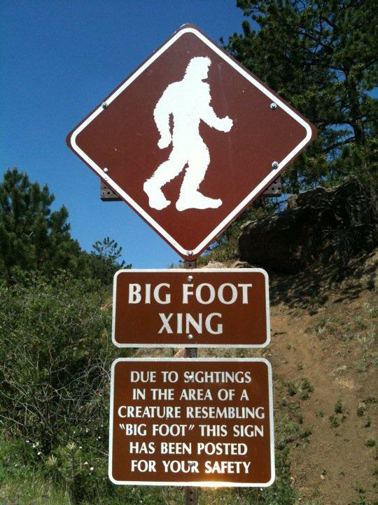
Is Sasquatch a “beast?”
Read article “Oklahoma State Lawmaker Files Bill Calling for Bigfoot Hunting Season.”
Answer the following questions:
  Are Sasquatch scary?
  Why do Okies want to hunt them?
Notes:
Dreamstime. (n.d.) Bigfoot crossing sign. [Digital image]. https://www.dreamstime.com/stock-photo-big-foot-crossing-sign-warning-sightings-area-image76431365

Slide 7
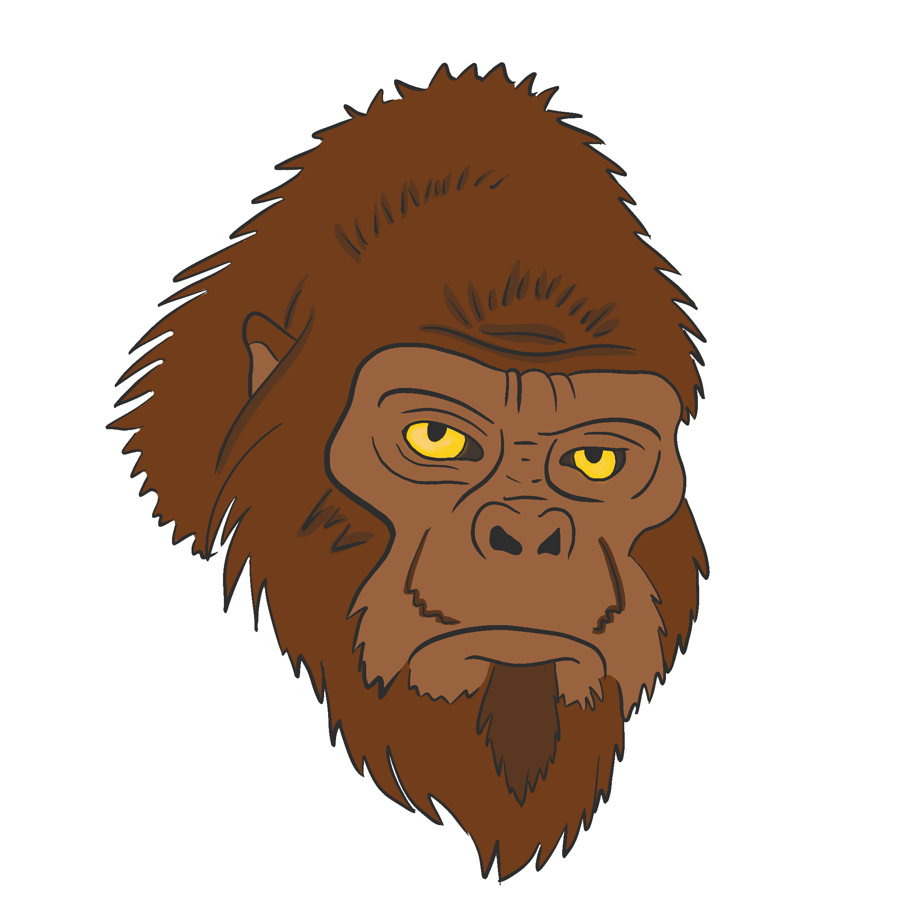
Card Sort: Sasquatch or The Beast
Read statements on each card.
Sort the individual cards into two categories based on whether the card describes Sasquatch or the Beast.
Notes:
K20 Center. (n.d.) Original graphics.
https://learn.k20center.ou.edu/strategy/147u)

Slide 8

Categorical Highlighting: Mock Pig Hunt
As you read about the Mock Pig Hunt in the Chapter 6 excerpt, highlight the following:
Underlying feelings of the boys;
Actions the boys display.
Notes:
K20 Center. (n.d.). Original graphic.
https://learn.k20center.ou.edu/strategy/192

Slide 9
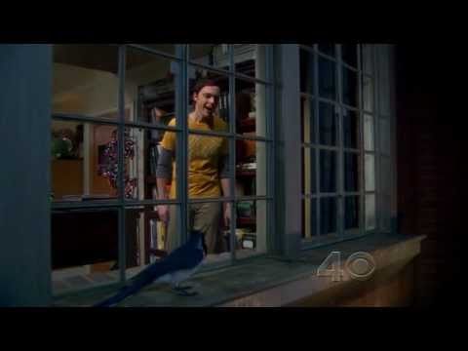
Notes:
YouTube. (2012, Jan. 26). The Big Bang Theory. Sheldon Bird on Ledge. S05E09. [Video]. https://www.youtube.com/watch?v=SKtURlmsnXU

Slide 10

Creating a Storyboard
Take notes over key information and specific events that happen in the video.
Organize the events into a summary of the story, dividing the summary into parts (panels or frames) in sequential order.
Notes:
https://learn.k20center.ou.edu/strategy/79

Slide 11
Sheldon and the Blue Jay (1)
Sheldon is afraid of birds.
A Blue Jay lands outside of his window.
The Blue Jay will not leave.
Sheldon tries everything to get the Blue Jay to leave.
He pretends to be a cat.
He has Wolowitz build a bird death ray.
Dressed like the Mandalorian, Sheldon opens the window and tries to shoo away the bird with a broom.
The bird flies into the open window and sits in Sheldon’s spot.

Slide 12
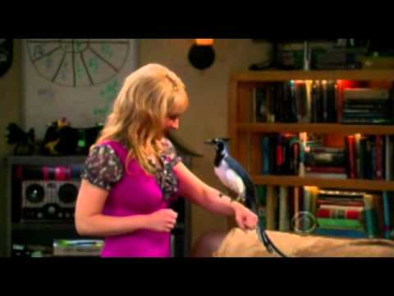
Notes:
YouTube. The Big Band Theory. Sheldon pats a bird. S5x9. [Video]. https://www.youtube.com/watch?v=fTheN1VvHVM

Slide 13
Sheldon and the Blue Jay (2)
Bernadette walks over to the Blue Jay.
The bird hops onto her arm.
Sheldon asks her to slowly flush it down the toilet.
Sheldon gets up the courage to pet the bird.
He insists again that Amy or Bernadette flush the bird down the toilet.
Sheldon calls Amy and Bernadette to come help.

Slide 14
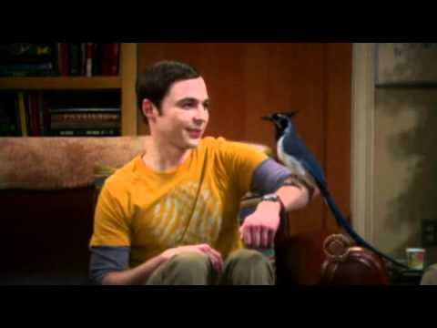
Notes:
YouTube. (2011). The Big Bang Theory. Come back, Lovey Dovey. S5x9. [Video]. https://www.youtube.com/watch?v=wXXi80gLAmw

Slide 15
Sheldon and the Blue Jay (3)
Sheldon allows the bird to sit on his arm.
He offers the bird a beverage.
Sheldon wants a photo with the Blue Jay.
Sheldon names the bird Lovey Dovey.
Amy offers to bring a cage for the bird.
Sheldon doesn’t want it.
He opens the window to bring the bird’s nest inside.
Lovey Dovey, the Blue Jay, flies out of the open window.

Slide 16
Fear and Feelings
Come up with an example of a character who is afraid, but their actions and words show otherwise.
Pull your example from one of the following:
  Books
  Television
  Movies
How does this character evolve throughout the story?

Slide 17
Creating a Storyboard
Compare Sheldon’s evolution in the Blue Jay videos to the boys’ post-hunting evolution described in Chapter 6.
  How have the boys changed thus far in the novel?
Include this information in your very own storyboard.

Slide 18
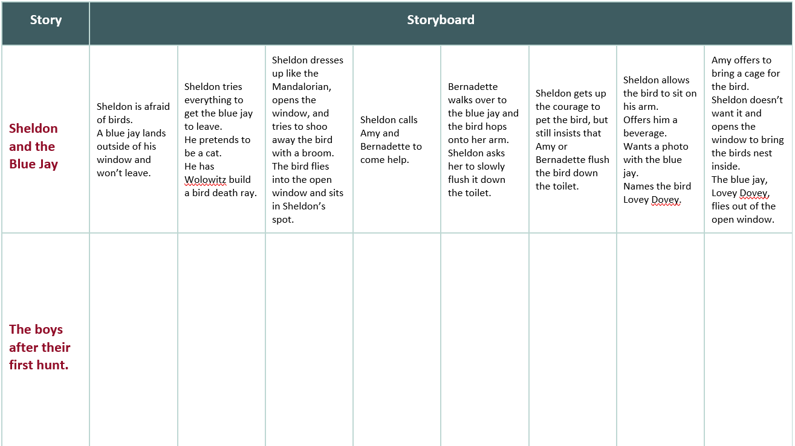
Storyboarding On Your Own

