Slide 2
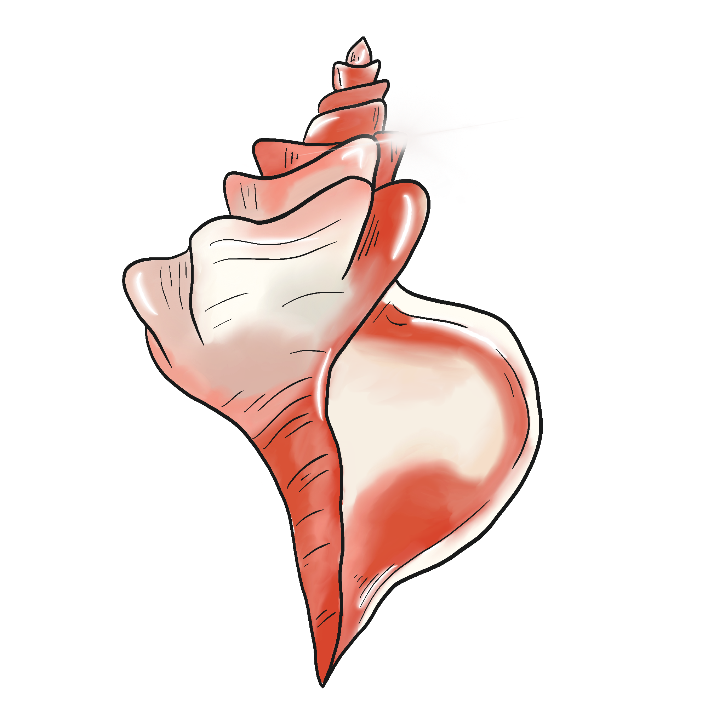
I’ve Got the Power
Lord of the Flies Unit Lesson 6

Slide 3
Essential Question
How does the author use symbolism to develop characterization and theme?

Slide 4
Lesson Objectives
Analyze a text for symbols of power.
Categorize evidence from the text to support the claim that either the seashell or the glasses were the ultimate symbol of power.

Slide 5
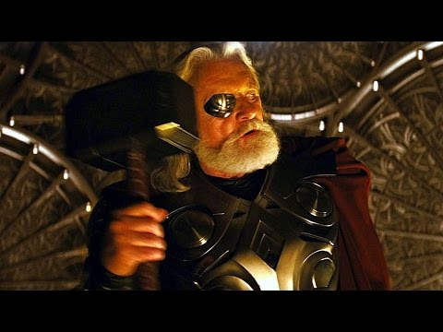
Notes:
YouTube. (2017). Thor vs Odin - Odin Takes Thor's Power (Scene) Movie Clip Hd. YouTube. https://www.youtube.com/watch?v=_IfYZZDTays.

Slide 6
Conch and Glasses T-Chart
Look through the novel for examples that identify the conch and glasses as symbols of power.
Write your examples on your T-Chart.
Notes:
https://learn.k20center.ou.edu/strategy/86

Slide 7
Conch or Glasses—Tug-of-War
On a sticky note, write your name and a quote from the novel that supports your choice: shell or glasses?
Place your sticky note under the appropriate image on the next slide.
Notes:
https://learn.k20center.ou.edu/strategy/98

Slide 8
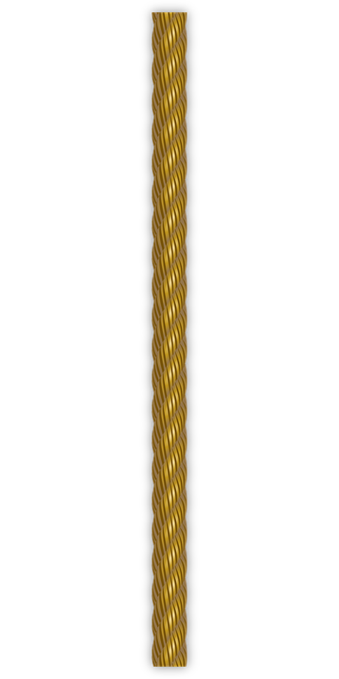
Which is a better symbol for power in the story?
Type here
Type here
Type here
Type here
Type here
Type here
Type here
Type here
Type here
Type here
Type here
Type here
Type here
Type here
Type here
Type here
Type here
Type here
Type here
Type here
Type here
Type here
Notes:
OpenClipart-Vectors. (2013). Rope. https://pixabay.com/vectors/rope-cord-sisal-string-material-160161/.
https://learn.k20center.ou.edu/strategy/98

Slide 9
Collaborative Word Cloud
What are some other symbols of power that appear in the novel?
Add a word or two that captures the concept of “power” to the Word Cloud.
Notes:
https://www.mentimeter.com/
https://learn.k20center.ou.edu/strategy/103

Slide 10
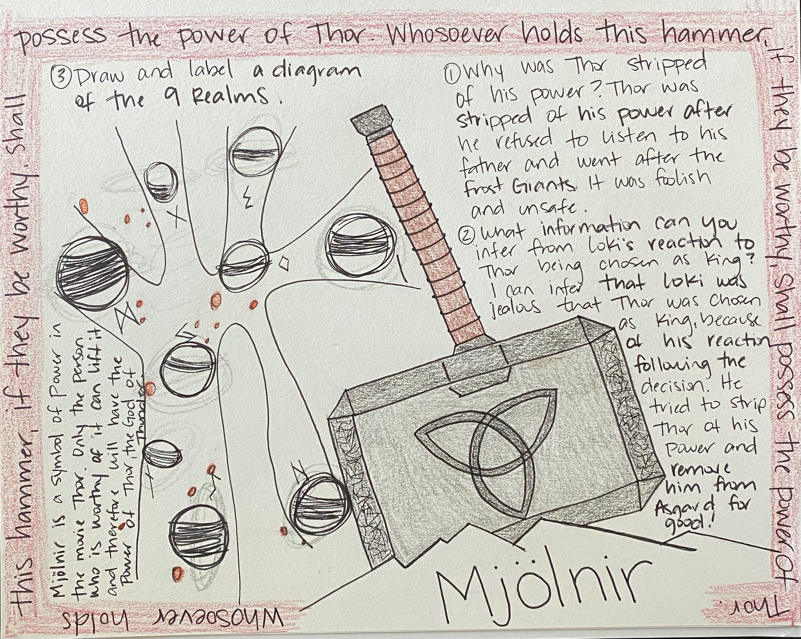
One-Pager
Example One-Pager from Thor
Choose an example of power from a movie and include the following:
Title
Border around the page that includes the theme
Image of the symbol of power
Three or more questions with the answers included
A statement about why you believe this to be a symbol of power
Notes:
https://learn.k20center.ou.edu/strategy/72

Slide 11
Border
Question 3
Question 1
A statement about why you believe this to be a symbol of power
Question 2
Image of the symbol of power
Title
Notes:
https://learn.k20center.ou.edu/strategy/72

Slide 12
One-Pager
Example One-Pager from Thor
Choose an example of power from a movie and include the following:
Title
Border around the page that includes the theme
Image of the symbol of power
Three or more questions with the answers included
A statement about why you believe this to be a symbol of power
Notes:
https://learn.k20center.ou.edu/strategy/72

