Slide 1
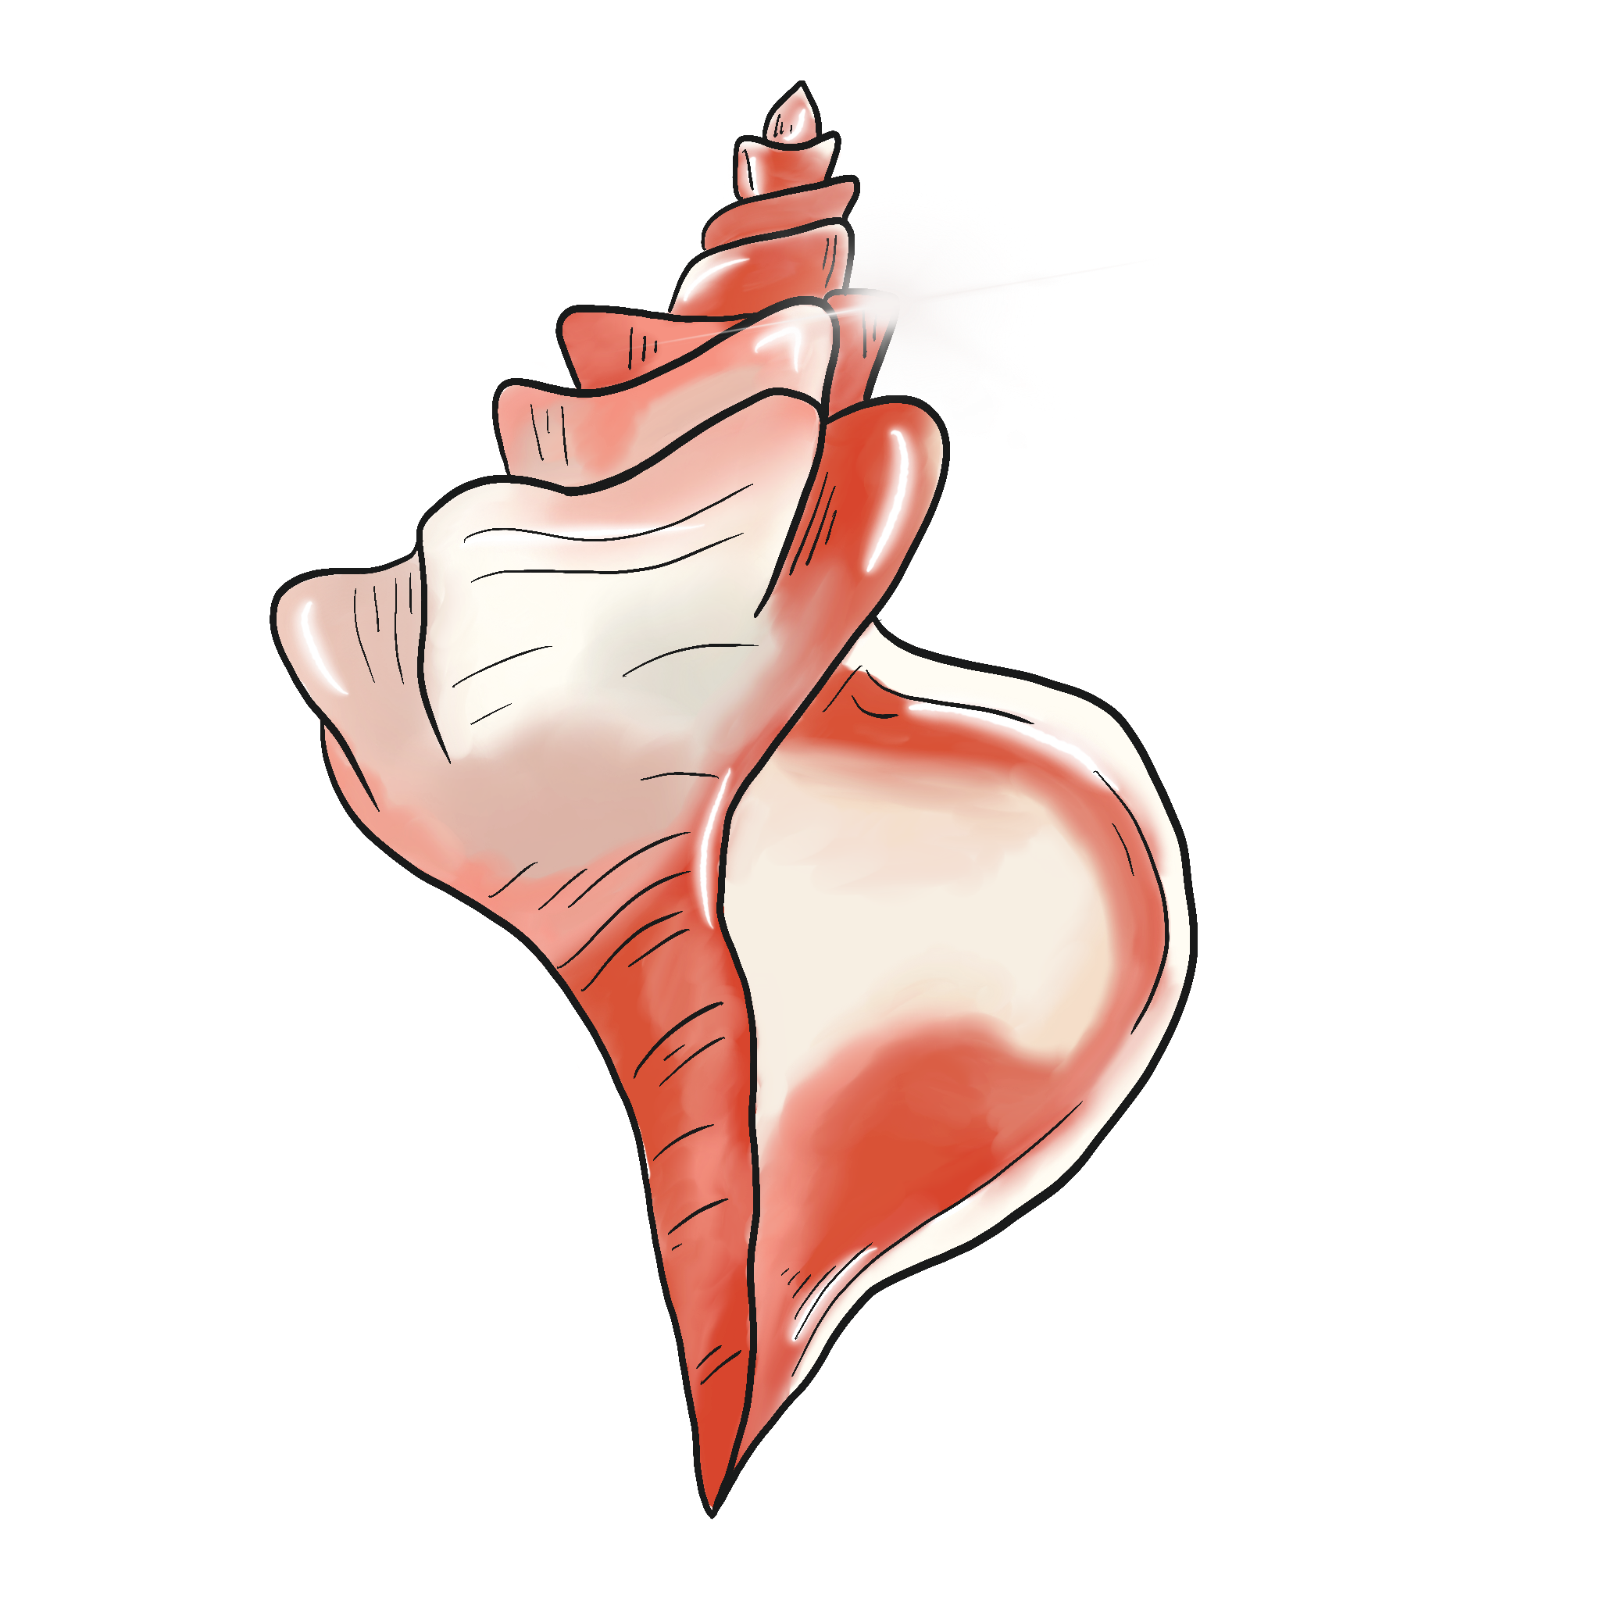
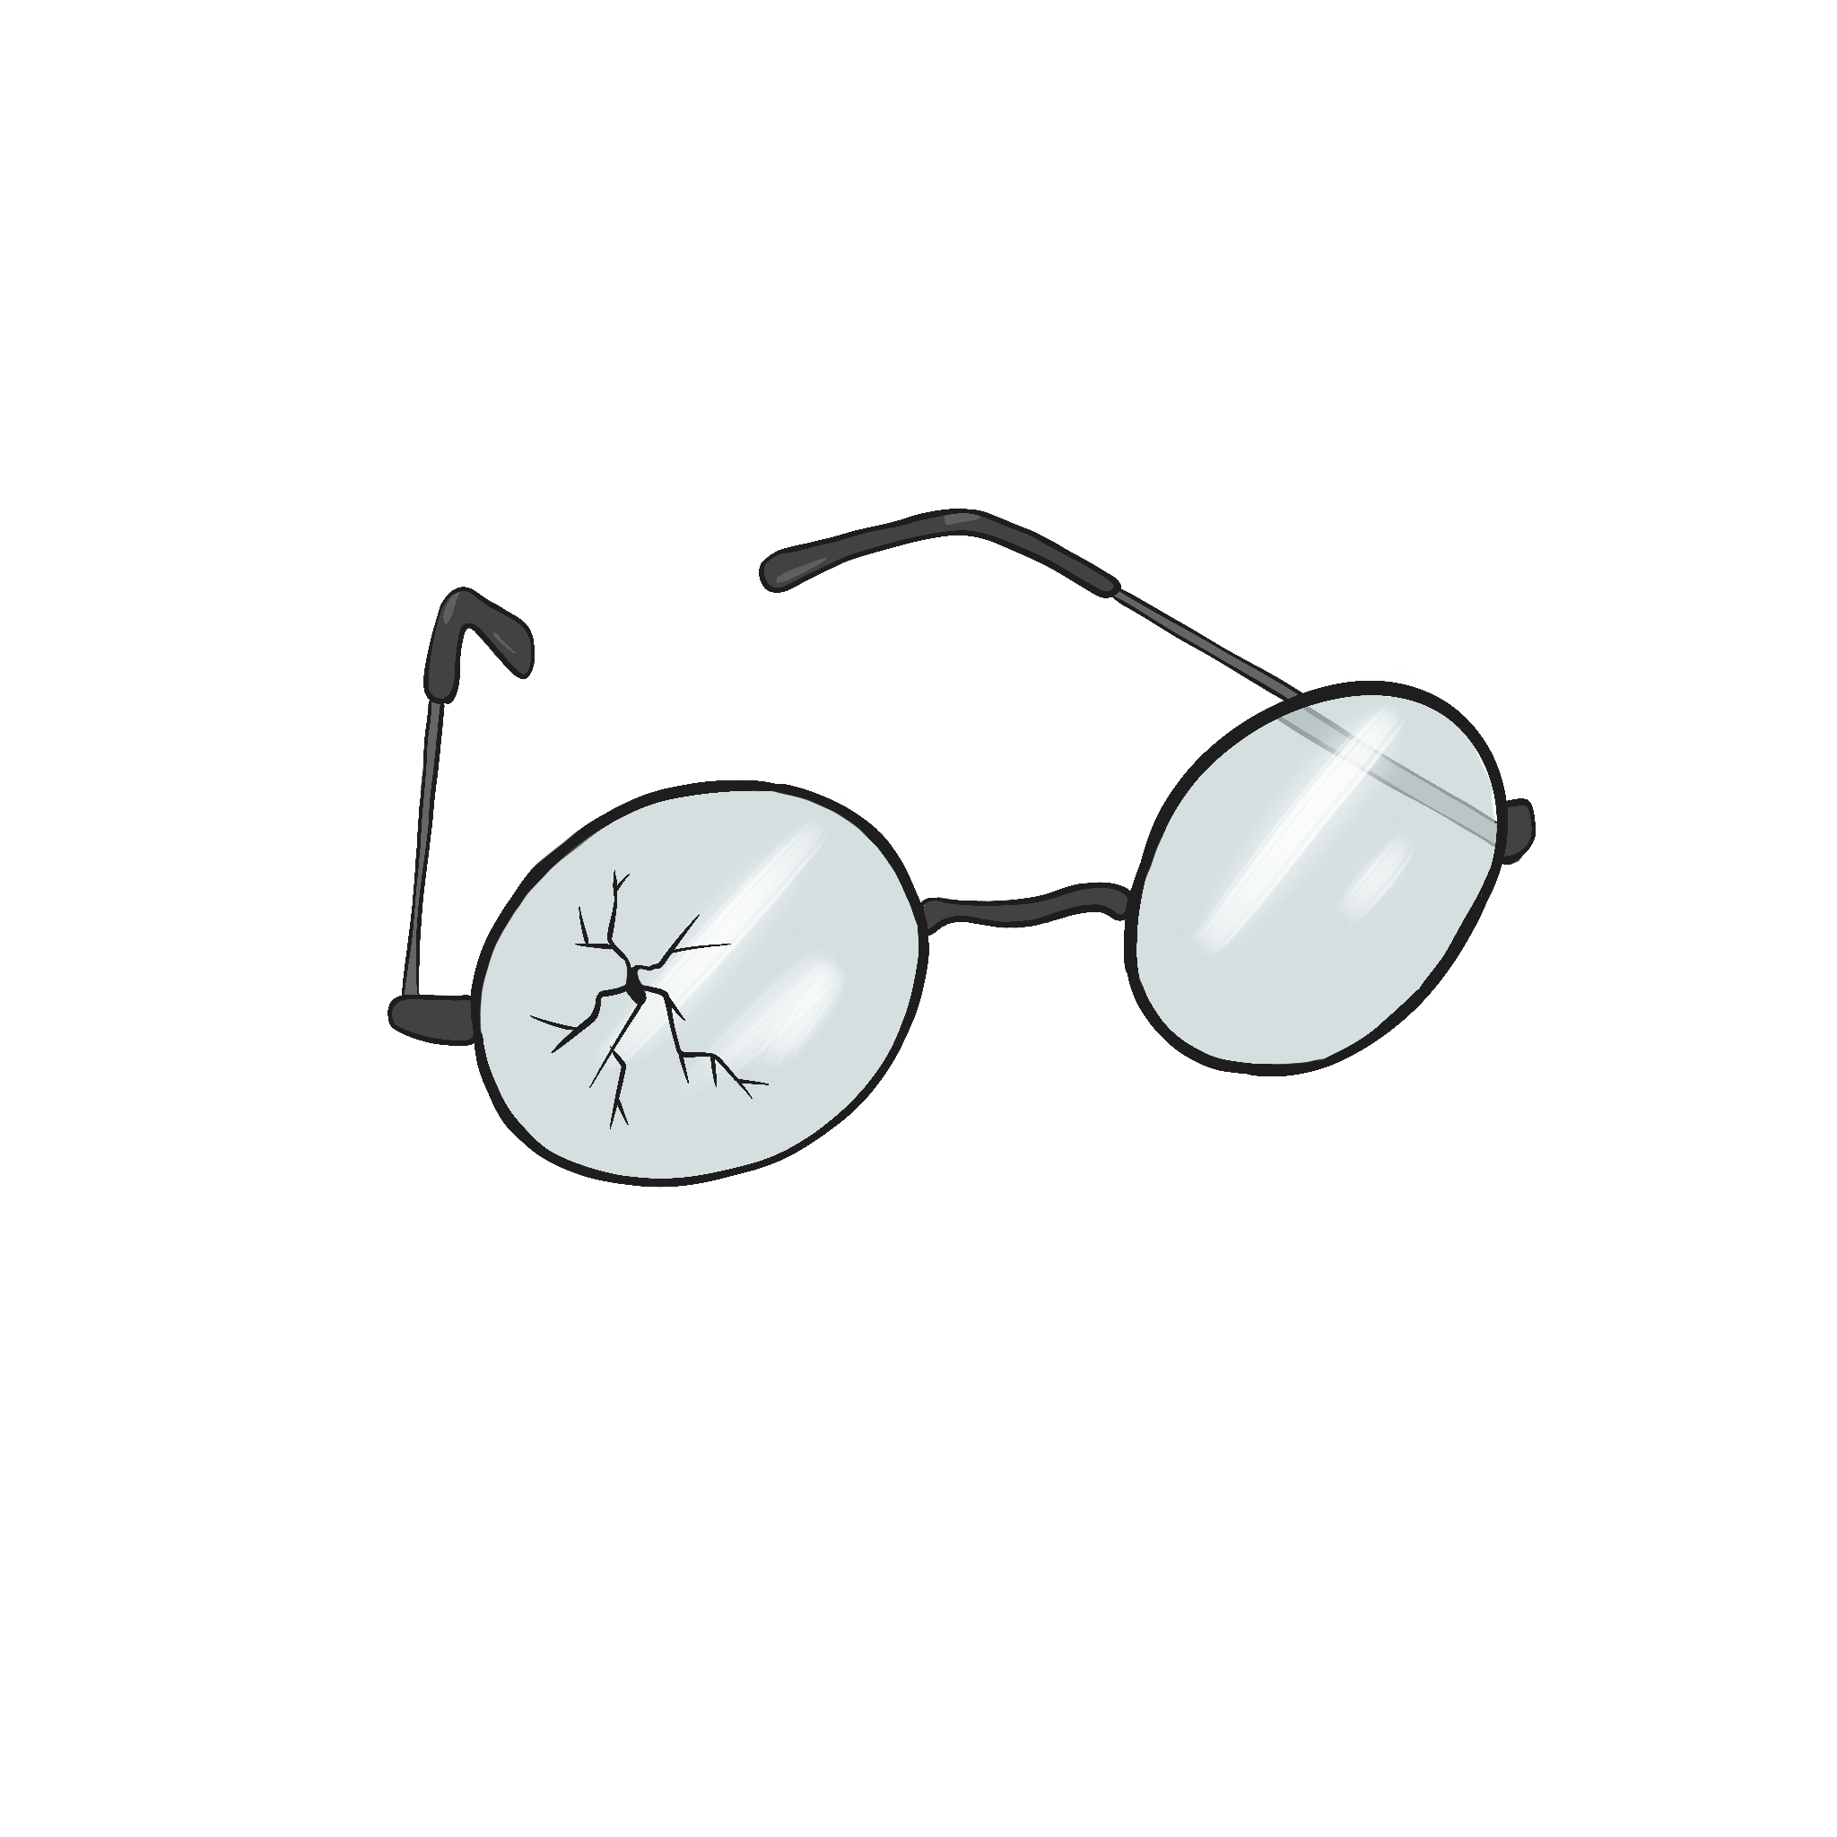
Conch or Glasses - Tug-of-War
Type/write your name and your reason for choosing the shell or the glasses as a better symbol of power.
Place your sticky note under the appropriate image.

Slide 2
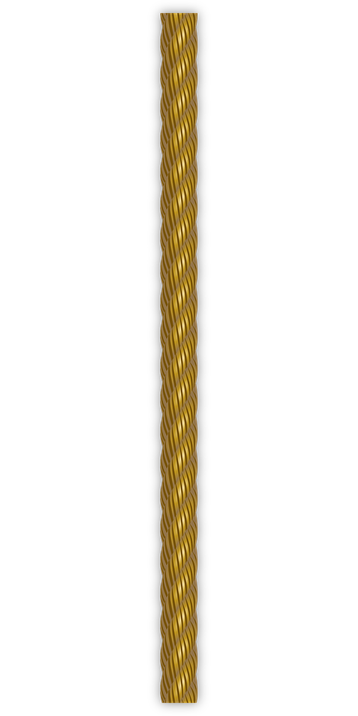
Which is a better symbol for power in the story?
Type here
Type here
Type here
Type here
Type here
Type here
Type here
Type here
Type here
Type here
Type here
Type here
Type here
Type here
Type here
Type here
Type here
Type here
Type here
Type here
Type here
Type here
Notes:
Create more sticky notes as needed by copying and pasting.
Type into the sticky note by placing your name and why you choose the shell or glasses as the better symbol, then move your sticky to the side you chose.
OpenClipart-Vectors. (2013). Rope. https://pixabay.com/vectors/rope-cord-sisal-string-material-160161/.

