Slide 2
Competition or Collaboration
Which is more influential for you?

Slide 3
Vocabulary Competition
Invent a word to describe the object on your table.
Now, decide as a table who came up with the BEST word.
Notes:
Engage
Invent a new word. (Some words might be dr. suess style or a combination of words.)
This is a competition for the best word!
1 minute to come up with a word

Slide 4
Vocabulary Collaboration
Combine efforts at your table to create a collaborative sentence of invented words to describe your object.
Notes:
Engage
Some word were new some were not… some sentences used all made up words

Slide 5
Competition vs. Collaboration
Which provided a richer description?
Which made you rethink your own work?
Which made you think about how to look at the world from a different perspective?
Which made you feel more confident about your work?
Which was more influential to you?
Notes:
Engage

Slide 6
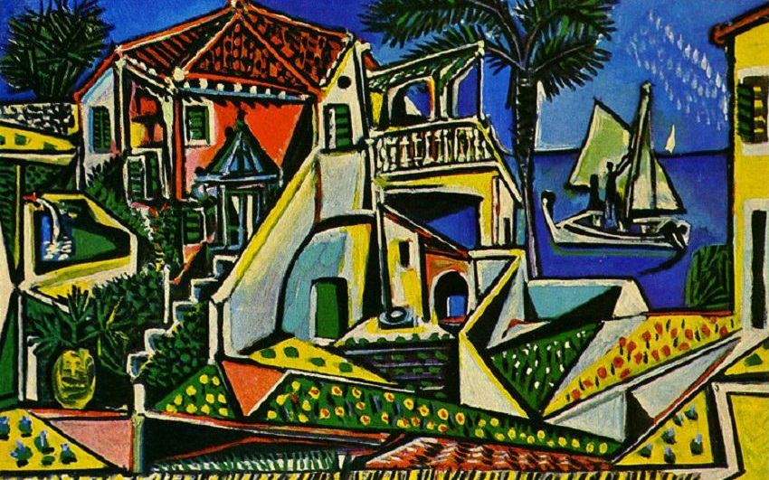
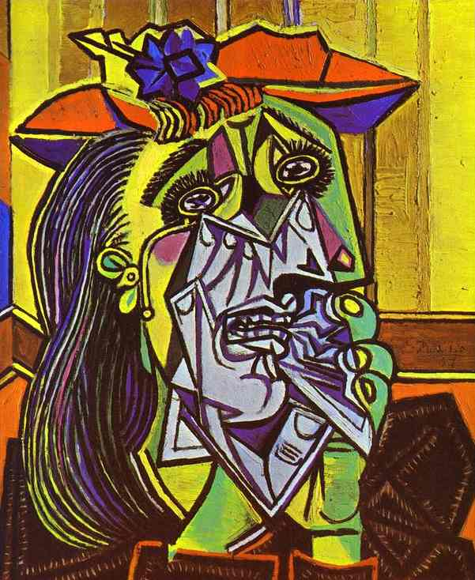
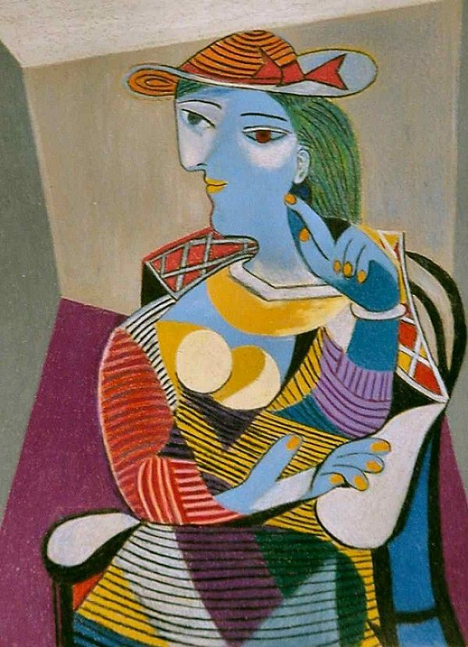
Notes:
Seconds to think and brainstorm words on post-it
ENGAGE #2 for background knowledge
Style of Artwork comparing Picasso and Matisse
Word Association: What are some words you would use to describe these paintings?

Slide 7
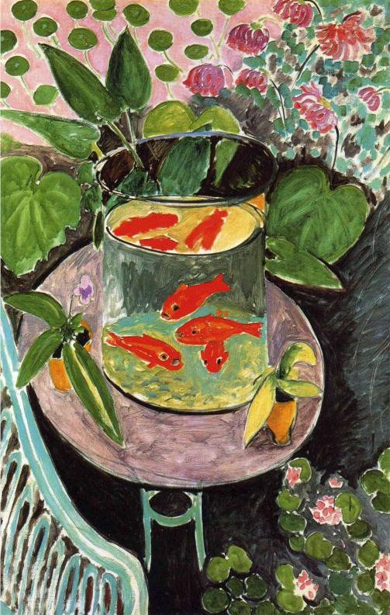
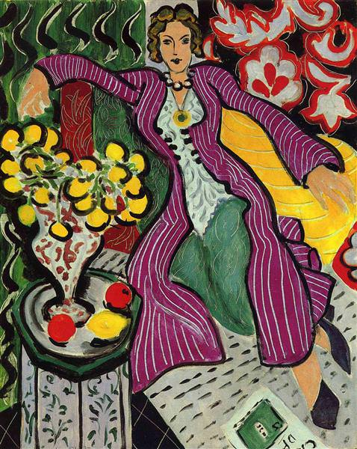
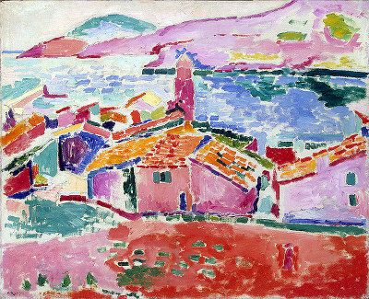
Notes:
Seconds to think and brainstorm a list of words on a different post-it
What are some words you would use to describe these paintings
??? Share these words out for each set of paintings.???

Slide 8
Picasso & Matisse
How are the paintings from each artist similar?
How are they different?
Notes:
Share out verbally.
Compare list? Contrast list?
We are about to find out if these artists were competitors or collaborators

Slide 9
When Pigasso Met Mootisse
by Nina Laden
Notes:
EXPLORE
Read book aloud
Then, have students interact with the text (see centers)

Slide 10
Literacy Centers: Pigasso and Mootisse
Complete the tasks provided at each station.
Notes:
EXPLORE
Allow students to select a literacy center (or pre-assign the first day if you have students that need to practice specific skills or concepts). Centers may be adjusted to meet the needs of your students. Also, some centers may need more adult guidance than others. The point of these centers is for students to interact with the book’s text, becoming more familiar with the text and practicing literacy skills/concepts that are important for individual grade levels.

Slide 11
HEADLINE
How did the relationship change between the two artists, and how did they influence each other in the story?
Thinking about what you have learned about Picasso and Matisse, write a headline using the word influence or influential.
Notes:
EXPLAIN
Influence or influential was a concept throughout the literacy centers.
Individually, create a headline/hashtag/title on a sticky note that explains the relationship between the two artist. You must use either the word influence or influential.
“Two artists influenced by one another.”
“#influenceanotherartist”
“Influential artists feud to friends.#frienemies”

Slide 12
Actual MoMA Exhibition Announcement
Matisse Picasso is the first exhibition dedicated to the lifelong dialogue between two of the most important artists of the Twentieth Century. Struck by each other’s genius since they met in 1906, each recognized the other to be his only true rival and measure of his success. Matisse Picasso tells the compelling story of two artists who, by looking at and learning from one another for nearly half a century, were driven to ever higher levels of accomplishment, and despite their personal differences, were closer in spirit than any other two artists of that time.
Notes:
“Could the headline you created have been used for this article?”
“Yes! The headline you created could have been used for this article presented by MoMA -- this is the first paragraph of an article announcing the Matisse Picasso exhibition. It was a collaborative effort where museums and individuals from all over the world brought their matisse and picasso paintings to be displayed together. It was a once in a lifetime exhibit.”
Identify any information in this article pointing to the concept of INFLUENCE
Extensions for Text analysis - Identify words that they know and don’t know in this announcement.

Slide 13
Overview of picture
Parts
Title
Influence
Claim
IT’S OPTIC-AL
For each set, try to identify which is Picasso’s work and which is Matisse’s work.
Notice any influences?
Record your analysis of the visual and graphic texts on the paper provided for each pair.
Notes:
EXTEND (upper grades) ***Provide a whole class example to work through so they understand what they are expected to do.***
“We are going to take a field trip to see this once in a lifetime exhibit today! I need you pack up and only take your pencil and the organizer I am going to give you. You will analyze the pairings of art and take notes using the graphic organizer for ‘It’s OPTICal’.”

Slide 14
I notice… I wonder… It reminds me of...
For each pairing, try to identify which is Picasso’s work and which is Matisse’s work.
Notice any influences?
Write an “I notice…” “I wonder…” and “It reminds me of…” statement for each set.
Notes:
EXTEND (younger grades) ***Provide a whole class example to work through so they understand what they are expected to do.***
“We are going to take a field trip to see this once in a lifetime exhibit today! I need you pack up and only take your pencil and the organizer I am going to give you. You will analyze the pairings of art and take notes as directed.”
Sticky notes for lower grades doing the I notice/I wonder/It reminds me of…. (this is the self and real world connections)

Slide 15
Influence in their own words...
Picasso told Pierre Daix, a biographer:
Matisse told Françoise Gilot, Picasso’s Friend:
“You have got to be able to picture side by side everything Matisse and I were doing at that time. No one has ever looked at Matisse’s painting more carefully than I; and no one has looked at mine more carefully than he.”
“We must talk to each other as much as we can. When one of us dies, there will be some things that the other will never be able to talk of with anyone else.”
Notes:
These are just statements to share and drive home the respect and influence of the two.
“How did you notice the two had influenced each other?”

Slide 16
Influence
Choose an art station and create a representation of someone in your life who is a competitor but could also be a collaborator.
Share: How does this person influence you?
Notes:
EVALUATE
See art stations
(this is the self and real world connections)

