Slide 2
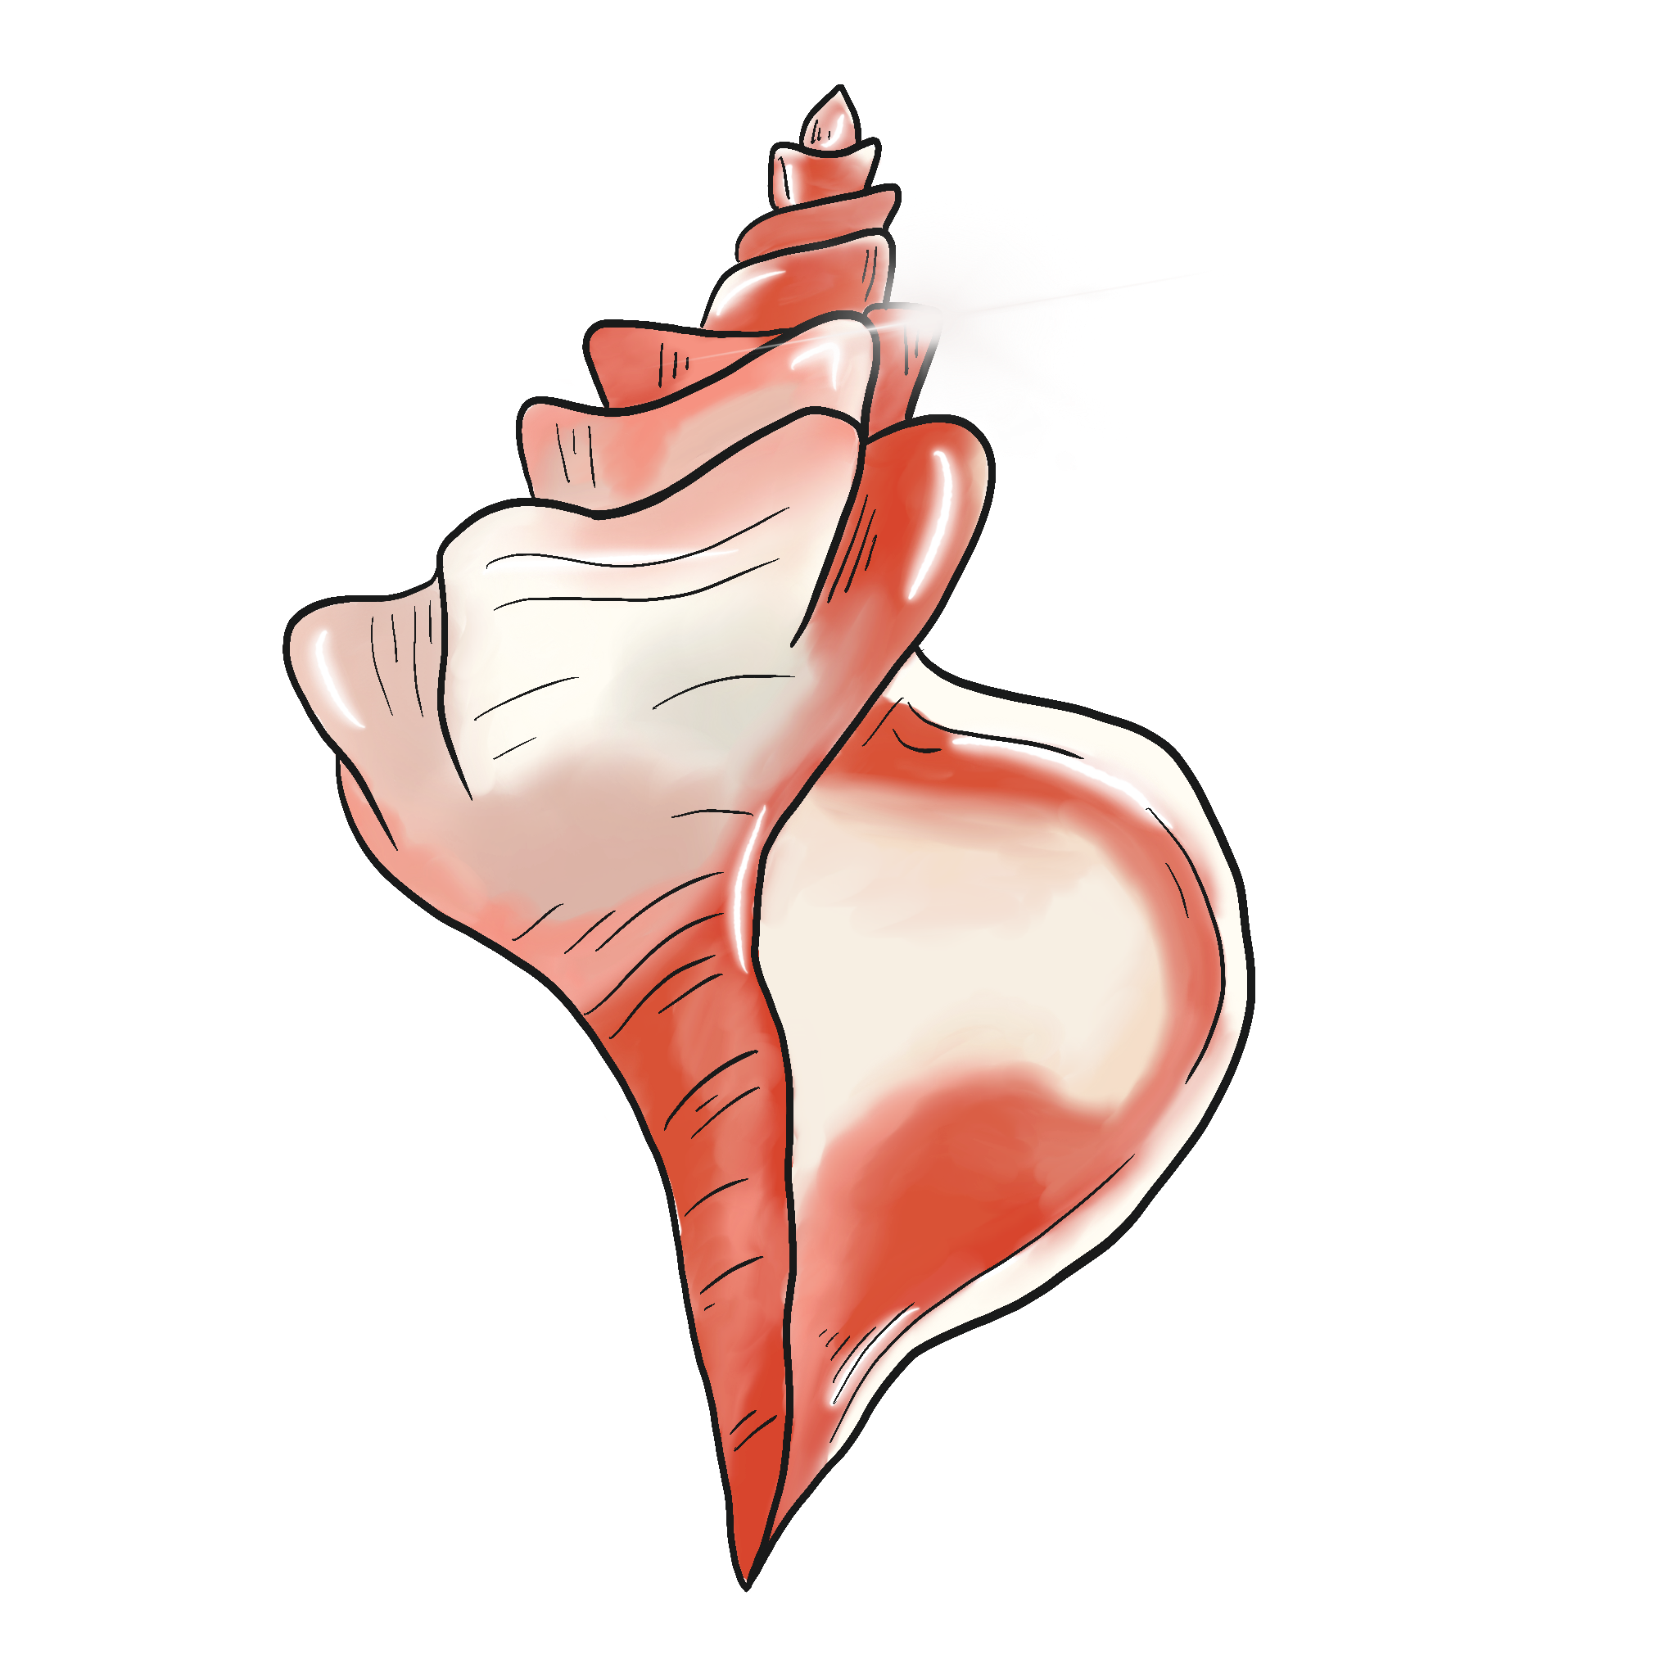
Good to be Bad
Lord of the Flies Unit Lesson 7

Slide 3
Essential Question
How does the author use symbolism to develop characterization and theme?

Slide 4
Lesson Objectives
Evaluate articles which examine the theme of why good people do bad things;
Develop arguments to answer the following:
Can we come back from the worst thing we have ever done?
Does the worst thing we have ever done define who we are?

Slide 5
Always, Sometimes, Never True
As you read each statement on the next six slides, choose which describes how often it is true:
Always
Sometimes
Never
Check the appropriate box on your handout.
Provide a justification for your answer.

Slide 6
Always, Sometimes, Never True
Children who commit violent crimes should be tried as adults.

Slide 7
Always, Sometimes, Never True
People who come from families who commit crime are more likely to commit crimes.

Slide 8
Always, Sometimes, Never True
Bad things are done for good reasons.

Slide 9
Always, Sometimes, Never True
People lie because they care.

Slide 10
Always, Sometimes, Never True
People are only good so that they look good to other people.

Slide 11
Always, Sometimes, Never True
People have a hard time admitting when they do wrong.

Slide 12
Jigsaw
As you read your assigned article, search for evidence that will help you answer the following questions:
Can we come back from the worst thing we have ever done?
Does the worst thing we have ever done define who we are?
Notes:
https://learn.k20center.ou.edu/strategy/179

Slide 13
Jigsaw
Explain the information in your article to your group.
Take down notes and important information from other sources as your peers share out their articles with you.
You will use this information in the next activity.
Notes:
https://learn.k20center.ou.edu/strategy/179

Slide 14
Socratic Seminar
Divide into two groups:
If you are in the Inner Circle, you will answer questions and discuss one of the questions with the group.
If you are in the Outer Circle, you will quietly record and observe the speakers.
Notes:
https://learn.k20center.ou.edu/strategy/781?rev=8866

Slide 15
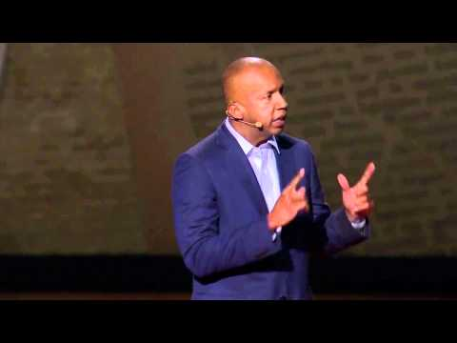

Slide 16
Padlet—Exit Ticket
Based on the reading and discussion, do you agree with the argument made by Bryan Stevenson?
Notes:
K20 Center. (n.d.) Padlet. Tech Tools. https://learn.k20center.ou.edu/tech-tool/1077

