Slide 2
Slope Matters
Slope-Intercept Form

Slide 3
Essential Question
How can we predict what the graph of a linear function will look like?

Slide 4
Lesson Objectives
Discover the relationship between the algebraic representation of a linear function with the graphical representation.
Predict the effect on a graph from changing the slope or from changing the y-intercept.

Slide 5
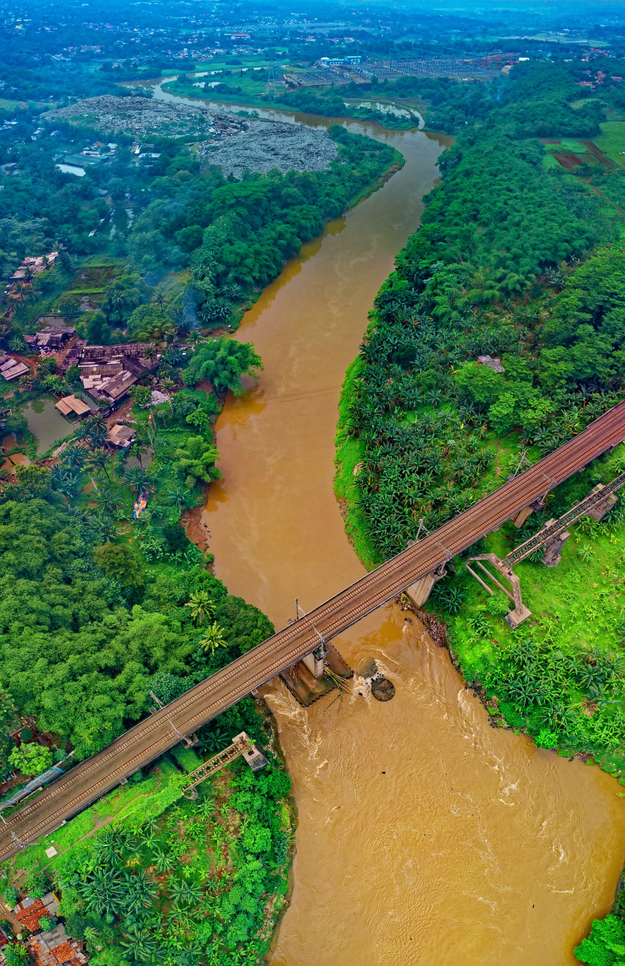
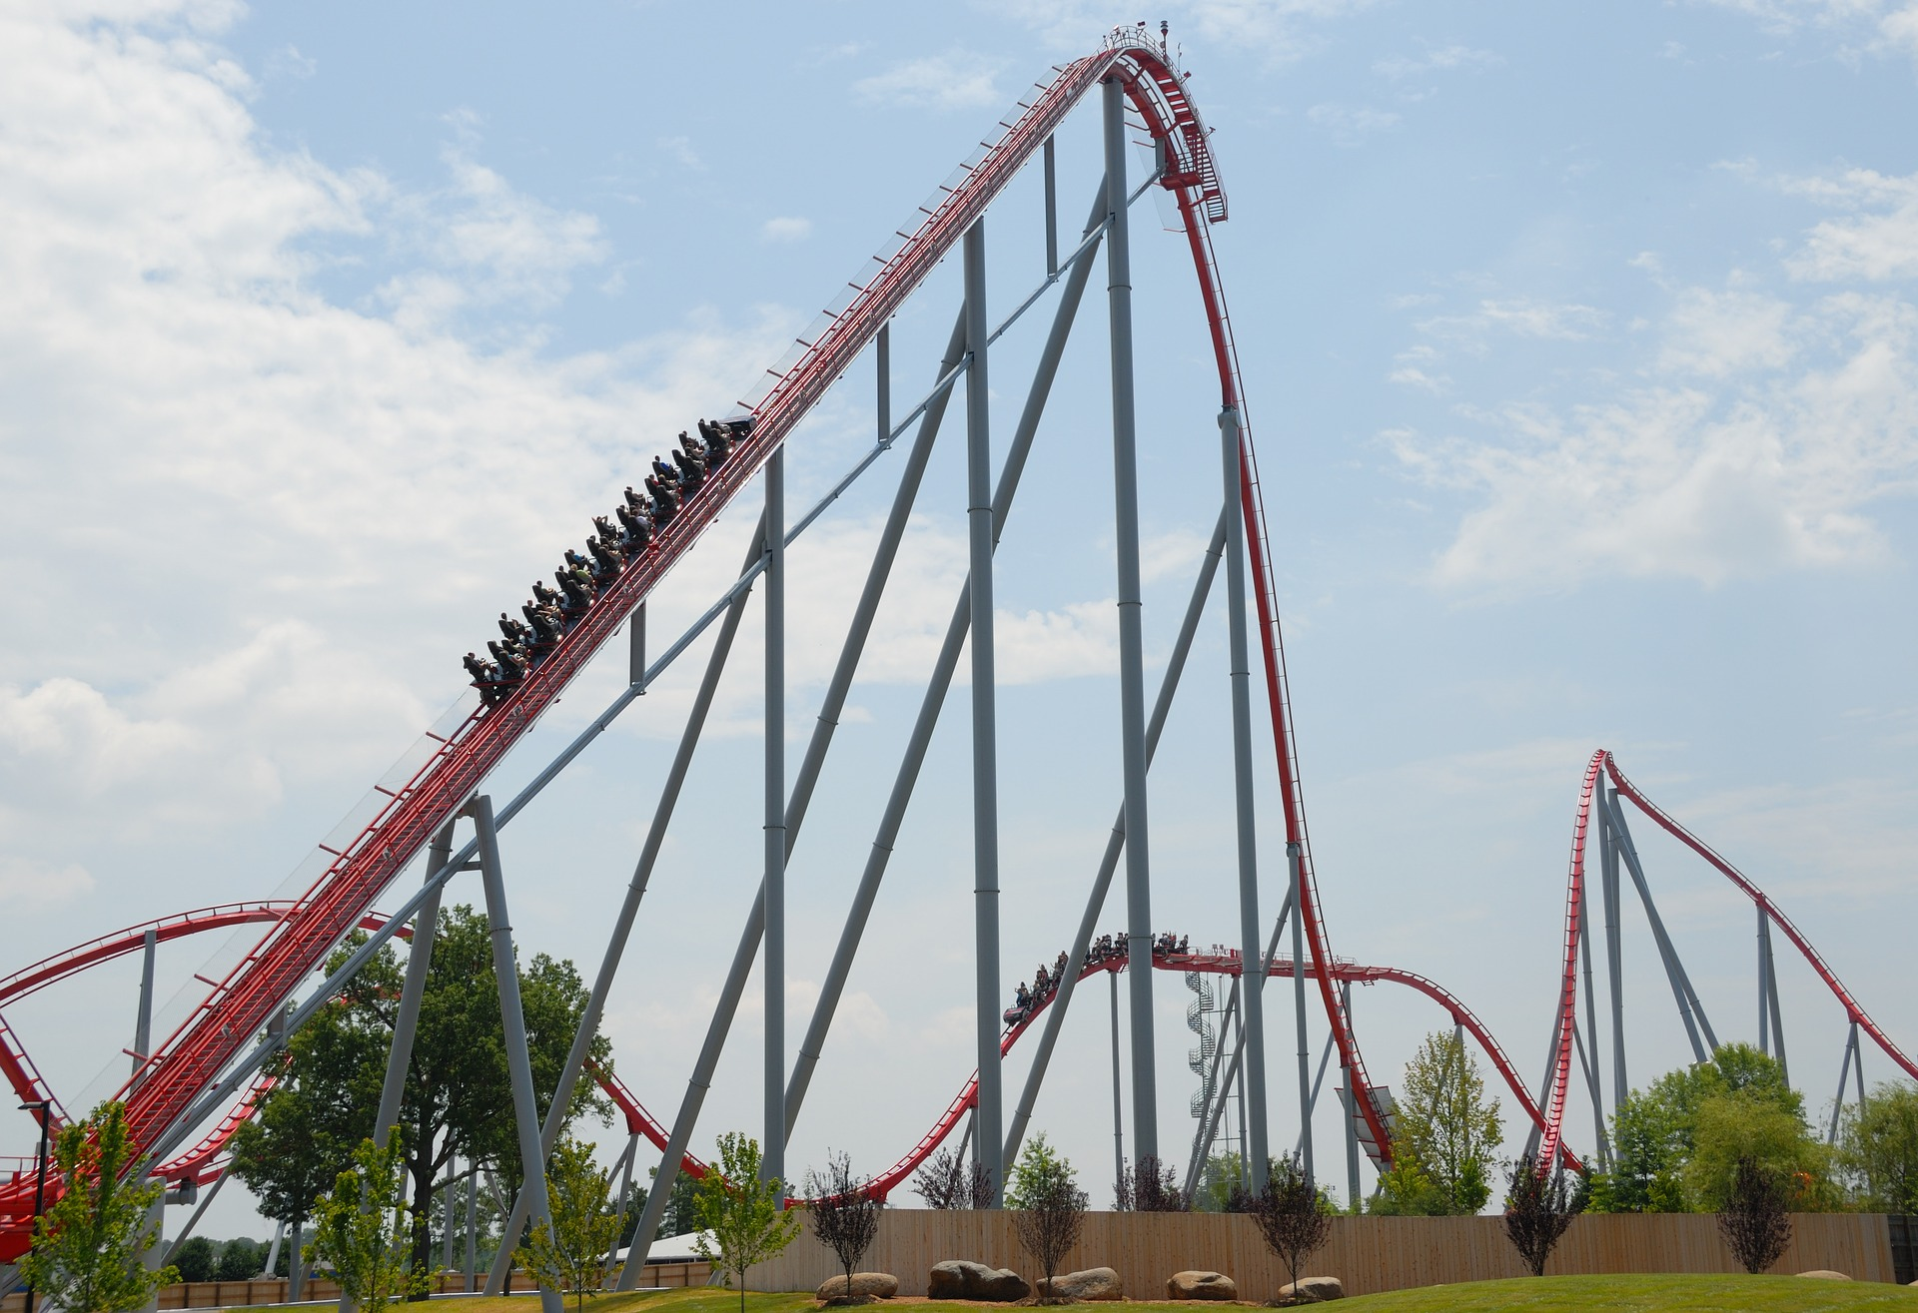
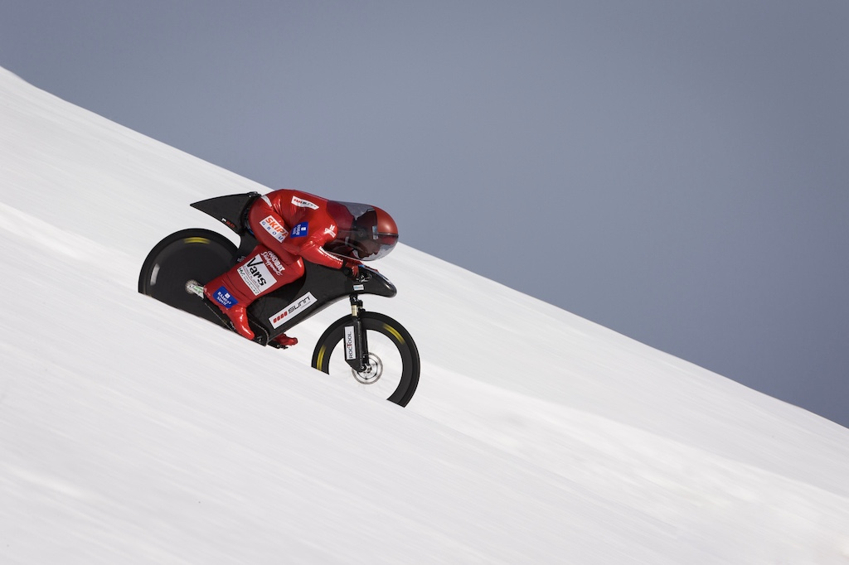
I Notice, I Wonder
I Notice | I Wonder
Write what you notice about each picture. | Write what you wonder about each picture.
Notes:
K20 Center. (n.d.). I notice, I wonder. Strategies. https://learn.k20center.ou.edu/strategy/180
Fisk, T. (N.D.). Aerial Photograph of Bridge [Photograph]. Pexels. https://www.pexels.com/photo/aerial-photography-of-bridge-1682407/
Bored, R. (2015, April 10). French stuntman Éric Barone broke the cycling speed record on a ski slope in the French Alps [Photograph]. Capo Velo. https://capovelo.com/eric-barone-sets-new-downhill-speed-record/
Brennan, P. (2016, August 1). Roller Coaster [Photograph]. Pixabay. https://pixabay.com/photos/roller-coaster-people-thrill-park-1553342/

Slide 6
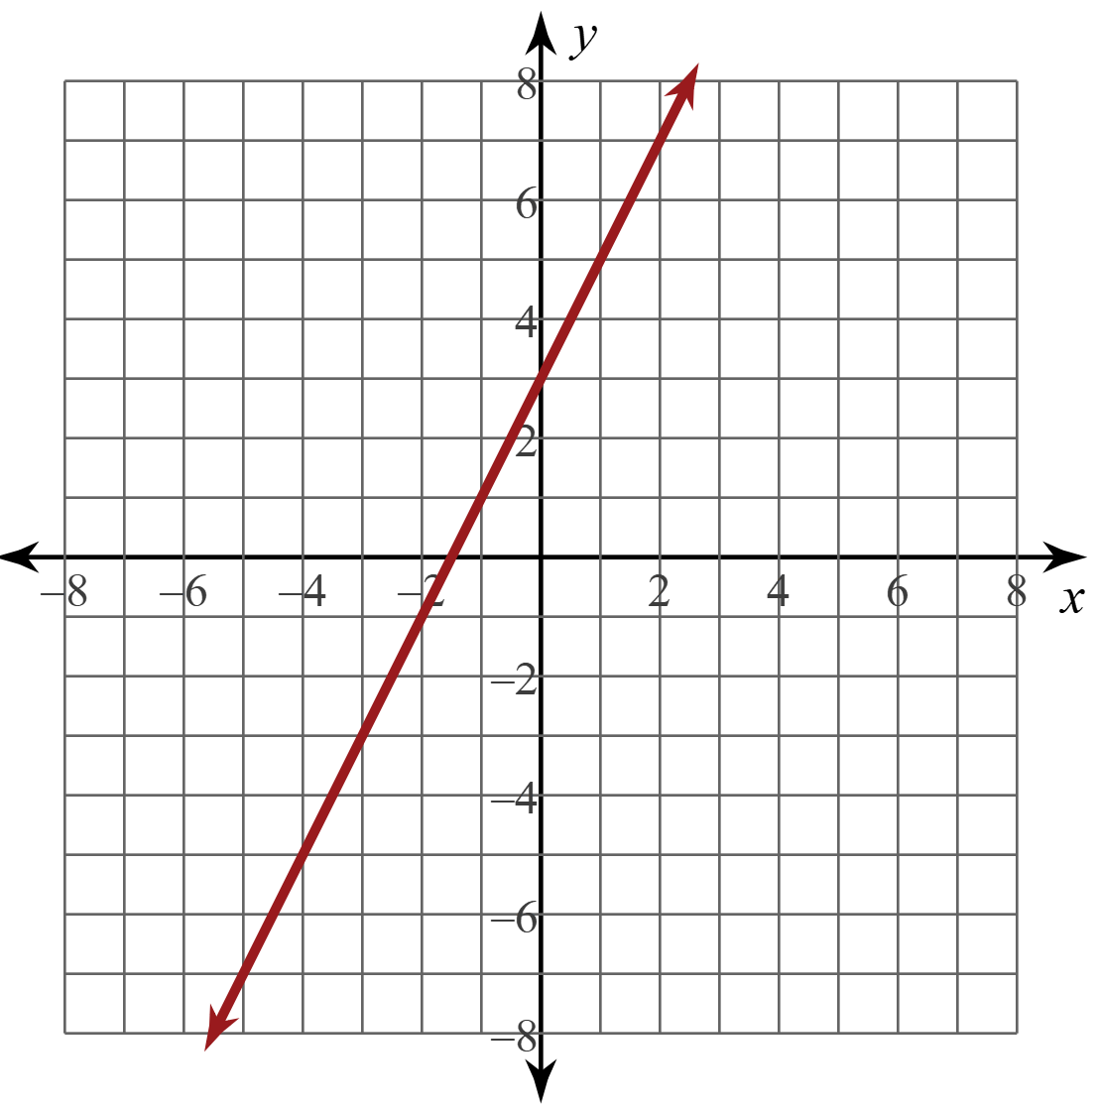
Predicting Changes (Front)
Go to Desmos.com.
  Click Open Graphing Calculator.
Type the equation
y = 2x + 3 in the
left column.
Copy the graph onto your handout.

Slide 7
Predicting Changes (Front)
Draw a card then, following the card rules, change the equation.
Write the new equation in the box above the coordinate graph. Circle what you changed.
Using Desmos, sketch the graph in pencil.

Slide 8
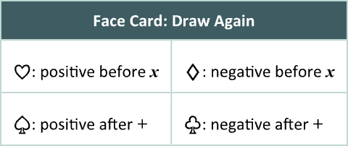
Card Rules
If you draw a…
Face card: Draw again
Heart: Change the number in the front of x to number on card
Diamond: Change the number in front of x to the negative
of the number on card
Spade: Change the number after + to number on card
Club: Change the number after + to the negative
of the number on card

Slide 9
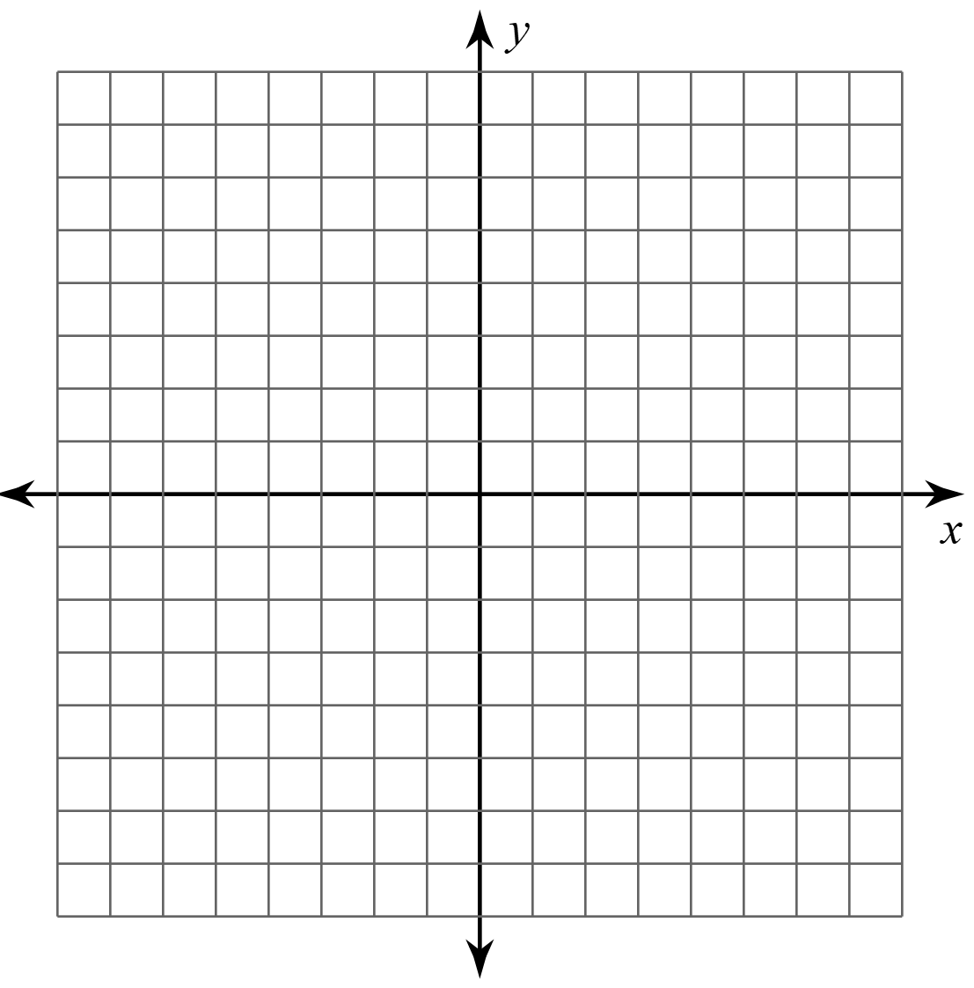

Card Rules (Example)
If you draw an ace of clubs, change the number after + to negative one.
y = 2x + 3
y = 2x + (–1)
A
A

Slide 10
Predicting Changes (Back)
Draw a card then, following the card rules, change the equation.
Write the new equation in the box above the coordinate graph. Circle what you changed.
Sketch your prediction of what the new graph should look like using a colored pencil.
Using Desmos, sketch the correct graph in pencil.

Slide 11
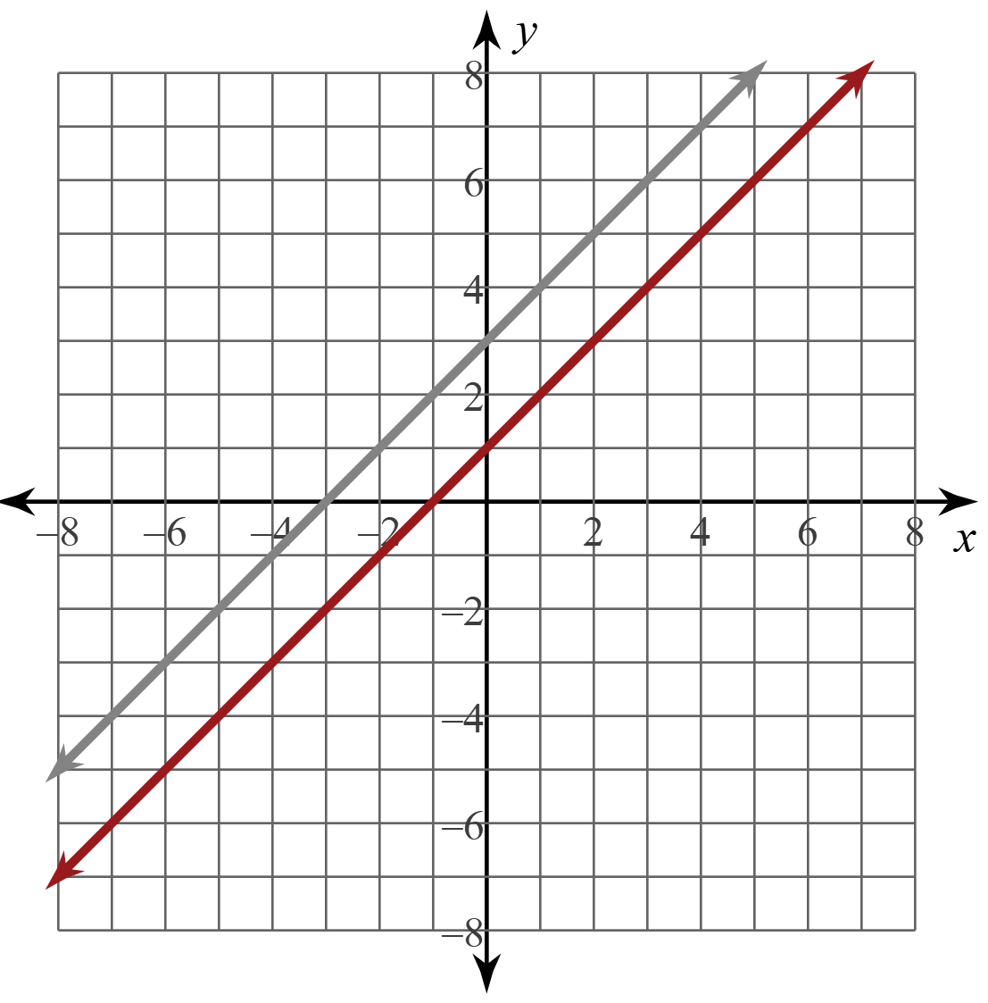
Predicting Changes (Back)
y = 1x + 3
Follow Card Rules

Slide 12
Graphing Reflection
Were your predictions correct?
If not, do you know why?

Slide 13


Commit and Toss
What does changing the number in front of the x do to the graph?
What does changing the number after the plus sign do to the graph?
What do these numbers represent?
Notes:
K20 Center. (n.d.). Commit and Toss. Strategies. https://learn.k20center.ou.edu/strategy/119

Slide 14
In Your Own Words
What’s the definition?
  slope:
  y-intercept:

Slide 15
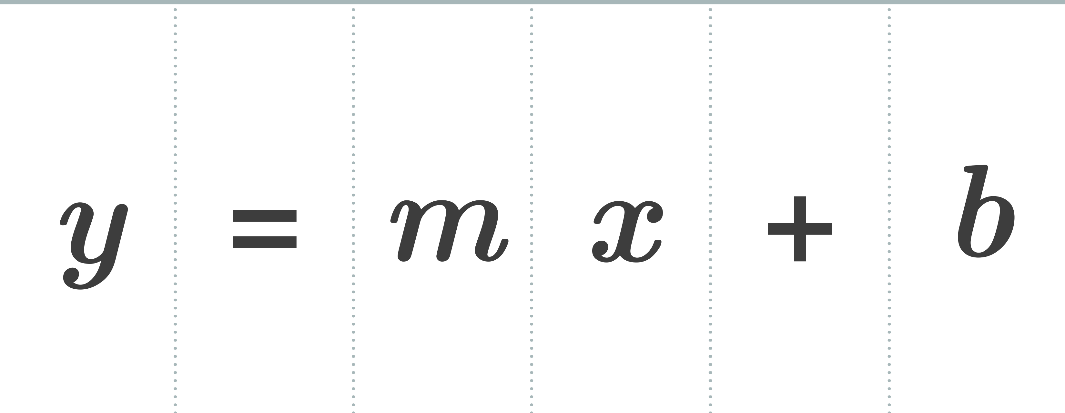


Foldable
— — — — fold — — — —
Fold the handout in half, like a
hot dog, along the solid line.
Unfold your paper.
Cut along the dashed line from one edge to the fold.
You will have 6 flaps that you can lift to see the definitions. Next, we will write the definitions.

Slide 16
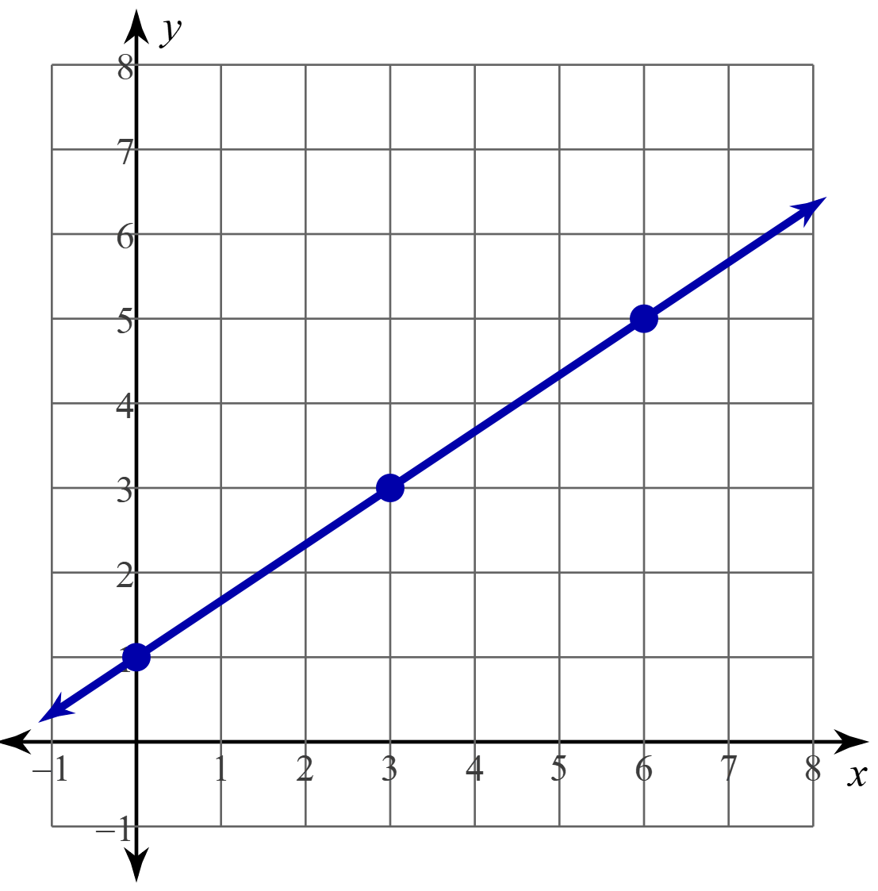
Slope

Slide 17
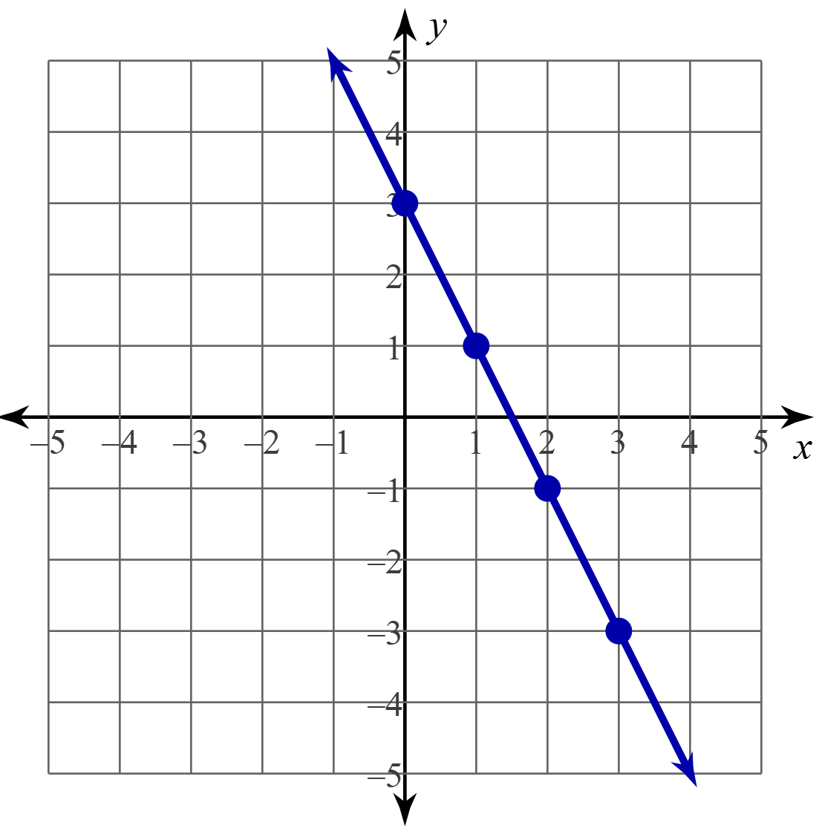
y-Intercept
The point where the function
crosses the y-axis
Written as (0, b)
The y-intercept of the blue line is (0, 3) because
the function crosses the y-axis at that point.

Slide 18
Foldable: Slope-Intercept Form
y-intercept:
the point where the line crosses the y-axis

Slide 19
Foldable: Slope-Intercept Form
dependent variable:
the y-coordinate of the
ordered pair
independent variable:
the x-coordinate of the
ordered pair

Slide 20
Foldable: Slope-Intercept Form
Reminder:
Make sure only 1y is on one side of the equals sign & everything else is on the other side.
Reminder:
Always simplify!
For example, rewrite
y = 2x + (–3) as y = 2x – 3.

Slide 21
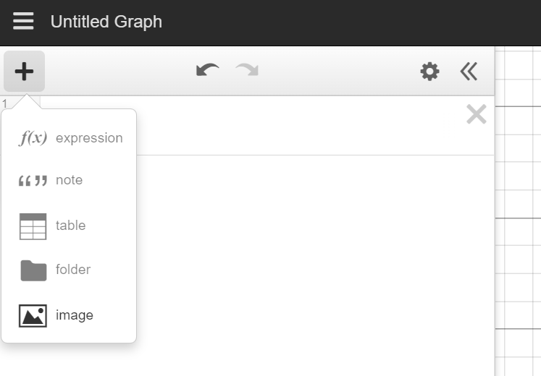
Slopes Around the School
Take a picture of two examples of slope somewhere in the school building.
Go to Desmos.com and select
Open Graphing Calculator.
Click the Add Item (plus sign) button,
then select image to add your picture.
Find the slope-intercept form of the
linear equation of the picture.

Slide 22

Examine and Reflect
How does changing the equation change the graph?
Crystal Clear
  What do you think is the easiest (clearest)
  part of what you learned today?
Muddiest Point
  What do you think is the most confusing (muddiest) part of what you learned today?
Notes:
K20 Center. (n.d.). Muddiest point. Strategies. https://learn.k20center.ou.edu/strategy/109

