Slide 2
Slope Matters
Linear Equations Discovery: Slope Intercept Form

Slide 3
Essential Question
What components are necessary for a function to create a line?

Slide 4
Lesson Objectives
Students will use different tools to explore how changing the y-intercept or slope of line, changes a graph.

Slide 5

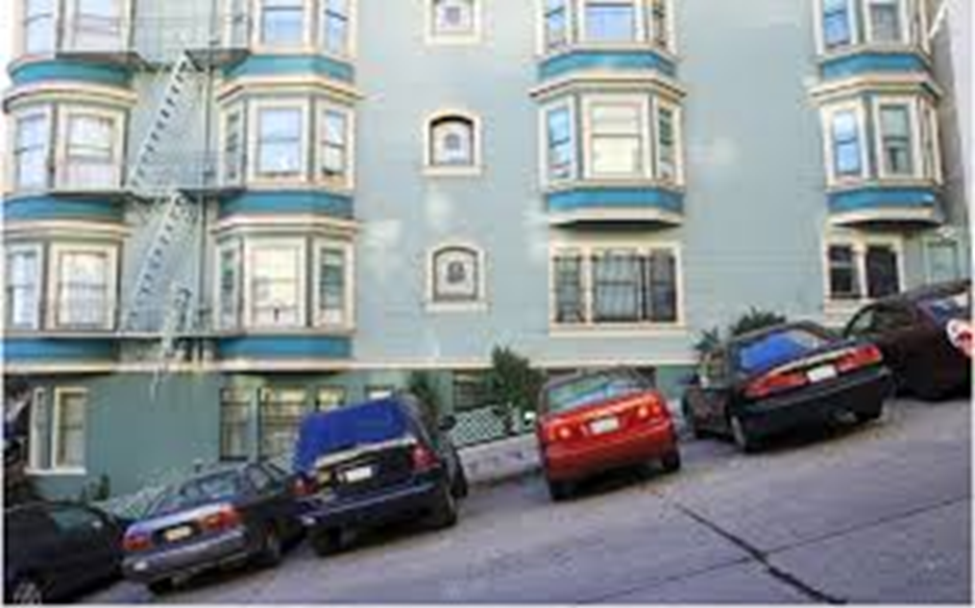


I Notice, I Wonder

Slide 6
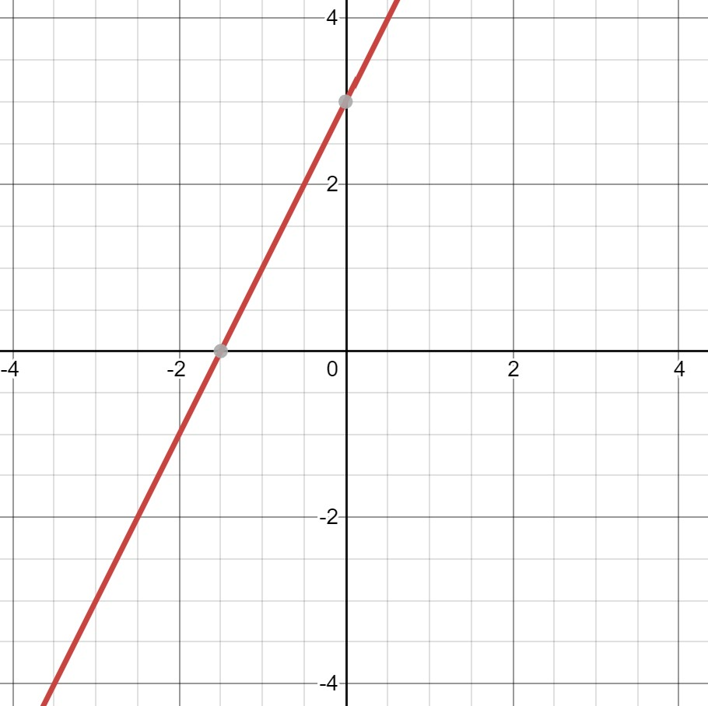
Exploring Through Desmos
Go to Desmos.com and click graphing calculator
Share your answer with a partner.
Type the equation y=2x+3 in the top left corner.

Slide 7
Exploring Through Desmos
In the box above each coordinate graph, write the equation and draw the graph from Desmos.
Draw a card from the deck, and make the changes in the equation in Desmos follow these rules:
  Face = Draw Again
  Heart = Number in front of x to number on card
  Diamond = Number in front of x to negative number on card
  Club = Number after + to number on card
  Spade = Number after + to negative number on card

Slide 8
Were the predictions correct? If not, why?
Answer the following questions:
What does changing the number in front of the x do to the graph?
What does changing the number after the plus sign do to the graph?
What do these numbers represent, and how do they interact?

Slide 9
What is the definition of..
Slope | Y - Intercept | Domain | Range

Slide 10
Slopes Around the School
Take a picture of two examples of slopes somewhere in the school building
Upload the picture on Desmos.com
Find the slope-intercept equation of the picture
Explain why the equation is correct

Slide 11
Evaluate
Create your definitions in the Slope Foldable
Once definitions are created, swap your equation created from the picture earlier with another group.
With the new equation, do the following:
  Graph
  Label the slope as either positive or negative
  Find the y-intercept

