Slide 1
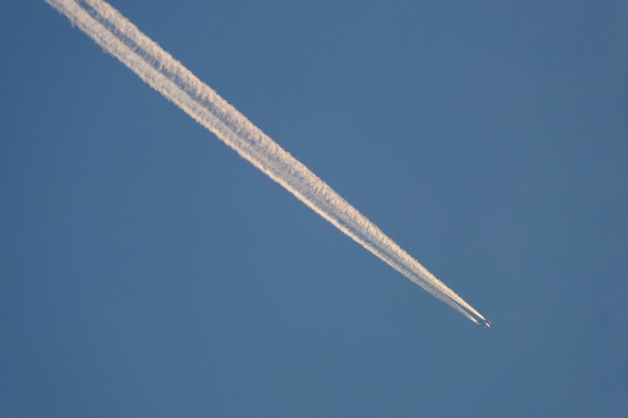
#1
Notes:
Schüler, A. (2015, June 26). Chemtrail [Photograph]. Pixabay. https://pixabay.com/photos/chemtrail-conspiracy-theory-822000/

Slide 2

#2
Notes:
Pixabay. (2015, November 30). White Stairs Wallpaper [Photograph]. Pexels. https://www.pexels.com/photo/contemporary-gradient-handrails-perspective-434645/

Slide 3

#3
Notes:
Luciann Photography. (2019, September 20). Aerial View of Road [Photograph]. Pexels. https://www.pexels.com/photo/aerial-view-of-road-3566393/

Slide 4
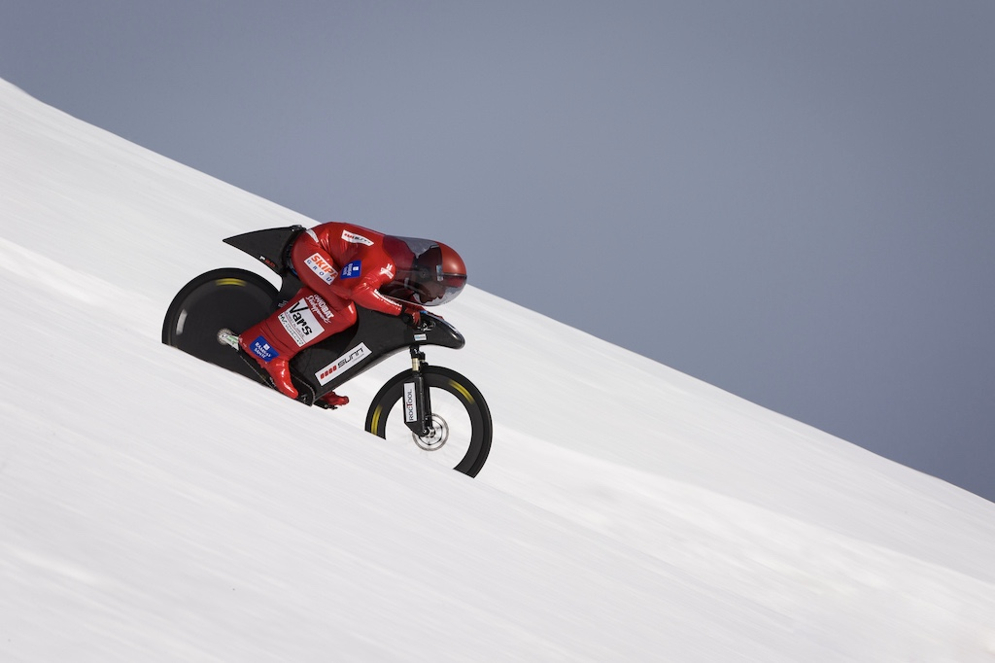
#4
Notes:
Bored, R. (2015, April 10). French stuntman Éric Barone broke the cycling speed record on a ski slope in the French Alps [Photograph]. Capo Velo. https://capovelo.com/eric-barone-sets-new-downhill-speed-record/

Slide 5
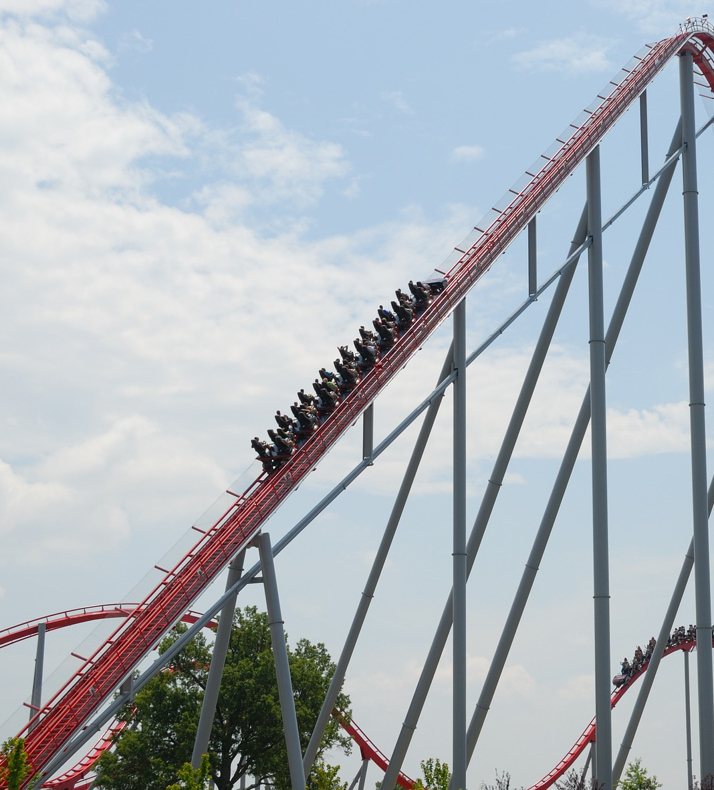
#5
Notes:
Brennan, P. (2016, August 1). Roller Coaster [Photograph]. Pixabay. https://pixabay.com/photos/roller-coaster-people-thrill-park-1553342/

Slide 6
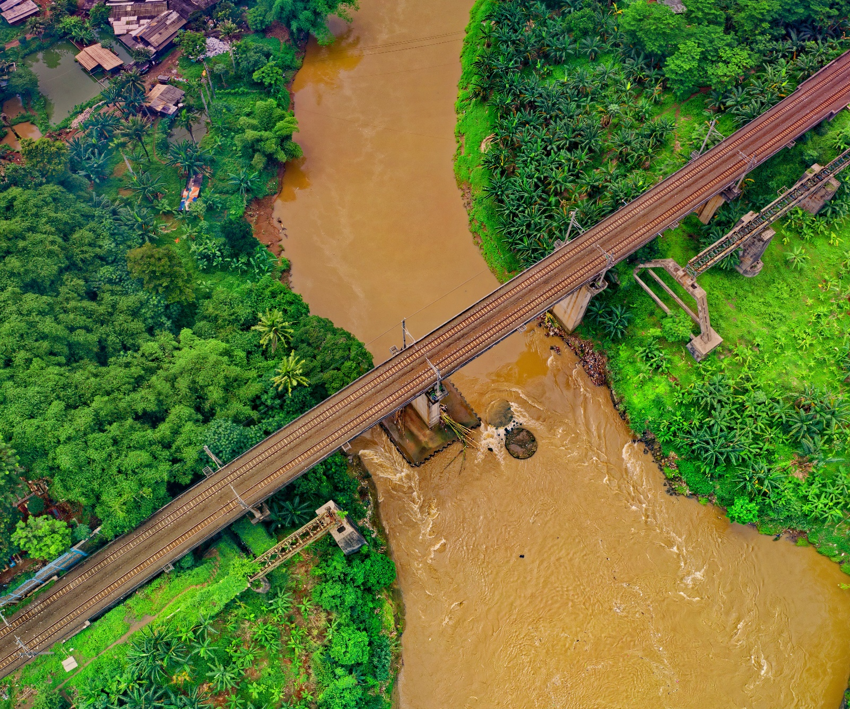
#6
Notes:
Fisk, T. (N.D.). Aerial Photograph of Bridge [Photograph]. Pexels. https://www.pexels.com/photo/aerial-photography-of-bridge-1682407/

