Slide 1
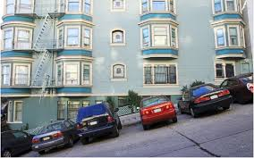
“SLOPE MATTErs”

Slide 2
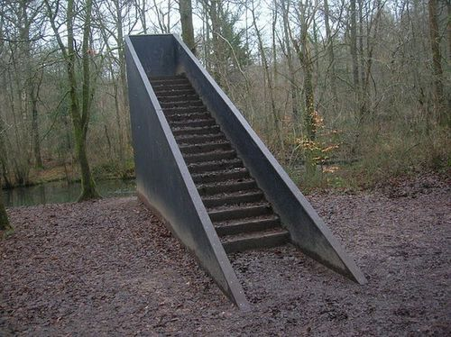
“SLOPE MATTErs”

Slide 3

“SLOPE MATTErs”

Slide 4

“SLOPE MATTErs”

Slide 5
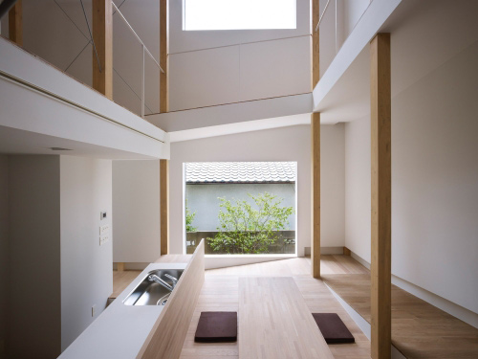
“SLOPE MATTErs”

Slide 6

“SLOPE MATTErs”

